Slide 1
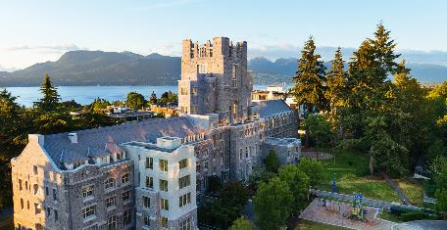

Policy in Canada: the case of population aging
May 2023
Kevin Milligan
Vancouver School of Economics
University of British Columbia
Universidad de Chile
Santiago

Slide 2
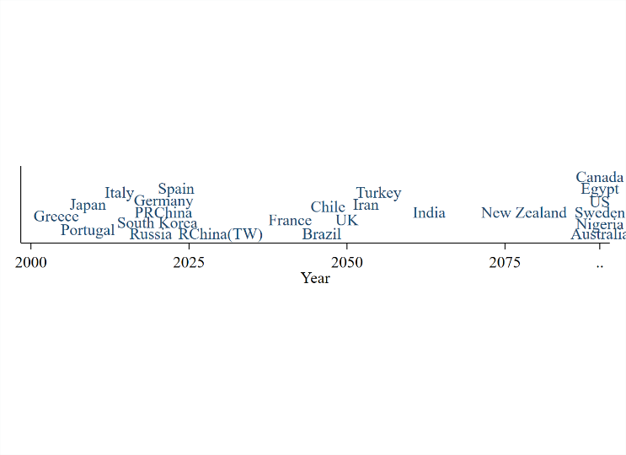
What does this timeline show?

Slide 3
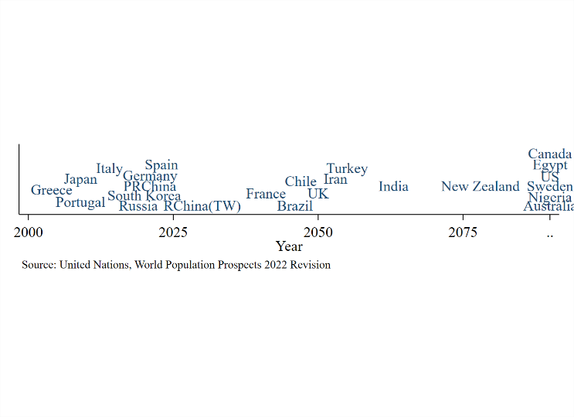
Year of peak population

Slide 4
Population is changing around the world

Slide 5
Population is changing around the world
…how does it affect government spending and taxes?

Slide 6
Population is changing around the world
…how does it affect government spending and taxes?
…how will it impact a federation like Canada?

Slide 7
What we’re going to do:
Look at population change in Chile and Canada.
Learn about Canadian taxation and govt spending.
Use population change as policy case study.

Slide 8
Let’s dig into the population data…

Slide 9
Let’s dig into the population data…
Best source for comparable global population data:
United Nations, Population Division
URL: https://population.un.org/dataportal/

Slide 10
Two things driving population change
Time trends in births.
Longer lifespans

Slide 11
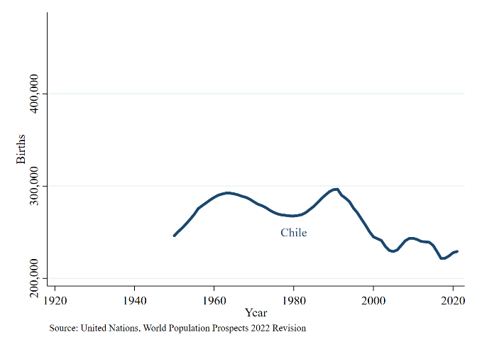
Start with the babies.

Slide 12
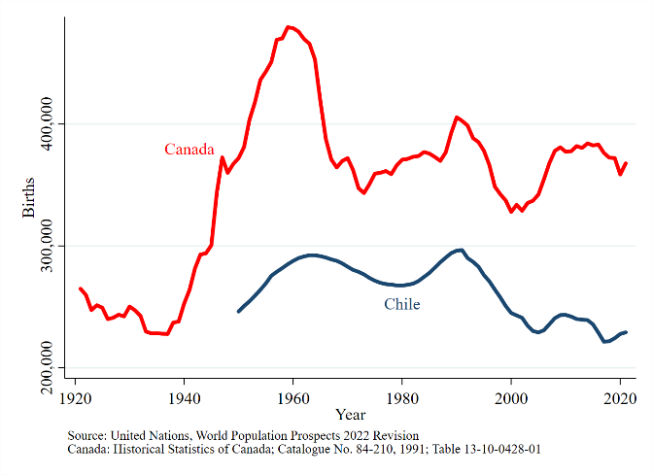
Start with the babies.

Slide 13
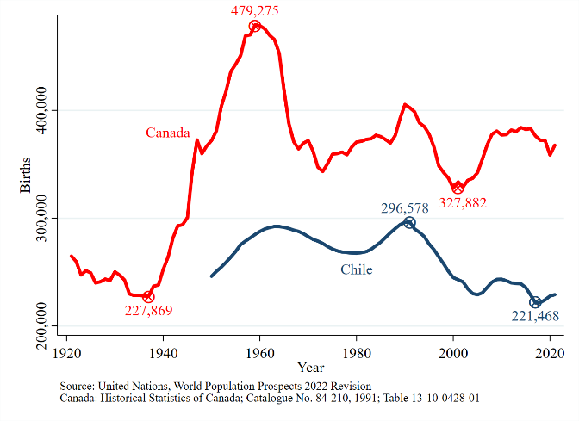
Start with the babies.

Slide 14
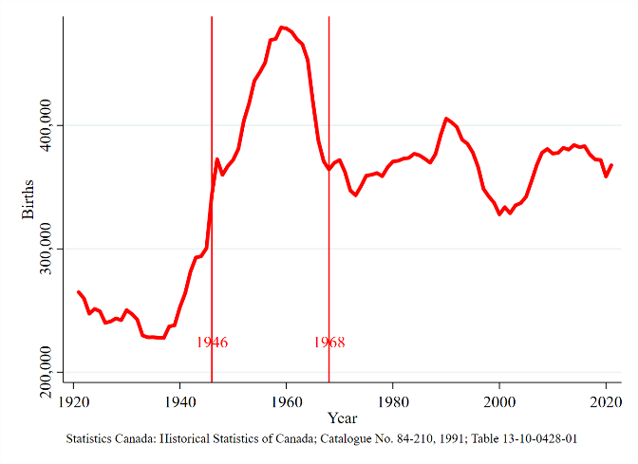
The baby boom.

Slide 15
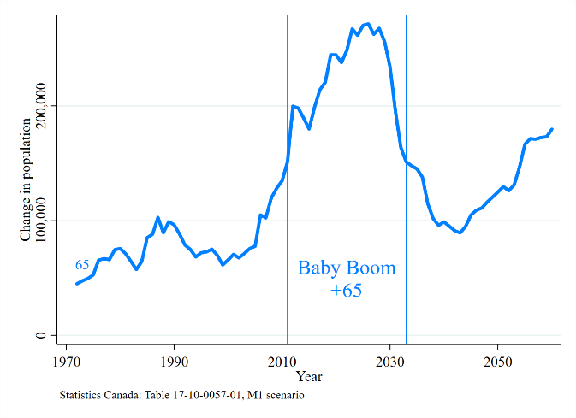
New 65 year olds.

Slide 16
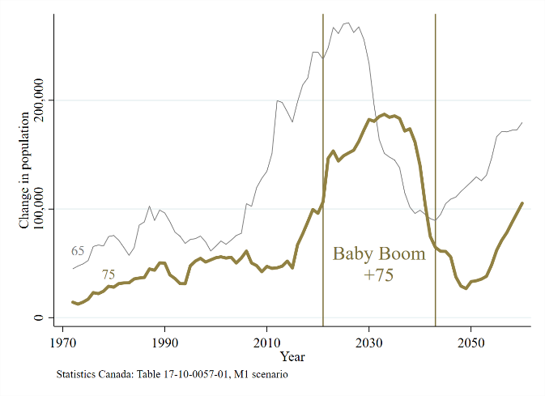
New 75 year olds.

Slide 17
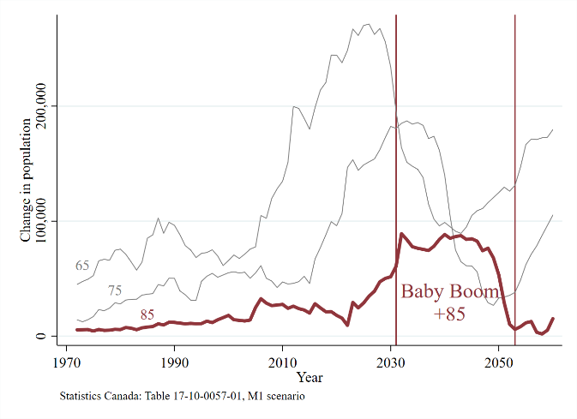
New 85 year olds.

Slide 18
Two things driving population change
Time trends in births.
Longer lifespans

Slide 19
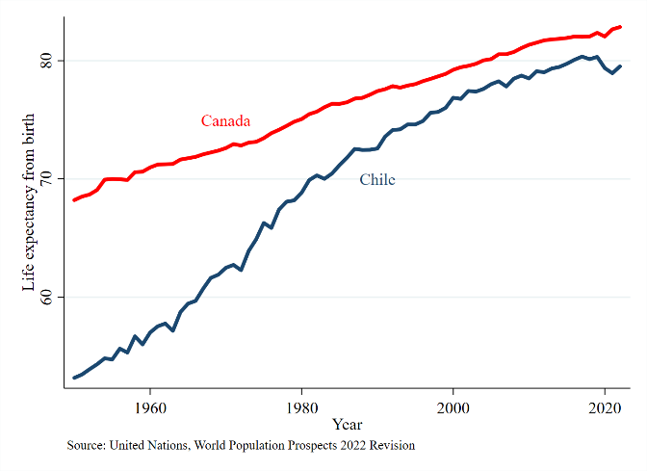
Life expectancy from birth

Slide 20
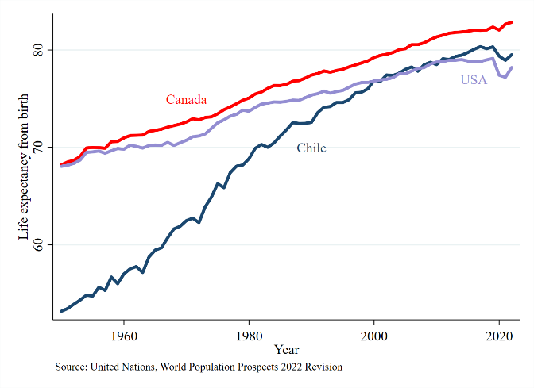
Life expectancy from birth

Slide 21
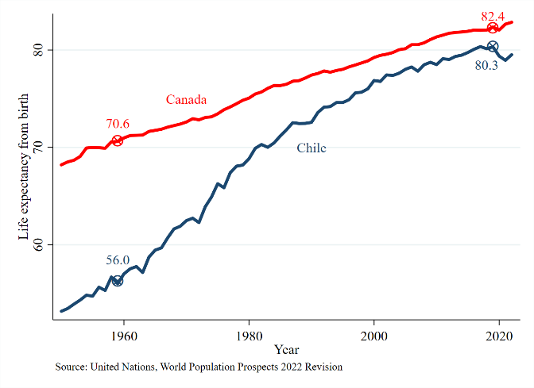
Life expectancy
gains 1959-2019:
Canada: +11.8
Chile: +24.3

Slide 22
Put it all together: Older populations
Birth changes + longer lives = older populations…

Slide 23
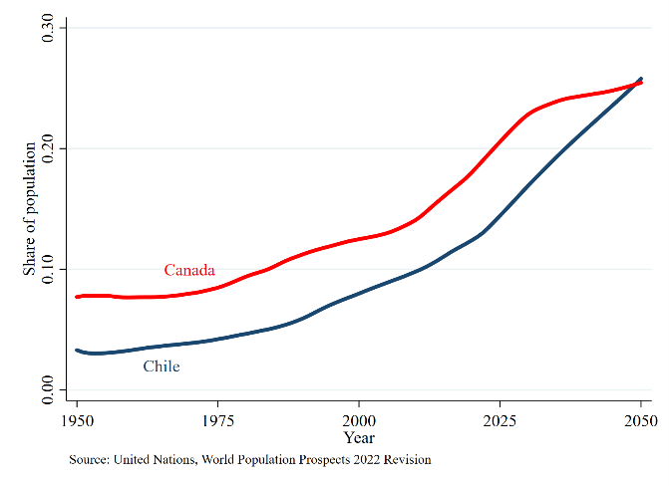
Population share 65+

Slide 24
Summary so far:
Aging of the population around the world:
  Canada and Chile too.
  Fewer births; longer lifespans.
Big policy consequences.
  Pensions
  Health spending
  Long-term care

Slide 25
Summary so far:
Aging of the population around the world:
  Canada and Chile too.
  Fewer births; longer lifespans.
Big policy consequences.
  Pensions
  Health spending
  Long-term care
Question: How will Canada handle these challenges?

Slide 26
What we’re going to do:
Look at population change in Chile and Canada.
Learn about Canadian taxation and govt spending.
Use population change as policy case study.

Slide 27
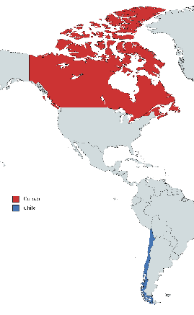
Canadian policy overview
Year formed | 1867
Population | 39.9 million
Width | 7,560 km
Height | 4,634 km
% Foreign born | 23%
% Indigenous | 5%
% French/English/Other | 21%/76%/13%
% live within 200km of US | 90%

Slide 28
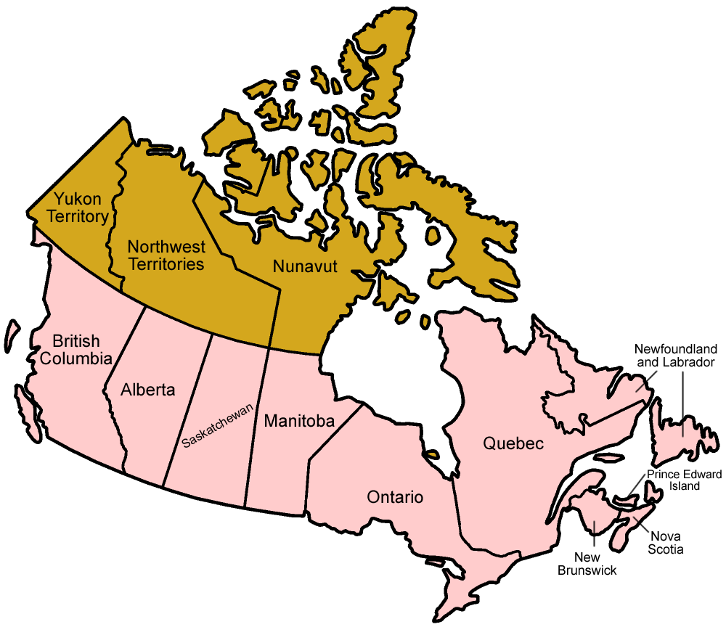
Canadian federalism
Canada | 39.9 million
Ontario | 15.3 million
Quebec | 8.8 million
British Columbia | 5.4 million
Alberta | 4.6 million
Manitoba | 1.4 million
Saskatchewan | 1.2 million
Nova Scotia | 1.0 million
New Brunswick | 821,000
Newfoundland and Labrador | 529,000
Prince Edward Island | 173,000
Territories | 130,000

Slide 29
Division of powers: 1867 British North America Act
Provincial
2. Direct Taxation within the Province in order to the raising of a Revenue for Provincial Purposes.
3. The borrowing of Money on the sole Credit of the Province.
4. The Establishment and Tenure of Provincial Offices and the Appointment and Payment of Provincial Officers.
5. The Management and Sale of the Public Lands belonging to the Province and of the Timber and Wood thereon.
6. The Establishment, Maintenance, and Management of Public and Reformatory Prisons in and for the Province.
7. The Establishment, Maintenance, and Management of Hospitals, Asylums, Charities, and Eleemosynary Institutions in and for the Province, other than Marine Hospitals.
8. Municipal Institutions in the Province.
9. Shop, Saloon, Tavern, Auctioneer, and other Licences in order to the raising of a Revenue for Provincial, Local, or Municipal Purposes.
11. The Incorporation of Companies with Provincial Objects.
12. The Solemnization of Marriage in the Province.
13. Property and Civil Rights in the Province.
14. The Administration of Justice in the Province
15. The Imposition of Punishment by Fine, Penalty, or Imprisonment for enforcing any Law of the Province
16. Generally all Matters of a merely local or private Nature in the Province.
In and for each Province the Legislature may exclusively make Laws in relation to Education
Federal
2A. Unemployment insurance. (1940)
3. The raising of Money by any Mode or System of Taxation.
5. Postal Service.
6. The Census and Statistics.
7. Militia, Military and Naval Service, and Defence.
9. Beacons, Buoys, Lighthouses, and Sable Island.
10. Navigation and Shipping.
12. Sea Coast and Inland Fisheries.
14. Currency and Coinage.
15. Banking, Incorporation of Banks, and the Issue of Paper Money.
17. Weights and Measures.
18. Bills of Exchange and Promissory Notes.
20. Legal Tender.
25. Naturalization and Aliens.
27. The Criminal Law
(1951) The Parliament of Canada may make laws in relation to old age pensions and supplementary benefits, including survivors’ and disability benefits irrespective of age, but no such law shall affect the operation of any law present or future of a provincial legislature in relation to any such matter.[

Slide 30
Division of powers: 1867 British North America Act
Provincial
HEALTH
The Establishment, Maintenance, and Management of Hospitals, Asylums, Charities, and Eleemosynary Institutions in and for the Province, other than Marine Hospitals.
EDUCATION
In and for each Province the Legislature may exclusively make Laws in relation to Education
Federal
UNEMPLOYMENT
(1940) Unemployment insurance.
PENSIONS
(1951) The Parliament of Canada may make laws in relation to old age pensions and supplementary benefits, including survivors’ and disability benefits irrespective of age, but no such law shall affect the operation of any law present or future of a provincial legislature in relation to any such matter.

Slide 31
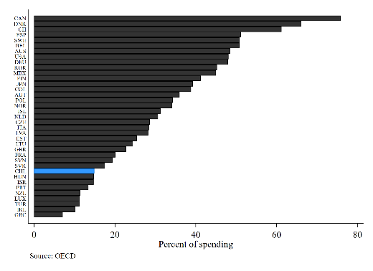
Subnational share of spending
All OECD countries.
Share of government spending at subnational level. (Not federal level.)
Chile

Slide 32
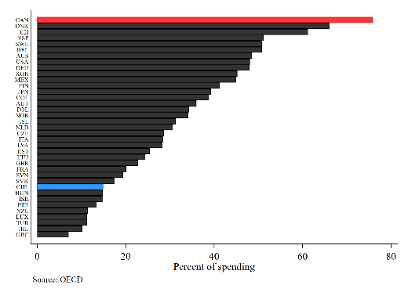
Subnational share of spending
All OECD countries.
Share of government spending at subnational level. (Not federal level.)
Chile Canada

Slide 33
How does Canada raise taxes?
Income taxes (corporate)
Income taxes (personal)
Payroll taxes
Sales taxes
Carbon taxes

Slide 34
How does Canada raise taxes?
Income taxes (corporate)
Income taxes (personal)
Payroll taxes
Sales taxes
Carbon taxes
For reference: CAN$1 = CHL$600

Slide 35
Income taxes (corporate)
Federal:
General: 15%
Small business: 9%

Slide 36
Income taxes (corporate)
Federal:
General: 15%
Small business: 9%
Provincial (general):
*collected by federal govt
*BC: 12%
Alberta: 8%
*Ontario: 11.5%
*Nova Scotia: 14%

Slide 37
Income taxes (personal)
Federal:
0-$53,359 15%
$53,359-$106,717 20.5%
$106,717-$165,430 26%
$165,430-$235,675 29.32%
$235,675+ 33%
British Columbia
collected by federal govt
0-$45,654 5.06%
$45,654-$91,310 7.7%
$91,310-$104,835 10.5%
$104,835-$127,602 14.7%
$127,602-$240,716 16.8%
$240,716+ 20.5%

Slide 38
Income taxes (personal)

Slide 39
Income taxes (personal)
Capital gains
Tax rate is half the normal rate.
So, max of 26.75%.
Dividends
Partial, notional integration with CIT.
Dividend tax credit to account for corp taxes.

Slide 40
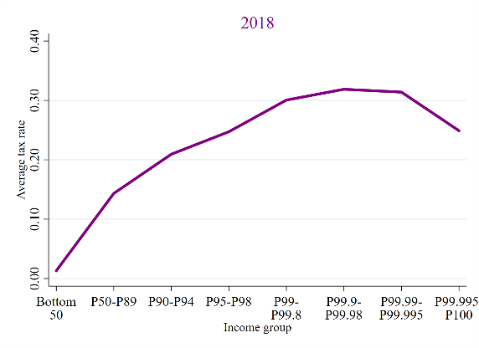
Income taxes (personal)
Average tax rate
Taxes / income.
Progressivity reverses: cap gains, dividends.

Slide 41
Payroll taxes
Canada Pension Plan
1st tier: up to $66,600
4.95% employer
4.95% employee

Slide 42
Payroll taxes
Canada Pension Plan
1st tier: up to $66,600
4.95% employer
4.95% employee
Employment Insurance
Up to $61,500
2.28% employer
1.63% employee

Slide 43
Sales taxes:
Federal VAT:
Goods and Services Tax
5% rate
Covers goods; services
  Not food; some other exemptions.
Refund for low earners ($49,000)
  $467 if you are single
  $612 if you are married or have a common-law partner
  $161 for each child under 19 years of age

Slide 44
Sales taxes:
Federal VAT:
Goods and Services Tax
5% rate
Covers goods; services
  Not food; some other exemptions.
Refund for low earners ($49,000)
  $467 if you are single
  $612 if you are married or have a common-law partner
  $161 for each child under 19 years of age
Provincial VAT:
Harmonized Sales Tax
Collected by fed govt, using same rules.
Rate of 8%-10%.
6 provinces.

Slide 45
Carbon taxes:
Federal carbon price
$50/tonne in 2022
$170/tonne in 2030.
Gasoline: $0.37 per litre in 2030.

Slide 46
What we’re going to do:
Look at population change in Chile and Canada.
Learn about Canadian taxation and govt spending.
Use population change as policy case study.

Slide 47
Policy Implications of Population Change
Pensions
Health
Long-term care
Fiscal balances

Slide 48
1. Pensions

Slide 49
1. Pensions
Old Age Security:
A federal responsibility.
$700/month. Flat; universal.

Slide 50
1. Pensions
Old Age Security:
A federal responsibility.
$700/month. Flat; universal.
Canada Pension Plan:
Joint prov/fed.
Pays 25% of earnings.
Funded by payroll taxes (4.95%/4.95%)

Slide 51
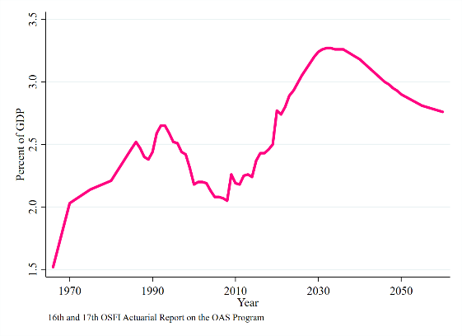
1. Pensions
Old Age Security:
Expenditures / GDP

Slide 52
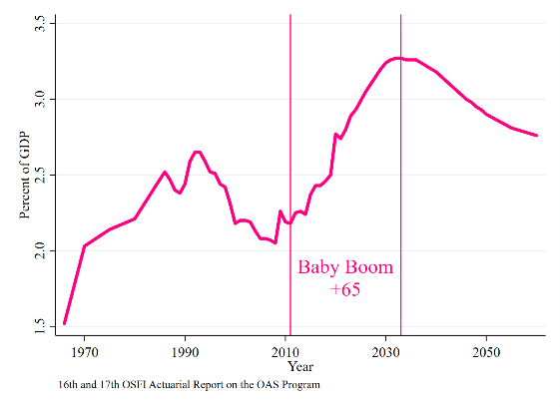
1. Pensions
Old Age Security:
Expenditures / GDP
Mostly for ages 65+

Slide 53
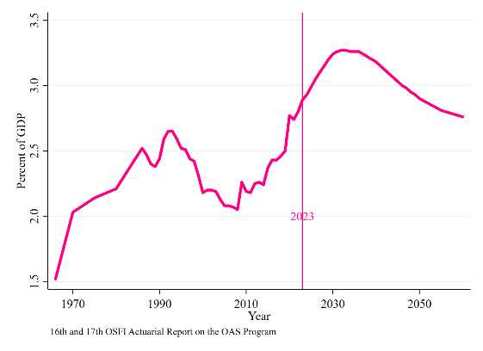
1. Pensions
Old Age Security:
Expenditures / GDP
Mostly for ages 65+
Peaking soon; not all that high.

Slide 54
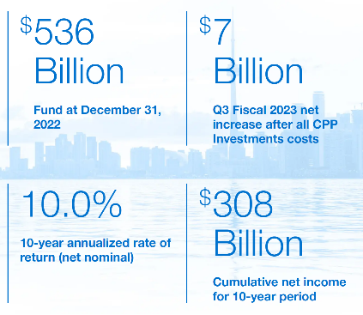
1. Pensions
Canada Pension Plan
Higher payroll tax since 1998.
Surplus saved in wealth fund; invested centrally.
Joint fed-prov governance.

Slide 55
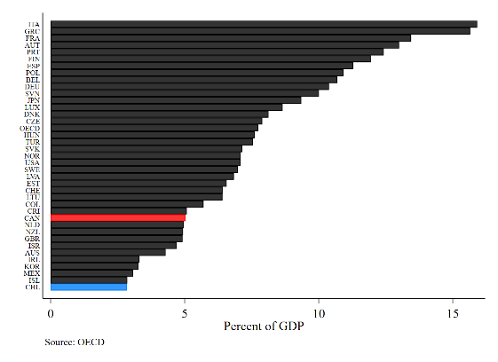
1. Pensions
OECD context: pension/GDP.
Canada and Chile
Pre-saving matters.

Slide 56
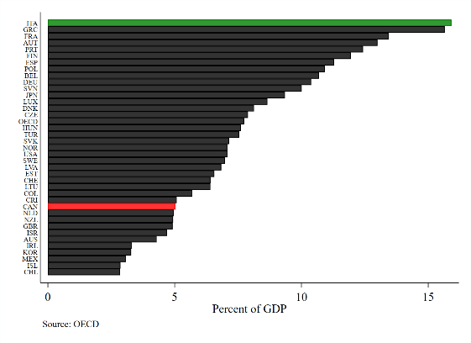
1. Pensions
OECD context: pension/GDP.
Pre-saving matters.
Italy spending x3 what Canada does.

Slide 57
2. Health
Mostly a provincial responsibility.

Slide 58
2. Health
Mostly a provincial responsibility.
How will population aging change health expenditures?
When will this happen?

Slide 59
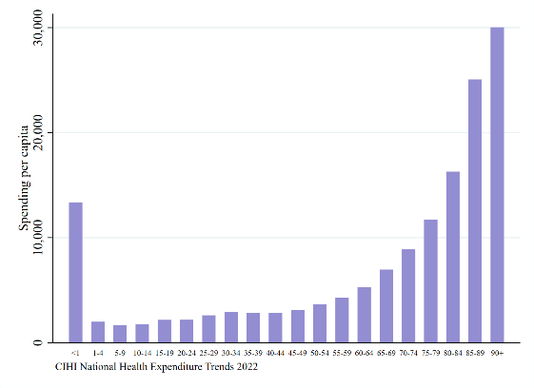
2. Health
Health expenditures by age group:

Slide 60
2. Health
Health expenditures by age group:
Starts to grow sharply by ages 75+

Slide 61
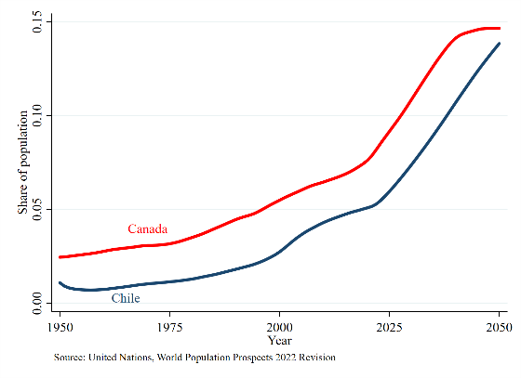
Age 75+:
New 75 year olds gaining quickly.
In Canada:
+3.6 million people in next 20 years

Slide 62
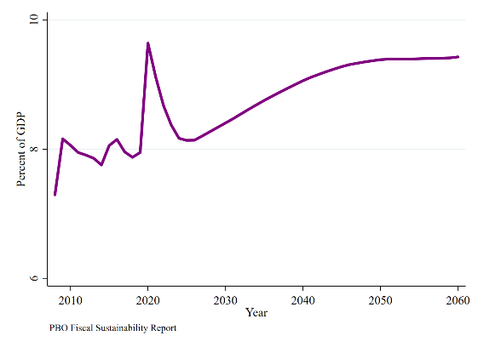
2. Health
Projected provincial health expenditures:
+1.5 points (PBO)
+3 points (C.D. Howe)

Slide 63
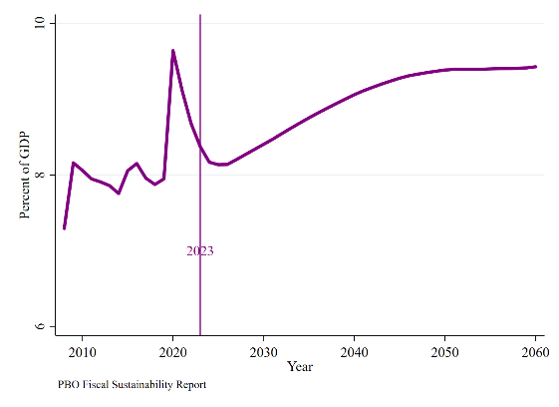
2. Health
Projected provincial health expenditures:
+1.5 points (PBO)
+3 points (C.D. Howe)
Starts picking up now.

Slide 64
3. Long-term care
Mostly a provincial responsibility.
How will population aging change LTC expenditures?
When will this happen?

Slide 65
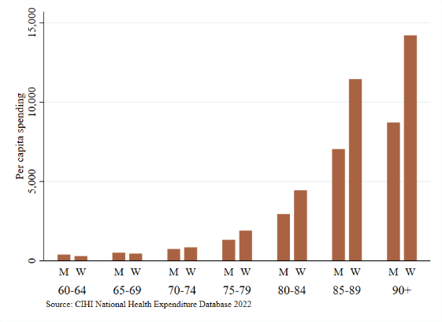
3. Long-term care
LTC expenditures by age group:
Really grows post age 85.

Slide 66
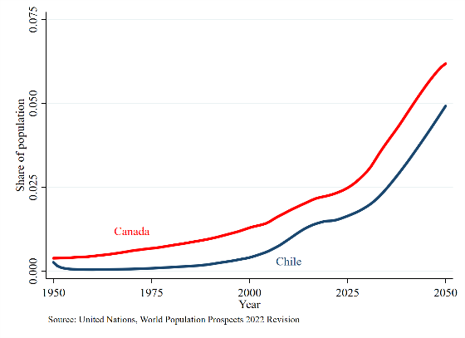
3. Long-term care
Age 85+:
Population share takes off after 2030.

Slide 67
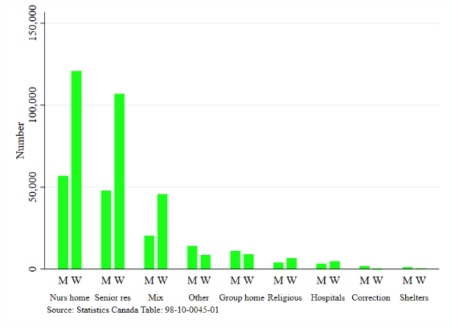
3. Long-term care
As of 2021:
About 400K in nursing home or senior residence.

Slide 68
3. Long-term care
As of 2021:
About 400K in nursing home or senior residence.
Are we ready to build and staff 2x beds?

Slide 69
4. Fiscal balances
Putting it all together.

Slide 70
4. Fiscal balances
Putting it all together.
Pensions: almost through it. (Federal)
Health: just starting the upswing. (Provincial)
LTC: need will grow in 2030s. (Provincial)

Slide 71
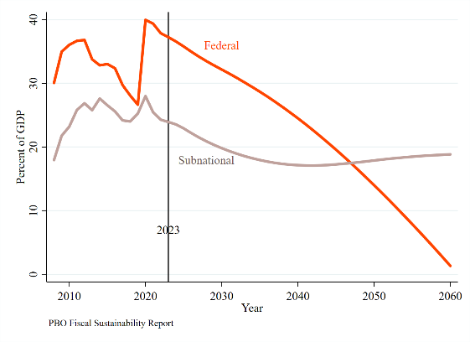
4. Fiscal outlook
Debt/GDP projections:
Fed-Prov differences driven by pension vs health responsibilities.
.
Too optimistic on low-cost government?

Slide 72
Possible policy responses
Cut other spending.
.
.
What to cut?

Slide 73
Possible policy responses
Cut other spending.
Borrow / inflate.
.
What to cut?
Not sustainable.

Slide 74
Possible policy responses
Cut other spending.
Borrow / inflate.
Federal finance; transfer $ to provinces.
What to cut?
Not sustainable.
Efficient? Accountable?

Slide 75
Possible policy responses
Cut other spending.
Borrow / inflate.
Federal finance; transfer $ to provinces.
Provincial finance.
What to cut?
Not sustainable.
Efficient? Accountable?
What tax to use?

Slide 76
Policy in Canada: the case of population aging
May 2023
Kevin Milligan
Vancouver School of Economics
University of British Columbia
Universidad de Chile
Santiago

