Slide 1
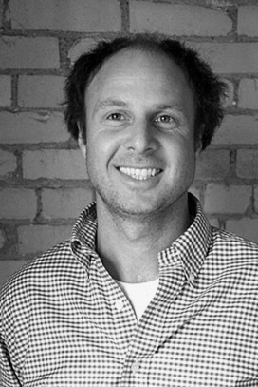
Nicholas Oldland

Slide 2
We have read three of Nicholas Oldland’s books.
Can you remember what they are called?
What are their titles?

Slide 3
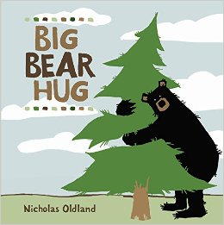
Big Bear Hug
By
Nicholas Oldland

Slide 4
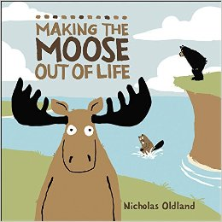
Making the Moose Out of Life
By
Nicholas Oldland

Slide 5
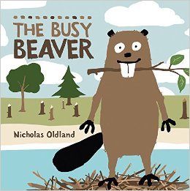
The Busy Beaver
By
Nicholas Oldland

Slide 6
