Slide 2
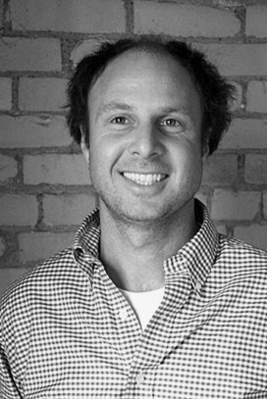
Nicholas Oldland

Slide 3
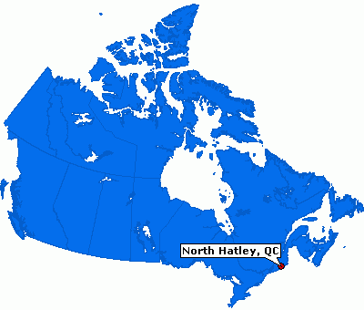
North Hatley,
Quebec

Slide 4
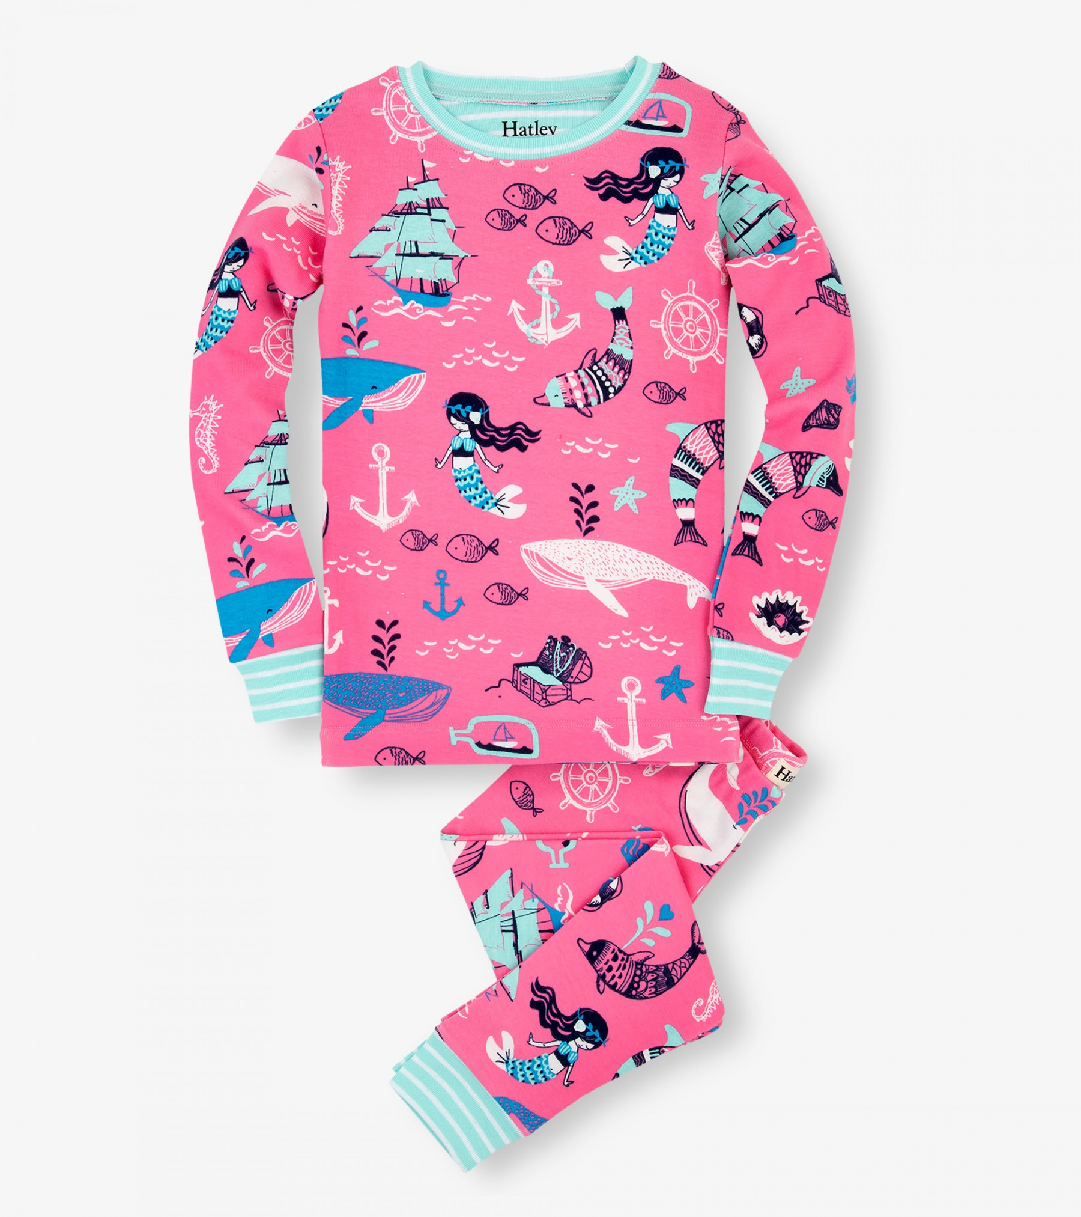
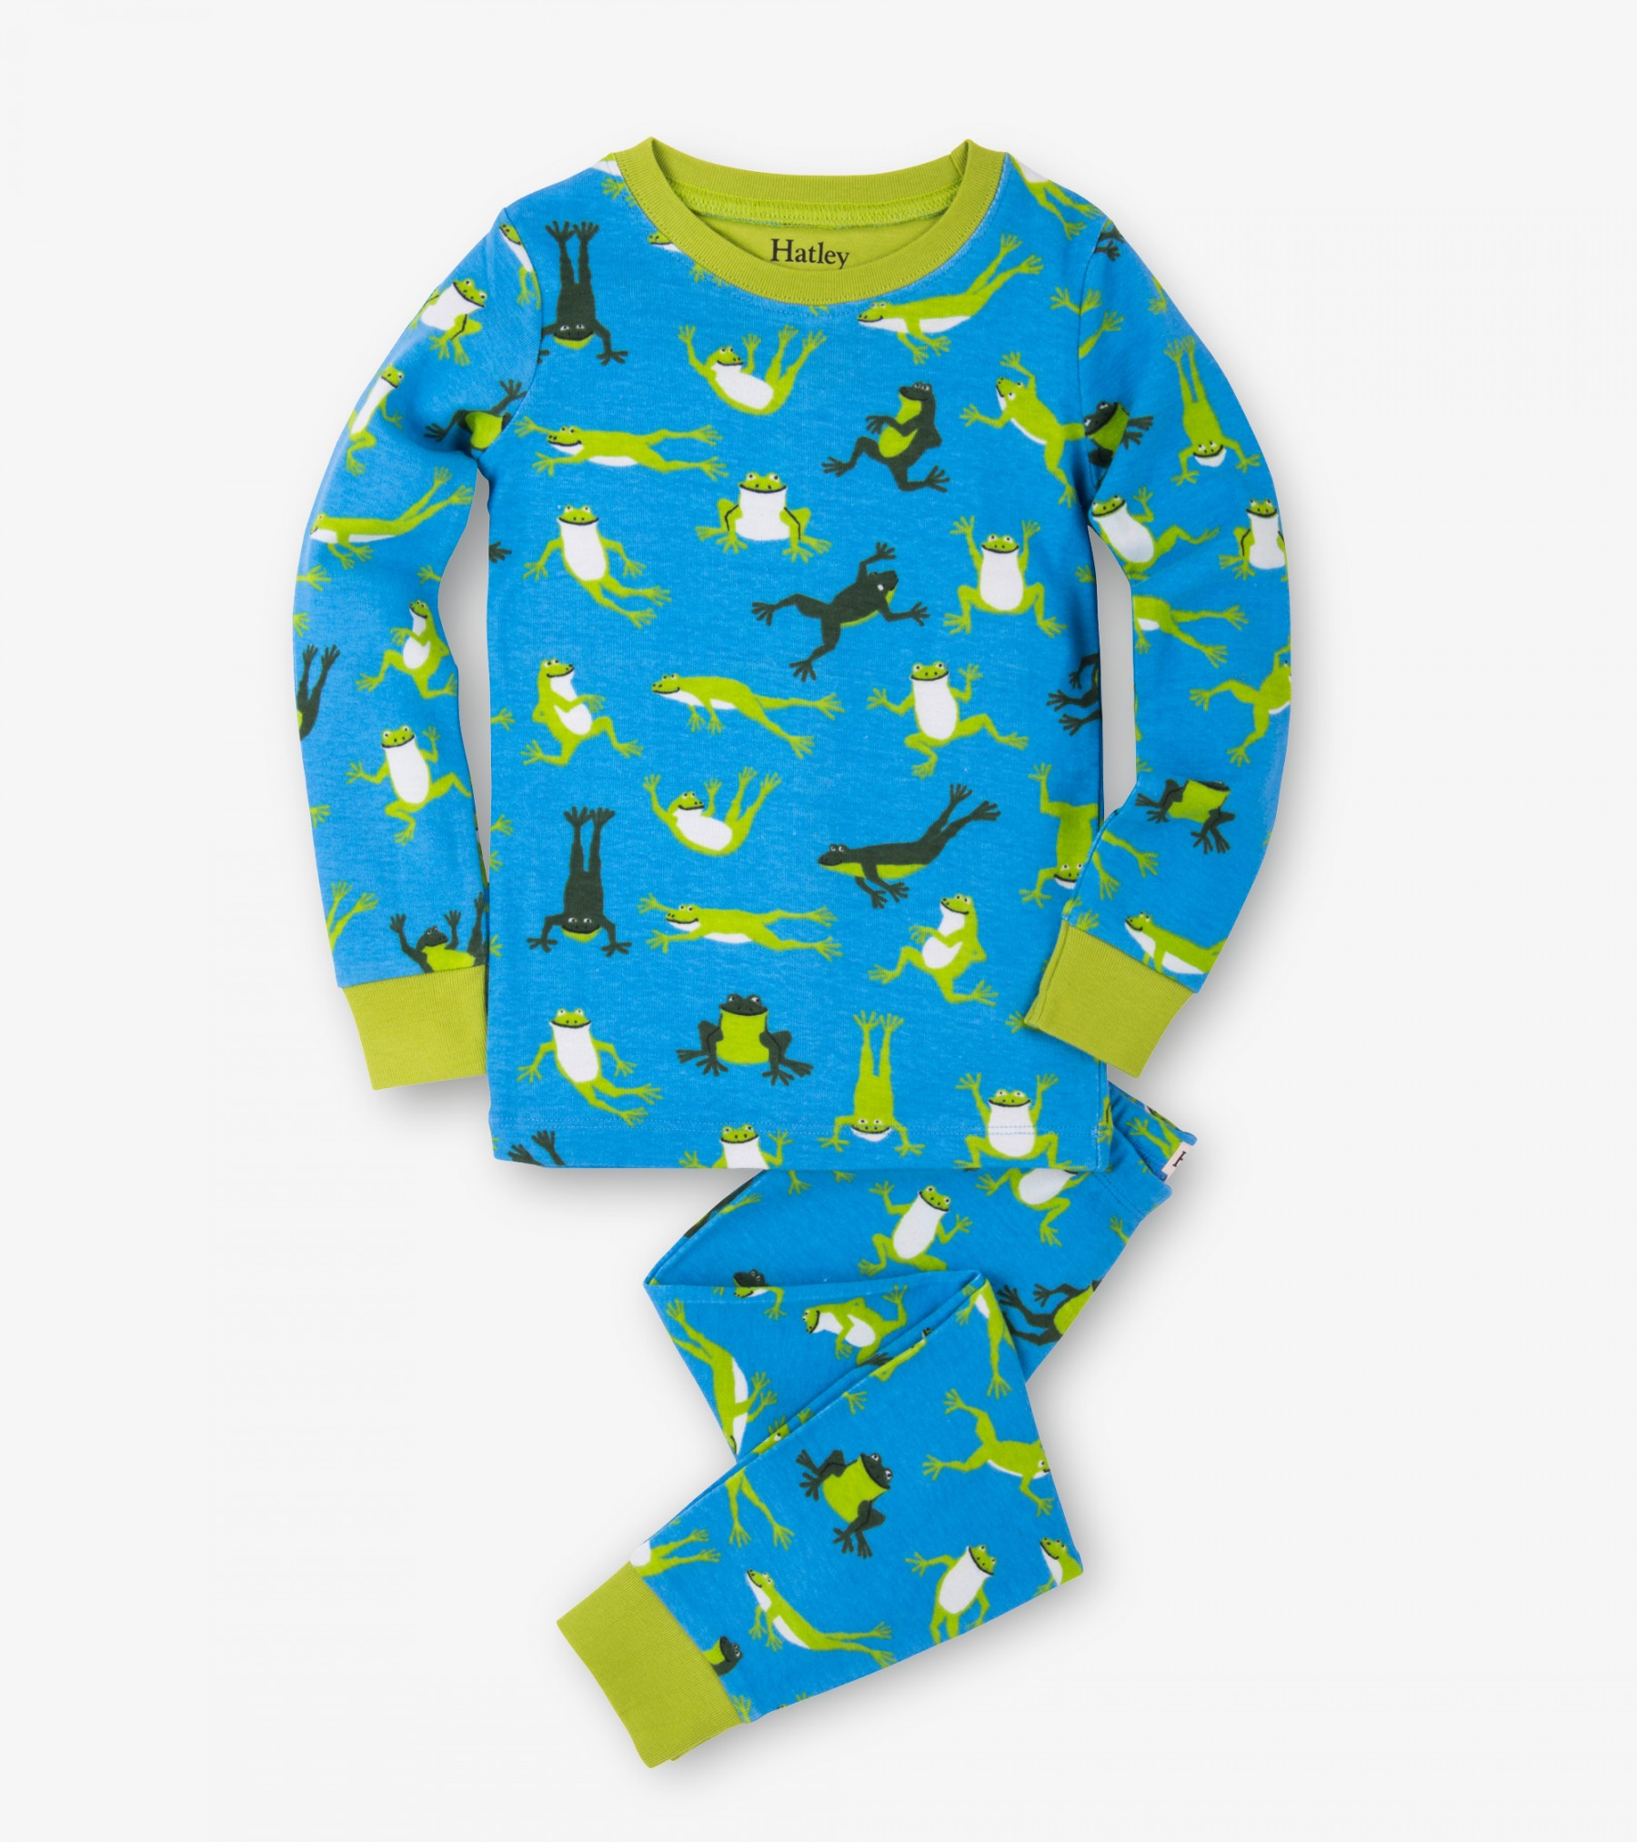

Slide 5
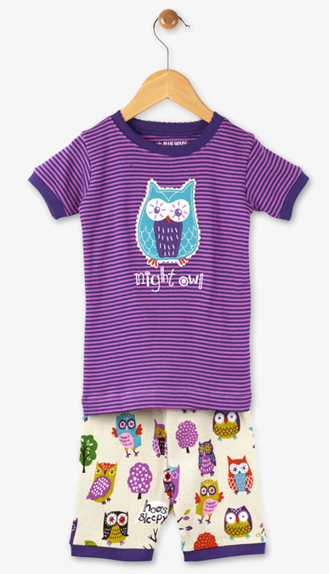
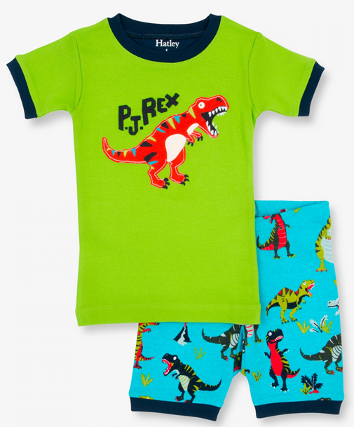

Slide 6
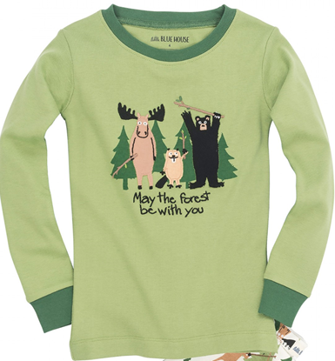
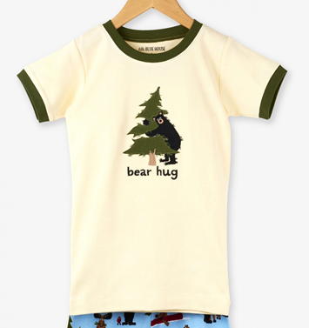

Slide 7
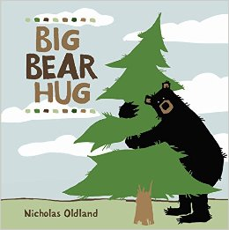
2010 - Best Books for Kids & Teens, Starred Selection, Canadian Children's Book Centre, Winner

Slide 8
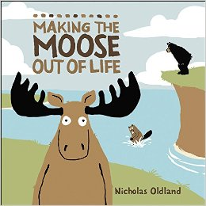
2011 - Best Books for Kids & Teens, Starred Selection, Canadian Children's Book Centre, Winner
2011 - Best Children's Books of the Year, Bank Street Children's Book Committee, Winner

Slide 9
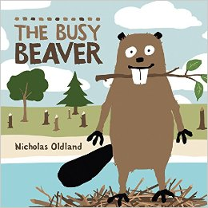
2012 - Best Books for Kids & Teens, Canadian Children's Book Centre, Winner

Slide 10
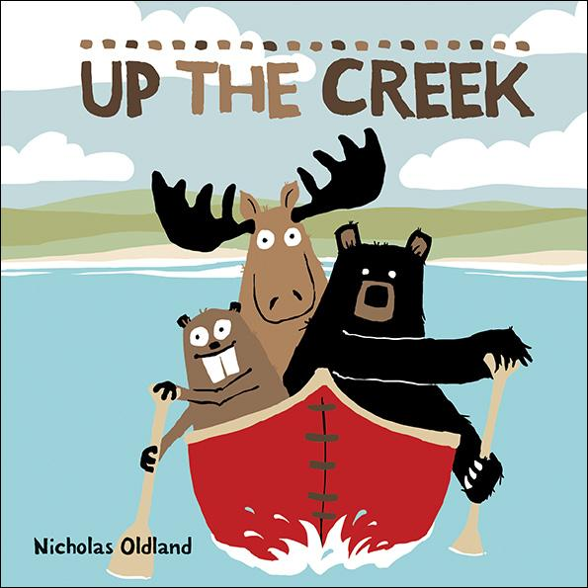
2014 - CCBC Choices 2014, Cooperative Children's Book Center, Winner

Slide 11
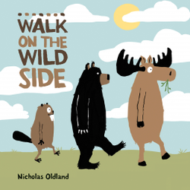
2015 - Best Books for Kids & Teens, Canadian Children's Book Centre, Winner

