Slide 1
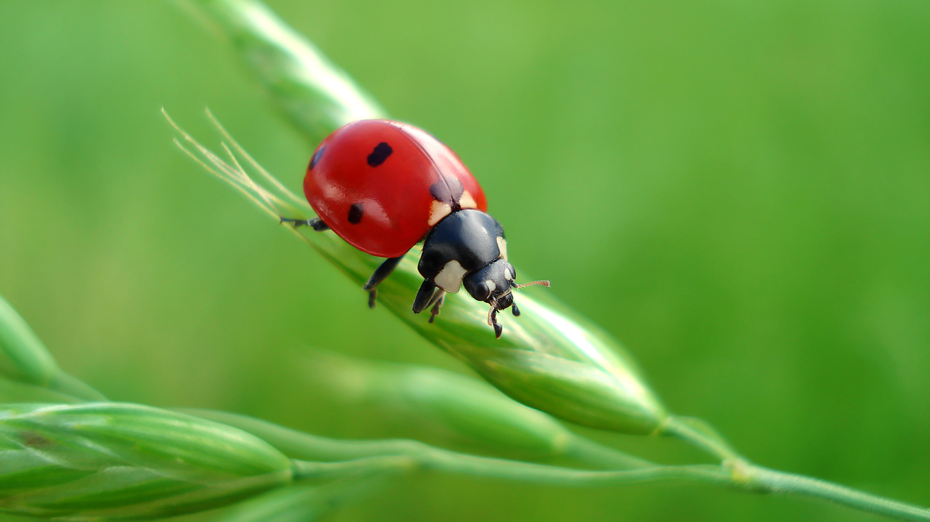
What do ladybugs eat?

Slide 2
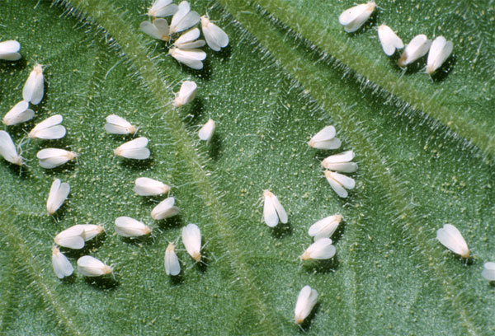
Ladybugs eat whiteflies.

Slide 3
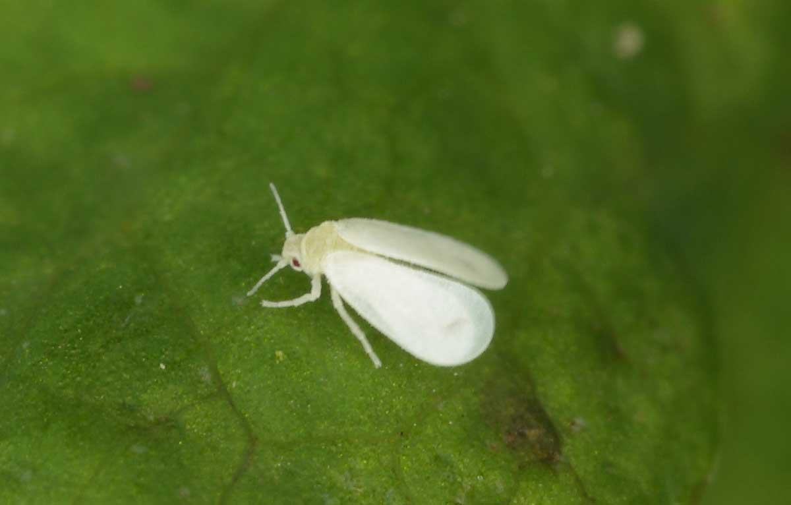
Ladybugs eat whiteflies.

Slide 4
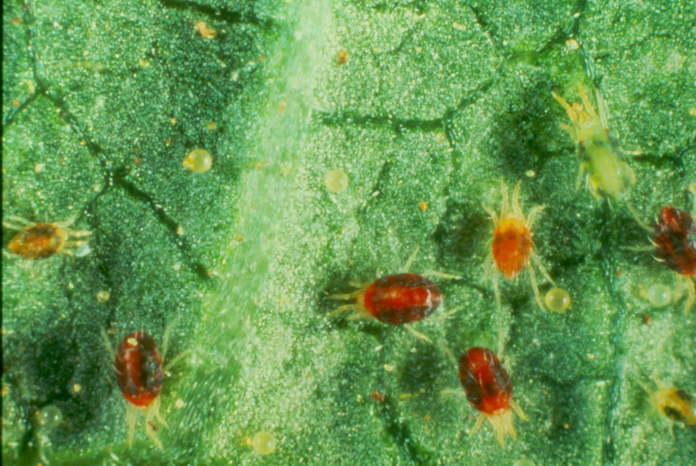
Ladybugs eat mites.

Slide 5
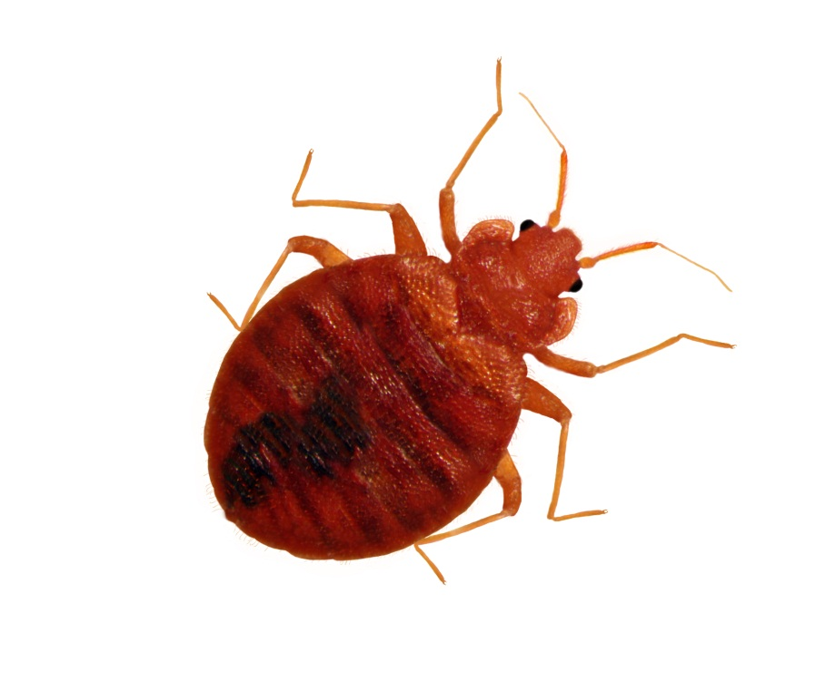
Ladybugs eat mites.

Slide 6
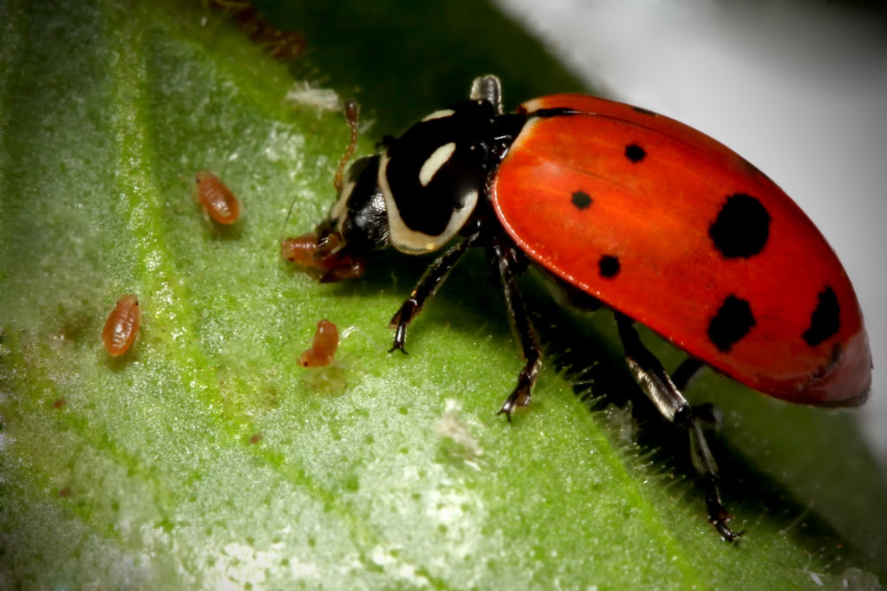
Ladybugs eat mites.

Slide 7
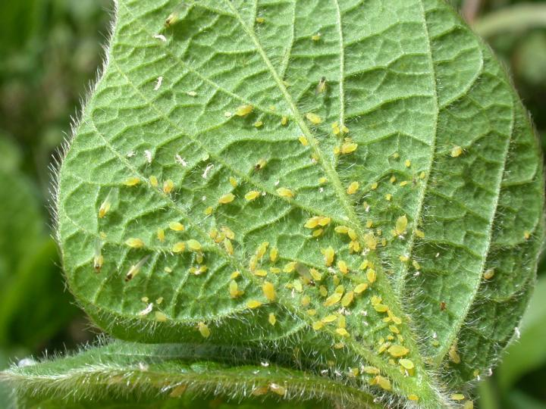
Ladybugs eat aphids.

Slide 8
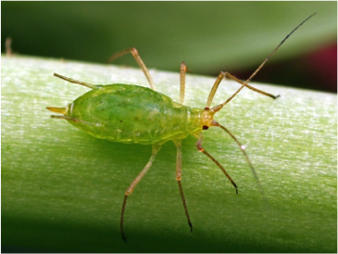
Ladybugs eat aphids.

Slide 9
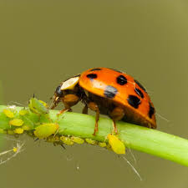
Ladybugs eat aphids.

Slide 10
Ladybugs eat aphids.

Slide 11
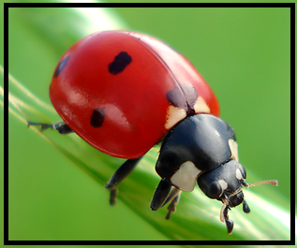
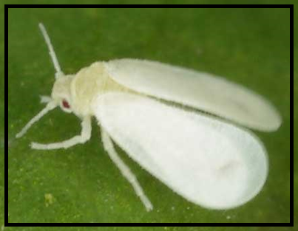
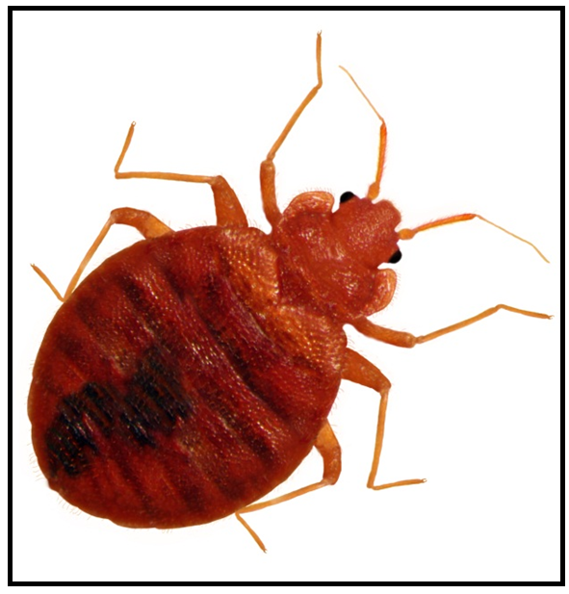
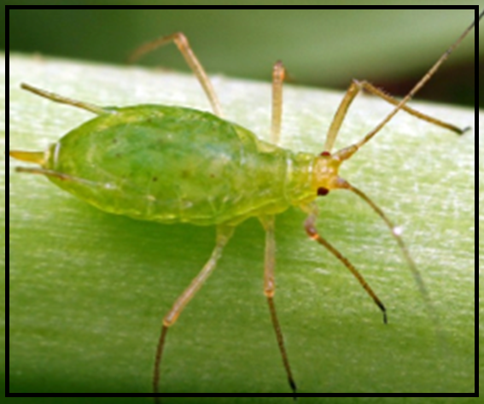
Ladybugs eat
whiteflies mites aphids

