Slide 1
Where do insects go when it rains?

Slide 2
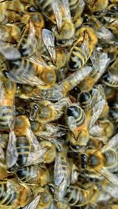
Bees
If bees get too cold, they’ll huddle together and shiver – just like us – to keep themselves warm. Queen bumblebees disengage their wings and use the flight muscles to generate heat to help them forage for food in the early, chilly spring.
Honey bees can sense the pressure changes in the weather, sometimes they stay home.

Slide 3
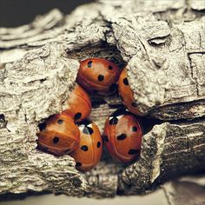
Ladybugs
Ladybugs hibernate in large groups in cold weather.
Some ladybugs will move in with humans when it is too cold outside.

Slide 4
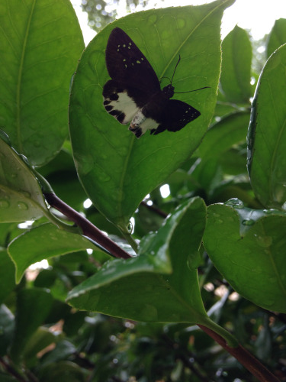
Butterflies
Butterflies hide when it rains. They usually go to the same places they do for the night. Some butterflies hide under large leaves, some crawl down into dense leaves or under rocks, and some just sit head down on grass stems or bushes with wings held tightly.

Slide 5
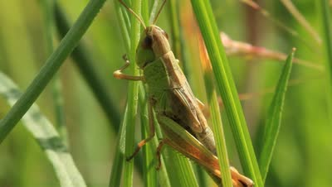
Grasshopper
Grasshoppers will go into sheds, buildings, crevices, and other places when it rains. Some grasshoppers will just stay on the grass or whatever vegetation is nearby when it rains.

Slide 6
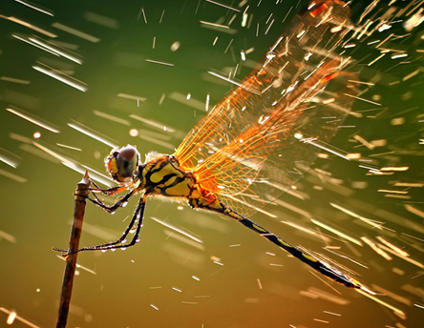
Dragonfly
Dragonfly wings are adapted to brushing off water (nanostructures on their wings that allow water to roll off), so a drizzle wouldn't hurt them, but they cling under vegetation for harder rain.

