Slide 1
Arpilleras
Art, Craft and Protest

Slide 2
Arpilleras
The Arpillera Workshops began in 1974 through the support of the Pro-Paz Committee
The Pro-Paz committee was an ecumenical aid organization founded by various churches in October 1973. The organization tried provided victims of the regime with material and legal help.

Slide 3
In December 1975, the government forced the Pro-Paz Committee to close, fearing it had gone beyond charity into “Political Activities”.
In January 1976 Cardinal Raul Silva reopened the committee as an independent vicariate of the Catholic Church, the “Vicariate of Solidarity”. Chilean law considered the Church as an independent entity, free from government interference.

Slide 4
The Arpillera workshops were designed to give women a marketable skill, as well as allow them an outlet to document their experiences.
Arpilleras are applique compositions in which pieces of cloth are shaped and sewn on a burlap backing.
Based loosely on folk art made in the 1960’s by the women of Isla Negra, bordadoras. Bordados depicted idyllic scenes of rural life with colourful wool thread. The arpilleristas used scraps found around their homes.

Slide 5
Each arpillera was the work and vision of one woman.
At first, arpilleras were about 14″x18″, but later smaller and larger ones were made as well. Reviewers in the workshops inspected the arpilleras for both quality and content.
Vicariate had few rules, but discouraged explicit depictions of torture (fear of reprisal)

Slide 6
The vicariate provided materials to the women, then purchased arpilleras from the workshops and sent them abroad through Church and diplomatic channels.
Chilean government considered them traitorous and forbid them to be shown or sold in the country. Arpilleras were smuggled out of the country in diplomatic pouches. Packages and suitcases suspected of containing them were confiscated.
To protect the women tapestries were generally unsigned, though the Vicariate turned over to them all the profits they received from selling the works abroad. Often, this money was the only income the women had.

Slide 7
Marjorie Agosin
“All of the arpilleras have very similar narratives: disappearances, abductions, mothers sitting at a table waiting for an empty seat to be filled. The narrative then is transformed and transposed into the arpillera. The material of the arpillera, it's also a very important component in the telling of the story. It is made out of the remnants of the poor. So you create a story, a narrative, a work of art out of leftover things, remnants. In the very beginning of the years of the dictatorship, the women made arpilleras out of the clothing of their missing ones and told a story that was silence inside the country.” --Threads of Life Conference, Brandeis University 2005.

Slide 8
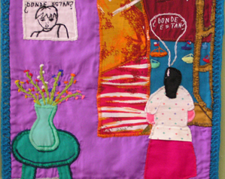
Arpillera from Marjorie Agosin’s collection: http://www.brandeis.edu/ethics/events/past/tellingthestory/agosin.html

Slide 9
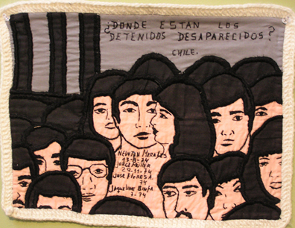
Arpillera from Agosin collection. http://www.brandeis.edu/ethics/events/past/tellingthestory/agosin.html

Slide 10
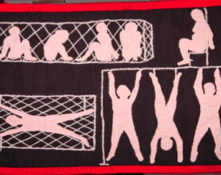
“Sala de Torturas” Arpillera from Agosin’s collection. http://www.cain.ulst.ac.uk/quilts/followup/docs/ISE_Arpilleras-II_020309w.pdf

Slide 11
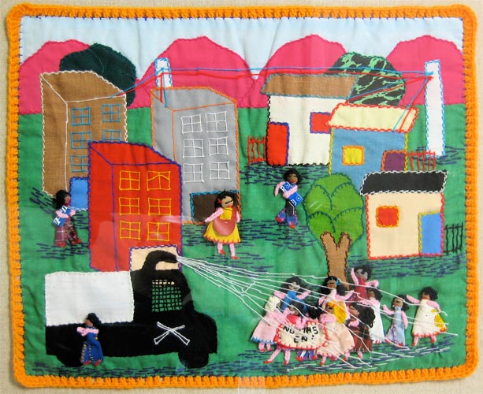
The William Benton Museum of Art Arpillera Collection http://benton.uconn.edu/arpillera/
A government truck is spraying
contaminated water on the protesting
women in this city. This is a political protest.
“No mas CNI” = no more CNI

Slide 12
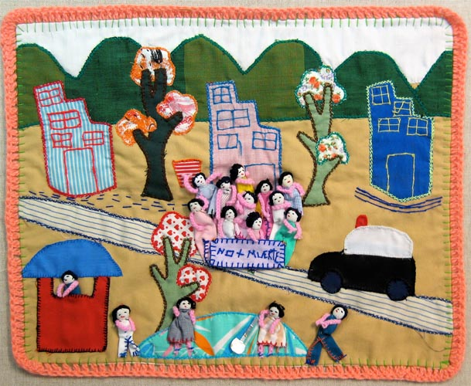
Protesters. “No + Muerte” = no more death.
Note the woman in the foreground with the
shovel, perhaps signifying another dead or
“missing” person. A police car is standing by.

Slide 13
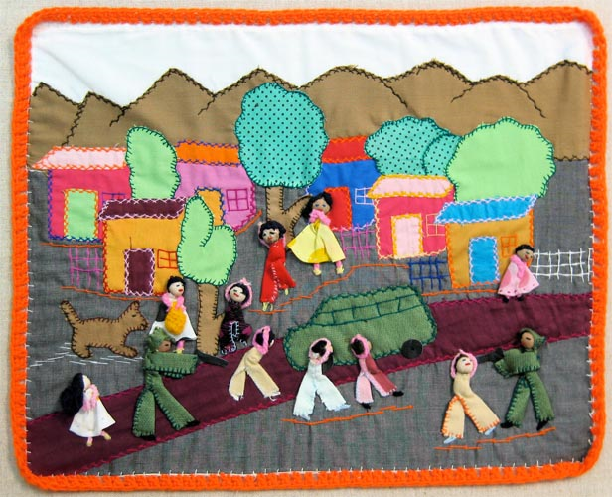
Military officers with guns are rounding up
villagers; all men. They will become part of the
“disappeared”. Note the women left behind
and the child left alone.

