Slide 1
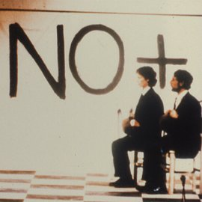
CADA: Art in Action

Slide 2
Dictatorial Rule
The 17 year regime is roughly divided into two periods, 1973-1980, 1980-1988
The first period was characterized by heavy and open use of military repression. Most of the mass-deaths and disappearances occurred during the seventies (Caravan of death 1973, DINA 1973-1977 Villa Grimaldi Prison Camp 1974-1978)
The second period, following Pinochet’s 1980 constitution involved “institutionalization”, integrating authoritarian principles into the executive framework of the country. (leftist political activities officially outlawed, special government powers ‘for emergencies’)
Culture remained under strict government controls through censorship bodies.

Slide 3
Social life was greatly reduced, characterized by extreme distrust and self censorship.
Manuel Alcides Jofre describes it as a reduction of Chilean’s “social aura”, “the psychological space within which one travels….everything is kept inside”
Sociologist JJ Brunner describes the regime’s ideology as combining “free market”, “repression” and “television” resulting in a “privatized public” revolving around consumerism.
In 1980 the institutionalization of the regime destroyed hopes of returning to democracy until at least 1997 (The period stipulated in Pinochet’s constitution)

Slide 4
Colectivo de Acciones de Arte
Formed by Raul Zurita, Diamela Eltit (Writers) Lotty Rosenfeld, Juan Castillo (Visual Artists) and Fernado Balcells(Sociologist) in 1979 and eventually became known as “Escena de Avanzada”
Group used public “art actions” to create semantic ruptures in the artificial rhythms of daily life under the regime.

Slide 5
Para no morir de hambre en el arte (1979)
Para no morir de hambre en el arte is a multi-faceted 'art action' performed in 1979 addressing the problem of hunger and poverty, endowing milk with the symbolic power to represent this unrepresentable political issue. The performance consisted of several actions: passing out milk to people in Santiago's slums; parading milk trucks through the city's streets; calling attention to the performance with full-page ads in periodicals; enacting the group's message in front of the local United Nations building; altering the façade of a museum to draw it into the theme of the performance; broadcasting, through loudspeakers located outside the CEPAL building, a critical speech; and filling an acrylic box with 100 milk bags, an issue of the periodical 'HOY' and an audiotape with the broadcasted critical speech in an art gallery. Shown in this video clip is camera material of the action inside the gallery.

Slide 6
Ay Sudamérica (1981)
On July, 12th, 1981, six small airplanes, flying in perfect formation over Santiago, dropped 400,000 flyers discussing the relationship between art and society. This action referenced the bombardment of the House of Government (La Moneda), which marked the fall of Salvador Allende's democratic government and the beginning of Augusto Pinochet’s dictatorship in Chile. Through this ‘acción sobre arte y política’, CADA reconstructed the political trauma of 1973, while proposing a new critical political perspective. The flyers contained a message that simultaneously upheld each person’s right to a decent standard of living and proposed that the general public was capable of instating an entirely new concept of art - one that could overcome traditional, elite boundaries and become part of public life

Slide 7
Viuda (1985)
In September 1985, CADA produced a portrait of a woman whose husband had been killed in a political demonstration against the dictatorship in Chile; they accompanied the image with the following text: ‘Mirar su gesto extremo y popular. Prestar atención a su viudez y sobreviviencia. Entender a un pueblo.’ (‘To look at her gesture, extreme and popular. To pay attention to her widowhood and survival. To understand a people’). They published this work in several journals (‘Análisis’, ‘Cauce’, ‘Hoy’) and in the newspaper ‘Fortín Mapocho’, all critical of Augusto Pinochet’s dictatorship. This art intervention was meant to celebrate civil protests against the dictatorship; these protests were brutally repressed by the government. ‘Viuda’ was meant to refer to this political situation, while pointing to women as surviving social subjects who remained in charge of entire families and homes after the disappearance of their husbands. Shown in this video clip are still images of the newspaper article

Slide 8
No + (1985)
In 1983, the 10th year of Augusto Pinochet’s dictatorship in Chile, CADA proposed the slogan 'NO +' (NO more). This was meant as an open text to be completed by the citizens, according to their specific social demands (No more ...). CADA invited Chilean artists from different fields to spread this message on walls all over Santiago. Wall tagging was the first form of NO+, but the slogan was soon used by different collectives all over the country as a massive public symbol of political resistance and non-conformity.S

Slide 9
More on Raúl Zurita
Born in Santiago in 1950, studied engineering and mathematics.
Was arrested by the military following the 1973 coup. Held for 21 days in the ship “Maipo”.
Published first poems in magazine supplements in 1974, later released Purgatorio in 1978,

Slide 10
Experiences of torture left Zurita with psychological scars which he expressed in his poetry. Diagnosed with “epileptic psychosis”
In 1975, he burned his face as an act of self effacement, purgation of suffering and solidarity.
Purgatorio explores Zurita’s own troubled psyche as well as refers to country’s political situation. The “purging” that takes place is both personal and collective.
Text includes images of Zurita’s burned face abstracted to appear a landscape, EEG readings, notes from his psychiatrist and Rorsarch test results.

Slide 11
Landscapes manifest human emotion and experience.
Landscape is also the seats of memory. (Victims of the regime were often buried in canyons, thrown into volcanoes or the sea). Zurita imagines the landscape “remembering” “mourning” and “speaking” (relation to Jewish and Christian prophetic language)
Also draws on Hispanic lyrical traditions about the relationship between humans and landscape (Neruda’s metaphoric and personifying evocations of Chilean landscape)

Slide 12
At the same time, Zurita’s poetry relies on what Nelly Richard calls “Fragments of the discard”. Loose compositions of remnants, ruins.
Attempts to compensate for the loss of common language and shared meanings by drawing on what remains (the body, landscape, woundedness, grief).

Slide 13
In 1983, Zurita had the poem “La vida nueva” written over the skies of New York.
CADA wanted to have the poem written over Santiago but was unable to.
Also had the phrase “Ni pena, ni miedo” bulldozed into the Atacama desert in 1993. Zurita’s intention was to express a hopeful message to people as an end to the oppression of the dictatorship.The single verse is 4 KMS long and is only visible from the sky.

Slide 14
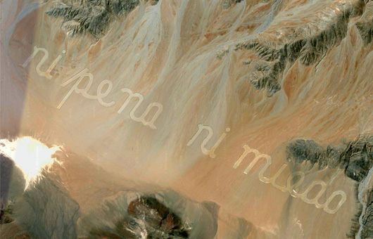

Slide 15
Discuss your thoughts on the Chilean dictatorship? What factors lead to the military coup? Why do you think the US got involved? How do you think Chile would have been different if Allende’s programme had been allowed to continue.
Discuss the differences between the two periods of the dictatorship. In what ways do you think things improved in the 1980s? in what ways did they get worse?
In what ways did the CADA art actions differ from other forms of protest art such as the Arpilleras and testimonies that took place around the same time?
The CADA installations functioned by creating social disruption and by evoking in a roundabout way what the dictatorship attempted to keep silent (hunger, memories of the coup) How effective do you think these strategies were?
Discuss which CADA installation you found the most interesting or impactful.
What are your thoughts on Zurita’s poetry? What impressed you about it? Do you think it was too “abstract” or “difficult” and would you have preferred a more openly denunciatory type of art?
Would you consider these art actions a form of popular culture? Why or why not?

