Slide 1
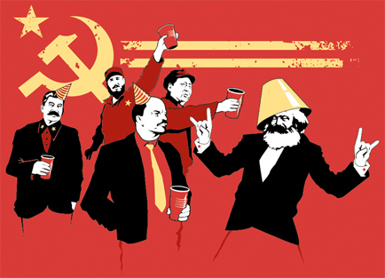
Marxism and Popular Culture

Slide 2
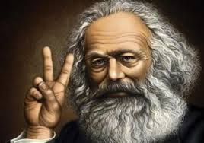
Classical Marxism
The Marxist method of historical interpretation differs from other historical approaches as it focuses on modes and relationships of production.
Cultural artifacts are inseparable from conditions of production and must be analyzed in relationship to them
The political, social and cultural shape of the any given society is determined by modes and relations of production

Slide 3
“modes of production” and “relations of production” compose a society’s “base.”
Institutions and modes of consciousness compose “superstructure”
Superstructure legitimizes base. Base conditions superstructure.
The ruling class in a society is also the intellectual class. Their ideas/values shape what is considered “universal”.
Marxist cultural analyses read texts in relation to their historical conditions while keeping in play a subtle dialectic between agency and structure (i.e. Raul Zurita’s poetry during the Chilean dictatorship)

Slide 4
Frankfurt School
Term refers to a group of German Marxist intellectuals associated with the Institute for Social Research at the University of Frankfurt between 1923-1933.
Group included Walter Benjamin, Theodor Adorno, Max Horkheimer, Leo Lowenthal, Herbert Marcuse and Erich Fromm among others.
Interested in the intersection of Marxist ideas and culture. Originated what is often called “Critical Theory”

Slide 5
Had a very negative view of popular culture, with the exception of Walter Benjamin.
Adorno and Horkheimer contrasted “culture industry” with “authentic culture”
“The culture industry” (popular culture) is not socially destructive as Matthew Arnold argued, but a tool of the system.

Slide 6
Horkheimer argues that the role of art and culture is to embody a utopian, unalienated vision of the world, that which capitalism denies and which could provoke in people the desire for a better world
“Mass culture” replaces this utopian vision with “wish dreams” like wealth, love, adventure which act as both pressure valves and the “carrot” at the end of the capitalist stick.

Slide 7
Adorno on popular music
Adorno’s disdain for popular culture is particularly evident in his treatise on popular music.
In it he argues that popular music is “standardized”, containing limited, rigid structure and themes (one octave, one note).
These structures are repeated and reused exhaustively, such that elements from one song can be moved to another.

Slide 8
Even elements of a song which might seem individualistic (bridges, dirty notes) are selected from a pre-established repertoire ‘pseudo-individualization’.
This is contrasts with “Serious music” whose “true meaning” requires both attention to context and a sense of the piece’s totality.
The “structural standardization” of popular music leads to “standardized reactions” creating “passive listeners”, eliciting preconditioned responses.
Popular music dulls the senses, while serious music fires the imagination, provoking a vision of “what life could be”

Slide 9
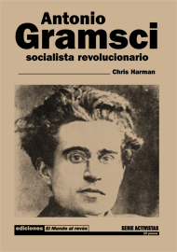
Antonio Gramsci
Gramsci looked at the lack of social revolution in capitalist countries developed the theory of “Hegemony”
Hegemony involves “rule by consensus” or the process of negotiation between classes to maintain a stable social structure.
Gramscian Marxism influenced cultural studies, particularly in terms of its concepts of hegemony and the role of the intellectual.

Slide 10
Hegemony involves a society in which class conflict is managed through negotiations and concessions rather than direct force. (Although force sometimes is used)
Cultural processes shift back and forth between “opposition” and “incorporation”
(ex. Punk music becoming “mainstream”)
Popular artists create out of their consumption of cultural texts, first as opposition, then as incorporation.

Slide 11
Popular culture is thus neither an imposed system of manipulation, (Frankfurt School) nor a sign of social breakdown (Matthew Arnold).
But rather, it is a mix of intentions and counter intentions, authenticity and commercialism, high and low.
“Articulation” (use) determines cultural significance as much as production.
The cultural field is marked by the struggle to articulate, disarticulate and rearticulate cultural products for certain ideologies and politics.

Slide 12
Dick Hebdige
In Subculture, the Meaning of Style Dick Hebdige attempts to analyze youth and marginal subcultures (punk, underground, gay movements in the 1970s) through a Gramscian and Barthesian lens.
Hebdige begins by recognizing two competing definitions of “culture”, referring to both the most elevated creations of the past (Arnold) and to the total creative and meaning-making work of a society (Williams)

Slide 13
Hebdige argues that contemporary Marxist theories (of the 1970s onward) attempt to bridge these two ideas. He cites specifically Roland Barthes and Antonio Gramsci.
Barthes’ work focuses on how all cultural phenomena become distorted into myth, or sources of particular semiological meanings.
This myth, however, reiterates the class structure and universializes the values of the ruling classes.

Slide 14
From Mythologies:
Barthes on Wrestling: “But what wrestling is above all meant to portray is a purely moral concept: that of justice. The idea of ‘paying’ is essential to wrestling, and the crowds’ ‘give it to him’ means above all else ‘Make him pay’. The baser the action of the ‘bastard’, the more delighted the public is by the blow he receives in return”
On Julius Caesar “all the characters are wearing fringes. Some have them curly, some straggly, some oily, all of them well combed, and the bald are not admitted although there are plenty to be found in Roman history….what then is associated with these insistent fringes? Quite simply the label of Roman-ness. We therefore see here the mainspring of the Spectacle (the sign) operating in the open. The frontal lock overwhelms one with evidence, no one can doubt he is in Ancient Rome.”

Slide 15
Gramsci again
Hebdige utilizes Gramsci’s theory to explain the practices of youth subcultures.
According to Gramsci, Hebdige explains, Hegemonies’ attempts to rule by consent means that its systems are never fixed, and that “myths” in Barthes sense can be demystified and deconstructed.
Youth subcultures, especially those that emerged in the postwar period (Hebdige looks at England specifically) perform this function, signalling a contemporary “breakdown of consensus”.

Slide 16
Questions for discussion
What does Marxist analysis tell us about popular culture? Discuss the relationship between capitalism and popular culture?
Discuss your response to the Frankfurt School’s view of popular culture? Do you agree? Can popular culture have socially critical functions as well?
How do you feel about popular music? Is Adorno right?
Using Barthes and Gramsci’s ideas, how would you analyze the following cultural creations:
Reggaeton music
Salsa and/or Latin pop
Epic Rap Battles of History (or any YouTube series)
The Simpsons (considering the show’s reception in the USA and LA)
Telenovelas (name some specific one’s you’ve seen)
Hollywood Films dealing with Latin American topics (i.e. Frida, The House of the Spirits, The Book of Life,)
Daytime talk shows such as Laura

