Slide 1
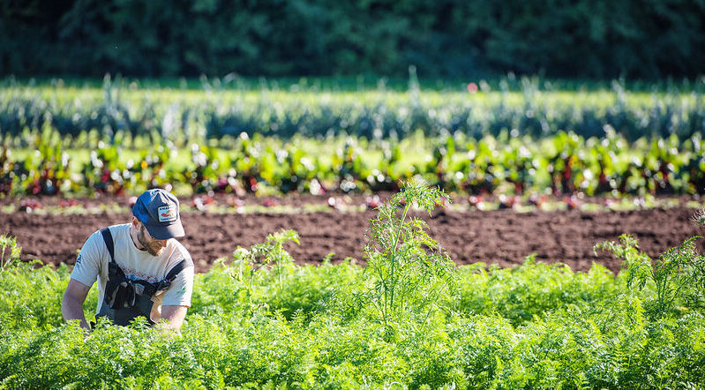
Extend Your Learning: Alternative Course Offerings

Slide 2

Land Acknowledgement
We reside, learn and play on the traditional, ancestral and unceded territories of the Squamish, Musqueam and Tsleil-Waututh Coast Salish Peoples

Slide 3
APBI 49X Courses
APBI 496
APBI 497
APBI 498
APBI 499
Applied Animal Biology Practicum
Directed Studies in Applied Biology
Undergraduate Essay
Undergraduate Thesis

Slide 4
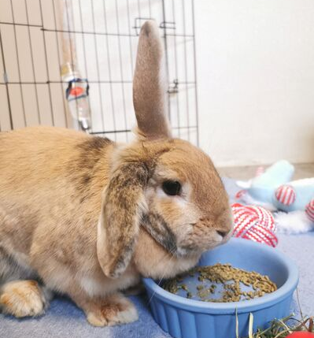
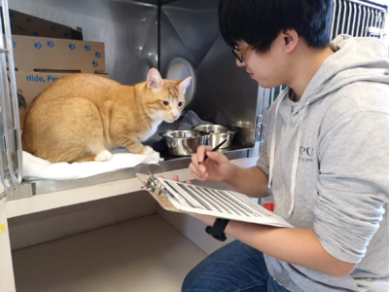
Applied Animal Biology Practicum APBI 496
Directed Studies in Animal Biology APBI 497
What: Hands on experience in the fields of wild, companion, lab, and farm animal welfare and management
When: Jan, May, July and Sept start dates in 3rd or 4th year
How do I prepare?
Take APBI 314 and/or APBI 315
Review course Wiki and syllabus
What: Customized projects that develop and strengthen research skills and accommodate special research interests
When: Any term in 3rd or 4th year
How do I prepare?
Take APBI 398 (not required)
Review course Wiki and syllabus
Discuss research interests with a professor
Notes:
You have to apply, go through student services or your program advisor to register in any of these courses
APBI 398 = Research Methods
APBI 496: https://wiki.ubc.ca/Course:APBI496
APBI 497: https://wiki.ubc.ca/Course:APBI497

Slide 5
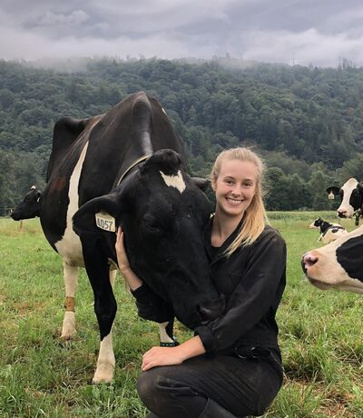

Undergraduate Essay
APBI 498
Undergraduate Thesis
APBI 499
What: customized literature review that will develop and strengthen research skills and accommodate special research interests
When: Any term in 3rd of 4th year
How do I prepare?
Take APBI 398 (not required)
Review course Wiki and syllabus
Discuss research interests with a professor
What: customized projects that will strengthen research skills and to accommodate special research
When: Any term in 3rd or 4th year
How do I prepare?
Take APBI 398 (not required)
Review course Wiki and syllabus
Discuss research interests with a professor
Notes:
You have to apply, go through student services or your program advisor to register in any of these course
APBI 398 = Research Methods
APBI 498: https://wiki.ubc.ca/Course:APBI498
APBI 499: https://wiki.ubc.ca/Course:APBI499

Slide 6
LFS 49X Courses and Other Options
LFS 496
LFS 490
LFS 450
Farm Practicum
Career Development and Food Systems
Directed Studies in Land and Food Systems
Land, Food, and Community III: Leadership in Campus Food System Sustainability
UBC Farm Practicum in Sustainable Agriculture

Slide 7
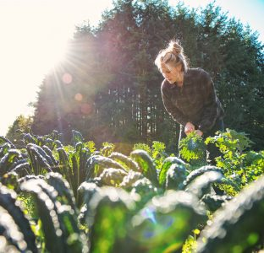

Career Development and
Food Systems
LFS 496
Directed Studies
LFS 490
What: Customized course where students plan the topic, deliverables and course outline with a faculty member
When: Any term
How do I prepare?
Take APBI 398 (Research Methods)
Discuss research interests with a faculty member
What: Mentored learning experience with a real food business or organization
When: Summer term
How do I prepare?
Watch for updates on available positions
Prepare your resume to apply
Notes:
LFS 496: https://ubcfarm.ubc.ca/learn/lfs496/
LFS 490: https://www.landfood.ubc.ca/undergraduate/classroom/guided-independent-learning-opportunities/

Slide 8
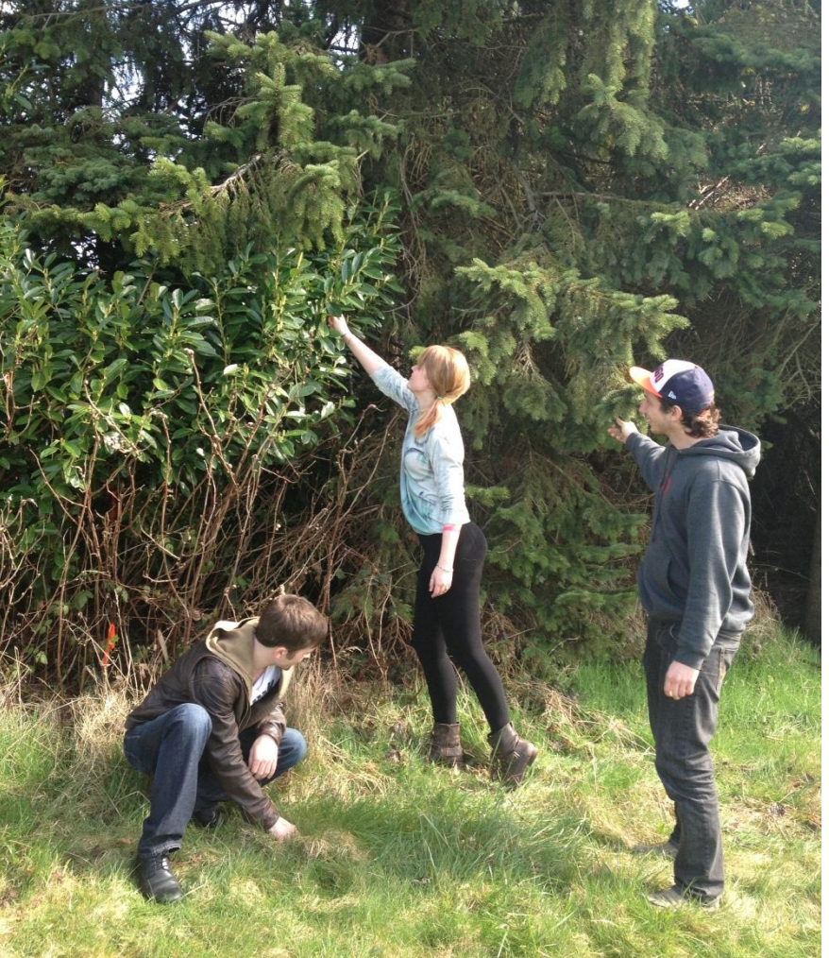
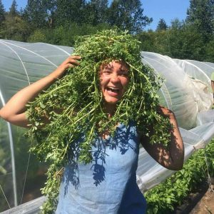
Land, Food, and Community III
LFS 450
UBC Farm Practicum in Sustainable Agriculture
APBI 365 and APBI 465 (up to 9 credits)
What: Project with community partner on campus focused on a sustainability related food system issue
When: Check course calendar
How do I prepare?
Take APBI 350 (not required)
What: experiential learning program where knowledge about sustainable agriculture and food systems is applied
When: April – August OR April - October
How do I prepare?
Review farm practicum website
Prepare your resume to apply
Prepare 2 references
Notes:
LFS 450 is the only course you can directly enroll in on the ssc
LFS 450: https://courses.students.ubc.ca/cs/courseschedule?pname=subjarea&tname=subj-course&dept=LFS&course=450
Farm Practicum: https://ubcfarm.ubc.ca/learn/practicum-in-sustainable-agriculture/

Slide 9

Thanks for coming!
Lesley Dampier – Lesley.Dampier@ubc.ca
Cara LeGault – lfs.apbi@ubc.ca
Andrew Riseman – Andrew.Riseman@ubc.ca
Sara Dubois – Sara.Dubois@ubc.ca

Slide 10


