Slide 1
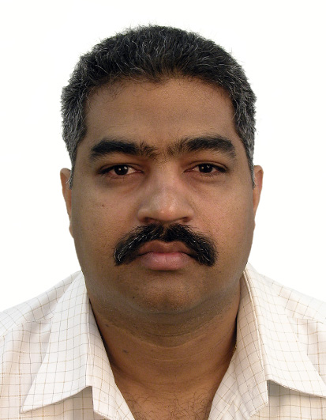
Wheat blast: An emerging and spreading disease threatening global wheat production
Monday, August 22, 2022
2:30 – 3:30 PM
MacMillan Room 158
Pawan K. Singh
Head, Wheat Pathology, GWP,
International Maize and Wheat Improvement Center, MEXICO
Hosted by Dr. Gurcharn Singh Brar, Assistant Professor

