Slide 1

Week Six: Oct 12
Topics | ● Creating an Inclusive Learning Environment
 | Intercultural projects Diversity in the curriculum Teaching to reach every student
Topics:
LLED 360
Dr. Lorna Ramsay

Slide 2
Sharing Assignment 2
Groups for facilitation one group joins another
Share between groups with scenario
Attendance
Break
Assignment One Group Two Presentation and discussion
Break
Scenario for refugees and trauma………strategies
Assignment 3 summary outline

Slide 3
Self Evaluation Assignment 2
● Clarity and completeness of the description.
● Sophistication of the critique, which should go beyond simple description.
● Insightfulness of the connections between the key concepts in the required reading, your own
ideas, and other resources related to the topic.
● Level of engagement and meaningfulness of the interactive class activity.
In reflection:
​
Did I make personal connections to the readings or discussion points? What really are important issues to take to Assig 3?
​
Is there more research to do or changes to make for Assignment 3?

Slide 4
https://www.weareteachers.com/10-things-about-childhood-trauma-every-teacher-needs-to-know/
Print out: Recognizing trauma
https://www.ocde.us/HealthyMinds/Documents/Resource%20Page/Recognizing%20Trauma%20in%20the%20Classroom.pdf
http://journals.sagepub.com.ezproxy.library.ubc.ca/doi/pdf/10.1177/0143034311400827
Speak the World: Hostel World……..translation App
http://www.hostelworldgroup.com/~/media/Files/H/Hostelworld/press-release/Hostelworld%20Introduces%20Speak%20the%20World%20Powered%20by%20Google%20Cloud%20Translate%20Technology.pdf

Slide 5
Canada resettled 40,081 refugees from Syria alone from November 4, 2015
to January 29, 2017 (#Welcome Refugees, 2017).
Families may struggle with social and economic factors in their new country,
frequent relocation,
and drastic cultural disorientation as well as threats, discrimination,
loss of status and alienation (Yau, 1995; Beiser, Simich, Padalangat, Nowakowski & Tian, 2011).
Swedish researchers determined that the group most psychologically affected are
children between ages 10-12 because events have had the strongest impact
on their personality formation (Lindencrona et al, 2007).
Dooley, K. (2009). Re-thinking pedagogy for middle-school students with little,
no or severely interrupted schooling. English Teaching: Practice and Critique, 5-22.

Slide 6
A task of schooling is to ensure that students acquire a mix of resources adequate
to the demands of the literate contexts in which they find themselves.
The four resources model (Freebody & Luke, 1990)
- code-breaking resources
(for example, knowledge of spelling patterns);
- resources for participating in textual meanings
(for example, vocabulary, grammar);
- text use resources
(for example, understanding the purpose of a text);
- resources for critical textual analysis
(for example, being able to identify an author’s world view).

Slide 7
“I also looked at using things that supplement that [reading program]
such as short sentence writing, spelling on a regular basis to address the literacy skills …
I think is the basis for them and also model,
very often in class if there is sentence writing,
but me showing the parts, students do one together, then to do it individually
give comments as much as they can at individual basis. …
to write short narrative, what is writing a news report. So to break,
to show them these parts, to make it as visual as you can, pointing, cutting, pasting, drawing,
you know, all these markers, different colours, and then putting it as a class together….”
http://edu.gov.on.ca/eng/document/esleldprograms/guide.pdf look at p.61

Slide 8
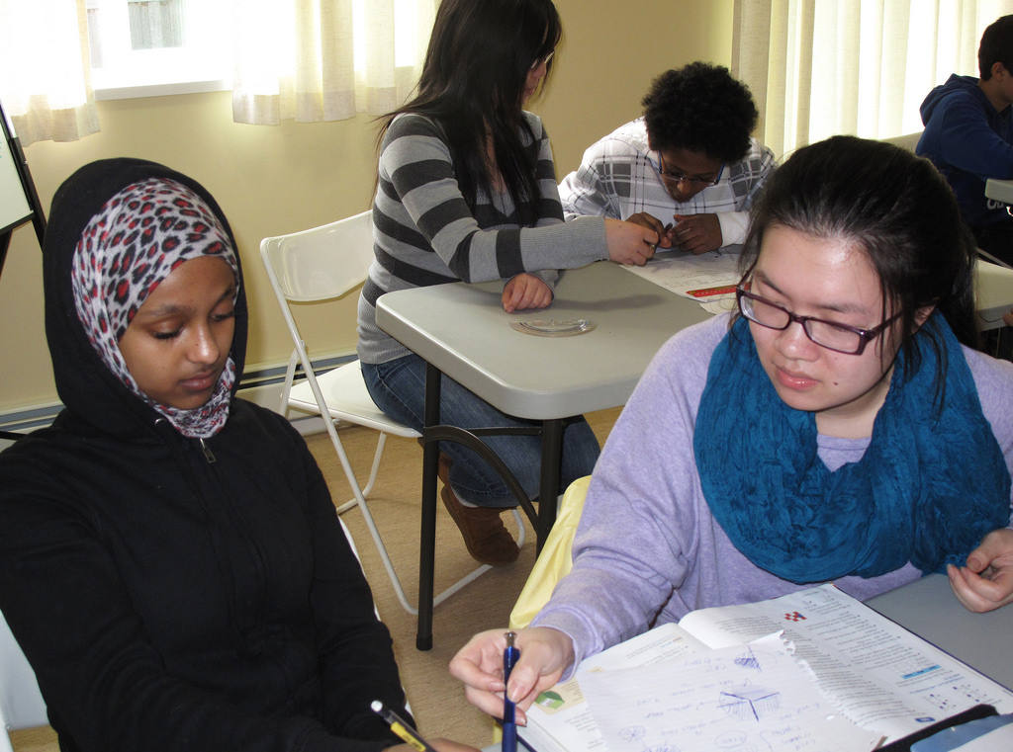
Your refugee student:
Background?
Behaviour? Trauma?
Language level?
Strategies?
This Photo by Unknown Author is licensed under CC BY

Slide 9
Oct 19 group 6 Lorna Chapter 9
Oct 26 group 7 Chapter 10………Summary Outline Assig 3 due
Nov 2 group 8 Chapter 11
Nov 9 Assignment 3 due

Slide 10
Resources: https://www.edutopia.org/blog/classroom-game-becomes-embedded-assessment-ross-flatt https://www.edutopia.org/blog/new-teachers-how-use-data-inform-instruction-rebecca-alber http://www2.gov.bc.ca/gov/content/education-training/k-12/teach/teaching-tools/english-language-learning

Slide 11
English Bridge Programme https://www.youtube.com/watch?v=yhTaV13376w
Listening in an ESL class https://www.youtube.com/watch?v=ghL4IWMfWHI
Coelho, E. Website video of Immigrant students Introduction
https://www.youtube.com/embed/YCrwUlTo2FE
http://www.colorincolorado.org/article/using-informal-assessments-english-language-learners
http://www.colorincolorado.org/sites/default/files/oral_0.pdf
http://www2.gov.bc.ca/assets/gov/education/kindergarten-to-grade-12/teach/pdfs/ell/ell-standards-secondary-oral-language.pdf

