Slide 1
Rebecca E. Linares
MEANINGFUL WRITING OPPORTUNITIES
Jay, Jovana, Jackie, and Makaela

Slide 2
KNOWLEDGE BASE
“It is necessary for teachers to access students’ existing repertoires of knowledge as a foundation for future learning and to teach in ways that reflect care for students’ well being and academic success.”
2

Slide 3
Identity Centred Writing Instruction
Advocating for reliance on first language
Code Switching
Natural response to new language
Confidence
Self regulate for Zone of PD
Transfer
Access knowledge and transfer between languages
Engagement
Personal experiences leads to investment

Slide 4
SCOPE OF LINARES’ RESEARCH
Goal: Investigate how particular writing instruction methods serve as dialogic, caring and responsive practices
Regular interviews, observations
Review student work over year

Slide 5
WRITE ALOUD - strategy
Modeled writing
Uses Think - Aloud strategy
teachers share their own thinking as they compose the process of writing in front of students, helping make the writing process visible and concrete.
Scaffolded learning
Great strategy for any level
Topic - anything
Can be used throughout the year
Whole class or small groups

Slide 6
Write Aloud - Activity
I use ______________to talk to __________
in__________.
How do you talk to people in your home country?
Brainstorm ideas within your group.

Slide 7
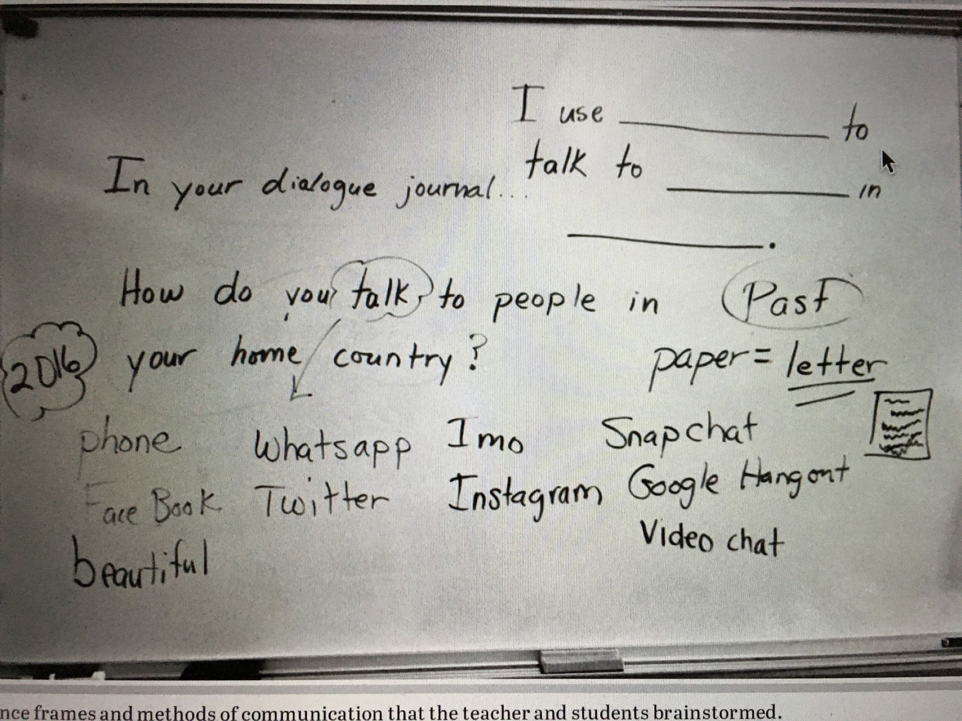
Write Aloud
15-20 minutes length
Sentence frames
Teacher and students
brainstorm ideas on
methods of communication
Modeling
Sharing
Student - student
Student- teacher
Group writing
Independent writing
(after the write aloud)
Linares (2019) Figure 1, pg. 525
Linares (2019) Figure 1, pg. 525
Linares (2019) Figure 1, pg. 525

Slide 8
Planning process for write alouds
Teacher questions:
“What would I like to see this week?”
“What can I model for them?”
“What can I talk about in class
that they can begin to work
with and to show and to master?”

Slide 9
What are the benefits of doing a write-aloud?
Students observe and collaborate in writing sessions with an experienced writer
Provides context- rich literacy instruction
Build vocabulary and syntax knowledge
Interactive and uses multiple modes
Viewing, speaking, writing, reading, listening
Promotes community; learn about students
Formative assessment

Slide 10
WRITE ALOUD - article summary
Vehicle for building background knowledge, providing context-rich literacy instruction, and learning about students’ lives
Teacher models process of writing by demonstrating the behaviours and strategies of an efficient writer
Voicing all things they are seeing, feeling, and asking as they create the text

Slide 11
Dialogue Journaling
Student journal for identity centered writing practice
Frequent teacher response, conversational style
Multimodal: can use combination of languages, symbols, or drawings to communicate ideas.

Slide 12
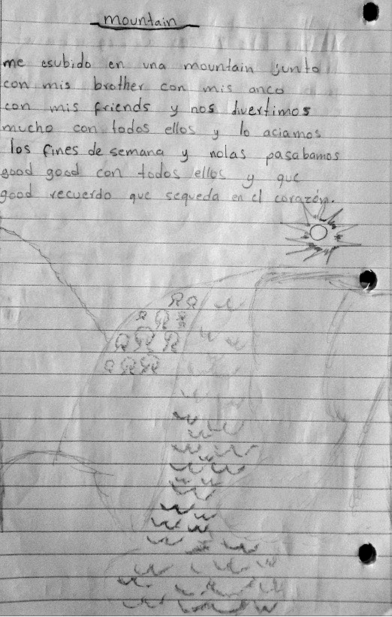
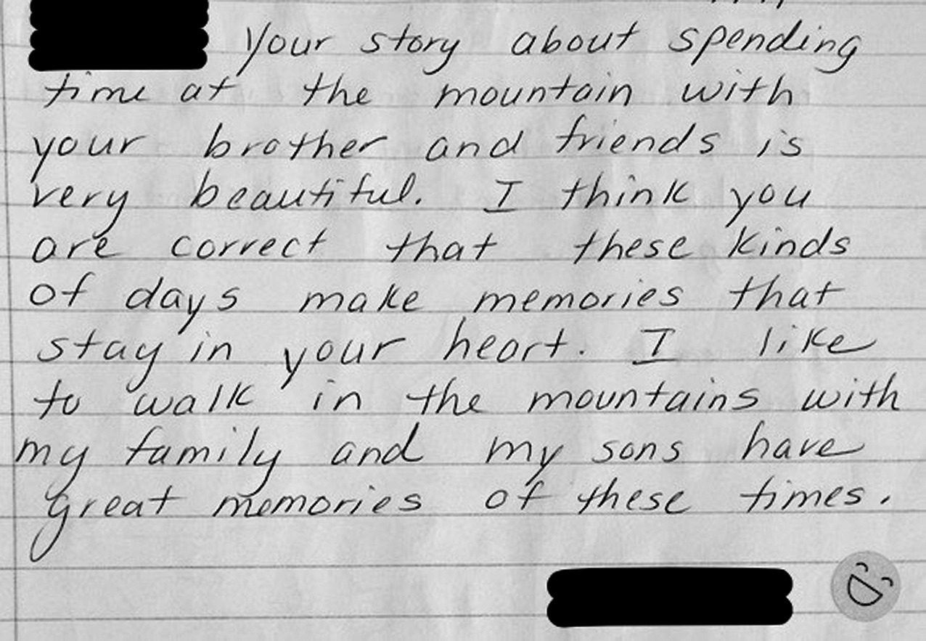
Student Journal
Teacher Response
Linares (2019) Figure 2 and Figure 3
Page 526

Slide 13
TODAY’S JOURNAL PROMPT:
Leapul tu ichbel…
Word Bank
Mama Papa Leioaf Atoar
Grandma Grandpa Yokpye
Nanhoe Nino Gato Kyle
https://lingojam.com/MinionTranslator

Slide 14
Teacher Response
Context clues and code-switching
Use translators or dictionaries
Meaningful dialogue not feedback

Slide 15
What are the benefits of dialogue journaling?
Formative assessment
Code-switch- facilitates transfer of knowledge
Takes into account student’s background
Builds sense of belonging and confidence
Supports social emotional learning
Process based- students can look back and reflect on their growth over time

Slide 16
How can you use write alouds and dialogue journaling in your classroom / subject area?
Are these useful in your discipline? Any limitations?

Slide 17
Resources:
Linares, R. E. (2019). Meaningful writing opportunities: Write‐Alouds and dialogue journaling with newcomer and english learner high schoolers. Journal of Adolescent & Adult Literacy, 62(5), 521-530. doi:10.1002/jaal.932
Write aloud: https://www.teachervision.com/writing-aloud
Minion Translator: https://lingojam.com/MinionTranslator not affiliated with Universal Pictures

Slide 18
Thank you

