Slide 1
Civil disobedience

Slide 2
Warm up – Venn Diagram
Listen to the two speeches by Malcolm X and Martin Luther King Jr. and answer the following questions:
Listen and watch Malcolm X’s speech. What words can you use to describe his philosophy? His tone? His character? Pick out specific words he uses that demonstrate his beliefs.
Do the same for the MLK’s speech.
After listening to both fill in the similarities that you notice between the two of them. Adjectives, characteristics, and ideas.

Slide 3
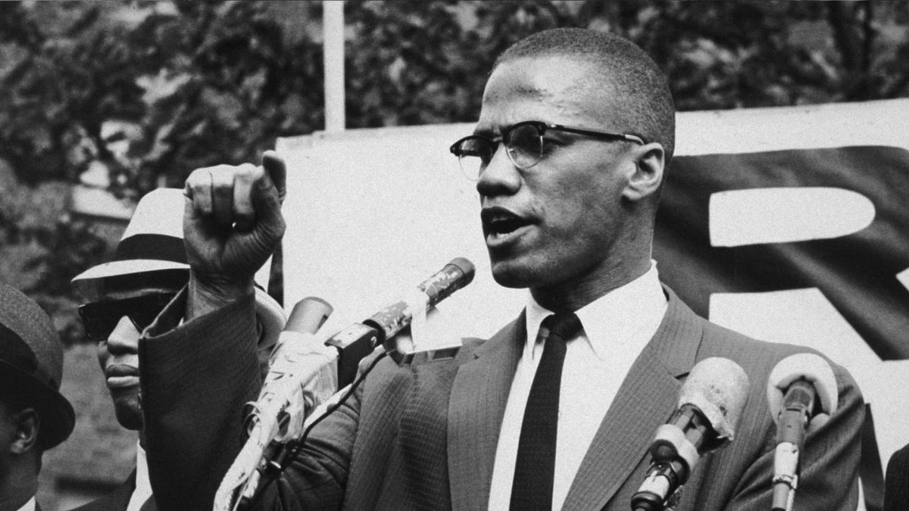
Malcolm X
https://www.youtube.com/watch?v=6_uYWDyYNUg

Slide 4
Martin Luther King Jr. https://www.youtube.com/watch?v=vP4iY1TtS3s

Slide 5
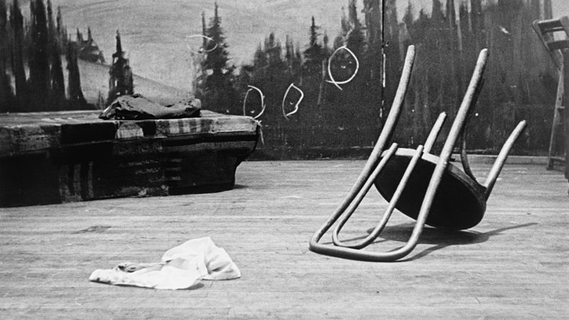
Malcolm X
Malcolm X was pronounced dead at 3:30 pm on February 21, 1965 in Manhattan, New York. The autopsy identified 21 gunshot wounds to the chest, left shoulder, arms and legs, including ten buckshot wounds from the initial shotgun blast.

Slide 6
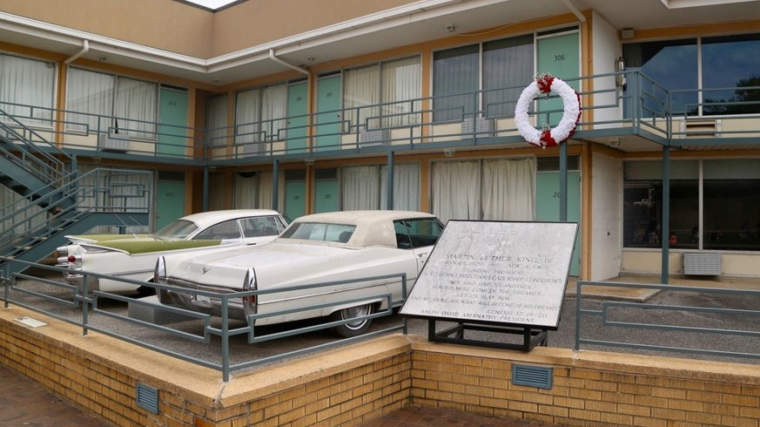
MLK
Was shot and killed at Lorraine Motel in Memphis, Tennessee, on April 4, 1968, at 6:01 p.m. CST. He was rushed to St. Joseph's Hospital, where he died at 7:05 p.m.

