Slide 1
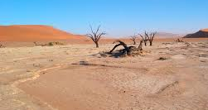
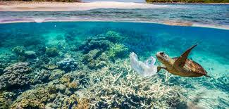
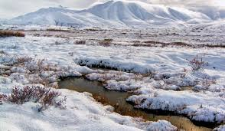
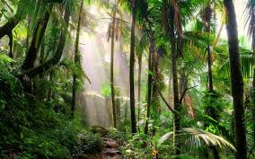
Ecosystems

Slide 2
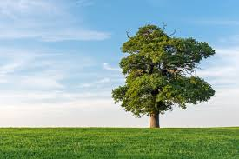
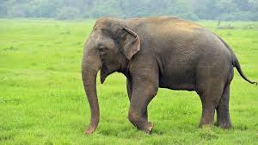
Producers vs. Consumers
Produce their own energy using sunlight (photosynthesis!)
Must consume other organisms to obtain energy

Slide 3
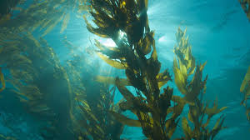
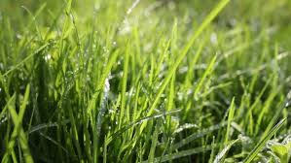
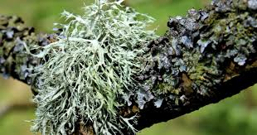
Photosynthetic organisms are called “primary producers” because they make food for other organisms.

Slide 4
Types of consumers
Herbivores | Omnivores | Carnivores
Eat only plants | Eat both plants and animals | Eat only animals

Slide 5
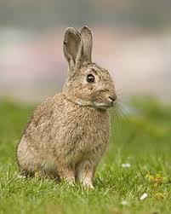
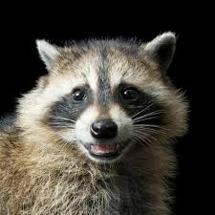
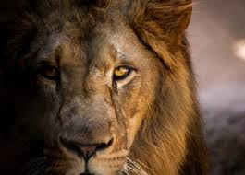
Types of consumers
Herbivores | Omnivores | Carnivores
Eat only plants | Eat both plants and animals | Eat only animals

Slide 6
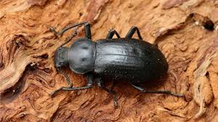
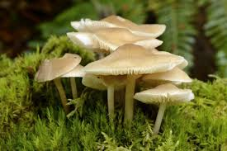
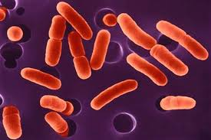
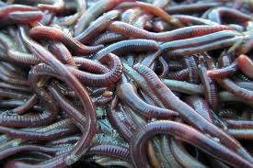
Organisms break down waste and dead organic matter in a process called biodegradation
Decomposers such as fungi and bacteria secrete enzymes to break down organic matter
Detritivores such as earthworms and beetles eat organic matter

Slide 7
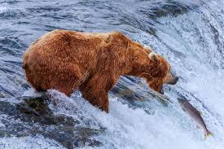
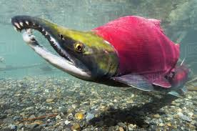
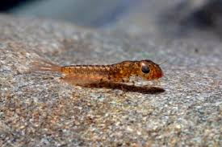
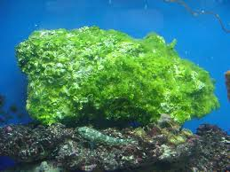
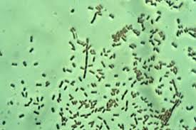
Food webs show the transfer of energy within an ecosystem
Tertiary consumer
Secondary consumer
Primary consumer
Primary producer
Decomposer
Notes:
Primary consumer: Mayfly larva
Decomposer: Soil bacteria

