Slide 1
Group 2A
Sara, Mark, Owen, and Kim
Annenberg Foundation (2017). Section 3 - Reading: Big ideas. In Reading and writing in the disciplines (Online course)

Slide 2
Getting Started with Disciplinary Literacy
Reading: Big Ideas
This unit explores the significant components of reading comprehension that relates to effective reading comprehension and learning across disciplines.
Reader Factors
Text Factors

Slide 3
Comprehension Strategies
Building disciplinary and world knowledge
Providing exposure to a volume and range of texts
Providing motivating texts and contexts for reading
Teaching strategies for comprehending
Teaching text structures
Encouraging students in discussion
Building vocabulary and language knowledge
Integrating reading and writing
Observing and assessing
Differentiating instruction
Notes:
Congratulations to table #__! So in this game we used strategies from the reading that facilitate and promote text-based comprehension. I would love to hear from some of you. Can someone give an example of a time when they used any of these strategies?

Slide 4
Notes:
We are going to play a game using text based comprehension strategies from the reading.

Slide 5
How to play Hot Seat
Break into 5 groups of 5.
One person is in the hot seat and sits
facing their team.
The team picks a comprehension
strategy from the pile. (mark hands them out)
You need to get your team member to say the phrase.
Once the team member says the whole phrase put a new player in the hot seat.
You may use verbal clues and actions. Be creative!
Keep track of how many phrases you can go through.
(we have 8 minutes)

Slide 6
Can you think of a time on your practicum where you used any of these strategies? How? What work? What didn’t? (first in your group then share with the class)
Comprehension Strategies
Building disciplinary and world knowledge
Providing exposure to a volume and range of texts
Providing motivating texts and contexts for reading
Teaching strategies for comprehending
Teaching text structures
Encouraging students in discussion
Building vocabulary and language knowledge
Integrating reading and writing
Observing and assessing
Differentiating instruction
Notes:
Congratulations to table #__! So in this game we used strategies from the reading that facilitate and promote text-based comprehension. I would love to hear from some of you. Can someone give an example of a time when they used any of these strategies?

Slide 7
Teaching content through literacy
How do you prepare students before they read texts?

Slide 8
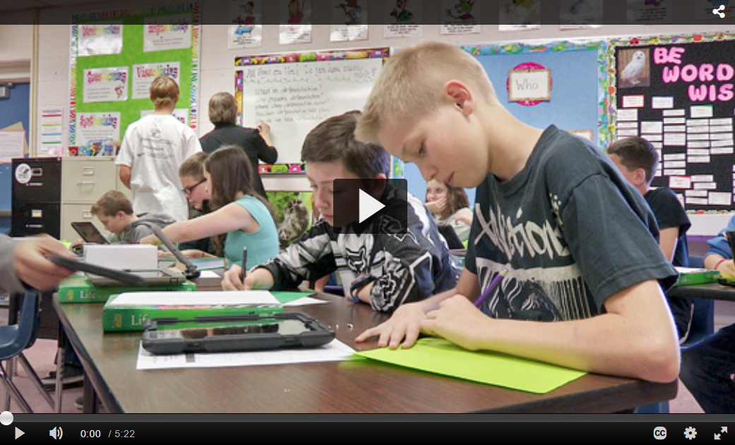
Teaching content through literacy
How do you prepare students before they read texts?
https://www.learner.org/courses/readwrite/video-detail/teaching-content-through-literacy.html

Slide 9
Teaching content through literacy
What strategies did you see the teacher use?
Was there anything that you think could be improved?

Slide 10
Summary
Reader Factors
Prior Knowledge
Significantly affects one’s comprehension and learning of new information
Important to assess students’ prior knowledge
Make decisions based on the assessment
2. Setting a purpose for reading
It will support students’ comprehension of important text ideas; focus their attention on the text; provide motivation for learning
Specific purpose rather than generic purpose
Connecting prior knowledge - KWL strategy
Notes:
It is important for teachers to assess what prior knowledge is necessary for effective comprehension of new content and what the students already know. However this is always easier said than done. Students come in from different background with different levels of understanding of the materials. Therefore the prior knowledge assessment should be an ongoing process.
Based on this assessment, teachers decide what knowledge students need to develop, how to help them access this knowledge using different resources and how to help them connect what they know to new learning.
Generic purpose: reading a chapter to answer questions at the end
Specific purpose: important information, key concepts and author’s purpose or point of view
KWL - Students determine what they already know about a topic, what they want to know by reading and what they learned after reading

Slide 11
Text Factors
Text Structures
Identifying the different text structures can help students organize information, determine key concepts and understand an author’s purpose or point of view
Challenge for students - use of multiple text structures within a particular text
2. Vocabulary
Tier 1 words - everyday, basic, high-frequency words: notebook, table, begin
Tier 2 words - more sophisticated: fallible, sustain, reiterate
Tier 3 words - used in specific disciplines: algorithm, mitosis, hyperbole
Notes:
Challenges: a high concept load; limited prior knowledge; discipline-specific vocabulary and academic discourse; finding the best way to approach a text

Slide 12
Strategies of proficient readers
Determining importance in reading
Making connections while reading
Asking questions
Visualizing
Synthesizing important ideas
Monitoring understanding and using ‘fix-up’ strategies
Notes:
These general strategies are common to all effective reading. We as teachers should explicitly teach them in our classes. The strategy instruction should not happen in isolation but they should be contextualized within a real reading experience.

Slide 13
Close Reading
A reading approach that provides opportunities to analyze text ideas, text structures and features, vocabulary use and author’s purpose.
The goal is for kids to engage in a deeper understanding of text ideas and to connect with their prior knowledge
Multiple-time reading on the same text
Multiple-level reading on the same topic
Notes:
First time reading, gain a general understanding of the information; second time reading, may focus on organization, structure, text features, key vocab; third time reading, go deeper to interpret and evaluate ideas and purposes.
Teacher prepares multiple texts of varying difficulty levels on the same topic. The process begins and ends with all students reading the most complex text in the set. After the first time reading the complex text together, if the kids have difficulty understanding, they can break into smaller groups to read about the easier text to build the needed knowledge. Once they feel they are ready, they can re-read the complex text and engage in more challenging tasks.

Slide 14
The End! Thank you for listening!

