Slide 1
Meaningful Writing Opportunities: Write-Alouds and Dialogue Journaling with Newcomer and English Learner High Schoolers
Rebecca E. Linares
Group 3B- Sean C. , Chloe R. , Priya S., Luke V.
Notes:
Introduction: Luke/Priya/Chloe

Slide 2
Identity Centered Writing Instruction
Monolingual Approaches to Literacy
Code switching or mixing of languages (ELLs)
Native language and personal experience to facilitate students writing
Literacy? linking personal experiences to writing
Promoted phonological awareness
Second language acquisition
Promote development of metalinguistic awareness
Notes:
Priya
Code switching- natural response to the introduction of a new language (including vocabulary); Facilitates participation and help build students’ confidence and comfort; important first step in creating a classroom community.
Research gathered in a multilingual 9th grade social studies class taught by Ms. Rosewall. Caucasian, monolingual English speaker with over 15 years teaching experience. Spent previous 8 years working with refugees (reason why the author worked with this teacher)

Slide 3
Write-Aloud’s
1. ) Provide a writing prompt, usually a question.
E.g., How do you talk to people in your home country?
2.) Brainstorm relevant vocabulary.
3.) Vocab and ideas are documented on the whiteboard so students can access during independent writing.
4. ) Teacher models how to turn prompt into a sentence.
5.) Students write their response
Notes:
Luke
Tied into dialogue journaling, used to scaffold learning and build in self-confidence
Write alouds helped with specific sentence structures using content vocabulary
Confidence building for students

Slide 4
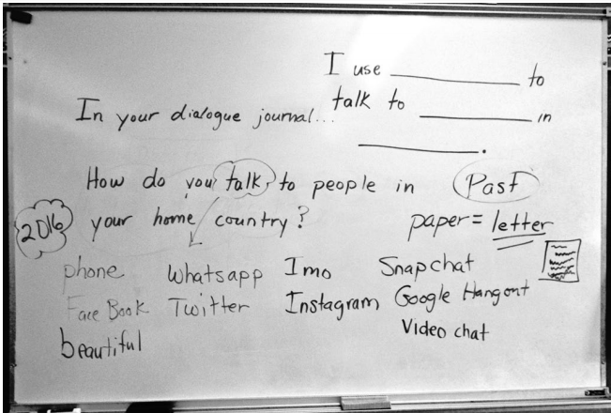
Write Aloud’s
Linares, R. E. (2019). Meaningful Writing Opportunities: Write-Alouds and Dialogue Journaling With Newcomer and English Learner High Schoolers. Journal of Adolescent & Adult Literacy , 62, 521-530.
Notes:
Luke
Ms. Rosewall’s class
Teacher modeled the process of writing by verbalizing her thinking and demonstrating the behaviours and strategies of an effective writer.
Planning process questions (What would I like to see this week? What can I model for my SS? )

Slide 5
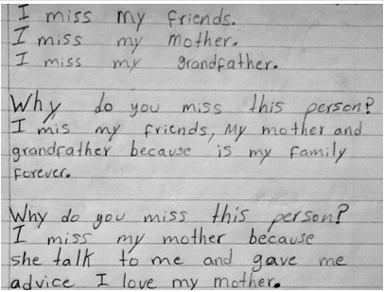
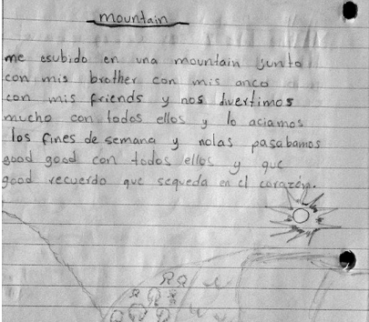
Identity Centered Writing
Notes:
Priya
Elias’s entries about how he responds to the write aloud and expresses himself in his journal writing.

Slide 6
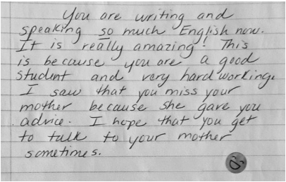
Teachers response
Notes:
Priya
Teacher’s response to Elias’s journal entry. Example of the relationship aspect of writing that is beneficial when you allow students to freely express themselves. (Even though Elias’s english isn’t that strong or he is writing in his Native tongue and illustrating his response)

Slide 7
Theoretical Underpinnings
The teacher is no longer merely the-one-who-teaches, but one who is him/herself taught in dialogue with the students, who in turn while being taught also teach. They become jointly responsible for a process in which all grow - Paulo Freire
The student is infinitely more important than the subject matter. - Nel Noddings
Notes:
Sean
Dialogue - learning as collaborative effort, learn from each other
Ethic of care - “open-ended common search for understanding, empathy and understanding of where student is coming from” - responsive to student needs so they feel comfortable in the learning environment

Slide 8
Dialogue Journaling in Writing Instruction
Useful for connecting with students to ensure their ideas and feelings are heard
Reflection for learning (connect personally to their learning)
From a teacher’s perspective, dialogue journals provide an opportunity to learn more about individual student’s abilities and everyday lives. Useful for lesson planning and individualized instruction.
Notes:
Chloe
Dialogue Journals = Written communication between a student and the teacher
Perspective of Ms. Rosewall’s class
Notebook provided to students
Teacher provides prompts for writing
Teacher collects the journals throughout the year

Slide 9
Activity 1 - Identity Centered Writing
Part I: Dialogue journal writing activity
My family....
My home before coming to Canada....
The place I feel most at home is...
A story about last time you visited your home country...
How do you talk to people in your home country?
Topic of your choice
Notes:
Chloe

Slide 10
Activity 1 - Identity Centered Writing
Part II
Trade your journal with a person at your table.
Respond to the dialogue journal in writing as if you are the teacher.
Notes:
Chloe

Slide 11
Activity 1 - Identity Centered Writing
Feedback:
Can you imagine using this activity in your future teaching practice?
Is there anything you found challenging about this activity?
Notes:
Chloe

Slide 12
Building Confidence and Community
Meaningful writing opportunities that prompt students to write about contexts and experiences with which they are familiar also promote engagement and participation in both a writing community and the classroom community (Stewart & Patterson, 2016).
Notes:
Sean

Slide 13
Exquisite Corpse
Groups of 4 or 5
Each group will receive a lined piece of paper.
Each person will fill in two lines and without saying anything aloud or letting anyone see, they will fold the paper to cover the first line only.
The next person in the circle will see only the second line and will contribute two lines in response to the last line.
Notes:
Sean

Slide 14
Exquisite Corpse
You can stop your line mid-sentence and force the next participant to complete it.
If anyone in your group speaks another language they can write their lines in that language and force the other group members to figure out how to respond.
Notes:
Sean

Slide 15
When I (a daily activity that helps you relax)
I feel (positive emotions)
When I was young (a childhood experience that brought about a negative emotional experience)
(Onomatopoeia)
(An accident or catastrophic incident)
I felt like (a natural disaster or some kind of environmental catastrophe)
So I (something that calms you down when you are nervous)
Life is like (a common expression or cultural mantra)
Notes:
Sean

Slide 16
Sharing
When your paper is full, open it up and see what you have created together.
Pick a reader and a second reader to read the final product to your group.
First reading, figure out the handwriting
Second reading
On the back pick a title and write everyones name on the back and as a group pick a title.
Notes:
Sean

Slide 17
Conclusion
Write- alouds and identity- centered writing are useful methods for connecting with students to ensure their ideas and feelings are heard.
Scaffolds challenging vocabulary/terms/concepts/ideas
Takes into account the perspective of the Students
Enhances student interest (Use of Native language)
Encourages teacher-student relationships (Reflection)
Notes:
Sean
Critique (Priya)
The article didn’t state how successful the students were at acquiring the vocabulary through write alouds, rather it suggested it was a useful method in the perspective of one teacher and her classroom.

