Slide 1
Static charge
Science 9
Physics-Electricity

Slide 2
Zap!!!
Notes:
It can strike without warning, at any moment.
You may be walking across a soft carpet and reaching for the door knob, when suddenly...zap!
To understand static electricity, we first need to know a bit about the nature of matter.

Slide 3
Preloading
The Nature of Matter

Slide 4
What Is The Nature Of Matter?
Everything in the world is made up of atoms.

Slide 5
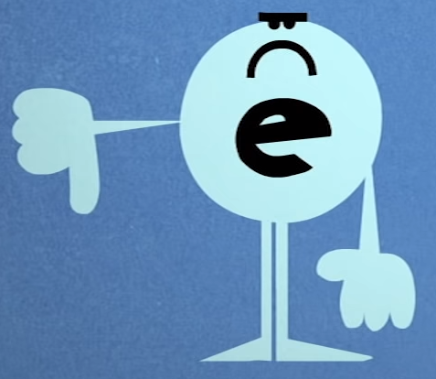
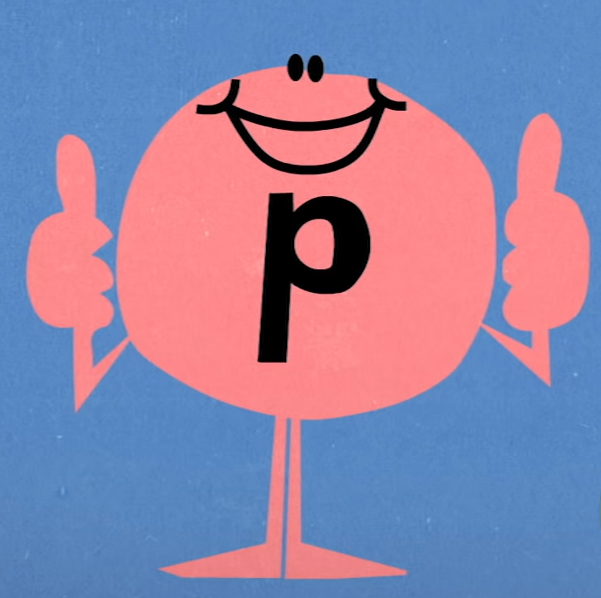
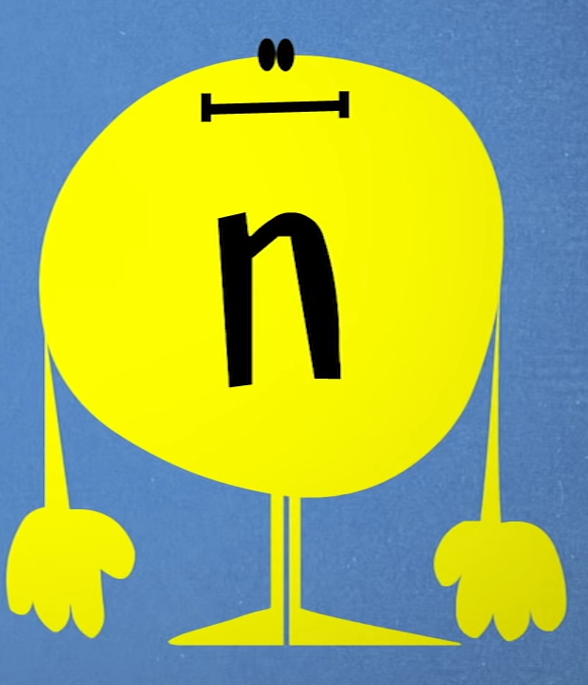
What Is The Nature Of Matter?
Negatively charged Electrons
Positively charged Protons
Neutral
Neutrons
Notes:
All matter is made up of atoms that consist of three types of smaller particles:
negatively charged electrons,
positively charged protons,
and neutral neutrons.

Slide 6
The Atom
Protons are located inside of nucleus
Neutron (neutral)
In Nucleus
Proton (positive)
N
Electrons loosely bound outside
P
Electron (negative)
In layers
Only electrons (negative charges) can jump from one object to another.
Notes:
Normally, the electrons and protons in an atom balance out, which is why most matter you come across is electrically neutral.
But electrons are tiny and almost insignificant in mass, and rubbing or friction can give loosely bound electrons enough energy to leave their atoms and attach to others, migrating between different surfaces.
When this happens, the charge on the particle will change.

Slide 7
Static charge
Natural & Charged Particles

Slide 8
What is Static Charge?
“Static” means “NOT move”
Static charge is the charge that stays on one object/place.
Only electrons (negative charges) can jump from one object to another.

Slide 9
Two Types Of Static Charge
If an atom contains equal numbers of protons and electrons, the atom is described as being electrically neutral.
Atoms is neutral with equal protons and electrons.
If an atom has an unequal number of protons and electrons, then the atom is electrically charged.
Atoms is charged with unequal protons and electrons.

Slide 10
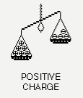
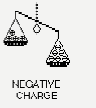
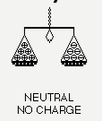
Charged V.S. Uncharged Atom
Charged Atoms |  | Uncharged Atoms
Positively Charged | Negatively Charged | Uncharged
number of electrons < number of protons
number of electrons > number of protons
number of electrons = number of protons

