Slide 1
LLED 361 – 921/928
Dr. Joanne Robertson
May 13, 2019
Notes:
Welcome – my background
Traditional welcome

Slide 2
Speed Introductions
Share with your Group:
Your name
One or two sentences that describe your background
Your practicum experience (school/subject areas taught)
30 sec./person!
GO!

Slide 3
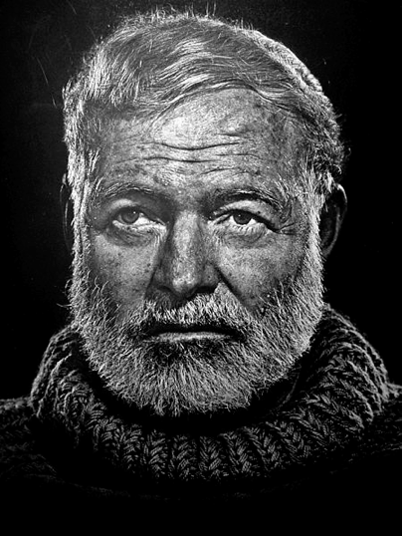
Six Word Memoirs
“For sale: baby shoes, never worn.”
Notes:
Once asked to write a full story in six words, legend has it that novelist Ernest Hemingway responded: "For Sale: baby shoes, never worn."
The success of Ernest Hemingway’s story lies in the multiple questions and possible meanings that lie between the lines. For example: Why is the narrator selling the shoes? Is the baby grown? Did she die? Did she simply go barefoot or was she sadly never able to walk? Is the narrator the mother? The father? The sibling? The former baby? Is the story about the end of childhood? The end of parenthood? The end of innocence or justice or happiness or all of the above? The questions are endless and the possible meanings are many.

Slide 4
Six Word Memoir Examples
Found on Craigslist: table, apartment, fiancé.
Adopted baby, got pregnant, instant family.
Told you I’d be published one day.
Bipolar, no two ways about it.
Acting is not all I am.
Google knows me, therefore I am.
Alzheimer’s: meeting new people every day.

Slide 5
Notes:
Can you convey the essence of your life in six words? Assignment for next week!

Slide 6
Empowered by language(s)
Inspired by stories.
Notes:
Joanne

Slide 7
Forever
learning,
that is
my thing.
Notes:
Memoire - lwong

Slide 8
Afraid of heights, I’m still climbing

Slide 9
TRAVEL
British Born
Set me free………
Notes:
Christine

Slide 10
Recovering control freak
practicing embracing imperfection
Notes:
Jen

Slide 11
A born optimist, a learned realist.
Notes:
Jennifer T

Slide 12
Breathe in. Breathe out. You’re ok.
Notes:
Lauren

Slide 13
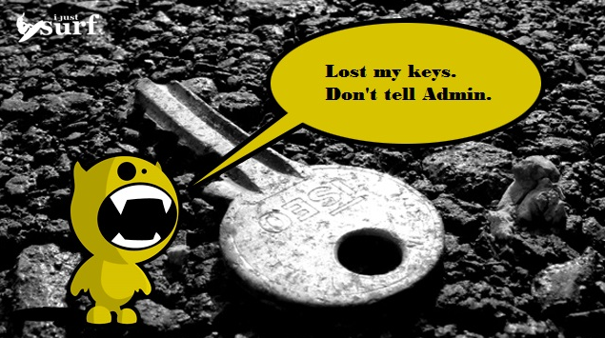
http://ijustsurf.com/reviews/%E2%80%9812-days-of-xmas%E2%80%99-1-surf-session-saver-key-lock-box/
Notes:
Lauren

Slide 14
Quick Write: Your Turn!
Create a 6 Word Memoir that describes your experience during your teaching practicum (5 min.)
Table Group Presentations
Each member presents 6 Word Memoir and brief explanation (1 min.)
Others take note on the post-it notes
Options for table group presentation:
Power Point slide (Keynote, etc.)
Drawing with words
Song, Poem, etc.
Other…?
GO!
Notes:
5 minutes to prepare
5 minutes to present in group (1min. Max./ – others take note of key themes
5 minutes

Slide 15
Course Syllabus + Blog
LLED 361 Syllabus - take note of readings, assignments, deadines
LLED 361 921 and 928 Blog –
Primary form of communication– please check regularly
Homework: Please send me your primary email and sign in to UBC blogs using your CWL
Assignment Uploading (to the “Home” page):
You must be logged in to post (Click on “New”, then “Post”)
Title your post (e.g. Name + ”Cross-Genre Translation”), write a description and upload media
Notes:
As for posting, first tell students that they MUST be logged in to post (it says “Howdy, Amber!” or whatever in the top right to indicate they’re logged in). Next, they go to the top left corner to click on the “+ New” option and select “Post.” Then they can upload media, write something, and title it all. For LLED 449, I just set it up so they uploaded everything in the “Home” of the blog - a huge dumping ground, yes, but everything is there at least. Remember to make each student an “Author,” not an “Administrator” when you invite them to the blog.

Slide 16
Assignment #1: Group Text Presentation
A discussion on a stimulating, contentious, or ambiguous aspect of a required text.
Providing the class with a brief introductory stimulus (5-10 minutes or so); the group will summarize the reading and lead a class in our learning on these texts (15-20 minutes).
CRITERIA:
Assignment 1 will be assessed based on the quality of the following aspects:
1. Clarity of the summary
2. Insightfulness of the questions and comments for facilitating the class discussion
3. Level of student engagement generated
4. Balance of student to facilitator talk

Slide 17
Reading Groups
Week 1: (this Friday May 17): Group 1
Week 2: Group 2a (Wed. May 22) and Group 2b (Fri. May 24)
Week 3: Group 3a (Mon. May 27) and Group 3b (Wed. May 29
NO CLASSES JUNE 3-7 (CSSE Conference)
Week Four: Group 4a* and 4b (both Wednesday June 12)
Week Five: Group 5a (Monday June 17)
Section 921 (morning): 36/9 groups = 4 per group
Section 928 (afternoon): 30/9 = 3 or 4 per group
Notes:
Note readings for Group 4a – under Monday

Slide 18
Break – Please sign up for a Reading Group!

Slide 19
How to present the chapter, article, or resource
(5-10 mins.)
Justify why this piece or resource is valuable to teachers, its practical applications
Summarize the resource—what it’s about
Overall summary + 3 key points is a good structure
(15-20 mins.)
Zone in on a stimulating, contentious, or ambiguous aspect of the chapter, article or resource
Facilitate a small group and then whole class discussion on this chosen aspect
Consider modeling the use of graphic organizers and/or interactive literacy teaching strategies

Slide 20
Duff, P. A. (2001). Language, literacy, content, and (pop) culture: Challenges for ESL students in mainstream courses. Canadian Modern Language Review (58)1, 103-132.
LLED 361 Section 924
Group Members’ Names: …
Notes:
Present the full article citation and your names

Slide 21
Summary of the article
Research site: Secondary school in Vancouver w/ 1,300 students, about half born outside of Canada
Many had been in Canada for about two years; others had come during elementary school
Two classes of gr. 10 Social Studies, taught by “Bill” and “Pam”—young, energetic, experienced teachers
24-28 students in each class; 17 ESL students in Pam’s and 8 in Bill’s; most Chinese but some Korean, Japanese, Indonesian
Duff visited each class once a week for six months and interviewed 39 students for half an hour each; she interviewed each teacher several times for 45-60 mins.

Slide 22
Finding 1: There were structural limitations beyond teachers’ control.
Topic: 18th to early 20th century Canadian history
Textbook: Our Land: Building the West (dated, exclusively white male perspective and content)
Pam and Bill had to use supplementary material on First Nations, women, immigrants, and discrimination
Photocopying was limited; handouts needed to be collected at end of class—students could not write on them or take them home to study later (!!)
What they could keep, they wrote numerous translations on
A lot of worksheets (key names, dates, terms) BUT students produced few extended writing assignments; on these, teacher comments were brief—either mechanical corrections or general comments
Each teacher taught over 200 students per week

Slide 23
Finding 2: Even though teachers did a good job with what they could control, it did not account for ESL students.
Bill and Pam were knowledgeable about social studies and current events, energetic and engaging, but did not modify their speech
For native English speakers, their teaching was ideal
The teachers used “art, literature, hands-on activities, structured and creative writing opportunities, reading scaffolds for text passages, and activities that promote discussion and debate” (Short, 1997, p. 221)
”Perspective-taking, empathy, and positionality in history were emphasized” (p. 113); there were critical discussions about First Nations history and racism, and guest speakers
BUT: English L1 (i.e., English as a first language) students were very disruptive, and became even more so while impatiently waiting for ESL students to respond
“The more narrative the approach, the more language seemed to be used and the fewer CBLI* techniques, such as graphs, diagrams, and other visual aids and organizers.” (p. 114)
Though multimodal, the class had an excessive focus on orality—films, songs, discussions, etc. flew by too fast for ESL students.
*Content-Based Language Instruction

Slide 24
Finding 3: Topics were West-centered and featured rapid turn-taking among L1 English locals, too fast for ESL students.
“Topics included White House scandals, the Columbine High School shooting, wars and unrest in other countries, natural disasters, scientific breakthroughs, little-known facts, and local events. Interspersed with these topics were references to sports scores, new movies or television shows, and pop-culture celebrities.”
During a conversation, the shift in topic happens within just a few seconds
For these conversations, there is a lot of subject-specific vocabulary that goes beyond everyday English vocabulary
Also, pop culture and academic discussions are interwoven, not separate (e.g., compare Marie Antoinette’s scandals and negative image with those of current political figures)
The pop culture, for local students, is the familiar content that makes academic content accessible
This strategy was of little use for new immigrant students, who found it hard to follow the talk

Slide 25
Discussion: How to solve the problems identified by Duff?
TIME. Do you think your official curriculum materials are dated or lacking? If so, how do you find time to supplement them? Also, if students don’t get quality feedback on enough extended written assignments, they won’t grow in this area. But what do you do if you have 200 students?
ORALITY. How do you deal with the “excessive focus on oral narrative” that can be troublesome for ESL students? (Keep in mind that this is engaging for L1 speakers, esp. those who lack academic literacy.) How do you make oral, multimodal input meaningful rather than incomprehensible for ESL students?
BACKGROUND KNOWLEDGE. How do you fill in lack of background knowledge on the fly, during class discussions? Is there another way—e.g., prep—to deal with the problem of lack of background knowledge? How do you find the time?
DISCRIMINATION. How do you open up a space for ESL students to participate in swift, intertextual cultural discussions?—How do you manage topical content and power dynamics from day one?

Slide 26
TIME
ORALITY
BACKGROUND KNOWLEDGE
DISCRIMATION
Notes:
From least to most important, challenging, costly, impact on learning for L1s or L2s

Slide 27
So that was just a model… adapt as necessary based on the nature of your resource.

Slide 28
That’s it. ☺
Four criteria:
clarity of the summary
insightfulness of discussion questions
level of student engagement generated
balance of student-to-facilitator talk
Low pressure! Easy compared to teaching in the practicum!
Please sign up in your groups during the 20-min. break.

