Slide 1
The Nitrogen Cycle
Science 9

Slide 2
The Importance of Nitrogen
Nitrogen is just as important as oxygen and carbon dioxide
Plant cells need nitrogen to produce chlorophyll
Animal cells need nitrogen to produce proteins
Notes:
The good news is that nitrogen is the most abundant molecules in the atmosphere!
However, the bad news is most living organisms cannot access this form of nitrogen directly

Slide 3
Nitrogen is essential to living organisms
Up to 78% of the atmosphere is composed of nitrogen
However, atmospheric nitrogen exists in a tight diatomic triple bond that most organisms cannot process
Notes:
The good news is that nitrogen is the most abundant molecules in the atmosphere!
However, the bad news is most living organisms cannot access this form of nitrogen directly

Slide 4
The Nitrogen Cycle
Bacteria that grow at the roots of plants convert nitrogen gas into nitrates for living organisms to consume
Nitrogen enters into biosphere through food chains
Nitrogen returns to the ground as waste and as remains
Notes:
The good news is that nitrogen is the most abundant molecules in the atmosphere!
However, the bad news is most living organisms cannot access this form of nitrogen directly

Slide 5
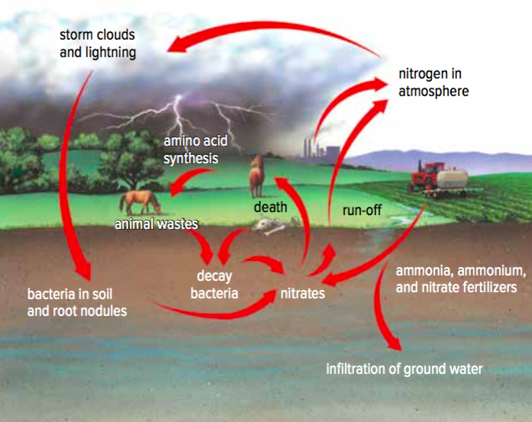
The Nitrogen Cycle

Slide 6
Farming with Nitrogen
Nitrogen is often used at fertilizers in agriculture
Excess nitrogen is being washed into streams
Results in nutrients build up in ponds and lakes
Notes:
Without nitrogen, plants cannot make chlorophyll for photosynthesis
Therefore, nitrogen is often added as fertilizers into vegetations

Slide 7
Eutrophication - Algae Blooms
Excess nitrogen promotes the growth of algae
Thick layer of algae blocks the sunrays from entering into the deep waters
Oxygen level decreases and aquatic organisms suffocate to death
Notes:
The good news is that nitrogen is the most abundant molecules in the atmosphere!
However, the bad news is most living organisms cannot access this form of nitrogen directly

Slide 8
Nitrogen Cycle Recep
How is nitrogen essential to all living organisms?
How is nitrogen introduced into the biosphere?
What effects do excess nitrogen have on ponds and lakes?

Slide 9
The phosphorous Cycle
Science 9

Slide 10
The Importance of Phosphorus
Phosphorus regulates protein synthesis in plants and animals
Provides structure and strength for the body with calcium
Essential for the growth and repair of body cells and tissues
85% of the body phosphorus is found in bones and teeth

Slide 11
The Phosphorus Cycle
Phosphorus is naturally stored in the geosphere as rocks
Rain dissolves phosphorus into the soil
Phosphorus is absorbed by plants and enters the biosphere
Phosphorus returns to ground as wastes or as remains

Slide 12
The Phosphorus Cycle
Notes:
Note that phosphorus also can be washed into the ocean and over time settle in the ocean floor and becomes part of the geosphere again

Slide 13
The Excess Phosphorus
Phosphorus is used in dish soap, laundry detergents and agricultural fertilizers
Run-off of phosphorus into streams also causes algae bloom
1 kg of phosphorus can produce up to 500kg of algae in a marine environment
Notes:
Note that phosphorus also can be washed into the ocean and over time settle in the ocean floor and becomes part of the geosphere again

Slide 14
Phosphorus Cycle Recep
Where is phosphorus naturally found?
How is phosphorus important to plants and animals?
What effects do excess phosphorus have on marine environment?

Slide 15
Ways to reduce nutrients in streams
Avoid phosphorus fertilizers for lawns and gardens
look at package for NPK number, eg. 22-0-15
the middle number for phosphorus should be zero
Plant deep-root plants such as sunflowers, shrubs or trees instead of turfgrass
Sweep grass clippings and fallen leaves, keep them out of the storm drains
Spread the word around to increase awareness!

Slide 16
What are some of the ways to reduce phosphorus that you are able start doing today?

