Slide 1
Learning how to read good and do other stuff good too.

Slide 2
Outline
Introduction/Summary
Comprehension
Text Structure
Proficient Reading Strategies
Vocabulary
“Close Reading”
Activity
Discussion

Slide 3
Summary- The Important Ideas while Reading
Background Knowledge (What do the students know already?)
Purpose (Why did the author write?)
Questions for The Readers (Before, during, and after reading the text)

Slide 4
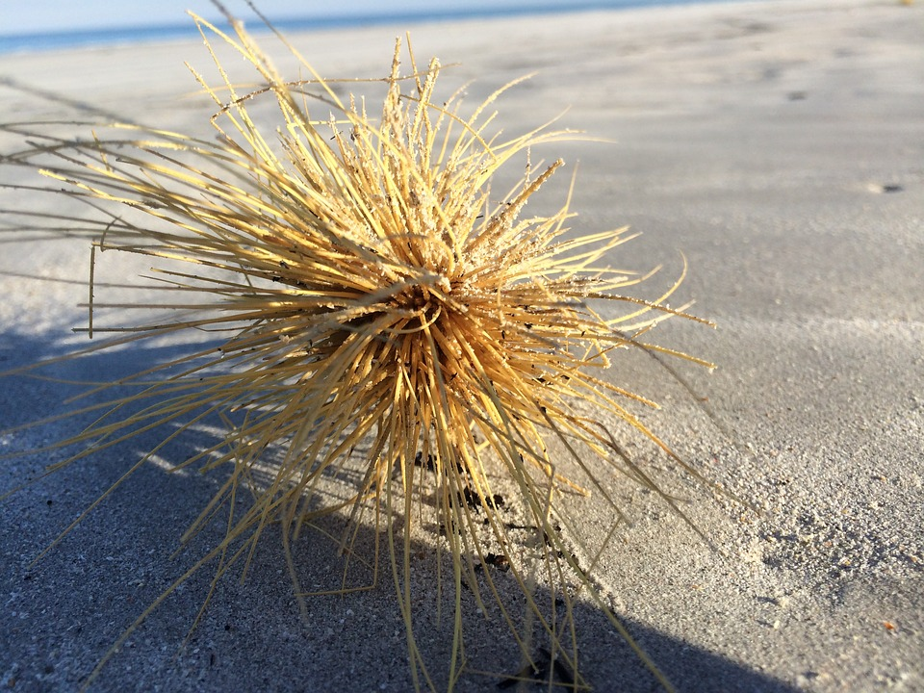
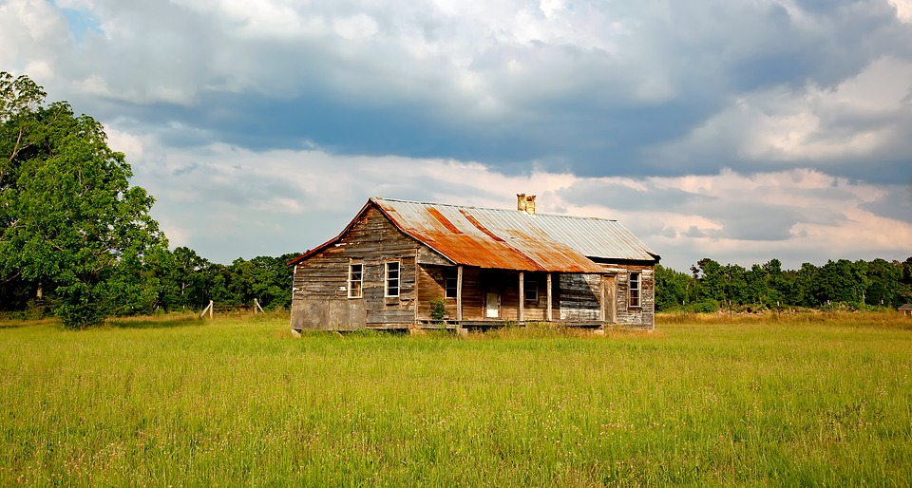
Prior Knowledge
As students come from different background, it is possible for them to miss out on reference to a text. The teacher’s duty is then to front load these knowledge.
For example, recent immigrant students can be lost if a literature takes place in Alabama. (What is the climate, what is the Southern Culture…)
Notes:
Brownie point: Name a famous literature that took place in Alabama (To kill a mockingbird)

Slide 5
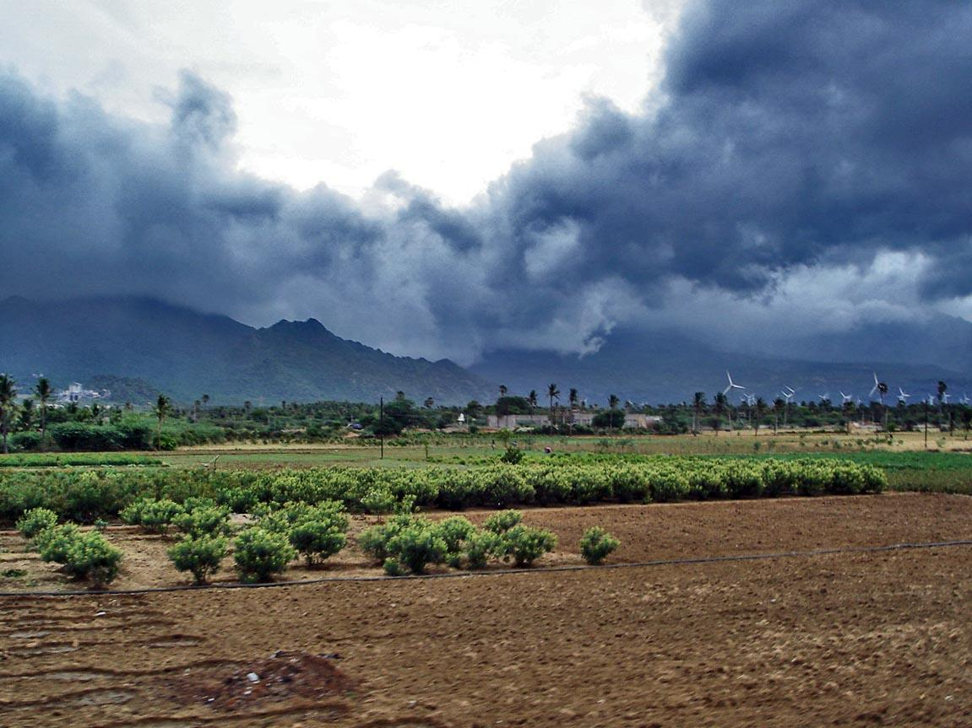
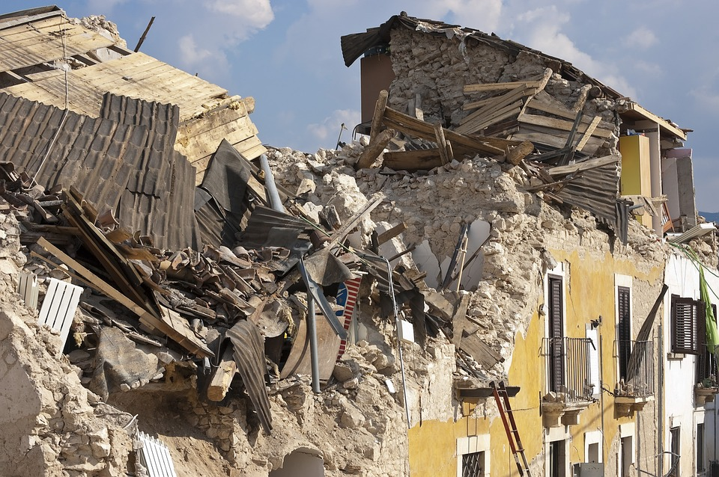
Prior knowledge cont.
Region specific natural events: Monsoons, Earthquakes, Tornados
Pop Culture: Freddie Mercury, Drake, The Canucks, The Simpsons

Slide 6
Purpose
What is the reason the author wrote the text?
How is the material connected to student’s life?
There has to be a SPECIFIC reason (ex: “it will be on your test” is not a good reason)
For example: Why do we learn about fusion reaction in stars?

Slide 7
Text Structures
The author suggests that allowing students to organize the text they are reading helps to enhance the learning. These are the 5 suggested ways.
Description: Information is organized around main ideas followed by supporting details. (ex: Music History: Romantic Era, Dvořák, The Carnival of the Animals)
Sequence: Information is presented in a specific order based on chronology (ex: Anakin turned to the Dark Side -> Obi-one had the high ground -> Anakin turned into Darth Vader)
Compare/Contrast: Key concepts are compared for similarities and differences
Cause/Effect: Topics are presented based on a relationship between causes and effects (ex: Cause: Germany invaded Poland, Effect: The Allies declared war)
Problem/Solution: A problem is introduced with subsequent information that leads to a solution (ex: Problem: A function has an infinite sum, Solution: Taylor’s polynomial)
Notes:
The potential problem: information overload

Slide 8
Proficient Reading Strategies
Determine importance
Make connections
Ask questions
Make inferences
Visualize
Synthesize ideas
Monitor understanding/use “fix-up” strategies
Notes:
Since we are all excellent readers...
What is important? (concepts, structure, purpose, captions, bolded terms, diagrams)
What are we connecting? (to the text, to other text, to our lives)
What does making inference mean? (Making inferences = making logical conclusions based on evidence)
How might we monitor understanding? (re-read, read out load, look up words, use context clues etc.)
Why is this particularly difficult for ELLs?

Slide 9
Vocabulary
Tier 1 Words: Everyday basic
Tier 2 Words: General academic vocabulary (e.g. contempt, gallantly, fallible, sustain, and reiterate).
Tier 3 Words: Specific academic vocabulary (e.g., algorithm, mitosis, mummify, hyperbole).
OR: Words with multiple meanings (e.g. product).
Notes:
There are levels, we talked about this last class, but these make different distinctions
We should consider:
1)students needs/level
2)Critical words for understanding
3)Words not defined in context (i.e. maybe its not in a sentence but on a title of a graph or something)
Explore vocab before, during, and after reading (meaningful connections work best)

Slide 10
“Close Reading”
What is it?
Analyzing text: ideas, structure, vocabulary, and purpose.
Why do it?
The goal is deeper understanding of complex text.
How do we do it?
Re-read the text with different purposes.
Notes:
I.e. analyzing a lot of the stuff we’ve just been talking about

Slide 11
Close Reading
With Billy (William) Wordsworth

Slide 12
The World Is Too Much With Us
BY WILLIAM WORDSWORTH
The world is too much with us; late and soon,
Getting and spending, we lay waste our powers;—
Little we see in Nature that is ours;
We have given our hearts away, a sordid boon!
This Sea that bares her bosom to the moon;
The winds that will be howling at all hours,
And are up-gathered now like sleeping flowers;
For this, for everything, we are out of tune;
It moves us not. Great God! I’d rather be
A Pagan suckled in a creed outworn;
So might I, standing on this pleasant lea,
Have glimpses that would make me less forlorn;
Have sight of Proteus rising from the sea;
Or hear old Triton blow his wreathèd horn.

Slide 13
Allusions
In Greek mythology, Proteus is a sea-god or god of rivers and oceanic bodies of water, one of several deities whom Homer calls the "Old Man of the Sea."
Triton is a Greek god, the messenger of the sea. He is the son of Poseidon and Amphitrite, god and goddess of the sea respectively, and is herald for his father. Triton's special attribute was a twisted conch shell, on which he blew like a trumpet to calm or raise the waves.

Slide 14
Levels of Meaning
Literal Meaning- What is happening in the text? Recognizing character’s identities and order of events. Provide a summary.
Stylistic Meaning- identifying stylistic choices that the author has made. Recognizing literary devices.
Thematic Meaning- offering an interpretation that is based on evidence from the text. Identifying the universal themes that the text addresses.

Slide 15
Levels of Meaning
Literal Meaning- What is happening in the text? Recognizing character’s identities and order of events. Provide a summary.

Slide 16
The World Is Too Much With Us
BY WILLIAM WORDSWORTH
The world is too much with us; late and soon,
Getting and spending, we lay waste our powers;—
Little we see in Nature that is ours;
We have given our hearts away, a sordid boon!
This Sea that bares her bosom to the moon;
The winds that will be howling at all hours,
And are up-gathered now like sleeping flowers;
For this, for everything, we are out of tune;
It moves us not. Great God! I’d rather be
A Pagan suckled in a creed outworn;
So might I, standing on this pleasant lea,
Have glimpses that would make me less forlorn;
Have sight of Proteus rising from the sea;
Or hear old Triton blow his wreathèd horn.

Slide 17
Levels of Meaning
Stylistic Meaning- identifying stylistic choices that the author has made. Recognizing literary devices (simile, metaphor, imagery etc). What is the author drawing your attention to?

Slide 18
The World Is Too Much With Us
BY WILLIAM WORDSWORTH
The world is too much with us; late and soon,
Getting and spending, we lay waste our powers;—
Little we see in Nature that is ours;
We have given our hearts away, a sordid boon!
This Sea that bares her bosom to the moon;
The winds that will be howling at all hours,
And are up-gathered now like sleeping flowers;
For this, for everything, we are out of tune;
It moves us not. Great God! I’d rather be
A Pagan suckled in a creed outworn;
So might I, standing on this pleasant lea,
Have glimpses that would make me less forlorn;
Have sight of Proteus rising from the sea;
Or hear old Triton blow his wreathèd horn.

Slide 19
(Very) Brief and Simplistic Historical Context
Wordsworth is a Romantic poet- focused on the recovery of emotion, imagination, and experience in the face of enlightenment rationality
“The World Is Too Much With Us” was written in 1807 during the first Industrial Revolution (circa 1760-1840)

Slide 20
Levels of Meaning
Thematic Meaning- offering an interpretation that is based on evidence from the text. Identifying the universal themes that the text addresses.

Slide 21
The World Is Too Much With Us
BY WILLIAM WORDSWORTH
The world is too much with us; late and soon,
Getting and spending, we lay waste our powers;—
Little we see in Nature that is ours;
We have given our hearts away, a sordid boon!
This Sea that bares her bosom to the moon;
The winds that will be howling at all hours,
And are up-gathered now like sleeping flowers;
For this, for everything, we are out of tune;
It moves us not. Great God! I’d rather be
A Pagan suckled in a creed outworn;
So might I, standing on this pleasant lea,
Have glimpses that would make me less forlorn;
Have sight of Proteus rising from the sea;
Or hear old Triton blow his wreathèd horn.

Slide 22
Closing Discussion Questions
What prior knowledge did you need to engage with today’s text?
Can you identify language specific to the teaching profession in the reading?
What is one practical way you could apply this text in your coming years of teaching?

