Slide 1
Reading to Learn
Lupo, S. M., et al. (2017). Building background knowledge through reading: Rethinking text sets. Journal of Adolescent and Adult Literacy, 61(4), 433-444
Group 2b: Gregg, Simran, Jenna and Anthony
Friday, May 24th, 2019
UBC

Slide 2
Criteria:
Conduct a discussion on a stimulating, contentious, or ambiguous aspect of a required text. Providing the class with a brief introductory stimulus (5-10 minutes or so); the group will summarize the reading and lead a class in our learning on these texts (15-20 minutes).

Slide 3
CRITERIA FOR ASSESSING ASSIGNMENT
Assignment 1 will be assessed based on the quality of the following aspects:
Clarity of the summary
Insightfulness of the questions and comments for facilitating the class discussion
Level of student engagement generated
Balance of student to facilitator talk

Slide 4
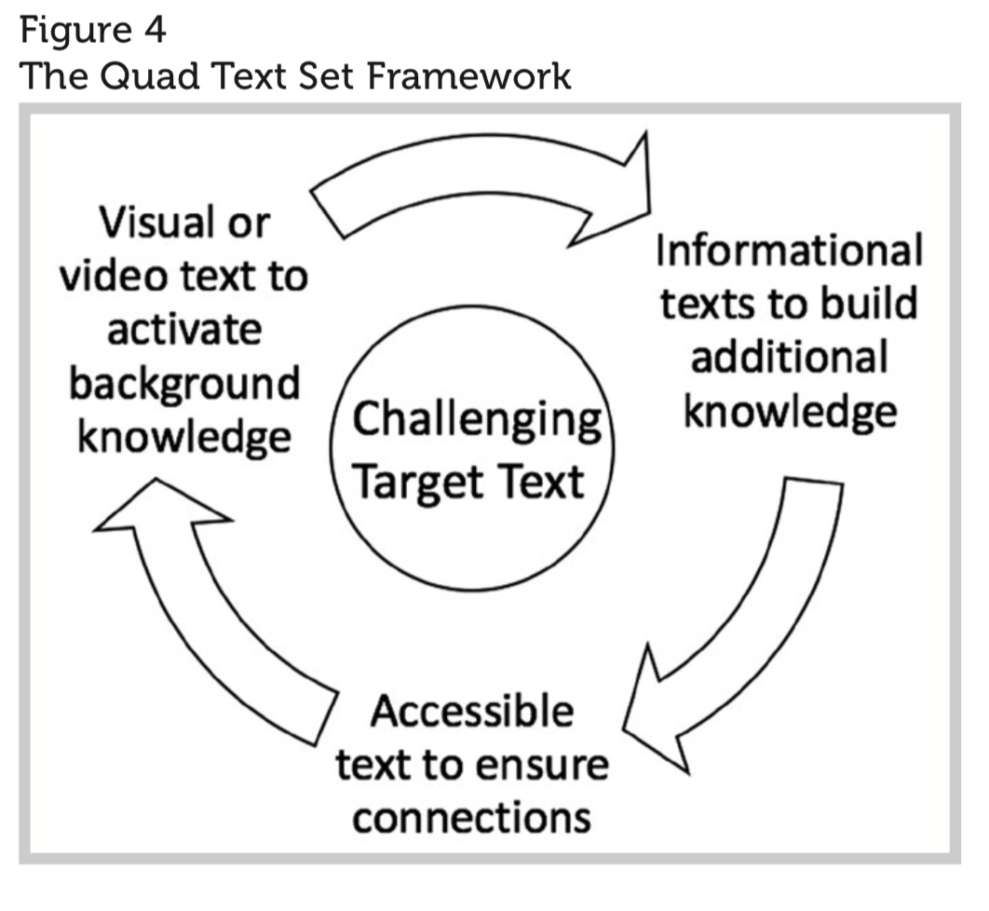
Gateway Texts
Visual text for banned books
Accessible text for Shakespeare
Information text on World War II

Slide 5
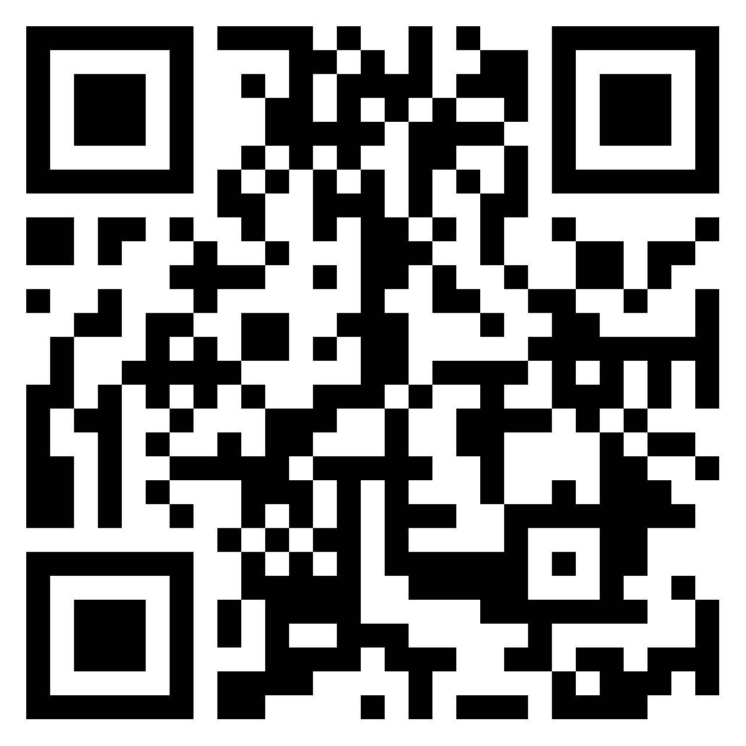
A Question to Pose:
With your group, discuss a ‘text’ that you have ‘read’.
Which kinds of supplemental texts have you viewed to help you understand the text more or broaden your knowledge?
5 minutes, then we’ll share.
Padlet: Scan the code to post the cover of your book.
Is it information, accessible or visual? https://padlet.com/greggwhitlock/pw89ba44y3ja
Notes:
Anthony can give examples of Harry Potter, or learning languages.
We can also write some examples on the board, or ask Joanne ahead of time for some white board markers so we can give them to our peers to write their ideas on the boards beside them.

Slide 6
Quad Text Set Framework
Visual Text
Informational Text
Accessible Text
Target Text
A four layered approach to set students up for success by:
a) increasing the amount they are reading,
b) making them more confident in their understanding and thus
c) preparing them to get the most out of the target text, which is typically higher level.

Slide 7
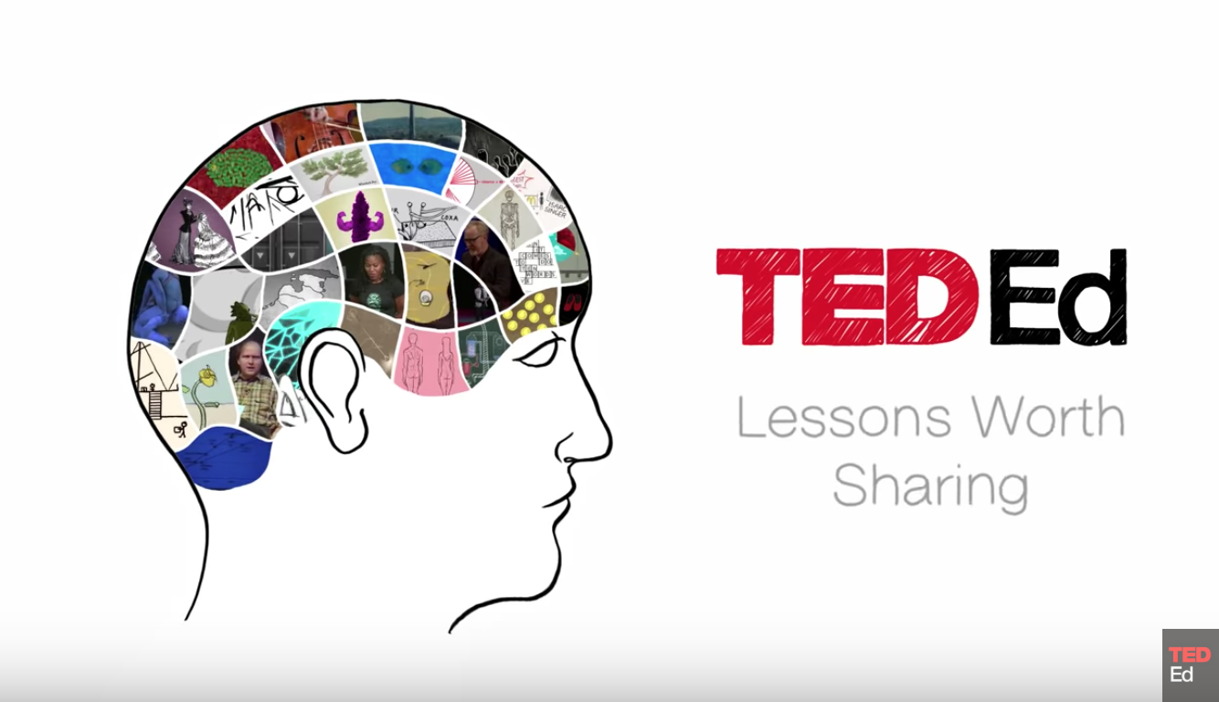
Quad text Set Example from Science

Slide 8
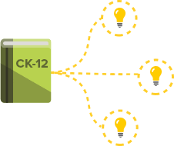

Slide 12
Knowledge or skill?
The authors state that using quad text sets supports both students’ knowledge building and their skill building, by practicing various texts (including “rigorous” texts).
Mixed texts and “successful reading encounters”

Slide 13
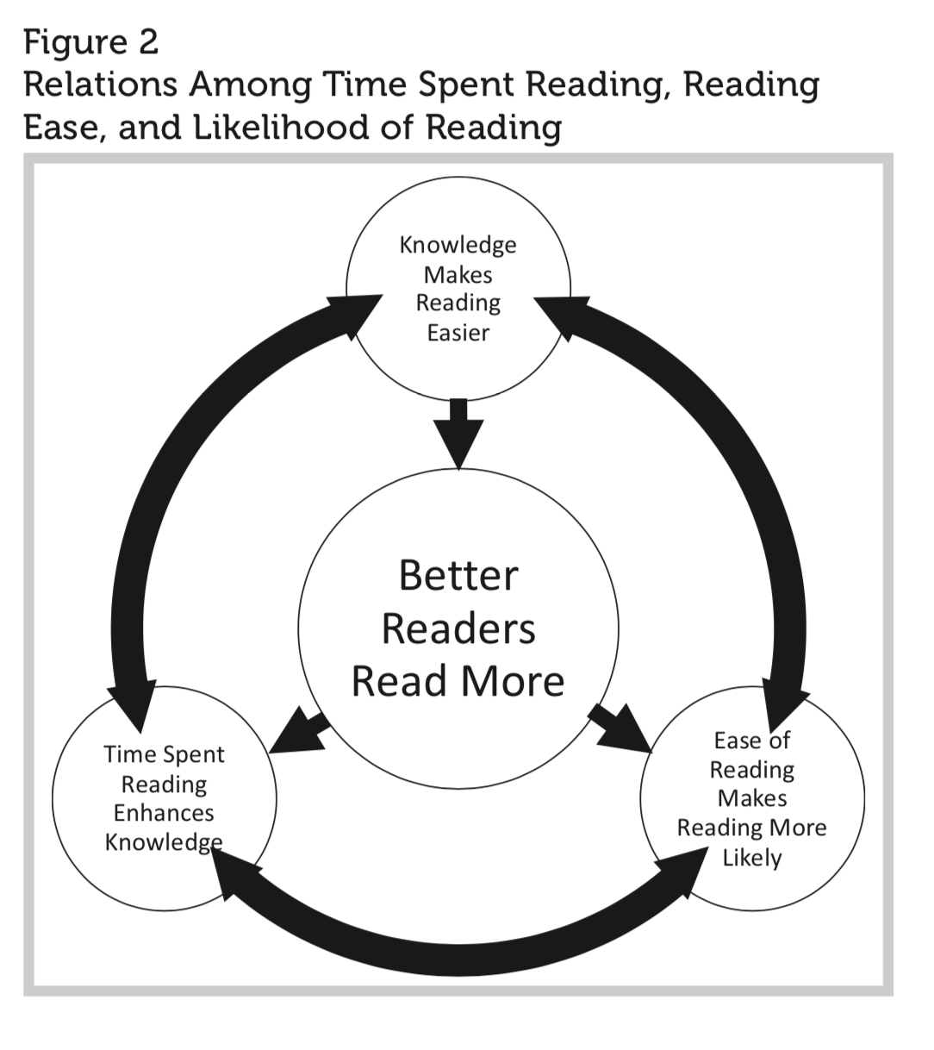
Increasing Reading Rates
“A child who reads independently for 20 minutes per day will read over 1 million more words per year than a child who reads for 10 minutes per day,” (434).

Slide 14
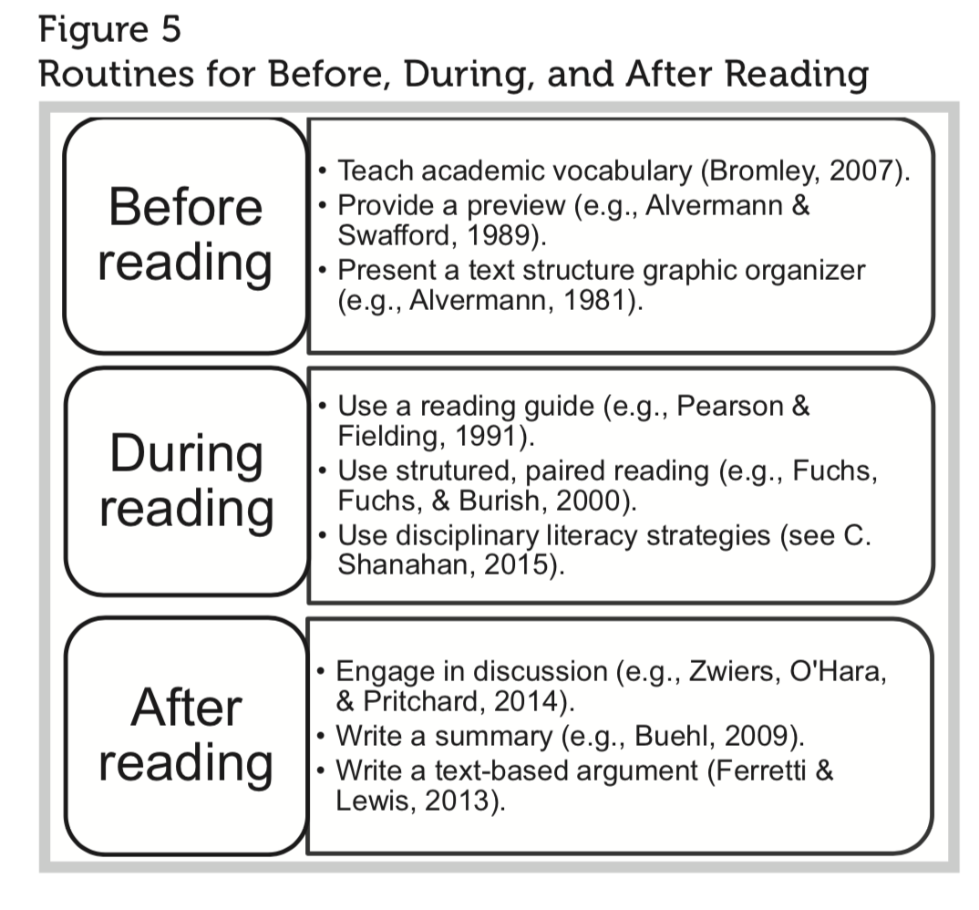
Before, During and After Reading
more content knowledge before they read, their understanding is better during reading (435)
connections between content and interests can secure the buy-in -authentic engagement (435)
Teachers have struggled to find easier texts that are appropriate for adolescents (441)
increasing the amount of time for reading challenging content area texts and providing opportunities for students to read relevant, accessible texts. (441)

Slide 15
What do teachers say?
When asked about the usefulness and feasibility of quad texts, the teachers referenced in the article say that their students:
Built relevant content knowledge and reinforced it.
Were better able to see themes in challenging texts
Increased the amount they read
Became motivated to read more challenging texts
Teachers admit that it takes more time to find suitable texts; the authors suggest working in teams as colleagues might alleviate that.

Slide 16
“Teachers are often unsure about how to link texts to other curricular objectives.”
-How Hard Should Students’ Reading Be?
-How Does Background Knowledge Support Comprehension?
-What Have Teachers Said About Quad Text Sets?
Notes:
Simran slides (notes will be read in person)
Providing the class with a brief introductory stimulus (5-10 minutes or so); the group will summarize the reading and lead a class in our learning on these texts (15-20 minutes).

Slide 17
Example from Social Studies

Slide 18
Activity #2: A Promising Way To Practice
Move into table groups based on your teachable
Hand out Activity #2 Handout
How could you implement this in your own teaching? Pick a target text and preliminary texts to prepare students. How would you plan it out in your lesson plans?

Slide 19
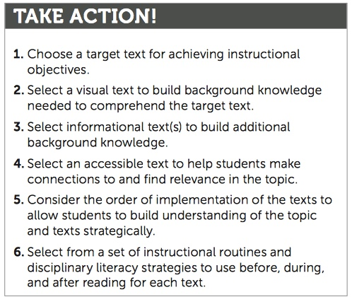
A Promising Way To Plan:
Notes:
SIMRAN: Explain this figure and suggest this activity.

Slide 20
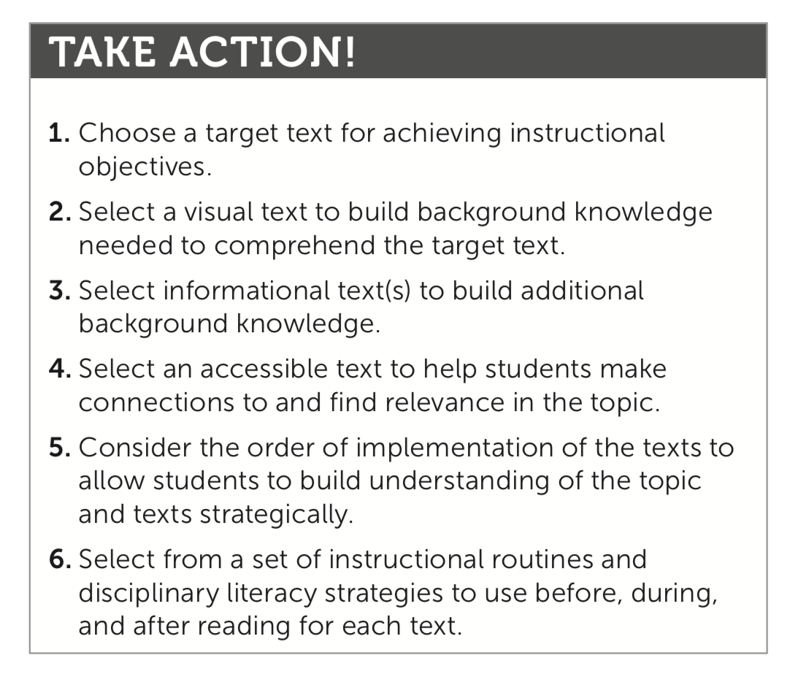
Activity Discussion:
Is this feasible or beneficial for your teaching practice, in terms of effectiveness and use of your time?
Or
If you did implement this during your practicum, share with your group some examples.
Notes:
Simran: I have the printout for this! Like a template

Slide 21
Summary
LITERACY
“Building background Knowledge using Text Sets: Rethinking Text Sets”
Goal: Increase challenging texts that students engage with in class.
Problem: How to link supporting texts to the curriculum…
Proposed solution: Develop an approach to text selection using the text set framework.
Factors considered: Reading volume, text difficulty, background knowledge, motivation.
Findings and Feedback: Takes time to curate and implement and was difficult to find relevant texts, but there was increased time reading in class and student were more engaged in target texts.

