Slide 1
Disciplinary Literacy
Writing: The Big Idea
Bethany, Hannah, Jingyi, Nancy and Sophia

Slide 2
What do you feel strongly about?
Social media?
Animal testing?
Northern pipeline?
Banning homework?
……………….?
Quick Write
Decide on a topic that interests you
Write a letter to an editor (~5 sentences) on your argument/opinion/topic

Slide 3
Writing: The Big Idea
In the Reading and writing in the disciplines
Annenberg Foundation
Notes:
Just as you need a recipe, ingredients, and proper tools to cook a delicious meal, you also need a plan, resources, and adequate time to create a good written composition. In other words, writing is a process that requires following steps and using strategies to accomplish your goals.

Slide 4
Brainstorming ideas and organize your ideas.
Sharing your writing with others.
Use your plan to create a rough writing paragraph.
Proofread and polish your writing.
Reread and rewrite your draft, focus on logic and content.
Summary - General components of the writing process
Notes:
Writing is a process that takes time to develop and is not just confined to the final paragraph written at the end of an investigation. It is a process that develops over time and includes planning, drafting, revising, editing and polishing.
Planning--Collecting ideas and thinking about forms, purpose, audience, role and structure.
Drafting--Getting it down on paper- skipping a line allows pupils space to make changes when they start to redraft or edit their work
Revising--Make changes to content, structure, organization, choices of vocabulary using a critical friend or a list of what to look for.
Editing--Check for accuracy in spelling, punctuation and grammar.

Slide 5
Revise VS Edit
Revise → use your “ARMS”
Add
Remove
Move
Substitute
Edit → check your “CUPS”
Capitalization
Usage
Punctuational
Spelling
Information in order to make your ideas clearer, more accurate, more interesting, or more convincing.
You fix any problems in grammar, punctuation, and sentence structure. You improve your writing style.
Notes:
When you revise, you take a second look at your ideas. You might add, cut, move, or change information in order to make your ideas clearer, more accurate, more interesting, or more convincing.
When you edit, you take a second look at how you expressed your ideas. You add or change words. You fix any problems in grammar, punctuation, and sentence structure. You improve your writing style. You make your essay into a polished, mature piece of writing, the end product of your best efforts.

Slide 6
Tips for using the writing process
1.It is not a linear process.
Depend on the needs, goals and purposes of writing, students can jump among different components.
2. Scaffold can be used in each component.
Provides some graphic organizer or some sentence structure in draft process..
Notes:
Students should understand the elements of the writing process, but not every piece of writing needs to reflect this full process. Teachers should consider the purpose and length of the writing assignment, the audience, and the cognitive demands of the task.

Slide 7
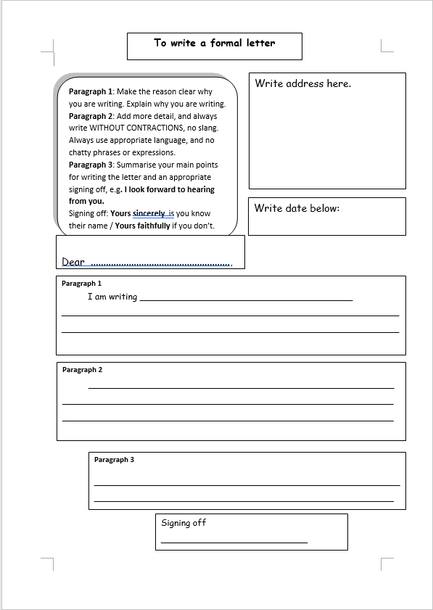
Tips for using the writing process
1.It is not a linear process.
2. Scaffold can be used in each component.

Slide 8
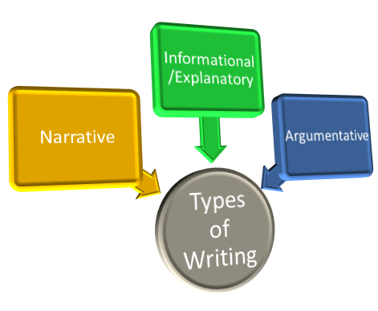
Summary

Slide 9
Narrative, informational, and argumentative writing should:
Reflect the goals of the unit or class
Promote critical thinking
Allow writers to integrate their background knowledge

Slide 10
Narrative Writing

Slide 11
Narrative Writing
Memoirs
Personal narratives
Fiction
Biographies
Poetry

Slide 12
Informational / Explanatory Writing

Slide 13
Informational / Explanatory Writing
Summaries
Lab reports
Directions
Procedural explanations
Reflections on learning
Research reports

Slide 14
Argumentative Writing

Slide 15
Argumentative Writing
Article reviews
Essays
Letters to an editor
Blogs

Slide 16
Example: Transition Words in Social Studies
→ It is important to teach students to use new vocabulary rather than identify it
→ Present the material outside of the course content so that each student is able to participate

Slide 17
Useful transition words that are helpful in a social studies class for students to write about complex events.
Cause & Effect Transitions
Because of ________
Consequently, ___________
________ so _______
As a result __________
Since _________
This led to ____________

Slide 18
Activity
Writing a Letter to the Editor
…...with scaffolds
Notes:
So now we are going to do our activity...with scaffolds. We pretty much just threw this writing exercise at you at the beginning of the presentation, but now I am going to give you a little more background information and a little more guidance as to how to do thing writing exercise.

Slide 19
A letter to the editor?
WHAT
Short persuasive writing on an issue you feel strongly about have
WHO
To the general public to promote more discussions within the community.
WHY
To influence the public and the policy makers.
Notes:
A letter to the editor is a short persuasive writing on an issue that you feel strongly about. It is a writing that is short, to the point, and it is usually no more than 300 words. It is a great way to voice out your opinion on an issue and to influence others to take actions with you.
The writing is published on a newspaper or magazine which allows you to reach to a wider range of individuals, and it has the potential to influence the public and even the policy makers.
So here I want to stress the point “to the general public”, this means that the language you are using are not going to be full of jargons, so that you can engage more readers. So use language that most people will understand.

Slide 20
How to write a letter to the editor
Open the letter with a simple salutation. Example would be a simple “To the Editor of the Vancouver Sun”.
Grab the reader’s attention. Tell readers what you are writing about. You want them to continue reading.
Explain what the letter is about at the start.
Explain why the issue is important.
Have suggestion on what could be done.
Sign the Letter.
Section 2. Writing Letters to the Editor. (n.d.). Retrieved from https://ctb.ku.edu/en/table-of-contents/advocacy/direct-action/letters-to-editor/checklist
Notes:
Simple greeting “Dear editor”
Right off the bate, tell the readers what you are writing about, engage them and make them want to read
Don't make the everyone wait to find out what you want to say. Tell them your key point at the beginning.
Next 2-3 sentences, support your main idea with
It would be great if you can provide a suggestion on what COULD be done to improve the situation
Lastly sign the letter with your name
Any questions? If not, please take about another 5 mins to write on another piece of paper
We have going to give you some

Slide 21
So, how did you feel?
How was your writing experience different from the first exercise?

Slide 22
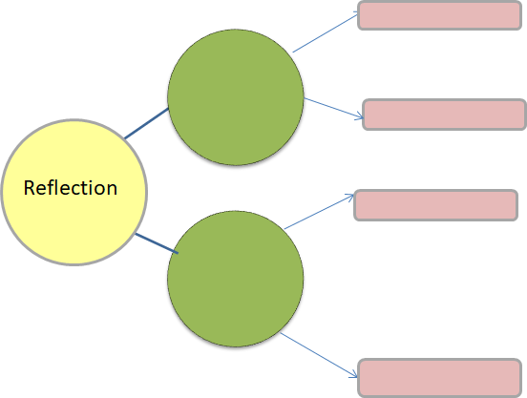
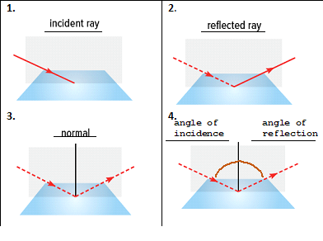
Disciplinary writings
In science:
Summaries of outcomes of experiments
Visual displays (charts, graphs) that highlight procedures.
How would you scaffold?
Paper
Diffuse
Clothing
Mirror
Specular
Glass
Notes:
Sophia helped us to scaffold writing this letter by providing step-by-step instructions and transition words.
Writing this letter could happen in an English class, but it could also happen in a Sc class that want to advocate to decrease animal testing. Many writings are inter-disciplinary, but there are examples that happen more frequently in a discipline. For example, regular science writings are: lab summaries and procedures
If you know your students would need to write lab summaries and procedures, how would you scaffold? For a summary of outcomes, I would ask students to use a mind map. They can report materials (such as paper, or clothing) that reflect light in a diffuse way, once they finish this map, they can do the writing part.
And for lab procedures, I will provide the title of each image and they will draw the images. Later, then can do the writing of the procedure.

Slide 23
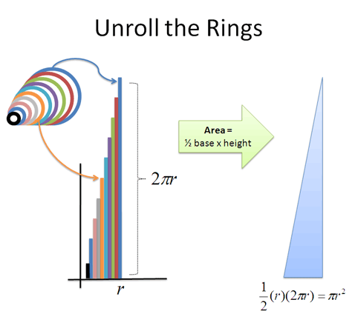
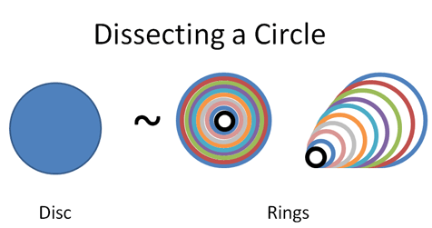
What specific supports or procedures for ...?
Math: Visual representations of processes
leading to solutions
English: Persuasive essays
History/Social Studies: Explanations of causes & effects of events
Notes:
Think about writing you have assigned or can assign in an English or social studies class
What supports or procedures you would use to help students scaffold?

Slide 24
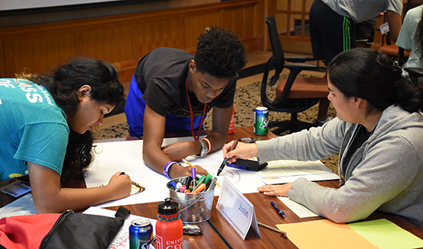
Group collaboration
Notes:
One type of scaffolding is:
Creating teams
Letting the team chose the theme when applicable

Slide 25
What does success with writing looks like in our disciplines?
Deeper understanding, responding critically
Voice: Background knowledge integrated
Group collaboration
Motivation and engagement
…?

