Slide 1
Writing: Disciplinary Literacy
Lauren Lyons & Shane Love

Slide 2
You will need a pen and paper
Season 1 | Season 2 | Season 3

Slide 3
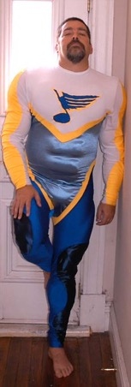
The loyalty written on his heart was written into his FASHION for the world to see.

Slide 4

Write, Right?
· “an increased emphasis on writing across the disciplines in [secondary schools]”.
· encourages “deeper understanding of a topic through organization, analysis, synthesis, and evaluation of key ideas”.
· often not given the same attention as reading.

Slide 5
SEASON 1
BEd

Slide 6
The Writing Process
Planning
· organizing and outlining ideas with a clear understanding of the purpose and audience.
o Why am I writing this? Who is my audience? What are the essential and supporting ideas I need to include?
How do I best organize it?
Drafting
· creating the initial representation of the written text.
o How do I begin? How much info is enough/too much? What questions do I need to address? How will I conclude?
Revising
· rereading and clarifying original draft.
o Are my ideas clear, understandable and sufficient? Is my word use appropriate for my audience and purposes?
Editing
· Finalizing the text by “polishing” grammar, spelling and punctuation.
o Can be seen as the final step in revising.
(Publishing/Sharing)
· Presenting the piece through various modes and methods.
(These steps are often interactive, occurring simultaneously)

Slide 7
SEASON 2
BEd

Slide 8

Scaffolding

Slide 9
Making Writing Explicit Through Scaffolding
· Students ought to know what is expected in each writing assignment based on the teachers’ purpose.
· Never assume students know how to successfully engage in the writing process.
· Support students’ writing with:
o Graphic Organizers
o Checklists
o Sentence Starters and Transition Words
o Discipline Specific Vocabulary Lists
o Mini-lessons to address/frontload writing needs
Scaffolding is ineffective if students’ ability to “stand alone” is never assessed.

Slide 10
SEASON 3
BEd

Slide 11

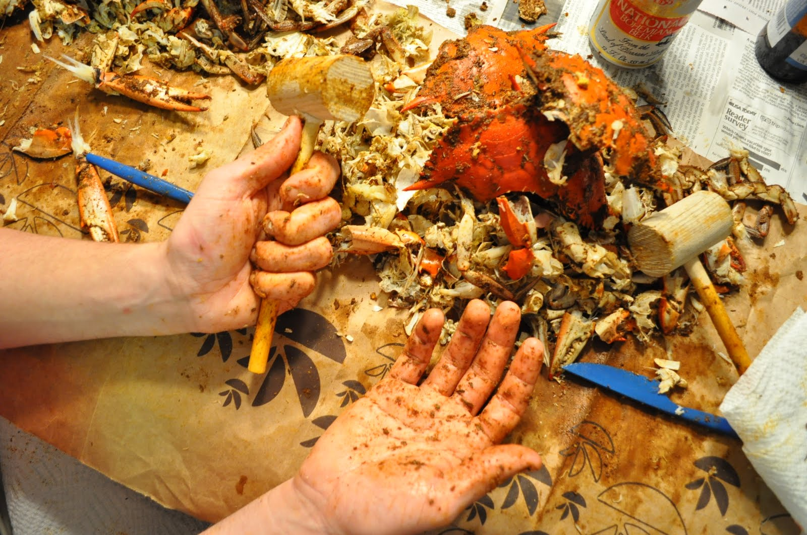
 | Outdoor Crab Shack Headgear Messy Jacket All-you-can-eat Pants Worse than meat sweats Hands Feet
Things to Consider Weather: -18 celsius Bear Threat: None Showshoes: Your shoes fit in them. Don’t wear cotton - wear wool if possible

Slide 12

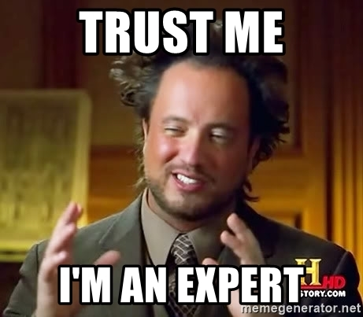
Disciplinary Writing
Writing is not only for English teachers!
Writing and reading like an expert
Teach BOTH tools for understanding, representing, and responding critically to ideas AND on the goals and formats of written communication in the discipline
Improves writing skills while allowing deeper understanding of the content

Slide 13
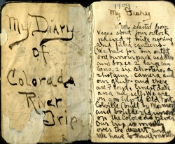
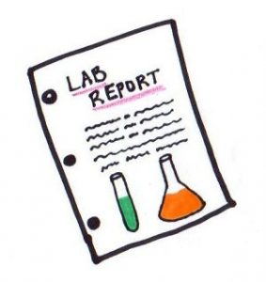
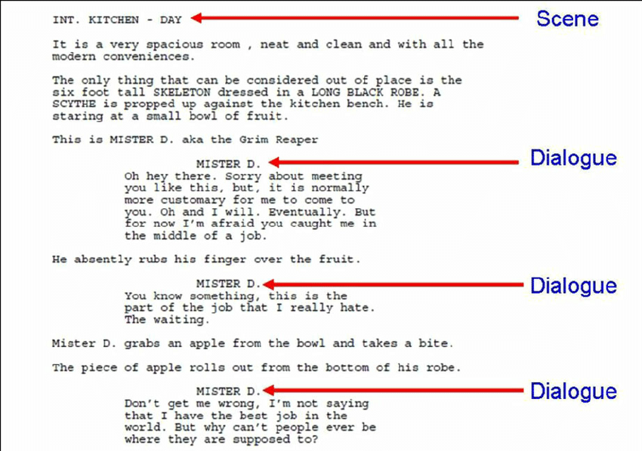
Examples: Scaffolding Disciplinary Writing
Social Studies - “Thinking like a historian”
Forming a argumentative essay with a thesis based on primary sources
  Requires lessons on thesis, essay structure, examination of author's bias, understanding of the historical time period, and assessing conflicting reports
Science - “Thinking like a scientist”
Writing a lab report
  Requires lessons on attention to accuracy of details, sequencing of procedure, and reliability of outcomes
Theatre - “Thinking like a playwright”
Writing and acting a short script
  Requires lessons on structure of dialogue, scene development, how to block a scene, character motivation, and direction

Slide 14

Discussion Question:
Think about writing you have assigned over practicum. What knowledge did students need to complete this assignment? How did you prepare students for this writing? Could you have done anything better?

Slide 15
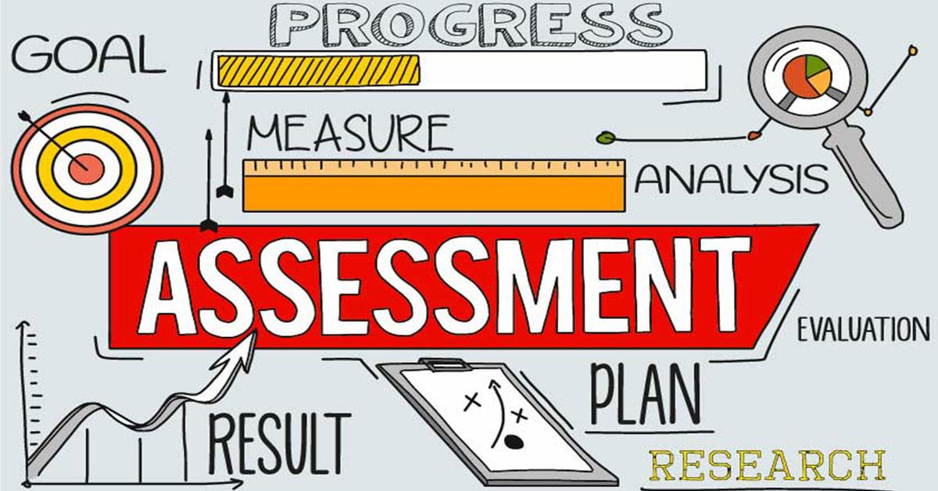
Writing Effective Assessment: Essential Questions
What do I want to know about each student’s learning?
  Content, writing craft, addressing unit goals, essential questions, and purpose
How will I know this? What form of assessment will provide this information?
How will I use the results to plan subsequent instruction?
  What are some future roadblocks?
Considerations: ELL’s may have challenges representing depth of knowledge in English, assess accordingly
Video:https://www.learner.org/courses/readwrite/disciplinary-literacy/writing-big-ideas/4.html

Slide 16

Practice:
Review these two student works that were written for a 6th grade science assignment on what it means to be healthy. Use the rubric to evaluate the student’s writing and write a few sentences on next steps for this student.

Slide 17

Questions:
What did you think about this assignment and the rubric? Did it fit any of the topics we discussed here today?
How did you feel giving “next steps” to the student?

Slide 18

… Thunderous applause

