Slide 1
LLED 361 – 921/928
Dr. J. Roberson
May 15, 2019

Slide 2
Welcome Back - Shape of the Day
Housekeeping: Attendance, Blog, Assignments
Review of Duff (2001)
Text Analysis Activity – Making Text More Accessible
Break
Hayes Jacobs – Strategies for reading, writing, speaking & listening (p. 1-13)
Literacy Teaching Strategies – Pre/During Reading
Review of Assignment #2

Slide 3
Duff, P. A. (2001). Language, literacy, content, and (pop) culture: Challenges for ESL students in mainstream courses. Canadian Modern Language Review (58)1, 103-132.
What were the key challenges/concerns raised by this author regarding Secondary English Language Learners?
Notes:
Present the full article citation and your names

Slide 4
Duff (2001) showed us what could go wrong in a class with a substantial # of ELLs (for the ELLS). But how might we do right?

Slide 5
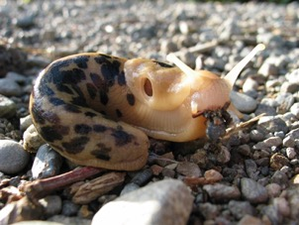
Making academic text comprehensible to ELLs (really, more comprehensible for everyone)
Make the text Structure explicit
Teach the Language required to understand
Cultural references are Unblocked
Use Graphic organizers/visual aids

Slide 6
Group Activity (First Peoples English 12 Exam)
Find the 3-4 people who have the same slide as you.
Sit down with them and analyze what ELLs (or others) might find difficult about this text.
Someone in your group will read the text aloud for the class.
Then your group members will explain how you’ll apply SLUG.
What structural elements in the text will you make explicit to students?
What language (vocabulary) will you teach and how?
What cultural references will you need to unblock?
What graphic aids/organizers might be helpful?
Finally, you’ll solicit other ideas from the class.
This is a low-stakes 5 -min. presentation whose sole purpose is for a learning activity and to prepare for Assignment #2. It is not for marks.
Notes:
What structural elements in the text will you make explicit to students?
What language (vocabulary) will you teach and how?
What cultural references will you need to unblock?
What graphic aids/organizers might be helpful?
Finally, you’ll solicit other ideas from the class.
This is a low-stakes 10-min. presentation whose sole purpose is for a learning activity and to prepare for Assignment #2. It is not for marks.

Slide 7
Groups – 921
Slide 1: Jacob, Puneeta, Victor, Alexa-Rae
Slide 2: Makaela, Lindsay, Devon, Nancy
Slide 3: Jingyi, Grant, Amanda, Kelsey
Slide 4: Jenessa, Sarah, Bethany, Krysten
Slide 5: Meno, James, Jonathan, William
Slide 6: Jackie, Shuqi, Rhea, Jovana
Slide 7: Amy, Hannah, Nicole, Rob
Slide 8: Janna, Dena, Paul, Sophia
Slide 9: Jeff, Lauren, Philippa, Timothy

Slide 8
Groups – 928
Slide 1: Kimberly, Jenna, Geetika, Sean
Slide 2: Sara, Cassandra, Jordan, Leo
Slide 3: Benjamin, Shane, Lauren
Slide 4: Chloe, Sean, Zac
Slide 5: Jose, Martin, April
Slide 6: Anthony, Marie-Josée, Carlyann
Slide 7: Mark, Tom, Priya
Slide 8: Dean, Simran, Lucas
Slide 9: Gregg, Dorothy, Owen

Slide 9
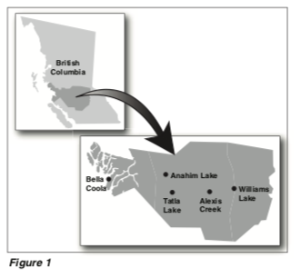
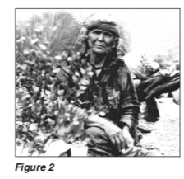
SLIDE 1
How anyone could live without shelter through a Chilcoltin winter, with temperatures plunging to –50°C, is a mystery. But then, much of Chiwid’s life story is a mystery. Stories and speculations surround this Tsilhqot’in woman, but one thing is certain: her choice to live most of her adult years outdoors, without tent or warm clothing, made her a legend.
Chiwid gained nationwide attention in 1959. Late that winter, ranchers near Tatla Lake heard a strange cry coming from the woods. Believing it might be a person in distress, they contacted the Alexis Creek RCMP detachment. Officers found Chiwid in a tiny makeshift camp among the pines, but she denied being in any difficulty and had no desire to be rescued.

Slide 10
SLIDE 2
Eight children were there at play, seven sisters and their brother. Suddenly the boy was struck dumb; he trembled and began to run upon his hands and feet. His fingers became claws, and his body was covered with fur. Directly there was a bear where the boy had been. The sisters were terrified; they ran, and the bear after them. They came to the stump of a great tree, and the tree spoke to them. It bade them climb upon it, and as they did so, it began to rise into the air. The bear came to kill them, but they were just beyond its reach. It reared against the tree and scored the bark all around with its claws. The seven sisters were borne into the sky, and they became the stars of the Big Dipper.
From that moment, and so long as the legend lives, the Kiowas have kinsmen in the night sky. Whatever they were in the mountains, they could be no more. However tenuous their well-being, however much they had suffered and would suffer again, they had found a way out of the wilderness.

Slide 11
A Pheasant on Deer Mountain
It is early spring and morning,
before the sun has arrived.
There is jus enough light to mark the path: A shadow,
darker than the twisted trees guiding it into morning. She is little more than silhouette when she steps one step then another
from behind an arbutus tree
into the wet path.
…
Because she has no words and I have no song, she accepts,
and I settle for a safe distance between us.
She was designed to disappear, if she hid I would pretend not to see her.
SLIDE 3

Slide 12
SLIDE 4
Coyote holds a place in the oral tradition of the North American Plains similar to the role Raven plays in West Coast stories. The trickster characters in King’s fiction have been icons of his literary and cultural sensibilities since he was a young man. Today, however, Coyote runs loose in King’s poems and fiction almost as if the clever marauder had been waiting all these generations for a writer to come along and allow him to get back to his tricks.
One cannot read King’ s fiction without laughing, but it isn’t just his loosely jointed plots and clutter of mythical and real characters that amuse. It is the way he convinces the reader of the absolute credibility of the people and animals who appear, often uninvited, into scenes, and how his stories have a way of slipping around in time and space to create a masterful blend of old and new oral traditions.

Slide 13
SLIDE 5
Hmm, says Old Coyote, where did those ships come from?
And pretty soon, she makes some people on the beach with flags and funny-looking clothes and stuff.
Hooray, says Old Coyote. You are just in time for the ball game.
Hello, says one of the men in silly clothes and red hair all over his head. I am Christopher Columbus. I am sailing the ocean blue looking for China. Have you seen it?
Forget China, says Old Coyote. Let’s play ball.
It must be around here somewhere, says Christopher Columbus. I have a map.
Forget the map, says Old Coyote. I’ll bat first and I’ll tell you the rules as we go along.
But that Christopher Columbus and his friends don’t want to play ball. We got work to do, he says. We got to find China. We got to find things we can sell.

Slide 14
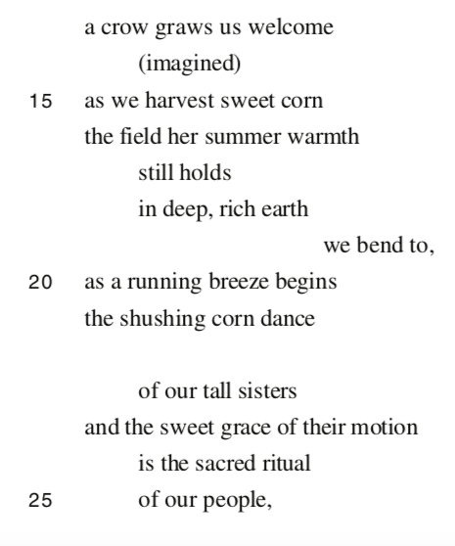
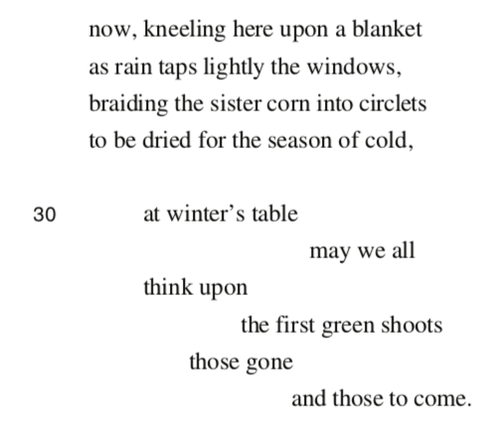
SLIDE 6

Slide 15
SLIDE 7
… He went on to serve two terms as band chief, and in 1987 was elected grand chief of the Cree of Quebec, a nation made up of nine communities with a total population of 12,000. As grand chief, Coon Come’s responsibilities in Cree communities involve domestic issues such as education, economic development, and health services, as well as larger political issues such as the inherent right of Aboriginal people to determine their future.
One of Coon Come’s greatest legacies is his leadership in the Quebec Cree opposition to
phase two of the James Bay hydro-electric project, known as Great Whale. The first phase of the project had been launched with the consent of the Cree through the signing of the James Bay and Northern Quebec Agreement in 1975, a treaty signed by Quebec, Canada, and the Aboriginal governments of the Cree and Inuit. No one, however, had anticipated the damaging effects that the initial phase of the project would have on Cree land and people. Besides the dislocation of entire Cree village sites that were submerged by the reservoirs, the project caused alarmingly high mercury levels in the fish that were consumed by the Cree, and loss of wildlife to habitat changes and drowning. The Great Whale Project had the potential of destroying more Cree ancestral land and further harming the environment in northern Quebec.

Slide 16
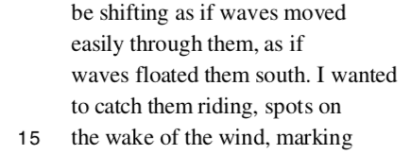
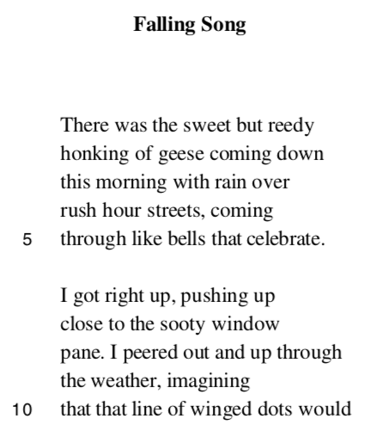
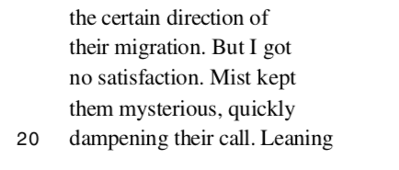
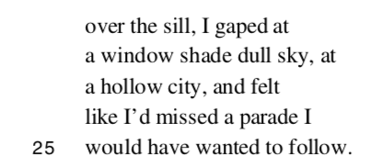
SLIDE 8

Slide 17
SLIDE 9
As soon as I saw the brown letter, the English words written upon it, I knew what it contained. I sat down beside the fire and stirred at it with a stick while Joseph read, first out loud and in his stumbling English, then for me in our language.
“‘Serial No. 6711. Deeply regret to inform you, Private First Class Xavier Bird, infantry, officially reported died of wounds in the field, November 3, 1918. Director of Records.’”
I waited for more, but that was all. When Joseph left, I was alone.
Many moons later, when the winter ice was leaving and travel was difficult, Joseph came back with another letter. He explained that it was in reference to Elijah… The letter said that Elijah had been wounded, that he had only one leg now, that he had tried to rescue another soldier, was given a medal for bravery. It said that although weak, he had healed enough to travel and was expected to arrive in the same town from which he and Xavier had left so long ago.
I had Joseph explain to me how the wemistikoshiw calendar worked, what month I was to be there, and I made careful preparations to journey by canoe to that town where Elijah would arrive. I left early in the summer and paddled up the river. It was difficult. I am older now, but I travelled light. Joseph had asked to come along, but I told him no.

Slide 19
Hayes Jacobs, H. (2013). Active literacy across the curriculum: Strategies for reading, writing, speaking, & listening. New York, NY: Routledge.
“Each teacher—at every grade level, in every subject—needs to embrace the notion that he or she is a language teacher” (p. 15).
Seven Essential Literacy Strategies:
Literacy instruction (listening, speaking, reading, writing) with all learners in every subject area
Specific Vocabulary Instruction
Creative note-Taking
Framework for Editing and Revision
Assessment of Formal Speaking Skills
Technical Instruction: Human Voice/Body as Communication
Curriculum Mapping: School/District
Take a moment in your group to talk about these 7 Strategies
Which quote resonated with you?

Slide 21
Grade 10 Science
Big Idea: Energy is conserved, and its transformation can affect living things and the environment.
Essential Question: How do energy transformations affect the environment?
Content – Students are expected to know:
Practical Applications and Implications of Chemical Processes
Competencies -
Questioning and Predicting

Slide 22
Pre-Reading Strategies
“... vocabulary is not learned best in English class alone. If it is acquired and deployed in all other subjects, the student has a genuine opportunity to build the ultimate language power tool: an internalized vault of words” (p. 20).
“Vocabulary that focuses on highly contextualized applications in specific fields or disciplines is identified as specialized terminology. These words and phrases are not used commonly among students in everyday speech, but they are certainly employed with regularity among specialists in a field. Specialized terms describe concepts or ideas that require definition in a context. (p.30)
“... students’ work improves if a teacher gives them words generously and requires them to actually use them actively” (p. 34).
SORT and PREDICT ACTIVITY

Slide 23
Sort and Predict Pre-Reading Activity
Each group has an envelope containing 15 words from an article on a topic related to the transformation of energy.
In your group, please sort the words in your envelope into categories that make sense to you (there are no right answers!).
Cluster and label the categories (use Post-Its to create labels)
Can you make connections between the clusters to create a concept map?
Make a predication about the specific topic of the article
Share/justify your predication with the rest of the class

Slide 24
Notes:
Differentiation: Give your ELL and students with learning challenges the list of words the day before so they can prepare for class.

Slide 25
So what do you think the article is about?
Resource Extraction: Hydraulic Fracturing (Fracking)

Slide 26
Pre-Reading Strategies
“The idea is to probe. Questioning is a means through which students can attain comprehension. This probing creates opportunities for students to link new knowledge to what is known, to challenge the texts, to visualize connections, to create mental summaries, and to monitor for meaning” (p. 49).
“When students speak about ideas in a public forum, and when they react to and rattle ideas around, it is an act of ownership and investment…By listening to others, we can infuse our own thoughts with associations, re- actions, and suggestions. When we hear ourselves out loud and get a response from others, there is the possibility of feedback and engagement.” (p. 81).
ANTICIPATION GUIDE STRATEGY
Notes:
Who talked the most Today?
“The problem with most classroom discussion is that all too often it is a great opportunity that is missed. Too often, discussion is canned and dominated by a teacher who leads a handful of habitual handraisers. Just as there can be static writing in school assignments, there can be inauthentic and stilted discussion. What passes for discus- sion is actually Q&A, where the teacher plays “Guess what I’m thinking.” This scenario can be countered with a different approach to and strategy for classroom discussion

Slide 27
Goodine, C. (2011). Fracking controversy: Rethinking the low-carbon label for natural gas. Retrieved from https://www.canadiangeographic.ca/article/fracking-controversy

Slide 28
Myth or Fact
The real “FRACKING” story

Slide 29
Myth or Fact?
Oil and natural gas reside in huge underground pools and lakes.
Myth
Oil and natural gas are trapped in sedimentary rock formations, such as sandstone and shale, in the Earth’s crust.

Slide 30
Myth or Fact?
MYTH and FACT
In places where fracking is used to produce natural gas which lowers use of coal, then greenhouse gas emissions are lowered.
In places where fracking is used for oil or where natural gas development does not reduce use of coal, then this adds greenhouse gases, contributing to climate change.

Slide 31
Review of Assignment 2: Friday, May 24
Please bring a “text” you used during your practicum (or one that aligns with your subject area). Focus on the Big Ideas/Concepts.
You will teach your partner the content of this text, emphasizing vocabulary (that might be new/challenging) and key concepts.
You will provide a visual aid (illustration, chart, map, graphic organizer) of your own creation (that contains no words or descriptions) to facilitate rapid content teaching and retention of key concepts.
Your partner will teach your “text” to the rest of the small group (4-6 people) who will assess the presentation using the rubric provided.
Each person will have a time limit of 10-15 min.

