Slide 1
LLED 361: Literacy and Assessment Practices - Secondary
Dr. J. Robertson
Wednesday, May 22, 2019

Slide 2
Welcome Back!
Reading Group 2a Presentation - Big ideas in Reading and Writing in the Disciplines
Text Sets (Lupo et al 2017)
Break
Text Sets for Social Justice
Partner Work Time – Assignment 2

Slide 3
TEXT SETS

Slide 4
Text Sets
Increasing the amount of challenging texts that students read has the potential to improve literacy outcomes
Biancarosa and Snow (2006) - adolescents should spend 2-4 hours/day engaged in literacy-connected learning across content area classes, reading many millions of words/year
But.. Swanson et al (2016) found that students (Grades 7-12) read for less than 15% of class time in SS and ELA
Why is this??
Lupo, S. M., et al. (2017). Building background knowledge through reading: Rethinking text sets. Journal of Adolescent and Adult Literacy, 61(4), 433-444.
Notes:
middle and high school
*2/3 of the reading time was spent listening to the teacher, watching videos or listening to other students read aloud

Slide 5
Stressors on Adolescent Text Experiences?
Lupo, S. M., et al. (2017)..

Slide 6
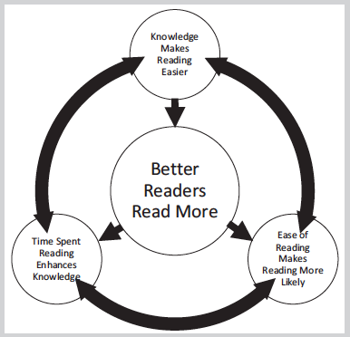
Relations Among Time Spent Reading, Reading Ease, and Likelihood of Reading
Lupo et al. 2017
Notes:
For skilled and unskilled readers, reading involves either a positive or negative reinforcing cycle.
The more/less you read…
The faster/slower you are decoding…
The more/less general knowledge you know…
The easier/harder it is to read…
The more/less pleasure you get from reading…
→ The more/less you read.

Slide 7
How can struggling readers have success with reading challenging texts?
Background knowledge building and support (scaffolding)
What students already know influences how easily they learn!
When students have more content knowledge before they read, their understanding is better during reading (Arya et al., 2011).
Knowledge building may be key to assisting adolescents in understanding rigorous texts.
Knowledge can improve higher level thinking skills and content learning (Willingham, 2006) and enable inference generation and memory for details (Pearson & Fielding, 1991).
Lupo, S. M., et al. (2017). Building background knowledge through reading: Rethinking text sets. Journal of Adolescent and Adult Literacy, 61(4), 433-444.

Slide 8
How can struggling readers have success with reading challenging texts?
Knowledge building and support (scaffolding)
A “Text Set Framework” allows teachers to strategically plan instruction that provides opportunities for students to build their background knowledge through reading texts at various levels of difficulty.
Lupo, S. M., et al. (2017).
Notes:
Students need a mix of easy and harder texts
Teachers often unsure how to link texts to curricular outcomes/objectives – need an approach to text selection and sequencing

Slide 9
GOAL
Increase Text Volume
Embrace Complexity
Build Background Knowledge
ACTION
Use a set of related texts
Select a challenging target text
Include visual texts and simpler informational texts
Deliberately select a text to garner buy-in
Target Motivation
Notes:
Rationale for choices in

Slide 10
Routines for Before/During and After Reading
Before Reading
Teach vocabulary
Provide a preview
Use text structure graphic organizers
After Reading
Discussions
Summaries
Reflections
Arguments
During Reading
Reading Guides
Structured reading (e.g. jigsaw, paired reading)
Reading Strategies

Slide 11
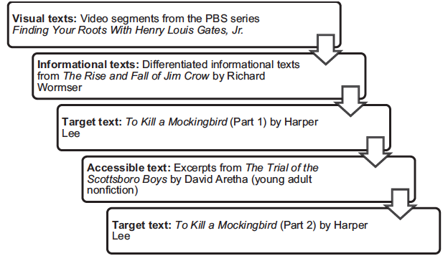
Lupo et al. - “Quad Text Sets” Example Target Text: To Kill a Mockingbird
Various people’s childhood experiences growing up under Jim Crow laws. Compare/Contrast Viewing Guide
Homogenous groups
Differentiated texts
Synthesis of Articles: Great Depression, KKK
YA novel: Reciprocal Teaching
Discussion: Courage
Peer-assisted learning (Fuchs et al. 2000)
Notice & Note Reading Guide
Notes:
Jim Crow laws were state and local laws that enforced racial segregation in the Southern United States. All were enacted in the late 19th and early 20th centuries by white Democratic-dominated state legislatures after the Reconstruction period. The laws were enforced until 1965.
Reciprocal teaching refers to an instructional activity in which students become the teacher in small group reading sessions. Teachers model, then help students learn to guide group discussions using four strategies: summarizing, question generating, clarifying, and predicting.

Slide 12
Quad Text Set in Social Studies
Notes:
Social Studies – sourcing, contextualizing, challenges of primary source documents

Slide 13
Quad Text Set in Science
Notes:
As we developed quad text sets for science, we considered disciplinary literacy practices related to scientific inquiry (Lee, Quinn, & Valdés, 2013).
constructing explanations and designing, solutions, engaging in evidence-based argument, and obtaining, evaluating, and communicating information.

Slide 14
Hartman & Hartman (1994): Alternatives to Single Texts…
Companion Texts (e.g. a series or collection of books)
Complementary Texts (exploring a similar topic or theme)
Synoptic Texts (exploring different versions or accounts of the same story)
Conflicting Texts (alternative perspectives on the same theme or issue – e.g. SS)
Focus on providing students with the chance to look “across texts” to build general and disciplinary knowledge.

Slide 15
From the local BC Curriculum – Social Studies 9: The Boer War
INFORMATION TEXT: Canadian War Museum
ACCESSIBLE TEXT: Letters and poetry
CONFLITING TEXT: Concentration Camps in the South African War: Here are the Real Facts
VISUAL TEXT: Photos, U Tube videos
http://theconversation.com/concentration-camps-in-the-south-african-war-here-are-the-real-facts-112006
Notes:
http://theconversation.com/concentration-camps-in-the-south-african-war-here-are-the-real-facts-112006

Slide 16
Teacher Feedback on Quad Text Sets…
Positives…
Students build relevant content knowledge and identify themes
Increased reading time in class
Students are more motivated to read challenging texts
Challenges…
Difficulty finding easier texts for adolescent readers
Time consuming to put together the text sets - collaboration recommended!
Resources online: http://comprehensivereadingsolutions.com/2013/12/17/quad-text-sets/

Slide 17
Your turn! (Building a Text Set)
TARGET/ANCHOR TEXT
INFORMATION TEXT
VISUAL TEXT
ACCESSIBLE TEXT
CONFLITING TEXT
In a group of 2-3 teachers, choose a topic (curricular content) from your discipline. Design a disciplinary text set
Choose a target or anchor text and at least one information text, one visual text, one accessible/engaging text and (possibly) one conflicting text.
Consider creating a one-pager or PPT slide and indicate pre, during, and after reading routines you might consider. Think about the literacy practices of your discipline!
After 20 minutes, we’ll have a few groups volunteer to share their texts with the class.

Slide 18
TEXT SETS

Slide 19
Assignment 2
Peer Teaching with Graphic Organizer

Slide 20
Section 921
Group A
Jackie and Jay
Jovana and Makaela
Jeff and Nan
Group D
Alexa-Rae and Bethany
Amanda and Sophia
Hannah and Jingyi
Remember your partner and group letter.
Group B
James and Victor
Nicole and Jana
Dena and Puneeta
Group E
Tim and Janessa
Grant and Rhea
Kesley and Meno
Group C
Jake and Pip
Lauren and Amy
Will and Paul
Group F
Lindsay and Sarah
Rob and Shuqi
Devon and Kristen
Notes:
36/6 = 6/group 921
30/6 = 5/group 928

Slide 21
Section 928
Group A
Martin and Leo
Simran and Gregg
Owen
Group D
Sara and Kim
April and Chloé
Jose and Tom
Remember your partner and group letter.
Group B
Marie-Josée and Jenna
Dorothy and Geetika
Sean M. and Mark and
Group E
Sean C and Lauren
Anthony and Shane
Luc and Priya
Group C
Cassandra and Dean
Jordan and Ben
Zac and Carly
Notes:
36/6 = 6/group 921
30/6 = 5/group 928

Slide 22
Partner Work on Assignment 2
You will meet with your partner and devote 15 mins. per person to go over each other’s graphic organizers
You will prepare to talk the other four people through the concepts and get them to fill out the graphic organizers → Bring 4 copies to class on Friday!
In the last 1.5 hours of next class (Friday)…
You will meet in your group, e.g., Jason/Daniela, Karen T./Rosilyn, Brian/Anna
Jason teaches Daniela’s lesson, gets feedback from the other 4
Daniela teaches Jason’s lesson, gets feedback from the other 4
Karen T. teaches Rosilyn’s lesson, gets feedback from the other 4
Etc. → 10-min. lessons; 5-min. feedback writing

Slide 23
Please provide feedback on these 4 criteria:
Organization: Information is presented in a logical and interesting sequence which the audience can follow
Subject knowledge: Presenter demonstrates full knowledge (more than required) by answering all questions with explanation and elaborations
Graphics: Explain and reinforce text and presentation
Speech: Presenter uses a clear voice and correct/precise pronunciation of terms so that all audience members can hear presentation

