Slide 1
LLED 361
Friday May 24 2019
Dr. J. Robertson

Slide 2
Text sets can also be used to teach social justice.
Batchelor, K. E. (2019). Using linked text sets to promote advocacy and agency through a critical lens. Journal of Adolescent & Adult Literacy, 62(4), 379-386.

Slide 3
The need for critical self-reflection on your own text sets
We all teach diverse students in terms of race, class, gender, language, sexuality, and ability
According to Batchelor (2018), the biases that reflect your background are often apparent in your contributions to text sets.
Batchelor asked 3 pre-service teachers to examine their own text sets of social justice issues and ask, “What am I leaving out?”
  #BlackLivesMatter
  Rape Culture
  Mental Health Awareness

Slide 4
Social justice text sets are a bit different from disciplinary text sets
There is often one academic “anchor text” that all students read, and perhaps a few supporting texts chosen by the teacher
However, for other texts, students find their own texts relevant to the topic, and present their chosen readings to each other
The teachers examined what was missing from their own text sets, which reflect individual biases—or from typical text sets on their chosen topic, which reflect societal biases.

Slide 5
The teacher whose text set was about #BlackLivesMatter found…
“The stories of many black women (specifically, black trans women) and girls are often ignored by mainstream media, as well as members of the LGBTQ and disabled communities.”
In her text set, the teacher added “voices often underrepresented when talking about the Civil Rights movement, such as Claudette Colvin. Her story about how she refused to give up her seat before Rosa Parks is told in the book Claudette Colvin: Twice Toward Justice by Phillip Hoose (2009).”

Slide 6
The teacher whose text set was about rape culture found…
“The majority of the protagonists and authors are white, middle class, heterosexual females centered on Western culture.”
She made sure to include more perspectives into her linked text set, such as “the male perspective, both as the victim of rape and the perpetrator as well as perspectives from other cultures and countries.”
The teacher also noticed that “most of the young adult literature centers the rape event during a party or ‘during a moment where the character is drinking alcohol.’” She said, “I think it’s important to include stories and perspectives from voices that fall outside of these supposed moments when rape is most likely to happen.”

Slide 7
The teacher whose text set was about mental health found…
“The majority of her texts center on female characters who are white, middle/upper class individuals.”
She especially noted how there is a lack of sexual orientation diversity in her characters.
She said, “After examining my [linked text set] from a broader lens, I am able to see more clearly that not all of the texts are relatable for all of my future students. I need to add more variety, more depth in demographics.”

Slide 8
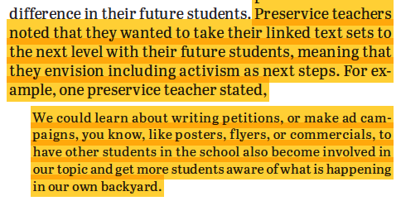
From text sets to social activism

Slide 9
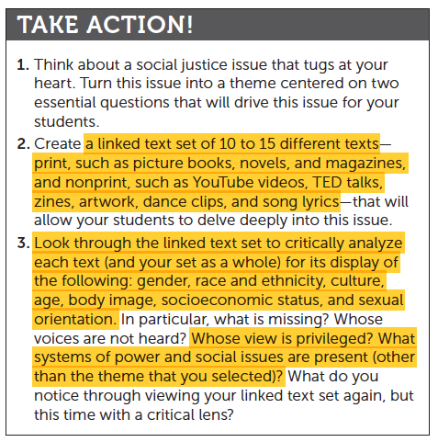
“Although some topics may be considered too controversial to teach, educators can position themselves by providing a list of high-quality, award-winning texts” (Batchelor, 2018, p. 385).

