Slide 1
Three primary colors
By shuqi

Slide 2
RGB color &CMYK color

Slide 3
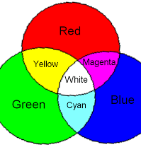
Color Math
Red +Green = Yellow
Green +Blue =Cyan
Red +Blue =Magenta
Yellow + Magenta=Red
Yellow + Cyan=Green
Magenta + Cyan=Blue

Slide 4
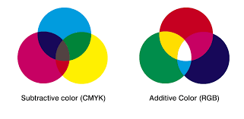
Subtraction
The sum of RGB=The sum of CMY
Red-Cyan=?
Blue-Cyan=?

Slide 5
How to change the lake color to green?

Slide 6
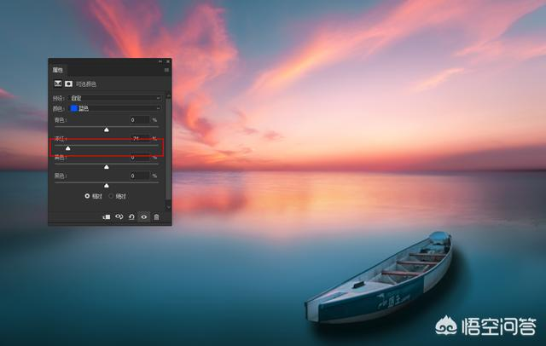
Green=Yellow +Cyan
Blue=Cyan + Magenta

Slide 7
Thank you

