Slide 1
LLED 361 - Critical Memetic Literacy
Educational Memes for Dummies
Geetika Bhasin, Sean McCulley, Jose Nihira, Dorothy Yan

Slide 2
Background
Notes:
Geetika
Introduce all of us
Etymology
Research article context - these researchers, providing recommendations to use memes in the classroom BUT USING CRITICAL MEMETIC LITERACY? -- intro to next slide...

Slide 3
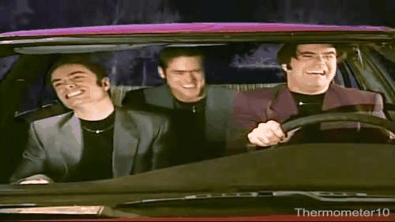
What is Critical Memetic Literacy? (Baby don’t hurt me)
Notes:
Geetika
What do we ‘meme’ ? :D hehe
Application of the process

Slide 4
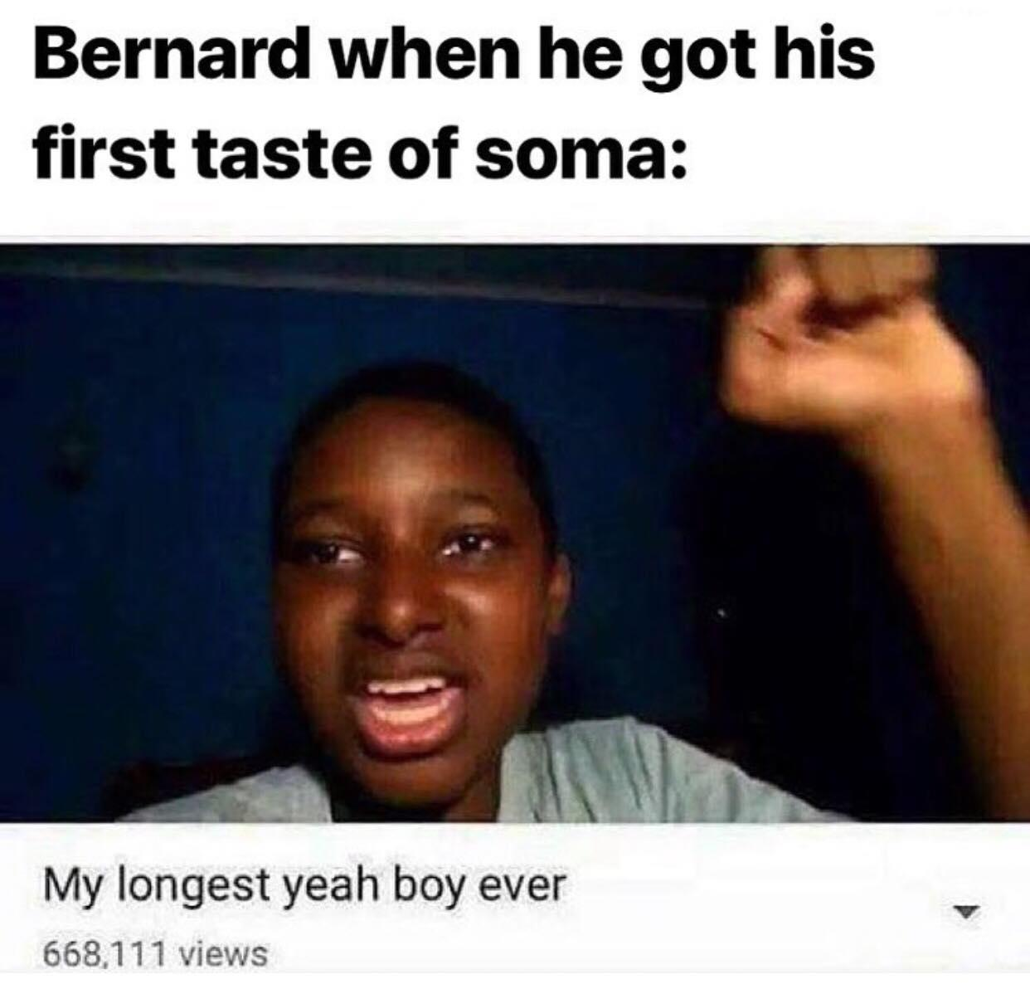
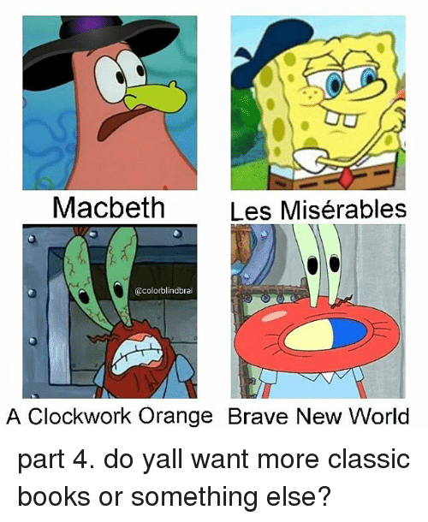
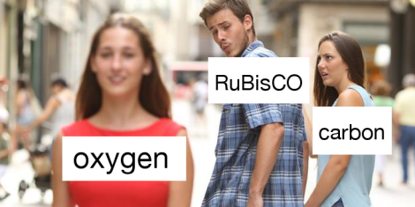
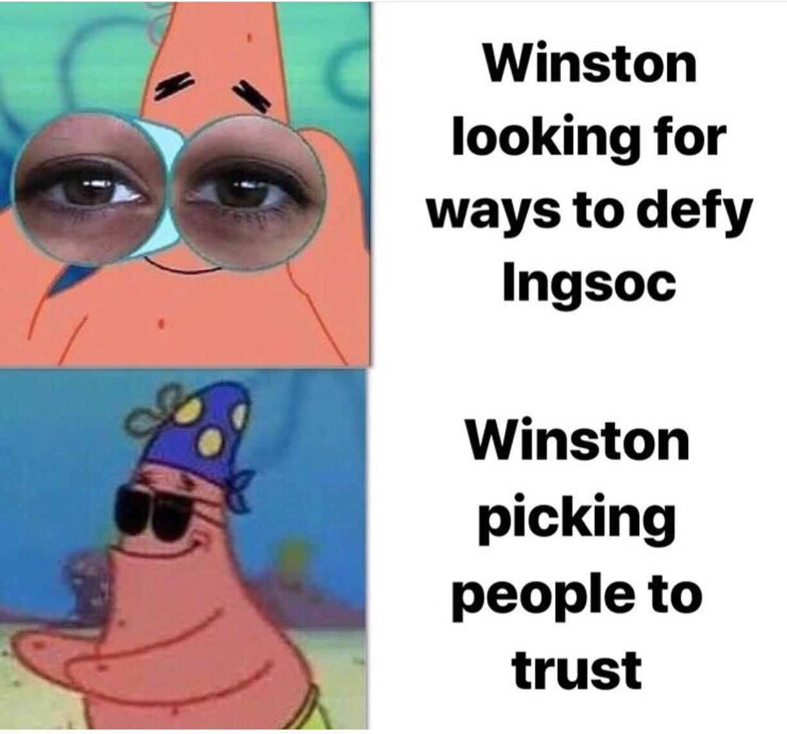
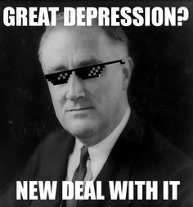
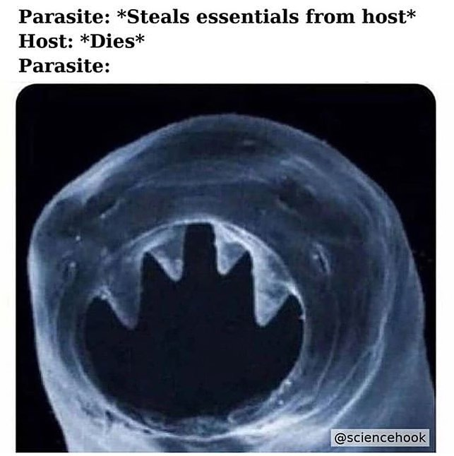
Where do we see memes?

Slide 5
Types of memes
Image macros
Exploitables
Memetic videos
Notes:
Jose
3 types- IEM

Slide 6
Image macros
Notes:
Jose
Images with text superimposed on top
Main image with text on top and along the bottom
Text on top= joke
Text on bottom=punchlines
Very templateable
When people hear of meme they usually associate with this

Slide 7
Exploitables
Notes:
Jose
Also uses images
Images that are added onto other images (using photoshop, etc.) to create a different meaning

Slide 8
Memetic videos
Notes:
Jose
Basically they are parodies of original videos
Not static
Often confused with the term ‘viral’ ← what does this mean?
All memetic videos are viral; not all viral videos are memetic
Memetic- invites users to change it up and make it their own
Viral- if it has a lot of views and is shared a lot
We will show you an example of a memetic video at the end

Slide 9
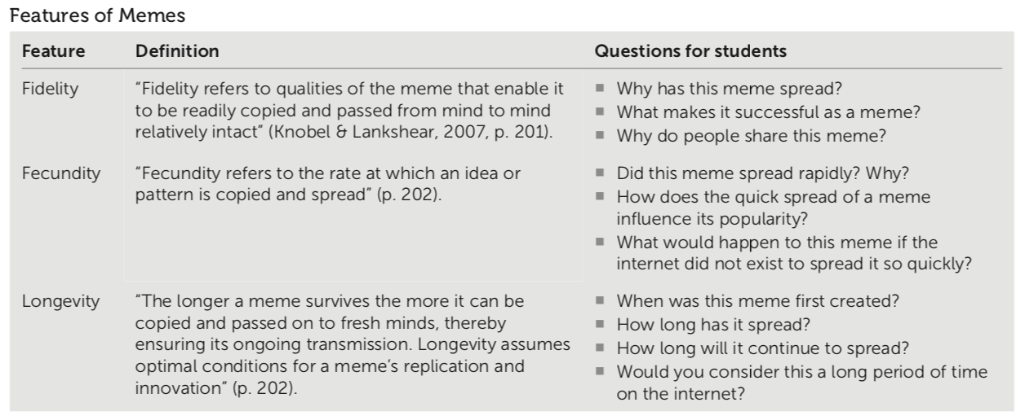
Features of memes
Notes:
Dorothy

Slide 10
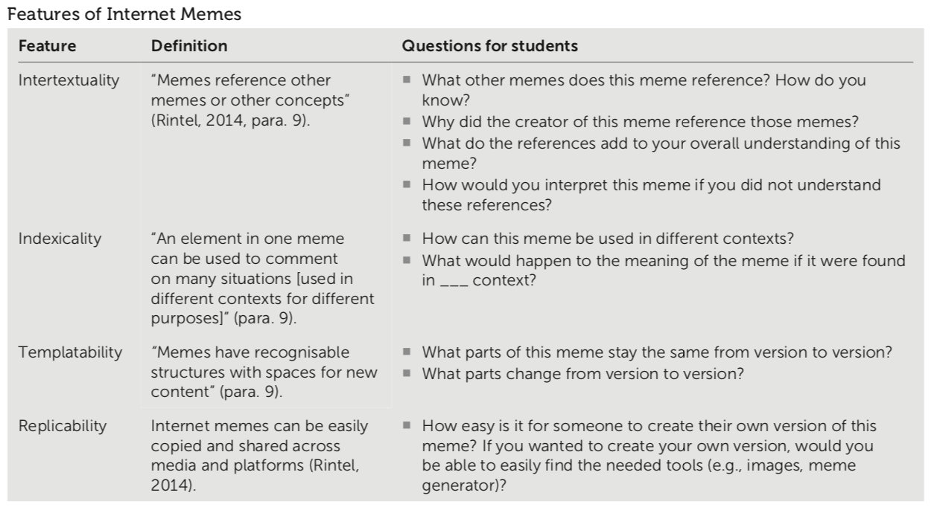
Features of Internet memes
Notes:
Dorothy

Slide 11
Make your own meme!
Find people in the same subject area
Go to https://imgflip.com/memegenerator
Think of a meme using the topic “teaching”
Be ready to present your meme!
Guiding questions:
What does this meme represent in the context of your discipline?
How would you interpret this meme if you didn’t understand the reference?
https://padlet.com/dorothydyan/memes
Notes:
Sean
Give Ss 5 mins to make the meme

Slide 12
Key Media Example
https://www.youtube.com/watch?v=dQw4w9WgXcQ
Notes:
Sean

