Slide 1
LLED 361
Group 4B
Jenessa, Kelsey, Meno, Tim

Slide 2
#MemesintheClassroom
Harvey, L. & Palese, E. (2018). #Neverthelessmemespersisted: Building critical mimetic literacy in the classroom. Journal of Adolescent and Adult Literacy, 62(3), 259-270.

Slide 3
Memes?

Slide 4
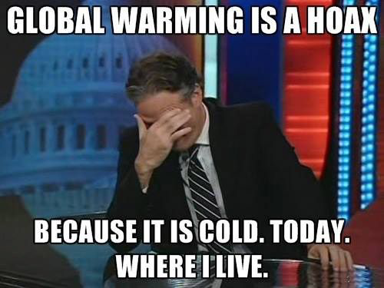
Relevance of Memes
Convey complex ideas in a short phrase or image
Connect people through the expression of identity and ideas
Phenomenons that are quickly spread, adapted, shared and critiqued
Make people think about connections between what they are reading/seeing and what is going on in the world

Slide 5
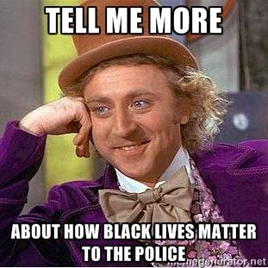
Building Memetic Literacy
Understanding memes and how they work
Questioning! Break down the social factors that influence how memes are made and spread
Not Just Images: Transferrable and adaptable pieces of cultural information that have influence

Slide 6
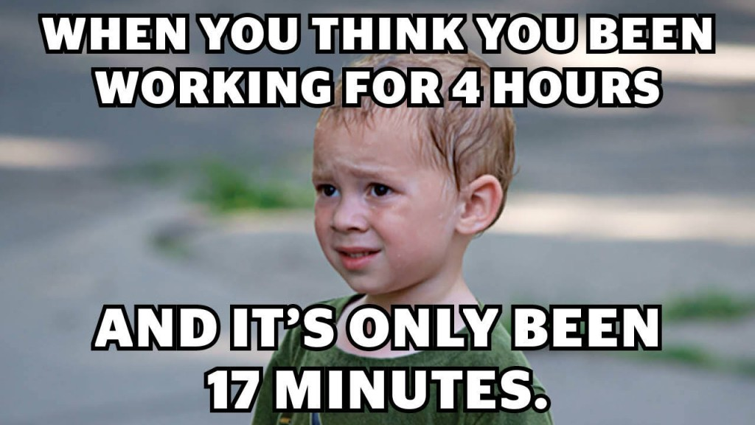
Type of Memes
Image Macro
An image with text placed over top of it.
Exploitable
A portion of an image cropped to fit within another image, creating an entirely new visual meaning.
Memetic Video
An original video that is made into a parody

Slide 8
Features of Memes
Fidelity: Qualities of the meme
What makes it so successful as a meme?
Why do people spread the meme?
Fecundity: Rate of a meme that is spread or copied
How does the speed of the meme being spread influence popularity?
Longevity: The optimal survival of a meme
How long since the meme has been created and spread?
How long will it continue to spread?

Slide 9
Features of Internet Memes
Intertextuality: The memes that reference other memes
“What other memes does this meme reference? What do the references add to your overall understanding of this meme?”
Indexicality: A meme element that can be used in other contexts.
“What would happen to the meaning of the meme if it were found in ______ context?”
Templatability: The structuring of memes
“What parts of this meme stay the same from version to version?” What changes?
Replicability: The level of replication for memes across media and other platforms.
“How easy is it for someone to create their own version of this meme?”

Slide 10
Internet Memes Importance
Community
Allows for opportunity of to participate in communities, uniting people through group membership and identity
Fight against injustices
Politics
Spark debates in online community, build social movements
Sharing preferences, critiques and/or praise
Advocate or show disapproval for certain causes

Slide 11
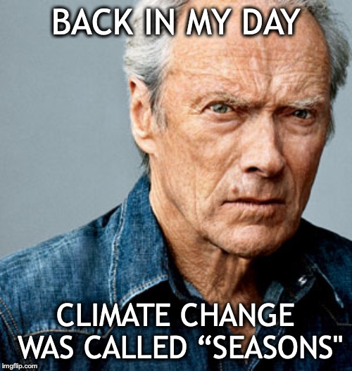
Meme Analysis
-Let’s apply the characteristics that from the previous slides to define/describe a meme.
-Remember, consider the image, text if any, references, etc.

Slide 12
Meme Analysis
Text:
Is this a meme? How do you know? What makes it memetic?
Is it macro, exploitable or a memetic video? How do you know?
Have you seen it before? Where & When? How was it used?
Audience
Who is pictured?
Purpose
What reaction would people have? Why?

Slide 13
Meme Analysis
-Fill in the blank!
-Which words automatically come to mind when seeing this image? In terms of its meme usage.

Slide 14
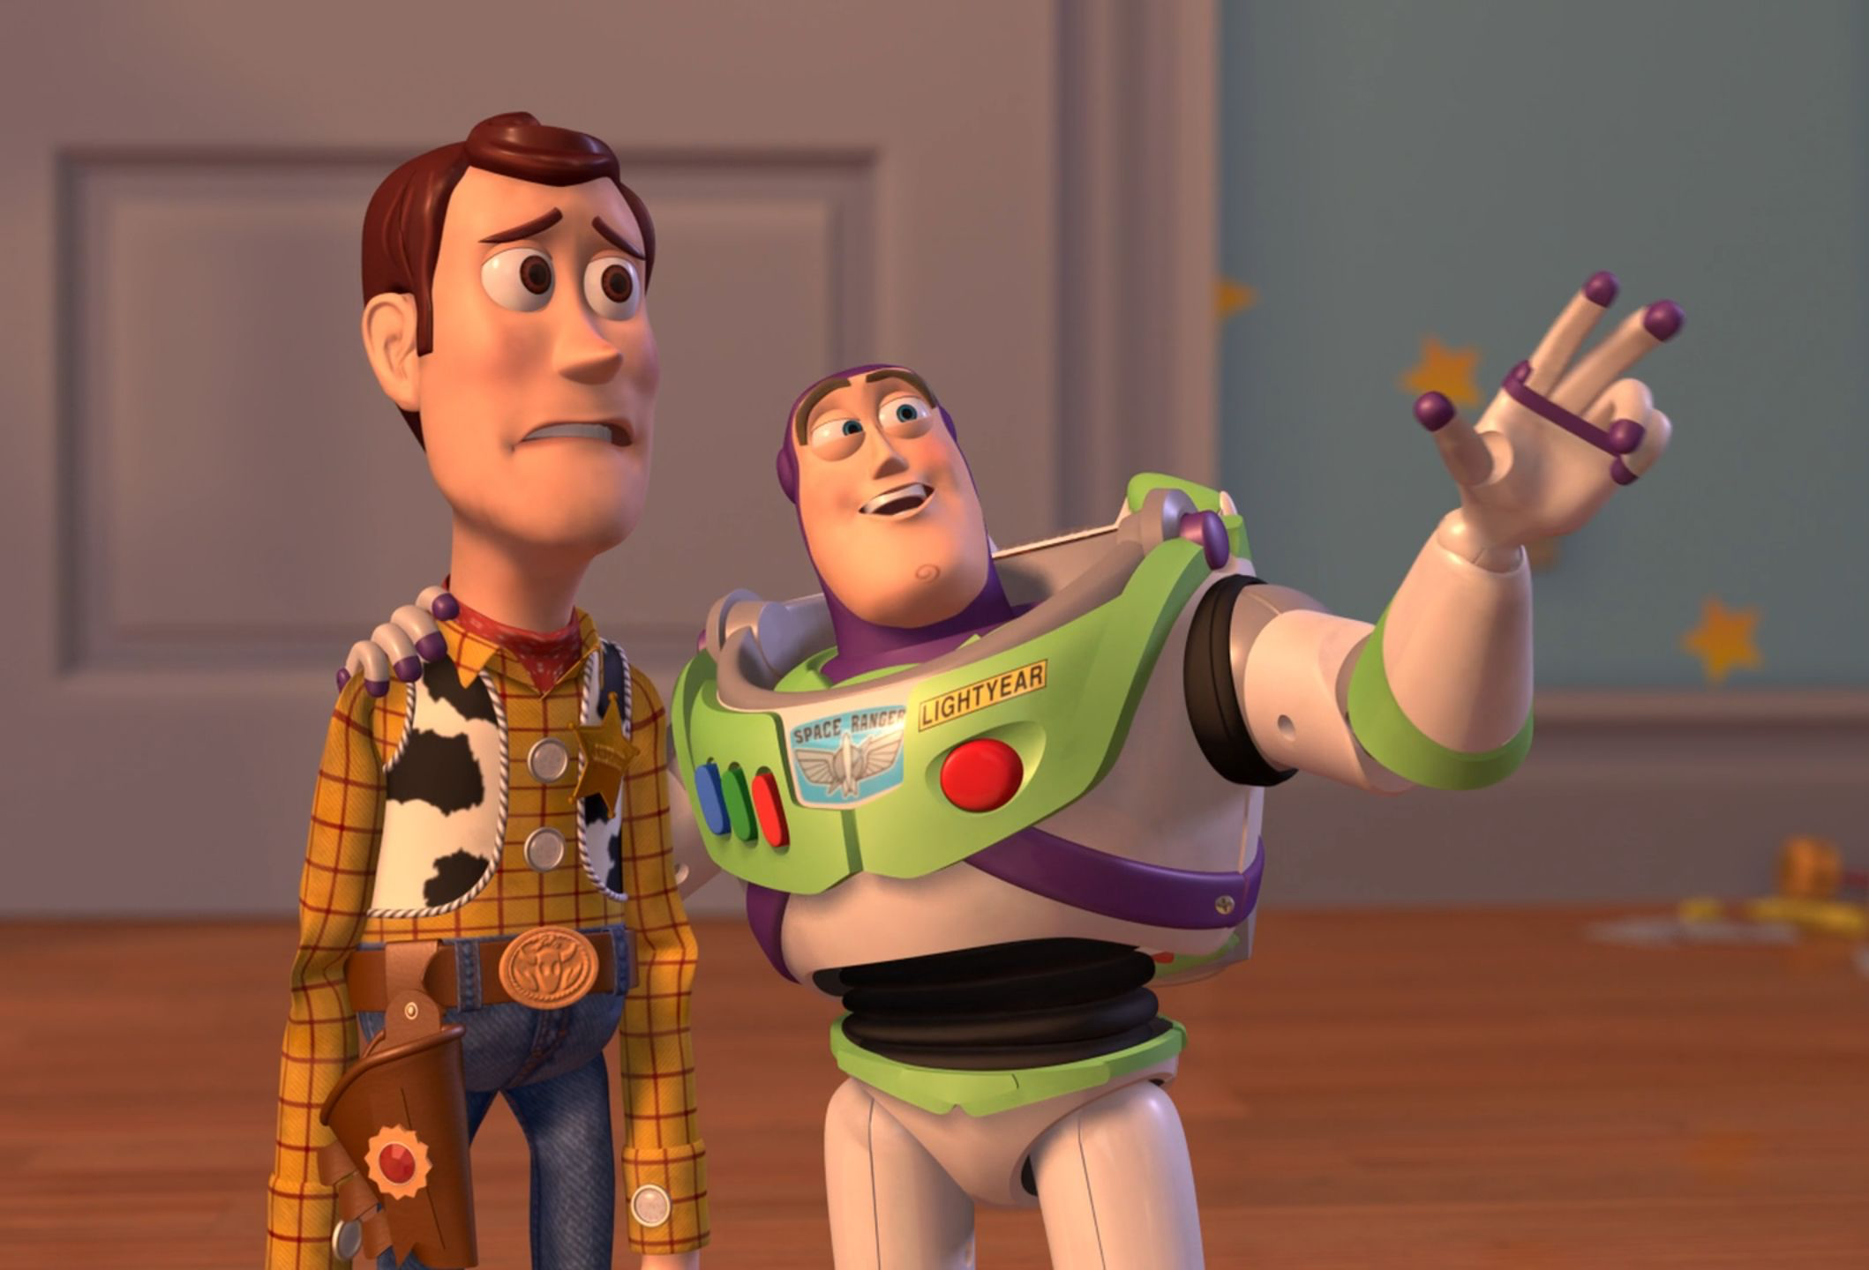
Activity Time!!!

Slide 15
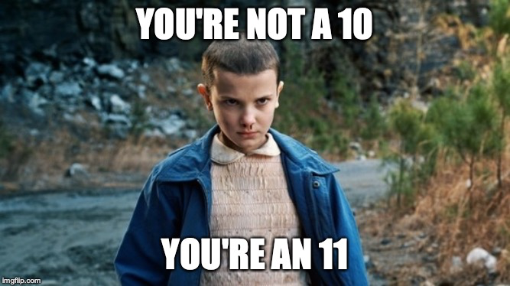
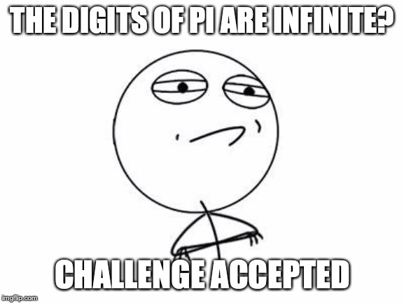
Discussion:
Because memes rely heavily on cultural familiarity, how do we address students who are new to Canada or unfamiliar with North American culture?
Can you think of ways you can incorporate memes in your classroom?
Can we foresee any issues or problems with using memes in the classroom?

Slide 16
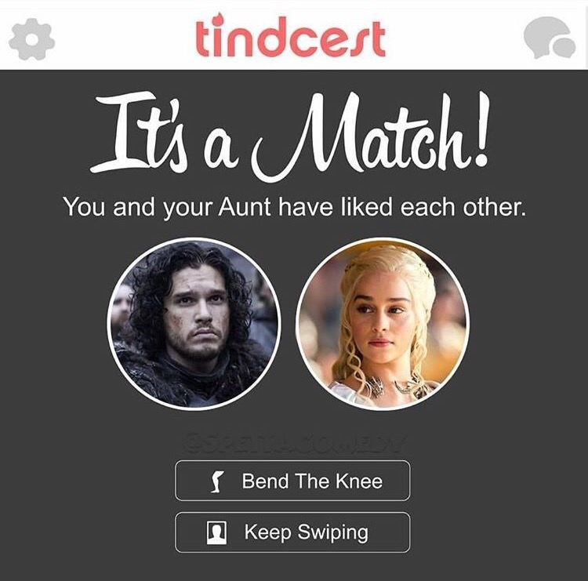
Considerations
Possible Roadblocks
Considering student’s background knowledge and cultural familiarity
However…
Can be an engaging opportunity to spark discussion for cultural awareness
Also builds upon existing language learning

