Slide 1
A PLANNING FRAMEWORK FOR INTEGRATING DIGITAL LITERACIES FOR DISCIPLINARY LEARNING
Jill Castek & Michael Manderino (2017)
Jordan H, Carly S, Ben K, Dean S

Slide 2
Table Discussion...
What does it mean to be digitally literate?
Ability to find, evaluate, and compose clear information through writing and other mediums (video, graphic, etc)
2. Based on your practicum experience, how would you generalize the digital literacy of your students?
Notes:
Before we begin, we are curious hear a bit about your own experience with digital literacy.

Slide 3
A changing landscape...
Media consumption patterns have shifted dramatically
Traditional forms of knowledge are increasingly obsolete
The onus for validation of knowledge is increasingly in the hands of the consumer
Research suggests that students (and teachers) are unequipped for this

Slide 4
A Framework for Digital Literacy
In the classroom, digital media is increasingly relevant
However, task of using these sources responsibly is daunting
Castek & Manderino (2017) offer a 3-point framework for educators develop critical digital literacy

Slide 5
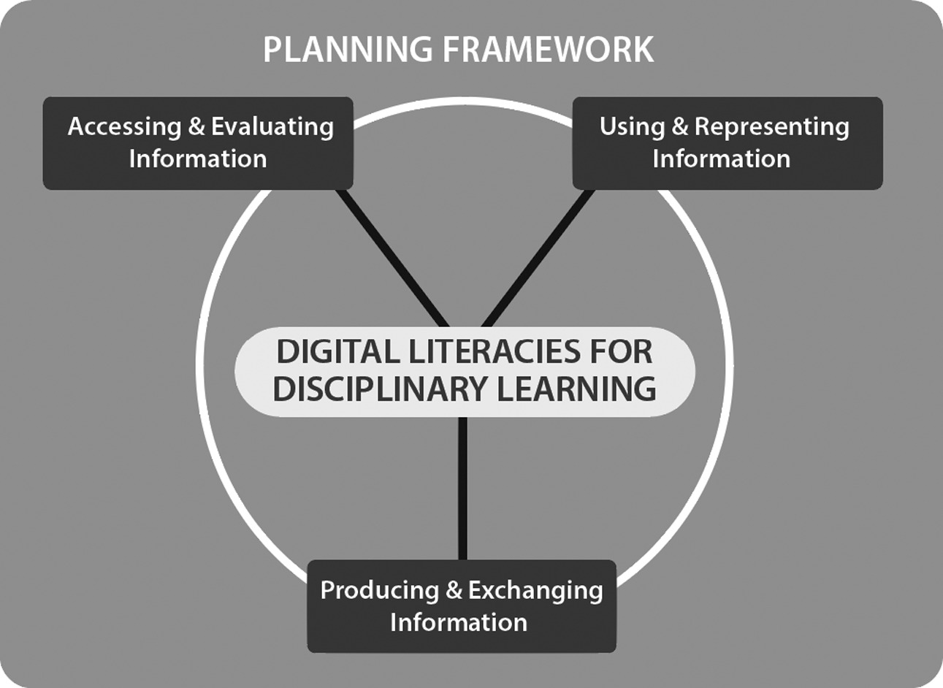
Notes:
Not hierarchical, but three separate entry points

Slide 6
Plan Opportunities to Teach Students How to Access and Evaluate Information
Involves locating quality resources.
Evaluation must happen in conjunction with accessing relevant information, having background knowledge in the given discipline is key.
Involves having students adopt a skeptical mindset and try to verify information through multiple sources/resources.

Slide 7
Plan opportunities to teach students to use & represent information

Slide 8
Each discipline values and privileges different types of texts for:
Communicating
Creating
Critiquing

Slide 9
To participate in the disciplines and use online information, one needs to read and engage with texts using the habits of thinking specific to the discipline
Example:
Historians using thinking skills such as sourcing a document for authorship & credibility

Slide 10
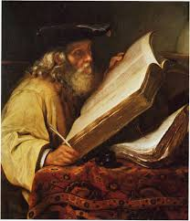
SECOND LAYER OF THINKING
ONE MUST EVALUATE THE HOSTING SITE AND THEIR IDEOLOGICAL, POLITICAL & HISTORICAL VIEWS

Slide 11
Instructional tasks must expand opportunities to create representations that reflect the complexities within the discipline

Slide 12
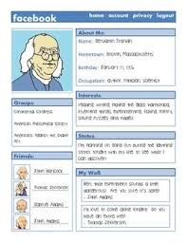
Facebook profile example:
Students to develop a historical profile using online sources requires:
Critical thinking
Refined searching skills
Deep reflection on historical context

Slide 13
Plan Opportunities to Teach Students How to Produce and Exchange Information

Slide 14
The digital age has amplified the ability to produce many kinds of disciplinary texts using a multitude of representational possibilities, such as:
Videos
Blogs
Podcasts
Info-Graphics

Slide 15
Additionally, digital platforms make exchanging disciplinary texts instantaneous and relatively simple. Audiences can be reached quickly, and texts can be shared and remixed as well.
Example:
Inquiry project where students swap projects part way and provide feedback for each other moving forward.

Slide 16
Teachers Must Adapt Their Digital Practice
As the role of texts and the ways students can exchange them evolves, teaching practices must keep pace. Student collaboration can be shaped by the habits of practice of the discipline.
As the habits of practice within disciplines shift with changing digital practices, so do opportunities to engage students in disciplinary practices that harness digital texts and practices.

Slide 17
Teachers Must Find Ways to Share Student Work Digitally
Although teachers value the role of blogging, only 40% of AP and National Writing Project teachers have had students share their work on blogs, wikis, or websites.
Less than 29% have had their students revise and edit one another’s work.

Slide 18
Group Activity
As a group, post the following to our class blog:
List 5 technologies you have used or would use in your subject area
Come up with lesson idea/activity that incorporates technology/digital media

Slide 19
https://sheg.stanford.edu/civic-online-reasoning
Notes:
Through Poynter Org.

Slide 20
https://www.youtube.com/watch?v=L4aNmdL3Hr0&t=16s

Slide 21
Reality Check: The Game
http://mediasmarts.ca/digital-media-literacy/educational-games/reality-check-game

