Slide 1
Languages and Literacies in the Classroom
• Importance of Fluency to Secondary Language Learning
• Concept of Multiple Literacies Across the Curriculum
MULTILITERACIES GROUP
Nikky, Jemma, Matthew,Michael,Syuku LLED 361

Slide 2
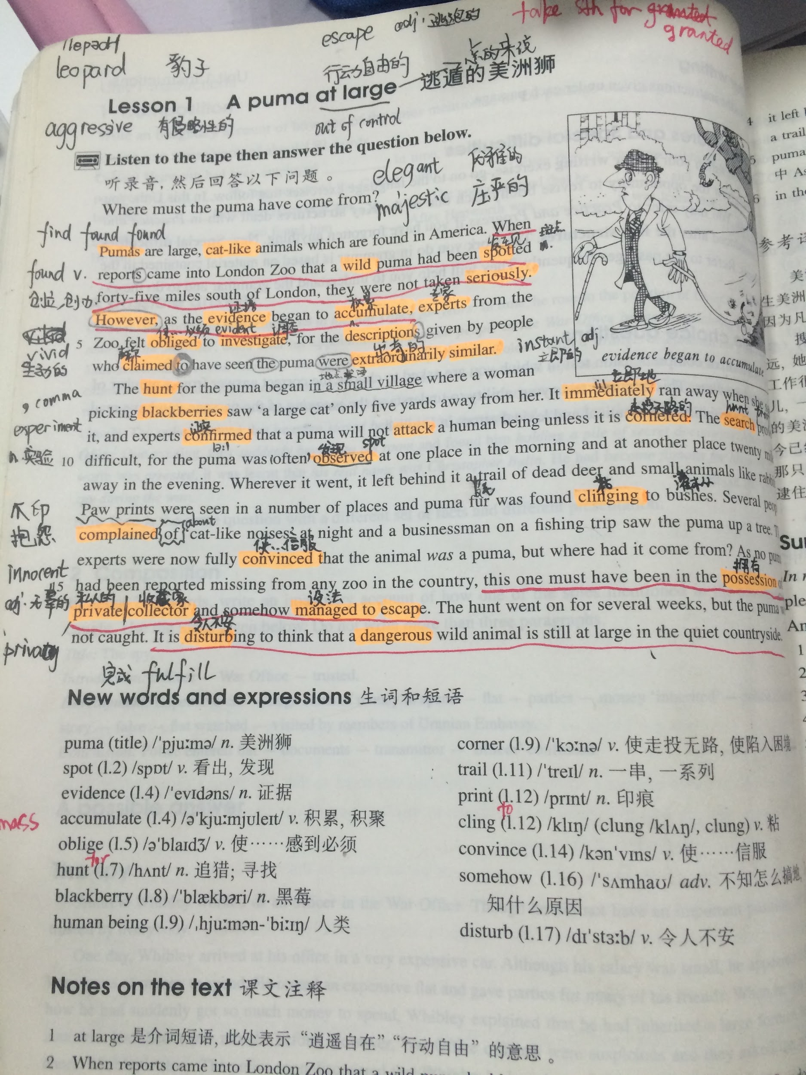
ESL student in different class
“To become fully integrated into the mainstream curriculum,these newcomers must learn to adapt to the linguistic,social cultural,discursive, and academic norms and practices in content areas,and various kind of accommodation on the part of the school community are also required”.

Slide 3
stRuggle continues….
A further challenge to learn about topics which are newly emerging such as history, social studies, french as a second language- students are expected to learn these topics and understand from different perspectives, often asked to reflect and do critical thinking of ongoing issue based on the topic. ( are they suppose to reflect on themself and try to know what they need/ want or reflect on these topics at that point?)

Slide 4
Finally, Educators (we as TEACHER): “ must become more aware of the complexities of language,content, and cognition in particular disciplines, and in the comprehension, critical analysis, and production of texts”.

