Slide 1
Multi-literacies and Multi-Genre Learning
Katie, Gladis, Yijia, Etel, Jeremy & Calvin

Slide 2
Reading #1
In this article Benjamin B. Dzeiedzic tries to explain how to understand books from films. The film is the directors’ artistic vision or interpretation of a novel.
There are various ways to interpret literature: analytical essay, base a play from a book, and as Dzeiedzic states film may be another method of interpretation.
So, how can his students read films effectively?
His class needs to know the language of film, then a framework for analysis.
Language of cinematic techniques are some of the terms used in the film industry such as the varieties of camera angles (low, high, eye-level); the kinds of shots (close-up, medium, long); some basic camera movements (panning, crane shots, hand-held); as well as concepts such as editing, special effects, sound effects.

Slide 3
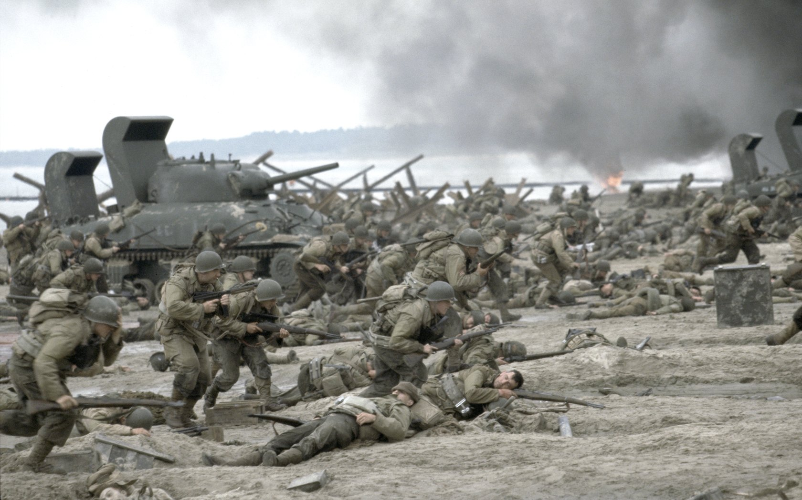
Reading #1
The framework has three elements:
Literary elements of film. Such as theme, dialogue, symbolism.
Dramatic elements of film such as costume and acting.
Cinematic elements of film such as editing, sound, special effects, camera work.
With this framework, his students watched a few films and wrote their reading of the films.

Slide 4
Reading #1
Step One: Close Readings of the film
Students watched a DVD at home and gave an oral presentation and interpretation of one scene in the film. Using the framework, they analyzed the scene effectively.
Step Two: Writing the Close Reading
The students wrote what they presented, with supporting details from the film. They used the framework of literary, dramatic, and cinematic techniques as a tool to enable their analysis.
Step Three: Making Connections
The students put together their readings into an opinion of whether the film differs from the book and if the directors changes make sense. Are the changes a natural interpretation of the book?

Slide 5
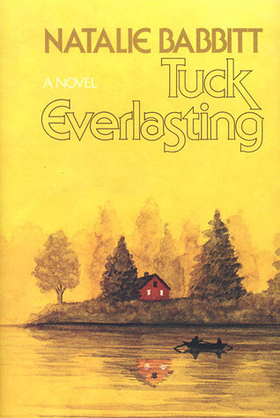
Let’s Watch a Book…
https://www.youtube.com/watch?v=hJ4VvxCunz4
K

Slide 6
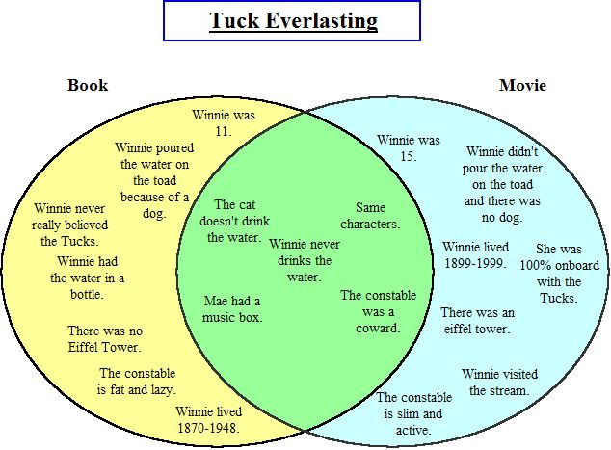
The
Comparison...
K

Slide 7
http://www.readwritethink.org/classroom-resources/lesson-plans/cover-cover-comparing-books-1098.html?tab=1#tabs
Comparing
Books to Movies
K

Slide 8
Reading #1
Writing across Genres: “multigenre content of the course [is] reinforced by multigenre writing assignments” (eg. Analytical essay, persuasive rejoinders, screenplay writing and film reviews)
- Persuasive Paper: vitriolic nature of the review incited the students to equally passionate responses that ranged from enthusiastic agreement to indignant critique.
- Screenplays: forced the students to make their own choices and led to a new respect for the difficulty of creative interpretation.
Format for writing a review:
1. A catchy introduction that hooks the reader's interest
2. A succinct summary that explains the main concerns of the film without giving away the ending
3. An analysis of the film's techniques (literary, dramatic, cinematic)
4. The reviewer's assessment of the overall success of the film
5. A conclusion that wraps up the reviewer's take on the movie

Slide 9
Reading #1 Cont’d
Author talks about the importance of photos, film and storytelling to the construction of memory and our own sense of identity.
“In writing, breaking out of ordinary models of interpretation and reinforcing the lesson that interpretation of art and the world in many different forms allow us to open our eyes to new thematic connections centering on memory and identity”.
Casting a wide net to gather texts across genres and media can provide an opportunity to examine ourselves and our world from a new perspective.
Notes:
The memories describe the curve of an elective, recalling a profound educational experience about the capacity of an idea to reveal itself through conversation and inquiry and proving the importance of giving a varied mix of students, as well as texts, the ability and opportunity to find their own path to meaning.

Slide 10
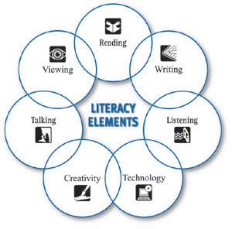
Which New Literacies?
Dialogue and Performance in Youth Writing

Slide 11
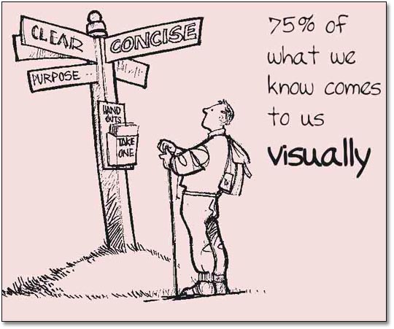
Global processes of urbanization and migration are reshaping needs, goals, and teaching in classrooms. Literacy is now routinely complemented by the terms multiliteracies: Awareness of the social, economic, and political forces enacted on curriculum; and the recognition of different modes of meaning making and communication (audio, visual, linguistic, spatial, performative, etc.

Slide 12
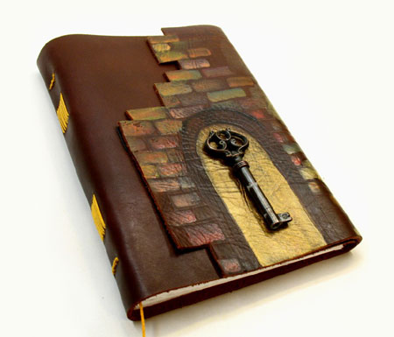
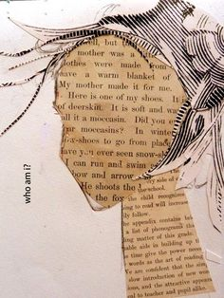
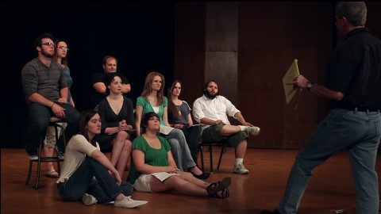
Mr. M prompt - Journal writing “Mister M, can we skip that part?” -The Play made me feel/think… -One performance that stood out for me was… -The style of the play was… because… -I think the lice metaphor was used because...
The play made me feel/think....

Slide 13
Where I am from poem
Students poster design George Ella Lyon http://www.georgeellalyon.com/where.html

Slide 14
Jeremy

Slide 15
Which New Literacies? Dialogue and Performance in Youth Writing
What was also clearly present in this example of the process of collective creation were the six different modes in the meaning-making process in multi-literacies pedagogy outlined by the New London Group (1996) and then by Kalantzis and Cope (2008): linguistic meaning, visual meaning, audio meaning, gestural meaning, spatial meaning, and the multi-modal intertextuality.
-The students used all forms of meaning to expresses their feelings about the closed or open door
-Students were told they had to vocally share a section of their writing, as well as act out how through visual, gestural and spatial meaning on a stage.
C.M

Slide 16
Activity Time!
For this activity each group will be given an idiom to depict through all literacies except linguistic.
GOAL: Get your other classmates to guess the idiom you were given
Examples of idioms: The devil is in the details, The early bird gets the worm, Break a leg
Each group will have two minutes to prepare a charade to depict their given idiom
The group members are allowed to make noises but words are not allowed.
You will have one minute of acting in front of the class to depict your idiom
C.M

