Slide 1
The Continuing Narrative
LLED 368
Dalyce, George, Leona, Naz

Slide 2
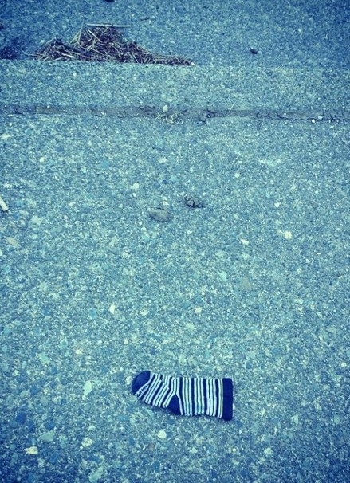
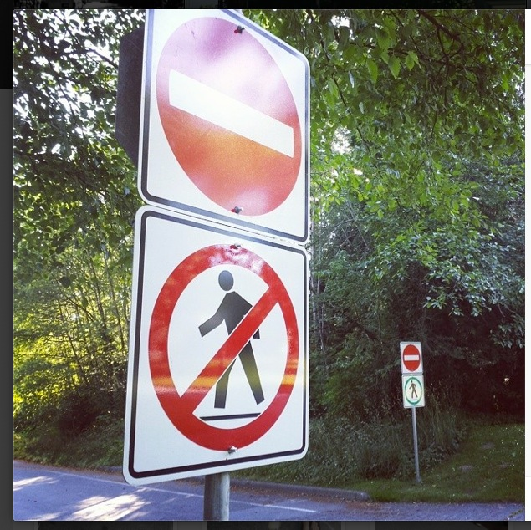

Slide 3
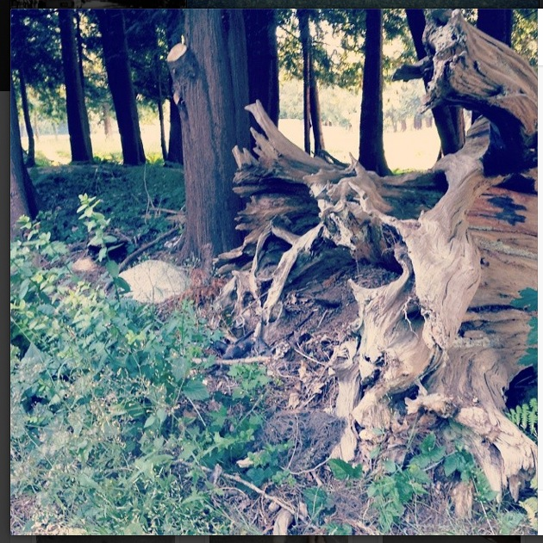

Slide 5
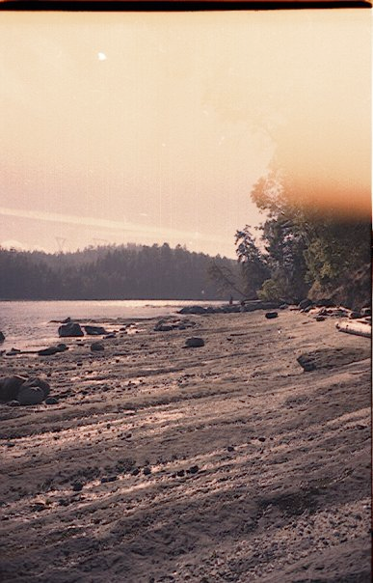
A walk on the beach is sometimes just a walk on the beach, nothing more and nothing less. Waves are waves, trees are trees, people are people. Though there are no people pictured here.

Slide 6
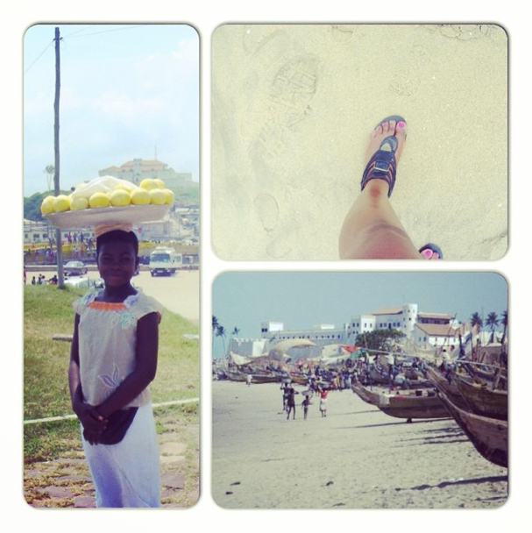
A walk is not just a walk. Intentions and purpose separate our footsteps. They become a fingerprint in the sand. Each print is unique to its owner and their thoughts. #instagramwisdom #takeawalkinmyshoes #ghana #eliminabeach #eliminacastle #history #tearsinthesandandwater

Slide 7
Questions?
Thoughts?

Slide 8
Thank You!
The tools we used:
Instagram: instagram.com/lgnd368
Tumblr: adapttheadapted.tumblr.com
iPhone: Film footage
Facebook: Interpersonal communication.
Google: Drive/Docs for the sharing of text and ideas.
Apple: Keynote

