Slide 1
https://www.23andme.com/en-ca/gen101/genes/

Slide 2
Genetics and MUTATIONS
Summary of 4.1
Central Dogma
Mutations – causes, effects

Slide 3
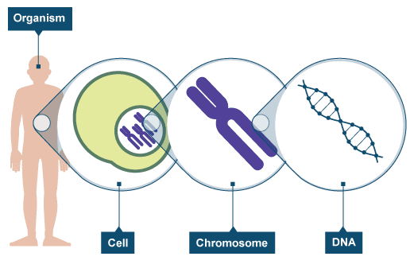
Nucleus as center of life
DNA containing information on cellular function
Organized into chromatin
Information travels outwards from the nucleus

Slide 4
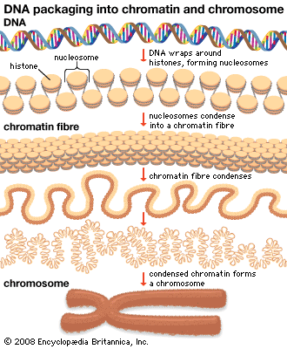
Relationship between DNA, chromatin, and chromosome
DNA: one molecule of double stranded deoxyribonucleic acid
Chromatin: DNA wrapped around proteins
Chromosome: condensed chromatin before cell divides

Slide 5
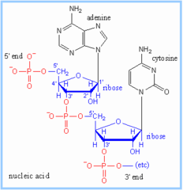
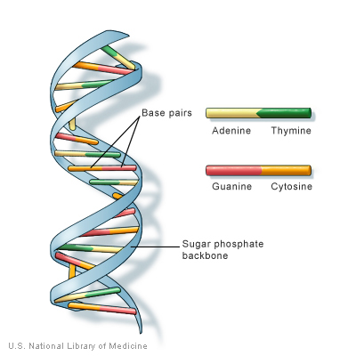
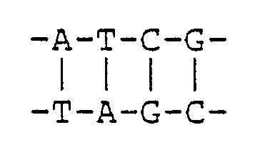
DNA
Sugar phosphate backbone
Bases: A, T, G, and C
Adenine, Thymine, Guanine, Cytosine

Slide 6
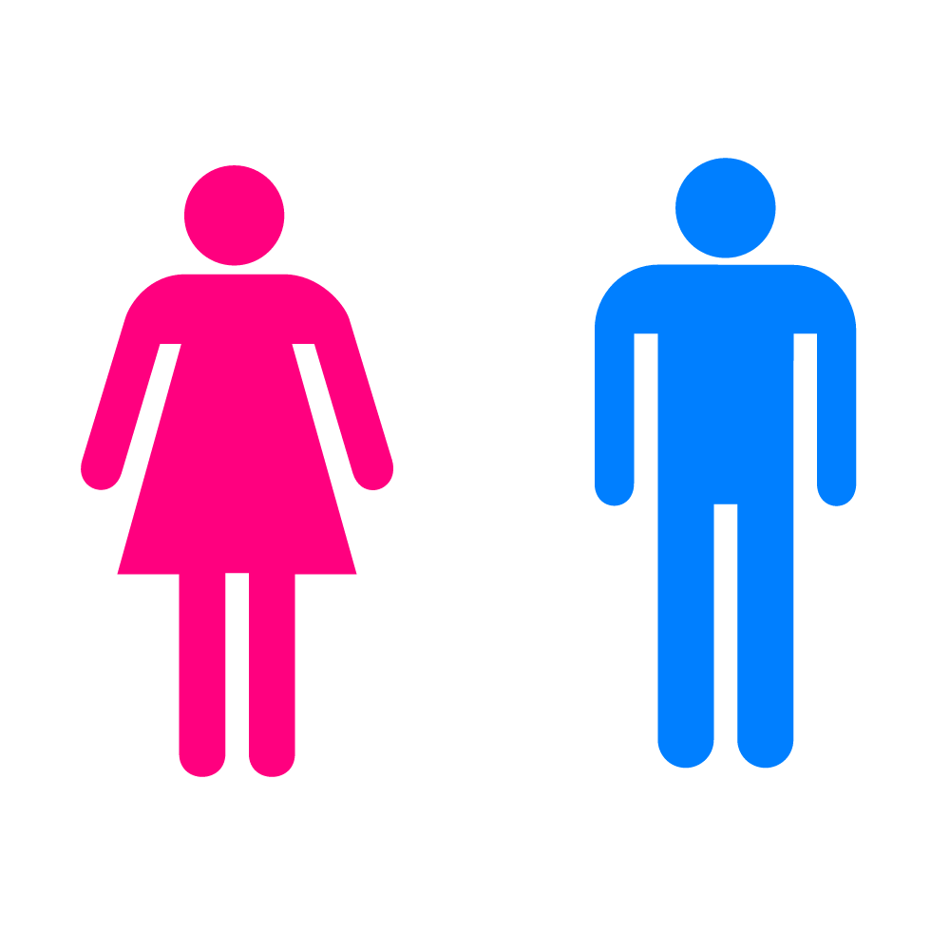
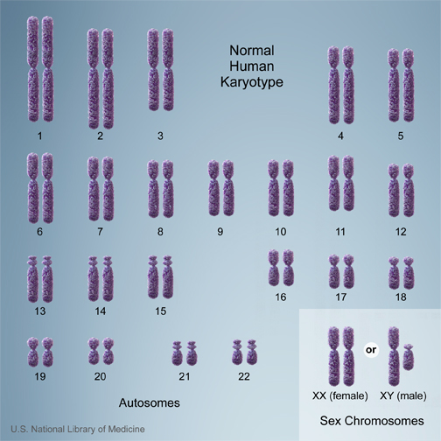
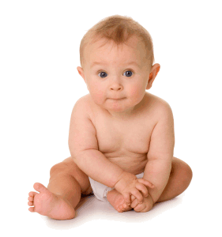
Chromosomes
Humans: 23 pairs of chromosomes, 46 chromosomes total
Chromosome number from 1-22, 23rd pair of chromosomes are sex chromosomes
Set of 23 chromosomes
Set of 23 chromosomes
= 46 chromsomes

Slide 7
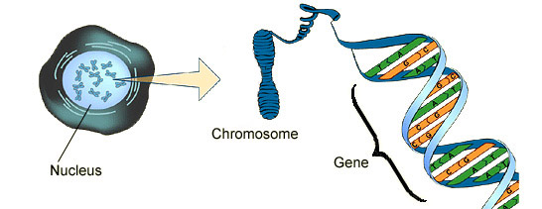
Where do genes fit in?
Segment of your chromosome
Sequence of DNA coding for a protein
The sequence is like a set of instructions to make this protein

Slide 8
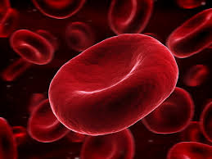
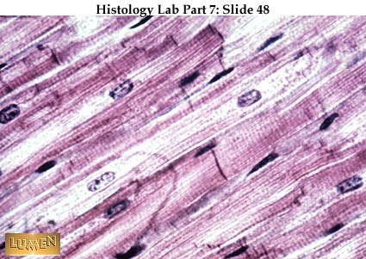
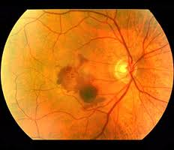
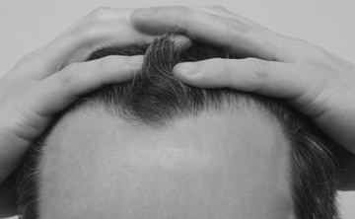
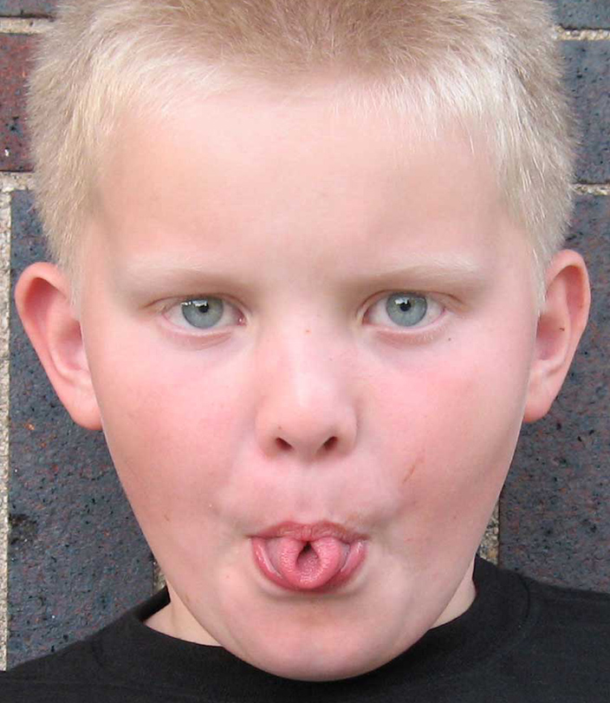
Genes -> Protein -> Trait/Function

Slide 9
Central Dogma
Nucleus
Flow of information

Slide 10
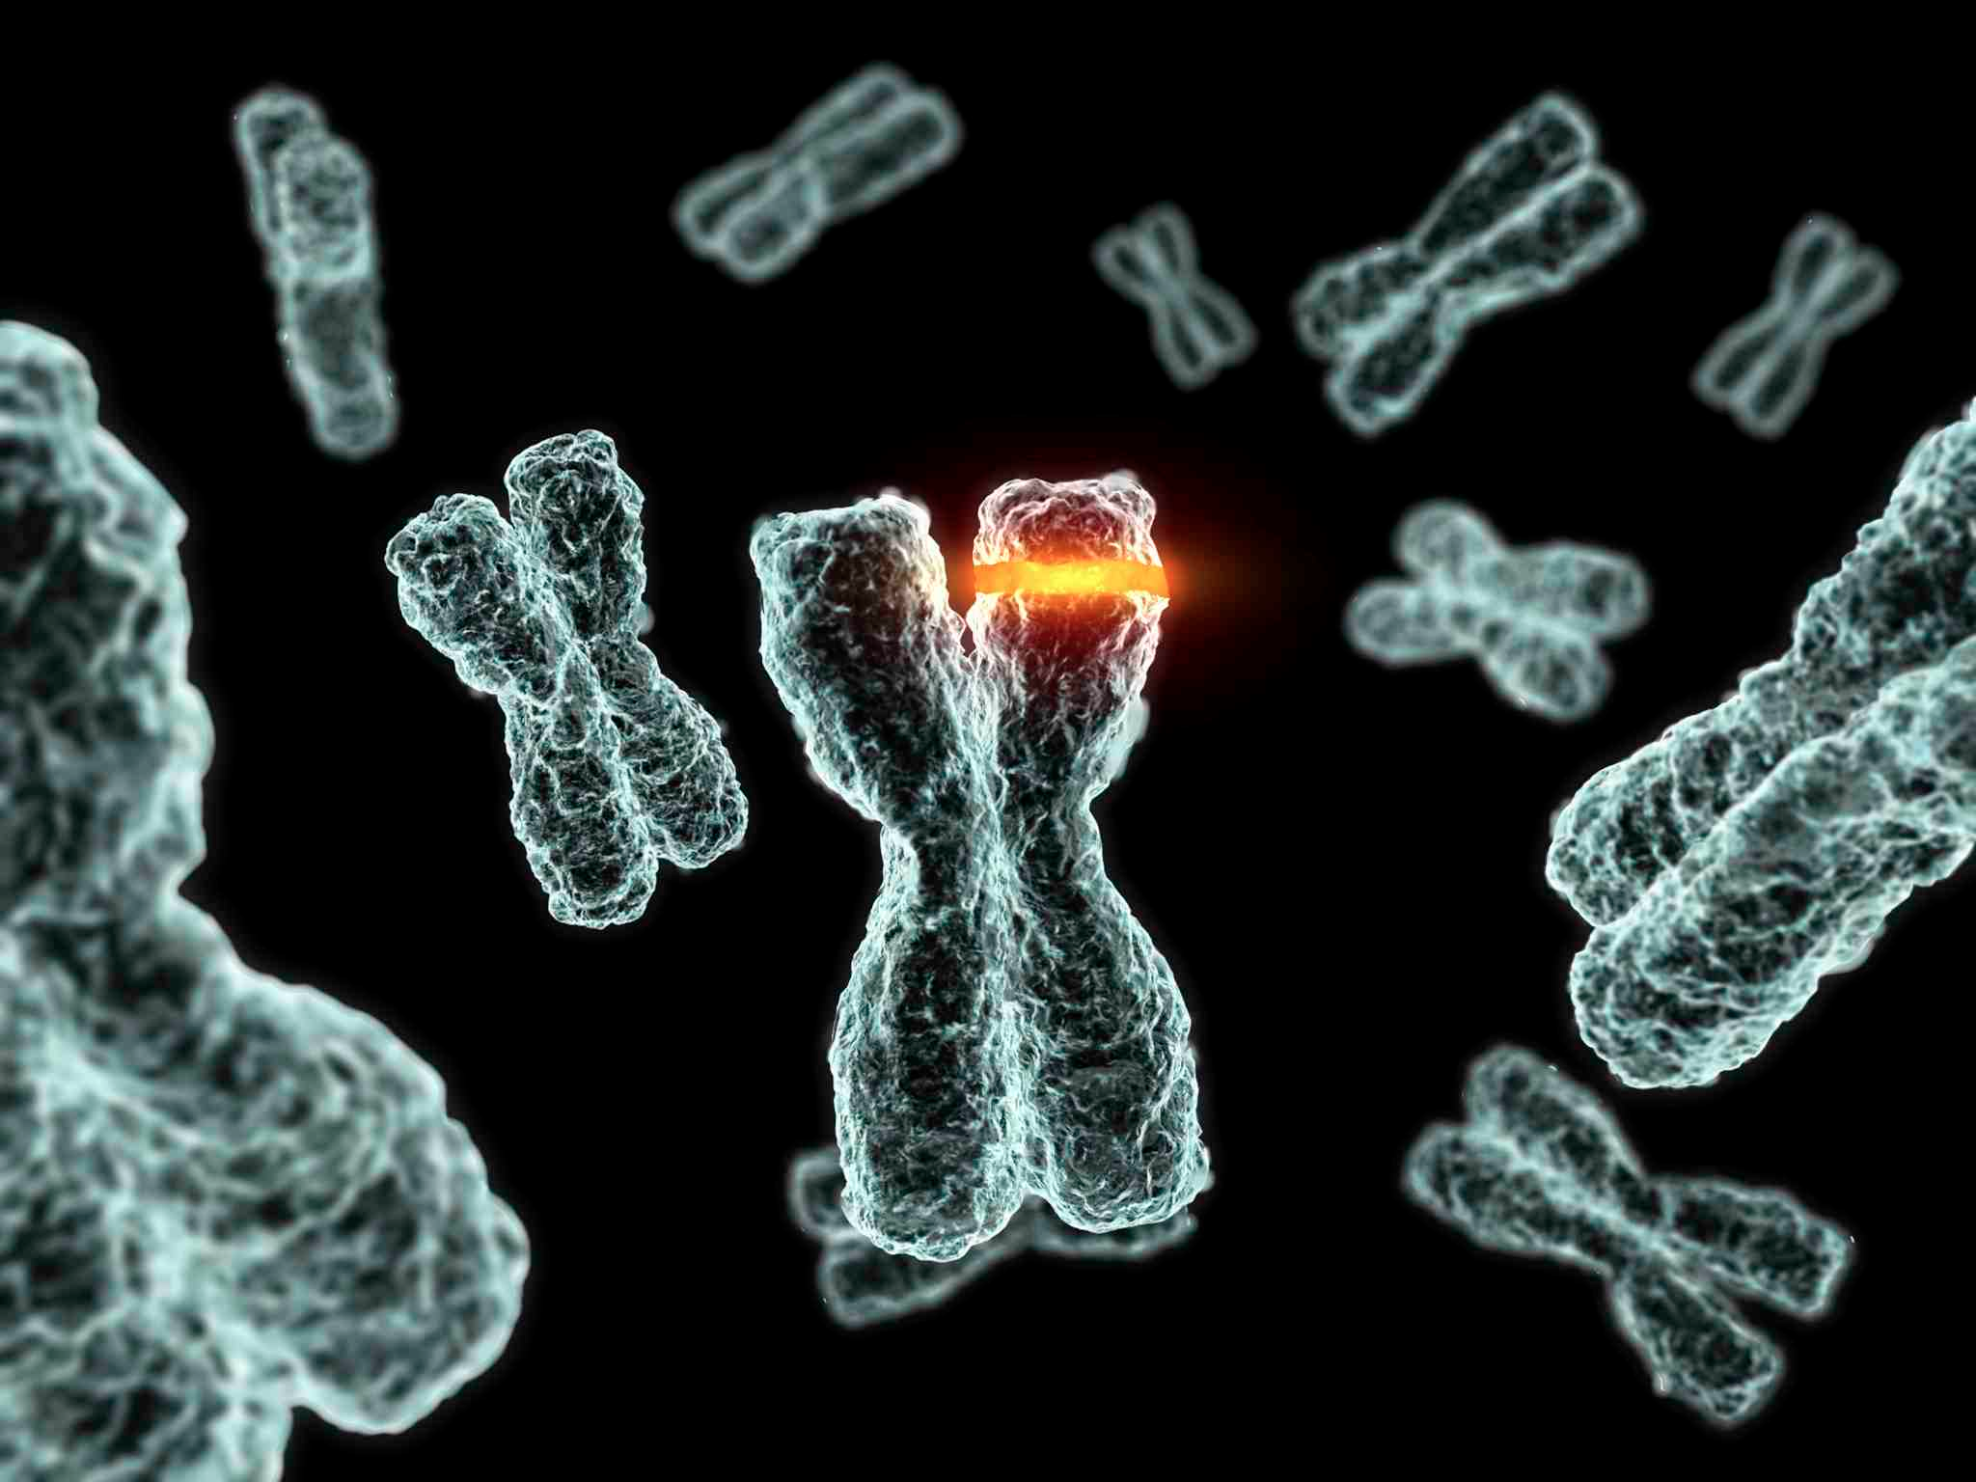
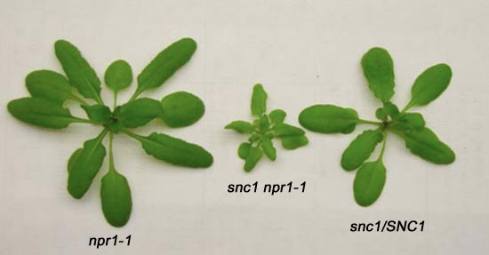
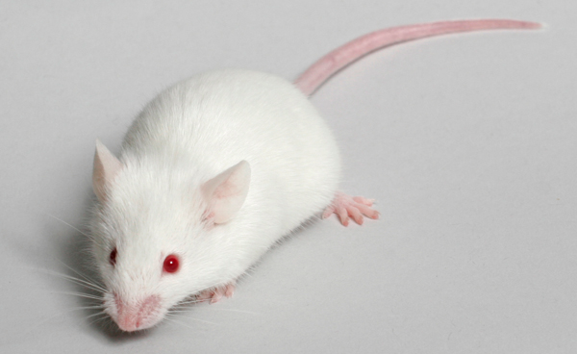
Mutations
A change in the DNA sequence of a gene

Slide 11
Types of Mutations
Deletion – a base missing
ATGGTCTGAGTA
ATGGTCGAGTA
Addition – a base added
ATGGTCTGAGTA
ATGGTCTAGAGTA
Substitution – a base switched with another
ATGGTCTGAGTA
ATGGTCTCAGTA
What if your DNA sequences were grouped into triplets? Which types of mutations would be more lethal?

Slide 12
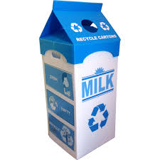
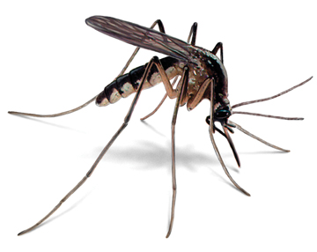
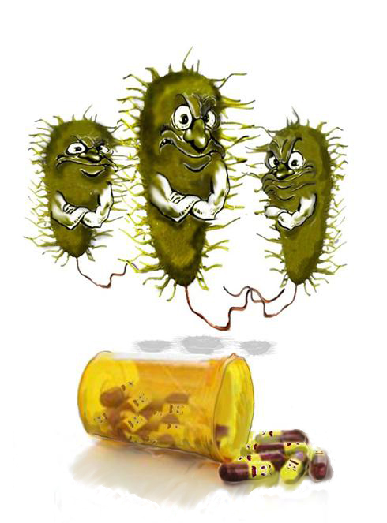
Effects of mutations
Positive mutations: benefits the organism
Negative mutations: harmful for the organism
Neutral mutations: no effect on the organism
Which type of mutation is most likely to be neutral?
Notes:
Negative: haemophilia, color blindness,

Slide 13
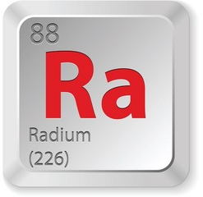
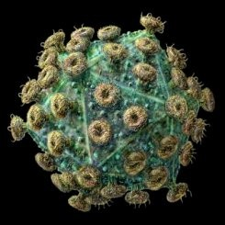
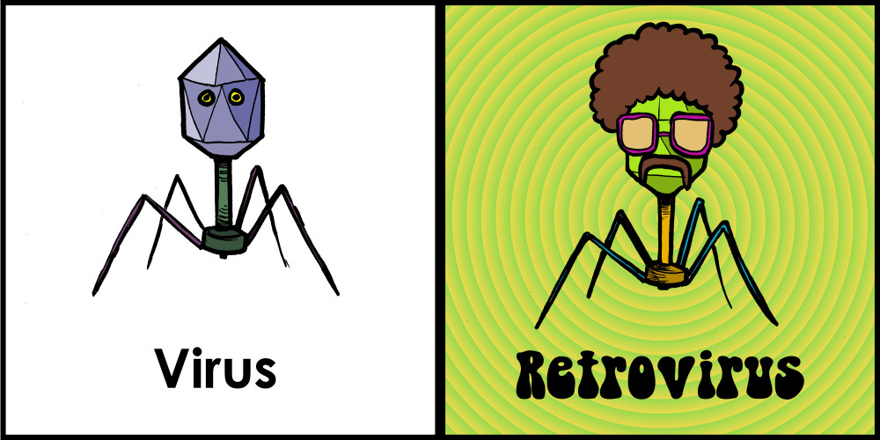
Causes of Mutations: Mutagens
Radiation – UV, gamma, X-rays, radioactive decay
Metals – arsenic, cadmium, chromium, nickel
Biological agents – viruses
Smoking
Notes:
NO CELL PHONE
NO MICROWAVES
Radium

Slide 14
Activity!

Slide 15
Exit Slip: answer on separate sheet of paper, hand-in before you leave
Question 1: compare each of your bees to the healthy bee (#1). How are these sick bees different? Which mutation caused them to be sick? Are these positive, negative, or neutral mutations? Why?
Question 2: How does a mutation in your bee's DNA sequence cause them to develop those traits? Trace the trait back to the genetic sequence that produced it.

Slide 16
Quiz next class (Chapter 4 minus gene therapy)
Read section 4.2
Problems:
(pg 145) 2, 3, 4, 7, 10, 11, 12, 14
(pg 146) 2, 6, 8, 10, 11, 12, 16, 21
2 Check your learning worksheets
Assignment 1 (due Tues after Easter long weekend)

