Slide 1
Law of Refraction
Snell’s Law
Critical Angle
Why is a diamond so shiny?

Slide 3
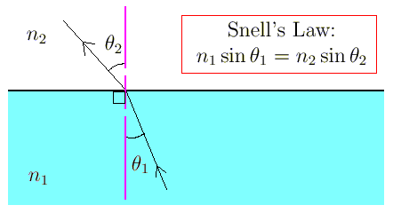
Law of Refraction (Chp 17.1)
Also known as Snell’s Law
Light bends when crossing boundaries between 2 media with different optical densities measured by their n
n_{x} is the refractive index of medium_{x}
θ₁ is the incident angle relative to the normal (pink line)
θ₂ is the refracted angle relative to the normal (pink line)

Slide 4
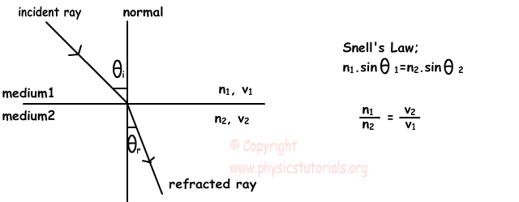
Speed of light changes
Speed of light, c ~ 3.0 x 10⁸m/s

Slide 5
Let’s try a problem together
n₁ for water is 1.33
n₂ for air is ~1.00
θ₁ is 30.0°
θ₂ = ?

Slide 6
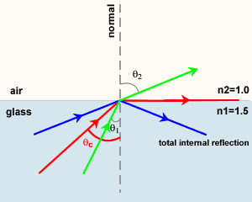
Total internal reflection
θ_{c} = Critical Angle

Slide 7
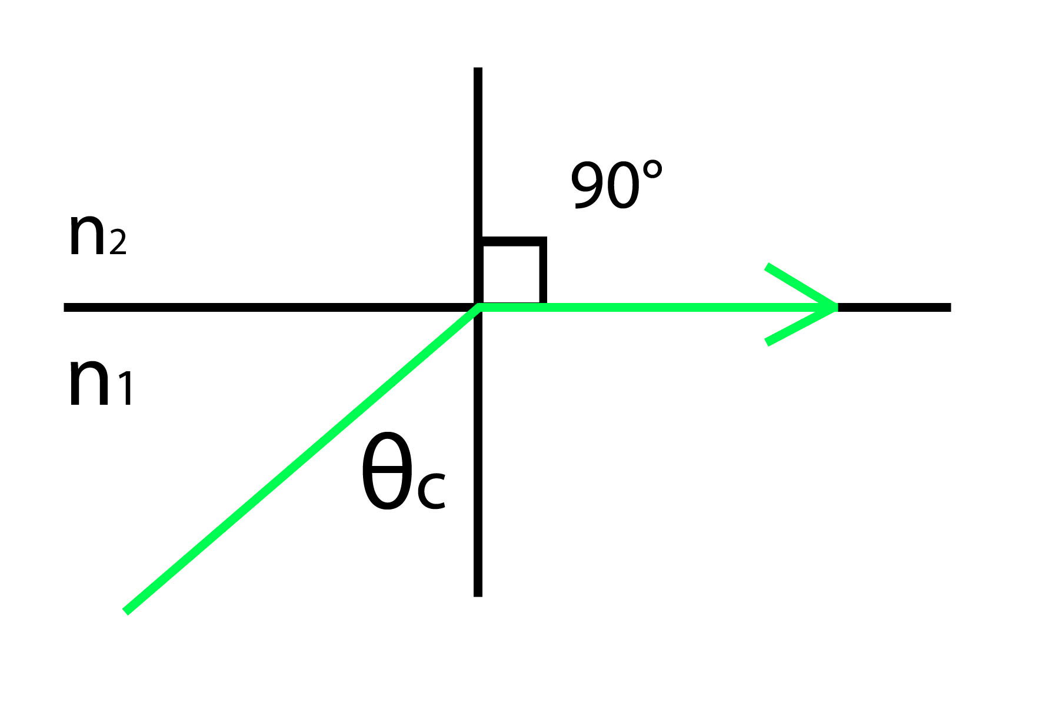
Critical Angle
Let’s find the critical angle of water
n₁ for water is 1.33
n₂ for air is ~1.00
θ₂ is 90.0°
θ₂ or θ_{c} = ?

Slide 8
Why is a diamond so shiny?
Total internal reflection!
What is the critical angle of diamond relative to air?
n_{d} for diamond is 2.42

