Slide 1
Meiosis
Purpose of Meiosis
Genetic diversity-mating, gene shuffling events
Ploidy
Meiosis I
Meiosis II
What happens when Meiosis goes wrong?

Slide 2
Sexual Reproduction Terminology
Genetic diversity: inherited genetic differences present in a species
Gametes: specialized cells for reproduction (egg, sperm)
Ploidy (xn): number of chromosome sets (ex. Our cells are diploid because we have 2 sets of chromosomes)
Fertilization: combination of female and male gametes
Zygote: product of fertilization, 1 cell receiving 1 set of chromosomes from each parent
Embryo: zygote cell undergoes mitosis to form a multicellular embryo

Slide 3
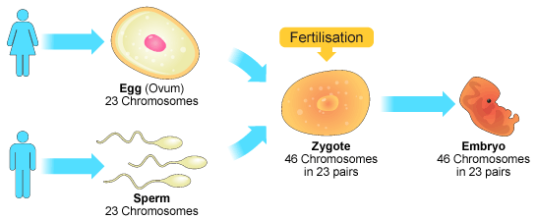

Slide 4
Purpose of Meiosis
Produce gametes (egg and sperm) for reproduction
Reduces the chromosome sets/number by half Diploid (2n)-----→Haploid (n) 46 chromosomes----→23 chromosomes 2 homologous pairs---→1 pair
Our gametes (egg, sperm) are HAPLOID (n)

Slide 5
Ploidy question
When your DNA replicates before Mitosis, are you 1n, 2n, or 4n?
ANS: 2n
Reason: you still have 2 sets of unique chromosomes from 2 parents. A copy of each set doesn’t mean you have 4 unique sets (4 parents? No…)

Slide 6
How do we get genetic diversity in MEIOSIS?
Mating choices – different parents, different combinations of genes, unique offspring
Gene shuffling events a) Crossing Over b) Independent Assortment

Slide 7
Meiosis Overview (pg 198-199)
DNA replication
46 chromosomes→ 46 chromosomes each with a sister chromatid
Meiosis I
Homologous pairs separate
2n→n
46 chromosomes (w/ sister chromatids) → 23 chromosomes (w/ sister chromatids)
Meiosis II
Sister chromatids separate
23 chromosomes (w/ sister chromatids) → 23 chromosomes (w/o sister chromatids)
1 cell
2 cells
4 cells
Independent Assortment
Crossing over
Happens here!

Slide 8
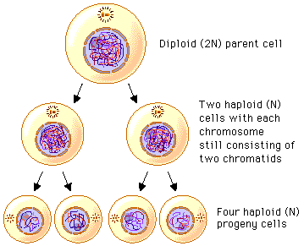

Slide 9
Meiosis I
Prophase I – Homologous chromosomes pair up, non-sister chromatids exchange genetic material (crossing over)
Metaphase I – Homologous chromosomes pairs line up at the equator and assort themselves independently from other pairs (independent assortment)**
Anaphase I – Homologous chromosomes separate and pulled to opposite ends of the cell
Telophase I – One chromosome (w/ sister chromatid) at each pole

Slide 11
Meiosis II
Prophase II - One chromosome (w/ sister chromatid) prepared to divide
Metaphase II – each chromosome line up at the equator
Anaphase II – Sister chromatids are pulled at their centromeres to the opposite poles of 2 daughter cells
Telophase II – One sister chromatid at each pole

Slide 13
What happens when Meiosis goes wrong?
Chromosome mutations!
Duplication – part of the chromosome is duplicated
Deletion – part of the chromosome is deleted

Slide 14
What happens when Meiosis goes wrong?
Chromosome mutations!
Inversion – part of the chromosome is duplicated
Relocation – part of the chromosome is deleted

Slide 15
Activity!
Goal: create a model of Meiosis
Materials Pipe cleaners
Scissors
Playdoh

