Slide 1
Explorations of the Relationship between Space and Personal Identity
A Visual Study

Slide 2
Isolation
Here, we see a wide and open space, devoid of any animate beings. However, life is present, in the form of the lone tree. The point to be made through the inclusion of this particular photo is that one can project one’s own concept onto such a photo; one viewer could describe this photo as a vision of isolation and of loss, whilst another may see a corner of paradise in which to be alone and reflect upon life.

Slide 3
Isolation Cont.
Through our musings on such abstract pictures, we begin to better understand, perhaps even begin to construct, our own personal identities. Thus, reflection on the space presented to us within this photograph may help us further our personal identities.

Slide 4
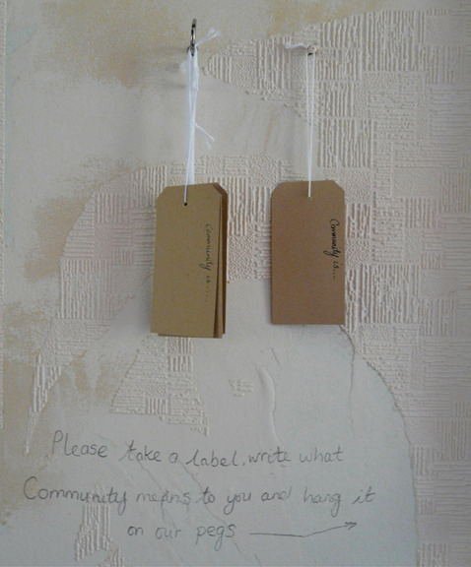
Place, Space and Identity
This is a photograph of a piece of artwork concerning place, space and identity. The idea here was that visitors would write the meaning of community to them on labels, which were then hung on pegs. Each label, then, acts as a representative for a unique personal identity; together, all these personal identities fill up a space on a wall, thus representing the melting-pot of society.

Slide 5
Place, Space and Identity Cont.
All these personal identities, formed through occupying various different spaces, come together to fill another space, which in turn may go on to inspire the development of yet more personal identities. Thus, specific spaces lead to the development of personal identities, which come together to occupy space, which in turn influences further development of personal identity. Space and personal identity are therefore interlinked and interdependent.

Slide 6
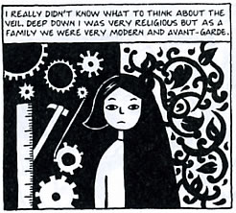
Persepolis
The relationship between space and personal identity is a key them in Persepolis. This particular frame is a prime example of this; Marji is seen occupying two very distinct spaces, the serious religious space and the more practically focused, avant-garde space.

Slide 7
Persepolis Cont.
As seen throughout the graphic novel, these two spaces result in her having a very distinct personal identity, one that is both fundamentalist in terms of religion and progressive thanks to her more avant-garde, rebellious side. Space in this novel is a huge influence on personal identity, and this frame illustrates the point that occupation of space, or spaces, helps to form the complete personal identity of a person.

Slide 8
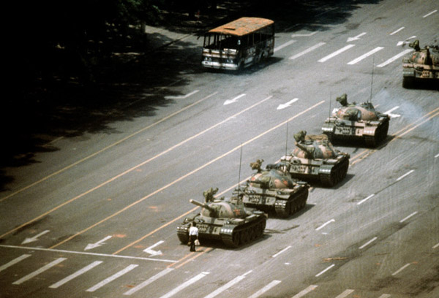
‘Tank Man’
Perhaps one of the most iconic photographs of the 20th century, this image of the Tiananmen Square ‘Tank Man’ is also a significant image in terms of the exploration of the relationship between space and personal identity. This is because the image occupies a specific space in the popular imagination; it is the archetypal image of the expression of personal identity in terms of political protest.

Slide 9
‘Tank Man’ Cont.
This image occupies its place in a space in the minds of many people, and it may go on to influence the development of one’s personal identity with relation to ideas such as political protest, oppression and individuality, all themes that are also dealt with in Persepolis. Thus, an image occupying a particular space in popular imagination may influence personal identity.

Slide 10
Works Cited
Griffiths, Louisa. (2011). Louisa Griffiths Photography. http://www.louisagriffiths.com/commercial-5218.html [Accessed 10th May]
‘Mayowa’. (2010). ‘The Lost Pleasures of Writing in Isolation’. Pens with Cajones. http://www.penswithcojones.com/2010/08/the-lost-pleasures-of-writing-in-isolation/ [Accessed 10th May]
Turner, Edwin. (2007). ‘Persepolis’. Biblioklept. http://biblioklept.org/2007/02/06/persepolis/ [Accessed 10th May]
Unknown. (2009). ‘20th Anniversary of Tiananmen Square Massacre’. Islam Times. http://www.islamtimes.org/vgle.e8pbjh8zz2zi1jjkr..html [Accessed 10th May]

