Slide 1



The Middle Years Development Instrument -- MDI
A tool for Monitoring Children’s Well-being
Notes:
© 2016 Human Early Learning Partnership

Slide 2
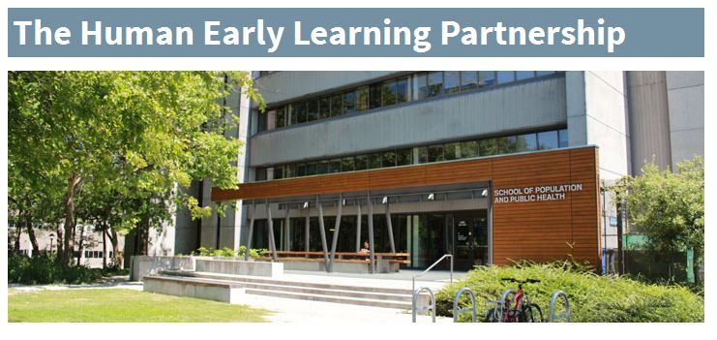
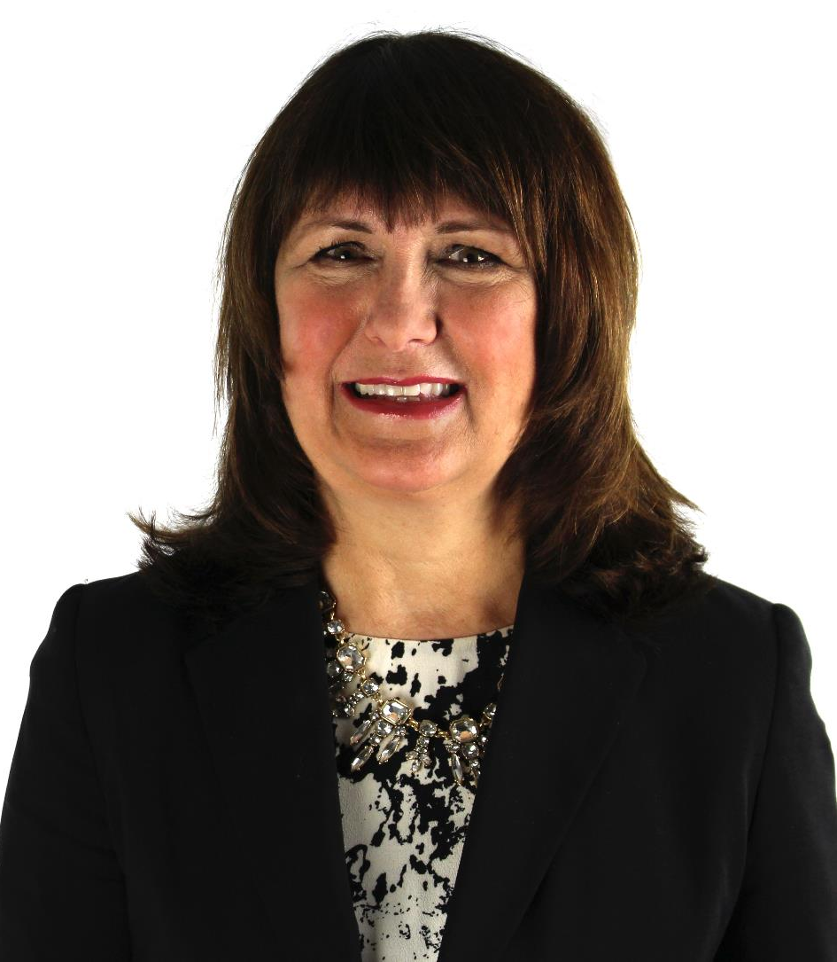
The Human Early Learning Partnership (HELP) at UBC
Notes:
Human Early Learning Partnership (HELP) is located at UBC.
This is a research cluster that studies early and middle childhood and their implications across the life course. But more than that – there is a deep commitment to ensure that the research gathered is useful and can be applied by schools, communities, parents, policy and decision makers, to make improvements in the lives of children, reduce vulnerability and increase well-being.
You may be familiar with the EDI (Early Years Development Instrument) that Kindergarten teachers complete about their students. In BC, HELP oversees the EDI as well as the MDI (Middle Years Development Instrument) and other projects.
(on click) This is our Director, Dr. Kimberly Schonert-Reichl. Talk about Kim’s background and her commitment to research that is used.

Slide 3




Birth
Adolescence
Early Childhood
Middle
Childhood
TIMELINE OF DEVELOPMENT
Notes:
Note: Animations on this slide
KEY MESSAGE:
In the past, research on child development focused on the significance of both the early years and adolescence. Yet, very little was known about middle childhood (the years from 6 to 12). Previously, it was believed that the middle years were a “latency period,” or a phase of relative stability where development was less dramatic than other stages.
With increased research on middle childhood, especially in the last 10-15 years, we now know that a number of very critical changes occur during this period of human development:
Cognitively children become more self-aware and more aware of others,
Socially children’s worlds begin expanding as connections to peers become increasingly important,
Academically children begin receiving grades and facing pressure to succeed,
Physically children are entering puberty (these changes have begun to present themselves at younger ages than in the past).
© 2015 Human Early Learning Partnership

Slide 4

Notes:
KEY MESSAGES:
The MDI is a population-based measure that helps us gain a deeper understanding of children’s health and well-being during middle childhood. Based on the emerging research on middle years development and social and emotional well-being, the MDI captures how children are doing in the middle years at a population level.
© 2015 Human Early Learning Partnership

Slide 5
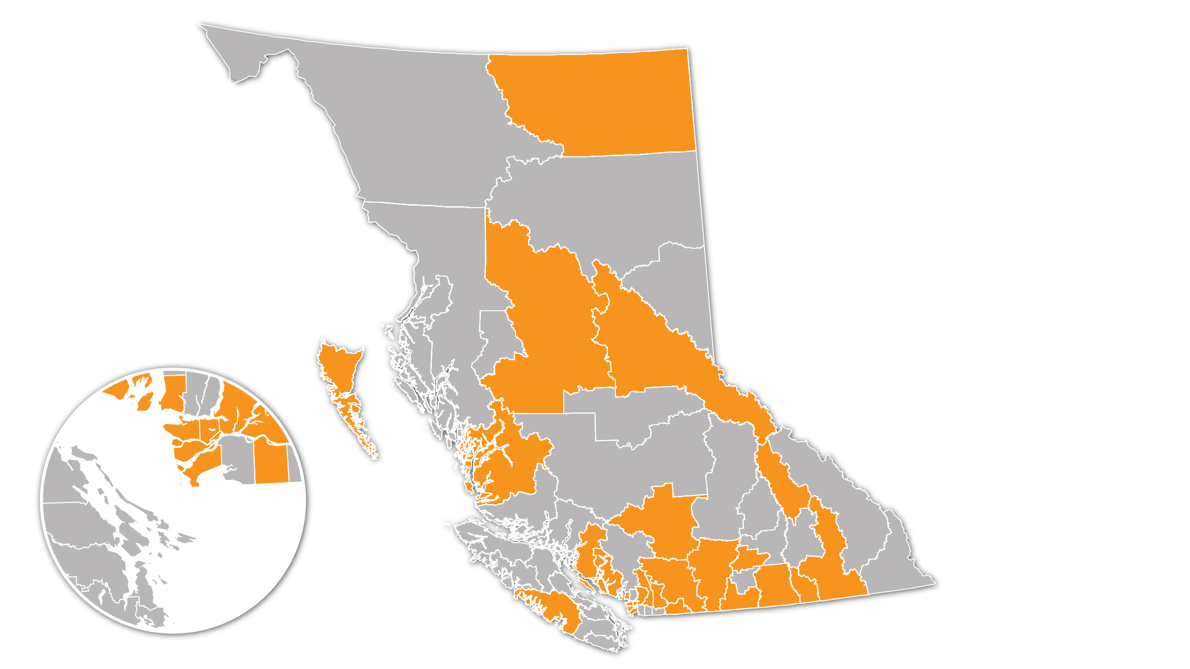
MDI PARTICIPATION
Total to date:
57,620
Grade 4 and 7 students
31
School Districts
Notes:
KEY MESSAGES:
To date, 31 school districts have participated in the MDI across the province of BC. MDI was piloted in the VSB in 2009-10 (gr 4)., and VSB participated again with Gr 4 in 2013-14. VSB also participated in 2012-13 with Grade 7.
This year we have 7 new districts participating. This will be our largest year ever, both in terms of number of districts and students.
© 2015 Human Early Learning Partnership

Slide 6
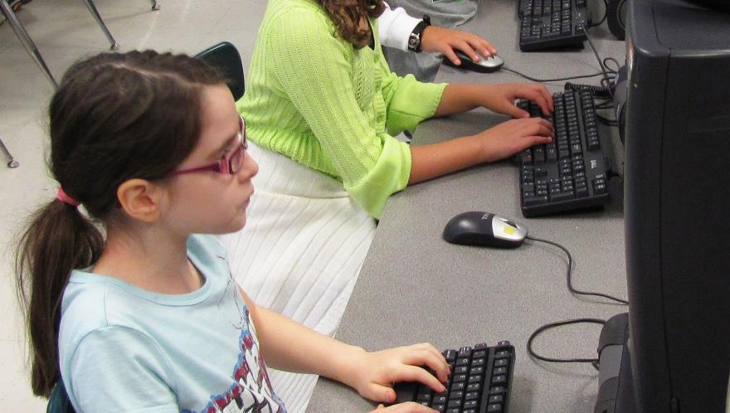

Self-report questionnaire for Children in Grade 4 and Grade 7
Computer Lab 4th Grade by Woodleywonderworks - Flickr CC Attribution
Notes:
KEY MESSAGES:
Why Grade 4 and 7 students? Why not older students? These ages are particularly important to be able to prevent problems before they arise. The time between Grade 4 and Grade 7 (ages 9 to 12) is a transitional periods in development in which we know there is increased risk but also increased opportunity to make a difference. Previous research has found that responses from children in grade 4 and above are as reliable and valid as responses from adults.
Children fill out the survey themselves online, it is administered by teachers or a principal during school hours, takes 1 class periods to complete for most grade 7 students (45 to 50 minutes).
Further Reading on the validity of children’s self-report:
Schonert-Reichl, K., Guhn, M., Gadermann, A., Hymel, S., Sweiss, L., & Hertzman, C. (2013). Development and validation of the Middle Years Development Instrument (MDI): Assessing children’s well-being and assets across multiple contexts. Social Indicators Research, 114(2): 345-369.
Varni, J. , Limbers, C. , & Burwinkle, T.(2007). How young can children reliably and validly self-report their health-related quality of life?: An analysis of 8,591 children across age subgroups with the PedsQL™ 4.0 Generic Core Scales. Health and Quality of Life Outcomes, 5(1): 1-13.
http://earlylearning.ubc.ca/mdi/
© 2015 Human Early Learning Partnership

Slide 7
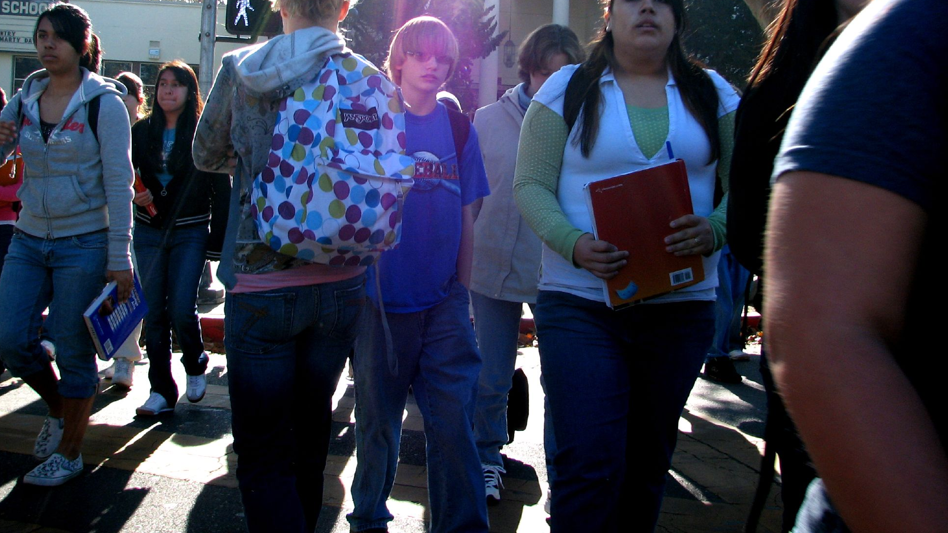

was developed …
based on recent scientific research on children’s social, emotional learning and development, positive psychology, and resiliency (assets).
Notes:
Walk by David - Flickr CC Attribution
The MDI was developed through a collaborative process involving research scientists, educators, parents, community organizations and students themselves. The measures used are all validated and tested and shown to be reliable measures. The MDI Grade 4 and 7 surveys were first piloted in the Vancouver school board and have since been answered by close to 60,000 students in BC.

Slide 8


Used at a Population Level
NOT used as an
Individual Diagnostic Tool
Notes:
MDI is a population-based survey
Tells us only about groups, neighbourhoods or broader geographic regions.
Allows us to see population trends in children’s well-being
Never used to evaluate teachers or schools
Children fill out the survey themselves at school, it is administered by teachers or a principal.

Slide 9
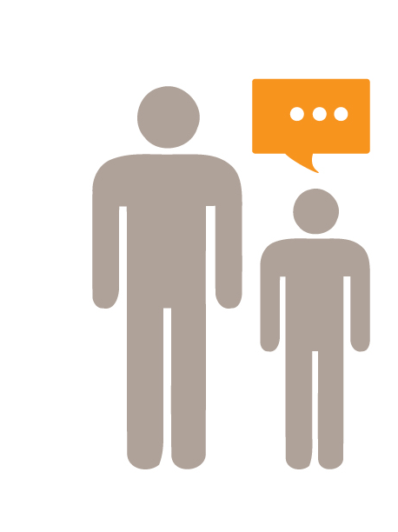
Upholding the Rights of the Child
Article 12:
Children have a right to give their opinion and be listened to by the adults around them
Notes:
KEY MESSAGES:
Unlike the EDI, the students complete the survey themselves, telling us about their experiences and their perspectives. The self-report nature of the MDI upholds Article 12 of the United Nations Convention on the Rights of the Child.
© 2016 Human Early Learning Partnership

Slide 10

BC’s new curriculum
Personal and Social Competencies | MDI measures
Positive Personal & Cultural Identity | Connectedness, Self-Esteem, Personal Meaning, Academic Self-Concept
Personal Awareness and Responsibility | Self-Awareness, Perseverance, Responsible Decision-Making, Self-Regulation, Well-Being
Social Responsibility | Citizenship/Social Responsibility, Empathy, Prosocial Behaviour
Notes:
I know many of you are probably getting familiar with the new curriculum.
One area that we are excited about is the Core Competencies aspect of the curriculum, specifically the three Personal and Social Competencies.
Kim Schonert-Reichl was part of the advisory group working on the new curriculum and you can see that many of measures included on the MDI are in alignment with these competencies, providing schools with a resource to see how their students are rating how they are doing in these areas.

Slide 11
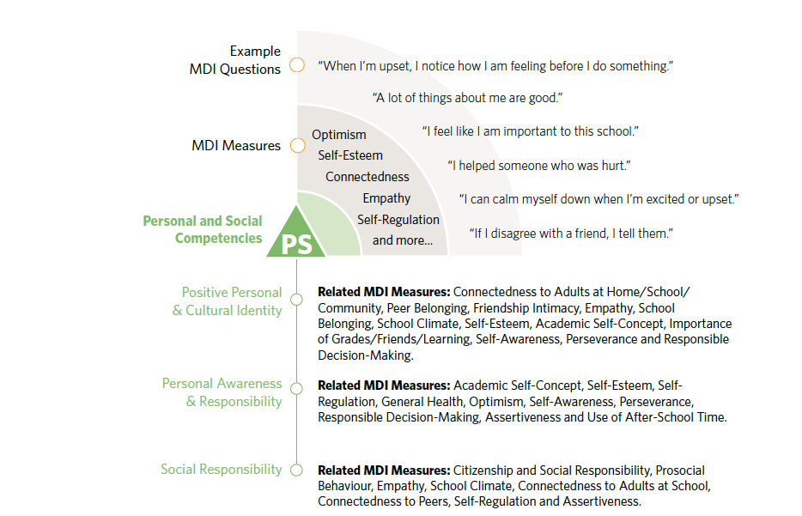

Slide 12
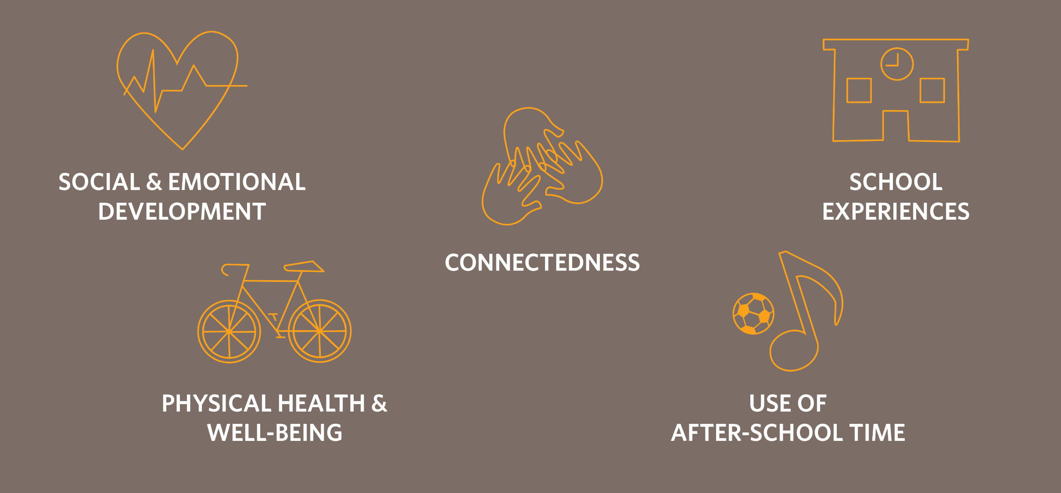
Measures areas of development
strongly linked to well-being, health
and academic achievement
Notes:
KEY MESSAGE:
The MDI measures these five areas of development that are strongly linked to well-being – looking at the whole child rather than just at academics. .
http://earlylearning.ubc.ca/mdi/
© 2016 Human Early Learning Partnership

Slide 13
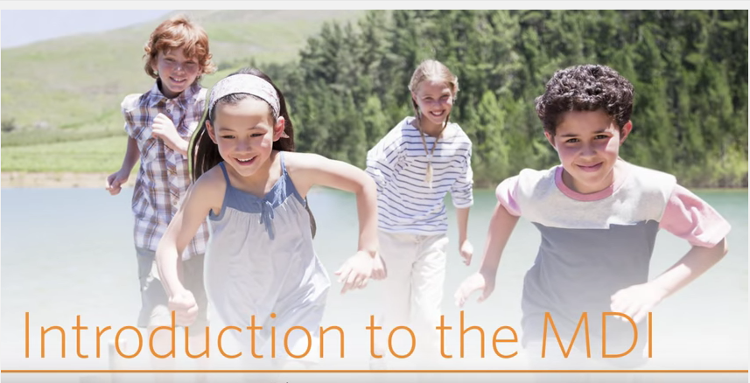
Notes:
Introduction to the MDI https://youtu.be/SsQkcHavTYo
This little video is a good introduction to the MDI, and the Principals may want to use it with their teachers.

Slide 14
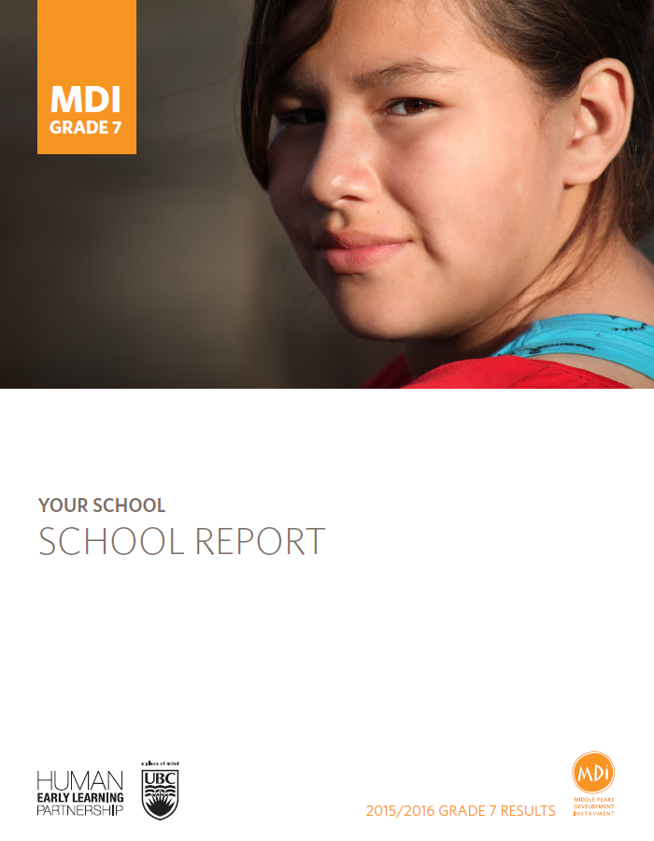
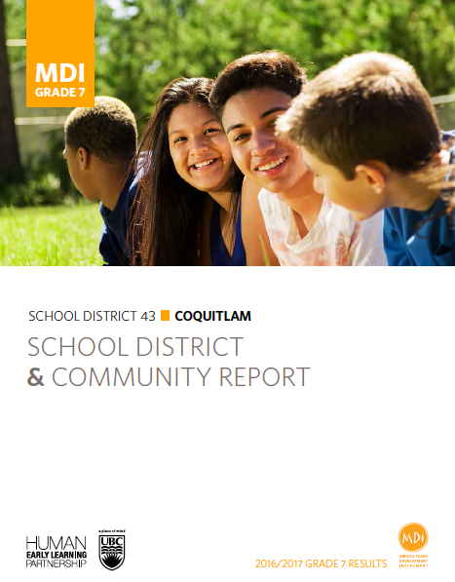
Notes:
In February each school will receive a school report in electronic form, that can be printed as a PDF document. In later spring, the VSB will receive a summary report for all participating Grade 7 students in the entire school board.

Slide 15


Who uses MDI Data
Community Planners
Funding Agencies
Students
Children’s Organizations
Recreation & Sport Programmers
Parents
Aboriginal Councils
Health Agencies
Educators
Policy Makers

Slide 16
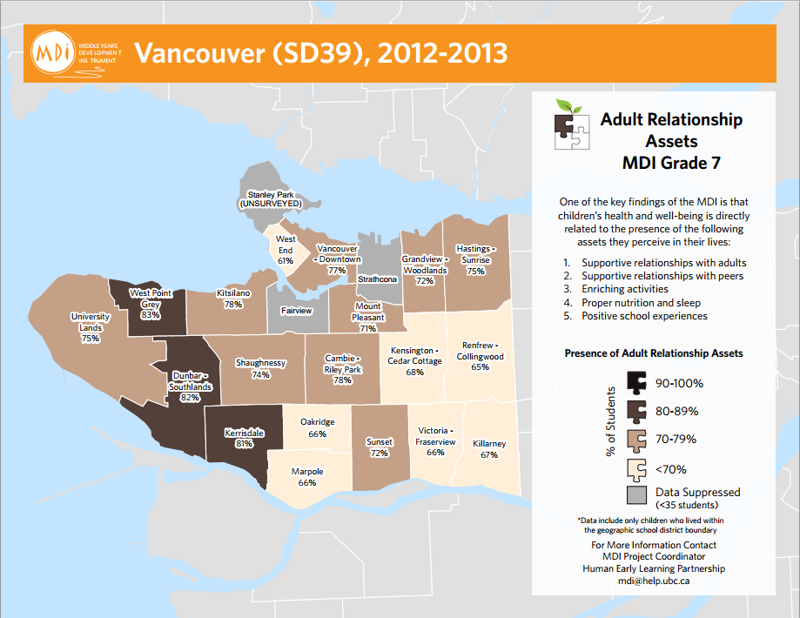
Notes:
Adult relationships
• At my school there is an adult who really cares about me.
• At my school there is an adult who believes I will be a success.
• At my school there is an adult who listens to me when I have
something to say.
• In my home there is a parent or another adult who believes I will be
a success.
• In my home there is a parent or another adult who listens to me
when I have something to say.
• In my home there is a parent or another adults who I can talk to
about my problems.
• In my neighbourhood/community (not from your school or family),
there is an adult who really cares about me.
• In my neighbourhood/community (not from your school or family),
there is an adult who believes that I will be a success.
• In my neighbourhood/community (not from your school or family),
there is an adult who listens to me when I have something to say.
Average rating is a little true or higher.

Slide 17
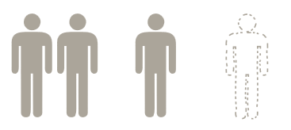
Alberni School District, BC
11%
One
51%
2 or more
38%
None
30%
None
14%
One
53%
None
19%
One
34%
2 or more
51%
2 or more
2013/2014
2014/2015
2015/2016
7
Notes:
How can schools use the MDI data for their school planning?
Here is an example of a way the Port Alberni School District in BC used the MDI to track their success with reducing the number of grade 7 students who were not able to identify an adult important to them at school.
The schools used various strategies to increase adult-student interactions outside the classroom, from the simple (such as knowing students’ names and saying hello in the hallways) to the more complex (such as using a strategy to ensure every student had one adult, who was not their classroom teacher, who would make a point of connecting with them each week).

Slide 18

MDI SURVEY ADMINISTRATOR ROLE
School Principals will receive a package, by email with:
MDI Survey Teacher/Administration letter
Parent/Guardian Information Letter
Survey Administration Guide
Information to access the MDI e-system
Notes:
Usually administered by the classroom teacher, but can also be done by the school principal or a counsellor.

Slide 19
How do you administer the
?
Training Session – Oct 30th at 3:30PM at Tupper
Webinar – Nov 2nd, 3:15PM
Video -- Steps to MDI Administration https://youtu.be/20wltNmJ-Tc
Notes:
KEY MESSAGES:
This next section highlights the details of how to administer the MDI with your students. The MDI can be administrated by a teacher, principal or other school administrator.

Slide 20
MDI ADMINISTRATION
November and December (closes Dec 15th)
1 class period for most Grade 7 students
Can be administered by a teacher, principal, counsellor or other School Staff
Online
Headphones (optional for voiceover)
Steps to MDI Administration https://youtu.be/20wltNmJ-Tc
Notes:
KEY MESSAGES:
Most Grade 7 students complete in one class period (45-50 minutes).
Online administration
Voiceover function is available for students who need it.
We know there is a mix of computer labs and mobile technology across schools.
The e-MDI survey works well on all platforms. Recommend Firefox, Safari or Chrome web browsers.
Prepare the computer lab under test conditions (have space between students if possible). Have a classroom set of headphones available, or provide headphones for students that may benefit from the “read aloud” function.
Prepare an alternate activity related to regular classroom activity for students that are not participating.

Slide 21
PRIVACY AND CONFIDENTIALITY
Behavioural Research Ethics Board (BREB) of UBC approved.
All information collected is kept confidential and used for research, planning and evaluation purposes only.
Parents are informed; participation is voluntary; consent is passive.
No child or teacher is ever identified in HELP’s reporting.
School reports are provided to the school district and the school principals, for use with their own school communities.
Notes:
KEY MESSAGES:
The privacy of children, families and teachers is paramount
All information that is collected is kept confidential and used for research and statistical purposes only
All information is kept at HELP and personal identifiers are stripped from the data
Participation is voluntary for teachers, parents and students.
Students may opt out at any time, even after they complete the survey.

Slide 22
Next Steps for Principals
Set dates for MDI Administration at your school
Book computer lab/technology
Tell teachers about MDI, share information with Grade 7 teachers
September -- Send information letters to Parents/Guardians
(Note: ONLY those who DO NOT want children to participate send back a form)
October – Collect any withdrawal forms
November/December – MDI is administered to students
February 2018 – school reports available (>5 students)

Slide 23
Videos
Introduction to the MDI https://youtu.be/SsQkcHavTYo
Steps to MDI Administration https://youtu.be/20wltNmJ-Tc
Educating the Heart https://youtu.be/SOYOa4FIj-Y
Every Opportunity https://youtu.be/VxyxywShewI

Slide 24
Key Contacts at HELP
Marit Gilbert
MDI Lead
Marit.gilbert@ubc.ca
Anna-Marie Bueno
MDI Coordinator
Annamarie.bueno@ubc.ca
Maddison Spenrath
MDI Project Manager maddison.spenrath@ubc.ca
Key Contact at VSB
Selma Smith
District Principal
Social Emotional Learning & Prevention
Shsmith@vsb.bc.ca

Slide 25

http://www.discovermdi.ca/how-to-illustrate-the-value-of-adult-relationships-in-under-4-minutes/

