Slide 1
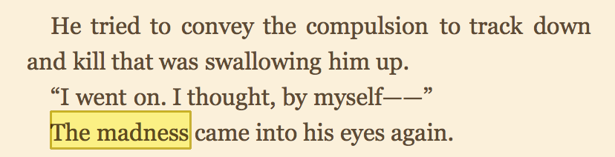
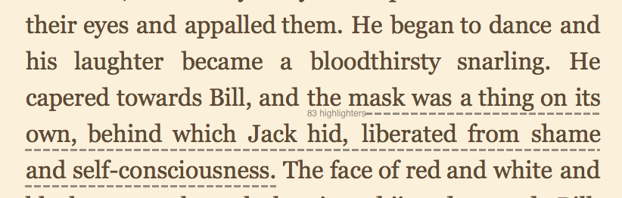
Chapter 3, 4

Slide 2
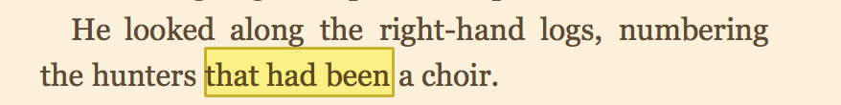
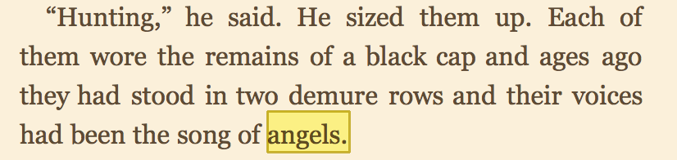
Chapter 8

Slide 3
Why are some of the boys in LOTF doing such savage, or evil, things?

Slide 4
Do you think these boys are innately savage or are their behaviors caused by outside influence?

Slide 5

Consider some social factors
OBEDIENCE TO AUTHORITY
CONFORMITY
POWER OF SITUATION

Slide 6
CONFORMITY

Slide 7
CONFORMITY IS is a type of social influence involving a change in belief or behavior in order to fit in with a group.
Or simply…
“yielding to group pressures”
Compliance: a change in behavior, but not attitude, due to the results of social pressure.
Acceptance: a change in both behavior and attitude.

Slide 8
Line Judgment Experiments
Stimulus
A
B
C

Slide 9
Line Judgment Experiment
Asch (1951;1956) completed two studies that demonstrate how easily conformity occurs
1 Subject is brought into lab with 6-8 confederates Asked to make a judgment about line length
Ordinarily subjects make mistakes 1% of the time, in this experiment 36.8% of the time

Slide 10
How did the boys submit to conformity?

Slide 11
OBEDIENCE TO AUTHORITY

Slide 12
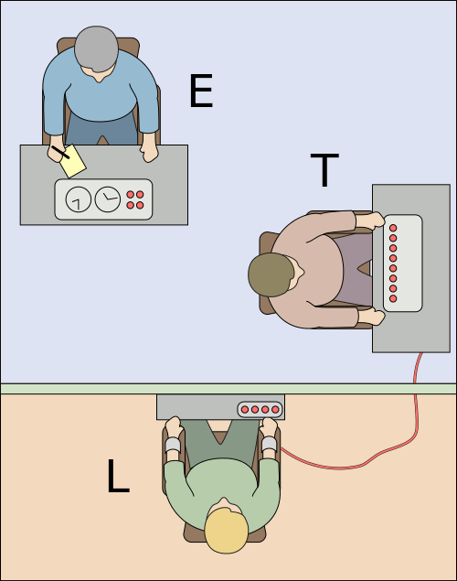
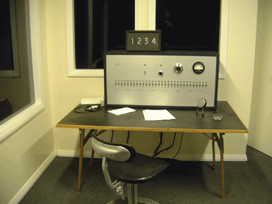
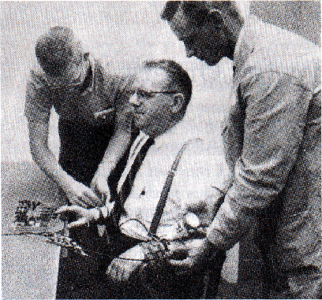
Milgram: Obedience to Authority
Participants brought into “experiment on learning through punishment”.
Notes:
Participant is always the “teacher,”.
Every time that the learner is wrong on a word recognition task the teacher must shock the l

Slide 13
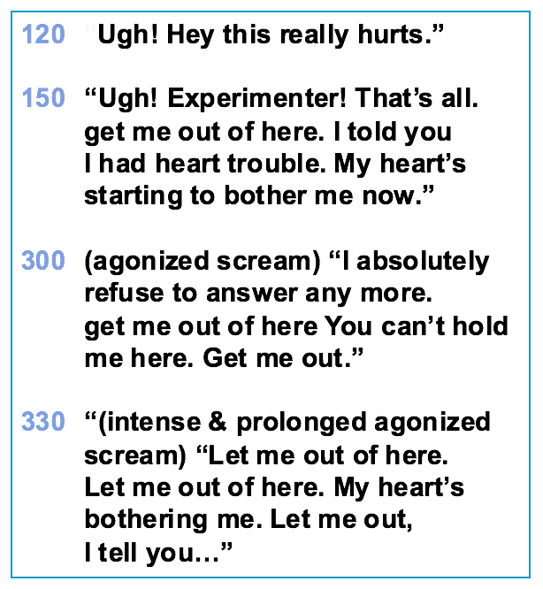
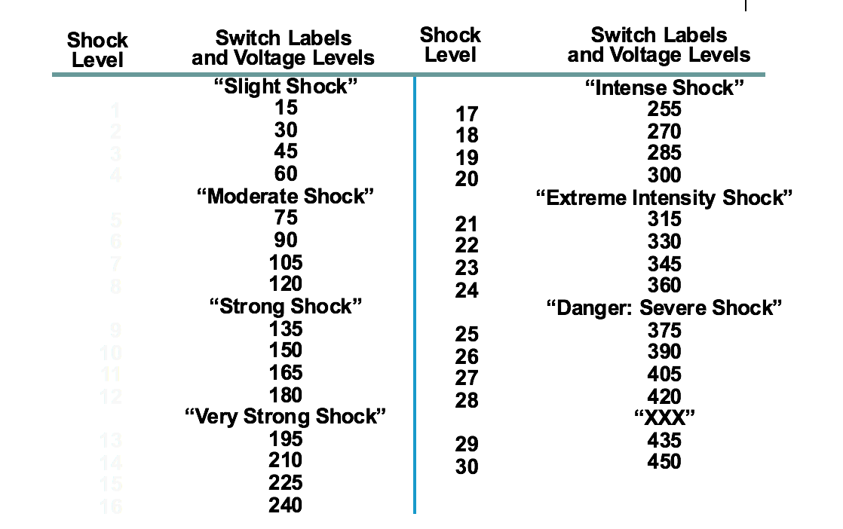
65% of the subjects went to the end, even those that protested

Slide 14
POWER OF THE SITUTION

Slide 15
Stanford Prison Experiment:
Conducted in the basement of the Stanford Psychology Department.
Volunteers were randomly assigned to play the role of guards and prisoners in a mock prison in the basement.
Both prisoners and guards rapidly adapted to their assigned roles, and lead to genuinely dangerous and psychologically damaging situations

Slide 16
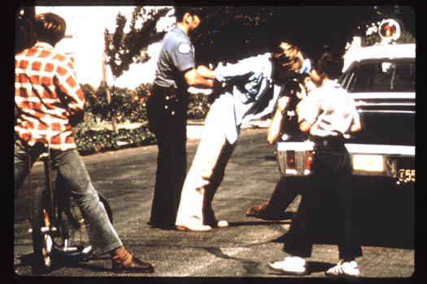
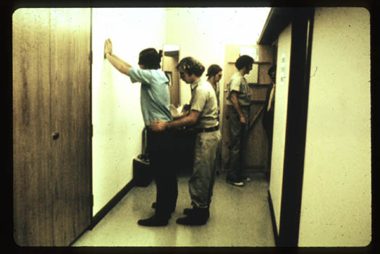
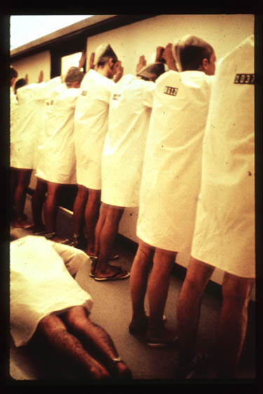
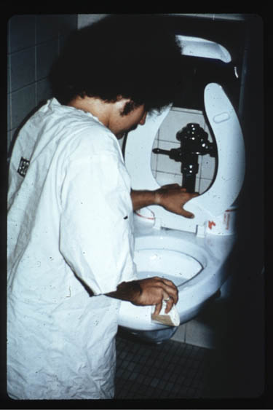
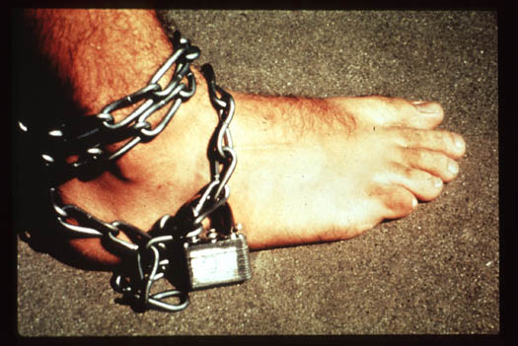

Slide 17
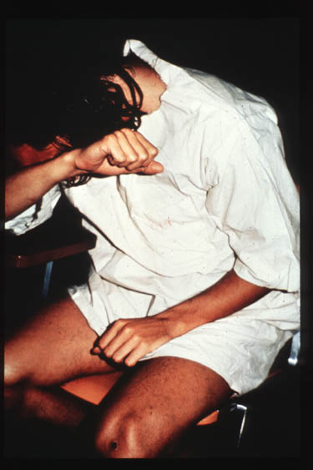
Experiment was abandoned after just six days because of the prisoners’ pathological reactions.
But remember these were all just normal people?
What happened?

Slide 18
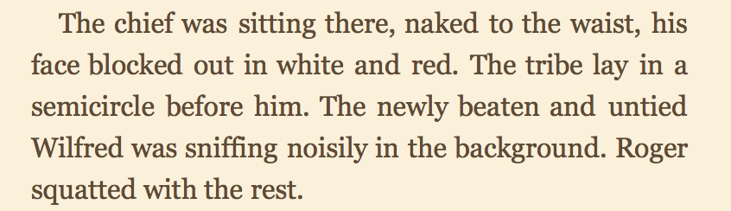

Slide 19
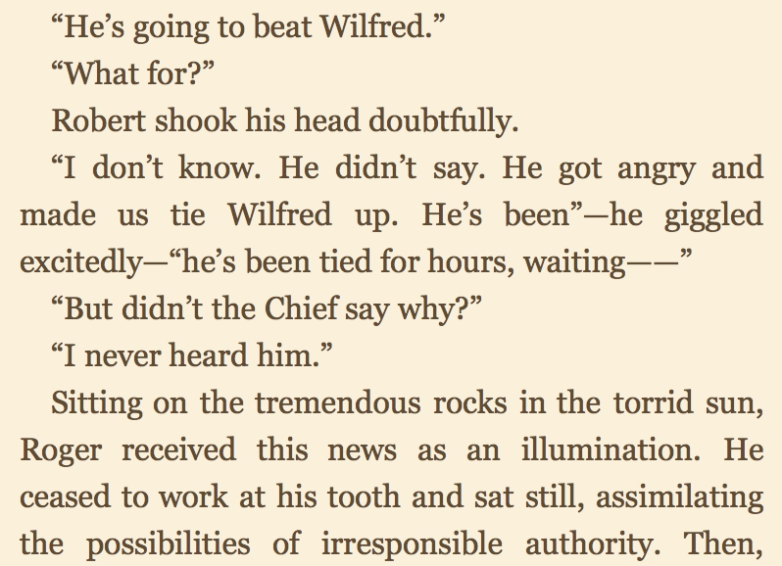

Slide 20
Find an example of each of these psychological concepts in LOTF
OBEDIENCE TO AUTHORITY
CONFORMITY
POWER OF SITUATION
…AND AND EXAMPLE THAT SHOWS THE BOYS ARE INNATELY SAVAGE

