Slide 1
FRE 501 2013 Lab 9 (Nov 5th)
Overview of Palm Oil
Plantation Economics and Policy
Corporate Behaviour - Hedging

Slide 2
Mission Statement
Understand how commodity futures markets work,
Formulate and refine trading and hedging strategies, Learn and practice risk management,
In preparation for future professional roles

Slide 3
Palm Oil Overview

Slide 4
We all eat palm, some of you put it on your face

Slide 5
Yihai Kerry brands in China
Brands in China | Icon | Products
Arawana “金龙鱼” |  | Edible oils, rice and flour
Koufu “口福” |  | Edible oils and soy milk powder
Wonder Farm “香满园” |  | Edible oils, rice, flour and grains
Gold Ingots “元宝” |  | Soybean oil, rice and flour
Orchid “胡姬花” |  | Peanut oil and blended oil
Fengyuan “丰苑” |  | Feed meals
Jin Li “金鸝” |  | Specialty fats
Huaqi “花旗” |  | Edible oils, flour and specialty fats
Reyland “銳龍” |  | Oleochemicals

Slide 6
Palm Oil’s place: Top 3 Veg Oils World Supply

Slide 7
Palm Oil cultivation
Oil Palm tree is originally from Nigeria, Africa – brought to Malaysia by the British
Over 90% of cultivated Oil Palm today is in Malaysia and Indonesia
Africans generally eat it unprocessed
Cultivation hasn’t taken off in a big way in South America – Palm Trees there plagued by ‘bud rot’ – has killed off entire plantations in as little as 2 years

Slide 8
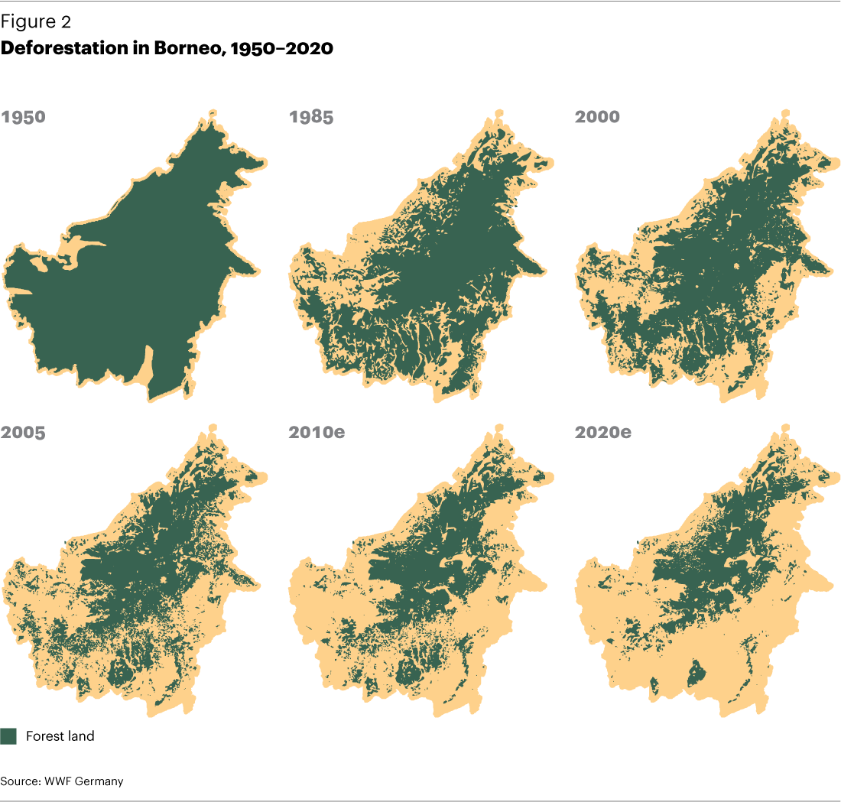
Rainforest->Logged->Oil Palm

Slide 9
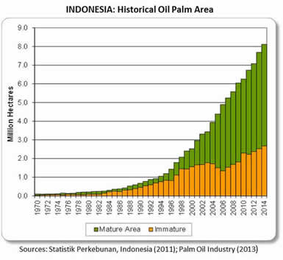

Slide 10
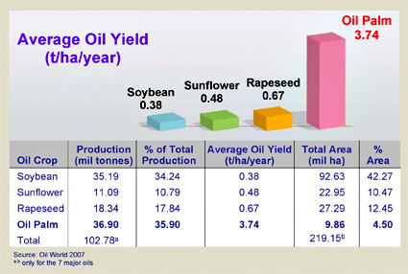
Palm – Friend or Foe?
This chart might shock you
Total US: ~360 mil ha
Oil Palm is now closer to 13 mil ha – 5 mil ha in Malaysia 8 mil ha in Indonesia

Slide 11
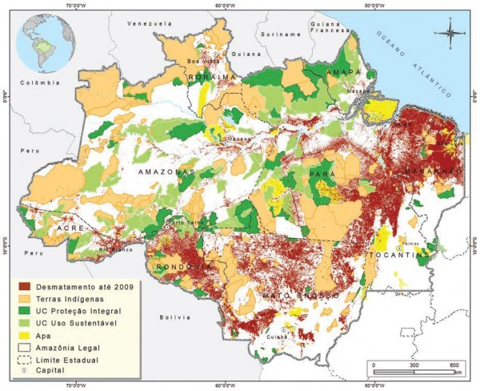
Amazon Deforestation

Slide 12
Palm is a long-lived perennial Palm Oil Yield with Age (FFB and Oil)
So why does yield drop with age?

Slide 13
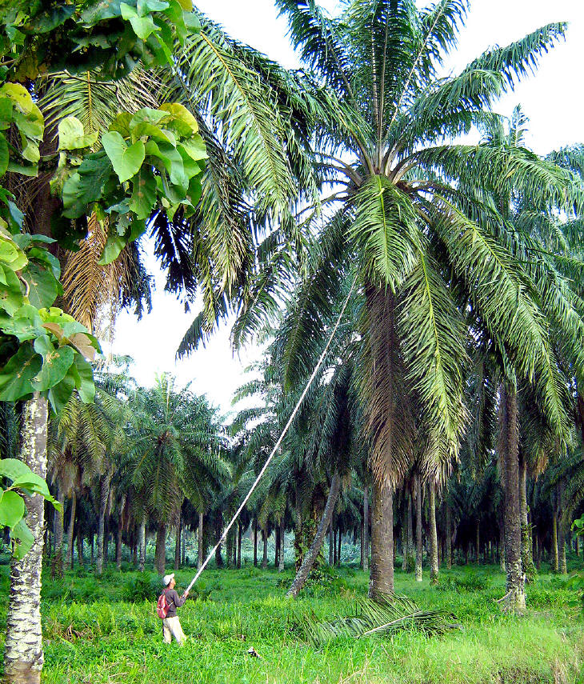
Harvesting Palm is “high”ly skilled job and a “tall” order
At ~ 6-7 years of age (prime)
At~ 15-20 years of age

Slide 14
Oil Palm is perennial but still exhibits Seasonality Corn and Soybeans are ‘annuals’
‘Dry’ Season
Rainy Season

Slide 15
Applying Storage Theory
Based on your understanding of commodity storage – should palm oil ‘normally’ be in backwardation or contango?
Backwardation There’s always more coming next month Contagos are rare, and great hedging opportunities

Slide 16
Plantation Economics and Policy

Slide 17
A brief history of palm (prices)
Change in EU biofuel stance
Biofuel policies begin
$750

Slide 18
Plantation Cashflow –long-term 30 year investments
Average cost of ~$250/mt. Current prices ~ $800 >60% Ebitda margin : One of the most profitable cash crops in the world

Slide 19
Financial modeling and forecasting – with array formulas yield matrix upgrade (practice your quant skills)
Year of planting
 | 1994 | 1995 | 1996 | 1997 | 1998 | 1999 | 2000 | 2001 | 2002 | 2003 | 2004 | 2005 | 2006 | 2007 | 2008 | 2009 | 2010 | 2011 | 2012 | 2013 | 2014 | 2015 | 2016 | 2017 | 2018 | 2019 | 2020
 | 19 | 18 | 17 | 16 | 15 | 14 | 13 | 12 | 11 | 10 | 9 | 8 | 7 | 6 | 5 | 4 | 3 | 2 | 1 | 0 | -1 | -2 | -3 | -4 | -5 | -6 | -7
2003 | 24.7 | 24.7 | 22.7 | 17.8 | 13.8 | 9.9 | 5.9 | - | - | -
2004 | 24.7 | 24.7 | 24.7 | 22.7 | 17.8 | 13.8 | 9.9 | 5.9 | - | - | -
2005 | 24.7 | 24.7 | 24.7 | 24.7 | 22.7 | 17.8 | 13.8 | 9.9 | 5.9 | - | - | -
2006 | 24.7 | 24.7 | 24.7 | 24.7 | 24.7 | 22.7 | 17.8 | 13.8 | 9.9 | 5.9 | - | - | -
2007 | 24.7 | 24.7 | 24.7 | 24.7 | 24.7 | 24.7 | 22.7 | 17.8 | 13.8 | 9.9 | 5.9 | - | - | -
2008 | 23.7 | 24.7 | 24.7 | 24.7 | 24.7 | 24.7 | 24.7 | 22.7 | 17.8 | 13.8 | 9.9 | 5.9 | - | - | -
2009 | 23.7 | 23.7 | 24.7 | 24.7 | 24.7 | 24.7 | 24.7 | 24.7 | 22.7 | 17.8 | 13.8 | 9.9 | 5.9 | - | - | -
2010 | 22.7 | 23.7 | 23.7 | 24.7 | 24.7 | 24.7 | 24.7 | 24.7 | 24.7 | 22.7 | 17.8 | 13.8 | 9.9 | 5.9 | - | - | -
2011 | 21.7 | 22.7 | 23.7 | 23.7 | 24.7 | 24.7 | 24.7 | 24.7 | 24.7 | 24.7 | 22.7 | 17.8 | 13.8 | 9.9 | 5.9 | - | - | -
2012 | 21.7 | 21.7 | 22.7 | 23.7 | 23.7 | 24.7 | 24.7 | 24.7 | 24.7 | 24.7 | 24.7 | 22.7 | 17.8 | 13.8 | 9.9 | 5.9 | - | - | -
2013 | 20.7 | 21.7 | 21.7 | 22.7 | 23.7 | 23.7 | 24.7 | 24.7 | 24.7 | 24.7 | 24.7 | 24.7 | 22.7 | 17.8 | 13.8 | 9.9 | 5.9 | - | - | -
2014 | 19.7 | 20.7 | 21.7 | 21.7 | 22.7 | 23.7 | 23.7 | 24.7 | 24.7 | 24.7 | 24.7 | 24.7 | 24.7 | 22.7 | 17.8 | 13.8 | 9.9 | 5.9 | - | - | -
2015 | 18.8 | 19.7 | 20.7 | 21.7 | 21.7 | 22.7 | 23.7 | 23.7 | 24.7 | 24.7 | 24.7 | 24.7 | 24.7 | 24.7 | 22.7 | 17.8 | 13.8 | 9.9 | 5.9 | - | - | -
2016 | 17.8 | 18.8 | 19.7 | 20.7 | 21.7 | 21.7 | 22.7 | 23.7 | 23.7 | 24.7 | 24.7 | 24.7 | 24.7 | 24.7 | 24.7 | 22.7 | 17.8 | 13.8 | 9.9 | 5.9 | - | - | -
2017 | 16.8 | 17.8 | 18.8 | 19.7 | 20.7 | 21.7 | 21.7 | 22.7 | 23.7 | 23.7 | 24.7 | 24.7 | 24.7 | 24.7 | 24.7 | 24.7 | 22.7 | 17.8 | 13.8 | 9.9 | 5.9 | - | - | -
2018 | 16.8 | 16.8 | 17.8 | 18.8 | 19.7 | 20.7 | 21.7 | 21.7 | 22.7 | 23.7 | 23.7 | 24.7 | 24.7 | 24.7 | 24.7 | 24.7 | 24.7 | 22.7 | 17.8 | 13.8 | 9.9 | 5.9 | - | - | -
2019 | 15.8 | 16.8 | 16.8 | 17.8 | 18.8 | 19.7 | 20.7 | 21.7 | 21.7 | 22.7 | 23.7 | 23.7 | 24.7 | 24.7 | 24.7 | 24.7 | 24.7 | 24.7 | 22.7 | 17.8 | 13.8 | 9.9 | 5.9 | - | - | -
2020 | 15.3 | 15.8 | 16.8 | 16.8 | 17.8 | 18.8 | 19.7 | 20.7 | 21.7 | 21.7 | 22.7 | 23.7 | 23.7 | 24.7 | 24.7 | 24.7 | 24.7 | 24.7 | 24.7 | 22.7 | 17.8 | 13.8 | 9.9 | 5.9 | - | - | -
2021 | 14.9 | 15.3 | 15.8 | 16.8 | 16.8 | 17.8 | 18.8 | 19.7 | 20.7 | 21.7 | 21.7 | 22.7 | 23.7 | 23.7 | 24.7 | 24.7 | 24.7 | 24.7 | 24.7 | 24.7 | 22.7 | 17.8 | 13.8 | 9.9 | 5.9 | - | -
2022 | 14.4 | 14.9 | 15.3 | 15.8 | 16.8 | 16.8 | 17.8 | 18.8 | 19.7 | 20.7 | 21.7 | 21.7 | 22.7 | 23.7 | 23.7 | 24.7 | 24.7 | 24.7 | 24.7 | 24.7 | 24.7 | 22.7 | 17.8 | 13.8 | 9.9 | 5.9 | -
2023 | 13.9 | 14.4 | 14.9 | 15.3 | 15.8 | 16.8 | 16.8 | 17.8 | 18.8 | 19.7 | 20.7 | 21.7 | 21.7 | 22.7 | 23.7 | 23.7 | 24.7 | 24.7 | 24.7 | 24.7 | 24.7 | 24.7 | 22.7 | 17.8 | 13.8 | 9.9 | 5.9
2024 | 13.4 | 13.9 | 14.4 | 14.9 | 15.3 | 15.8 | 16.8 | 16.8 | 17.8 | 18.8 | 19.7 | 20.7 | 21.7 | 21.7 | 22.7 | 23.7 | 23.7 | 24.7 | 24.7 | 24.7 | 24.7 | 24.7 | 24.7 | 22.7 | 17.8 | 13.8 | 9.9
2025 |  | 13.4 | 13.9 | 14.4 | 14.9 | 15.3 | 15.8 | 16.8 | 16.8 | 17.8 | 18.8 | 19.7 | 20.7 | 21.7 | 21.7 | 22.7 | 23.7 | 23.7 | 24.7 | 24.7 | 24.7 | 24.7 | 24.7 | 24.7 | 22.7 | 17.8 | 13.8
2026 |  |  | 13.4 | 13.9 | 14.4 | 14.9 | 15.3 | 15.8 | 16.8 | 16.8 | 17.8 | 18.8 | 19.7 | 20.7 | 21.7 | 21.7 | 22.7 | 23.7 | 23.7 | 24.7 | 24.7 | 24.7 | 24.7 | 24.7 | 24.7 | 22.7 | 17.8
2027 |  |  |  | 13.4 | 13.9 | 14.4 | 14.9 | 15.3 | 15.8 | 16.8 | 16.8 | 17.8 | 18.8 | 19.7 | 20.7 | 21.7 | 21.7 | 22.7 | 23.7 | 23.7 | 24.7 | 24.7 | 24.7 | 24.7 | 24.7 | 24.7 | 22.7
2028 |  |  |  |  | 13.4 | 13.9 | 14.4 | 14.9 | 15.3 | 15.8 | 16.8 | 16.8 | 17.8 | 18.8 | 19.7 | 20.7 | 21.7 | 21.7 | 22.7 | 23.7 | 23.7 | 24.7 | 24.7 | 24.7 | 24.7 | 24.7 | 24.7
2029 |  |  |  |  |  | 13.4 | 13.9 | 14.4 | 14.9 | 15.3 | 15.8 | 16.8 | 16.8 | 17.8 | 18.8 | 19.7 | 20.7 | 21.7 | 21.7 | 22.7 | 23.7 | 23.7 | 24.7 | 24.7 | 24.7 | 24.7 | 24.7
2030 |  |  |  |  |  |  | 13.4 | 13.9 | 14.4 | 14.9 | 15.3 | 15.8 | 16.8 | 16.8 | 17.8 | 18.8 | 19.7 | 20.7 | 21.7 | 21.7 | 22.7 | 23.7 | 23.7 | 24.7 | 24.7 | 24.7 | 24.7
2031 |  |  |  |  |  |  |  | 13.4 | 13.9 | 14.4 | 14.9 | 15.3 | 15.8 | 16.8 | 16.8 | 17.8 | 18.8 | 19.7 | 20.7 | 21.7 | 21.7 | 22.7 | 23.7 | 23.7 | 24.7 | 24.7 | 24.7
2032 |  |  |  |  |  |  |  |  | 13.4 | 13.9 | 14.4 | 14.9 | 15.3 | 15.8 | 16.8 | 16.8 | 17.8 | 18.8 | 19.7 | 20.7 | 21.7 | 21.7 | 22.7 | 23.7 | 23.7 | 24.7 | 24.7
2033 |  |  |  |  |  |  |  |  |  | 13.4 | 13.9 | 14.4 | 14.9 | 15.3 | 15.8 | 16.8 | 16.8 | 17.8 | 18.8 | 19.7 | 20.7 | 21.7 | 21.7 | 22.7 | 23.7 | 23.7 | 24.7
2034 |  |  |  |  |  |  |  |  |  |  | 13.4 | 13.9 | 14.4 | 14.9 | 15.3 | 15.8 | 16.8 | 16.8 | 17.8 | 18.8 | 19.7 | 20.7 | 21.7 | 21.7 | 22.7 | 23.7 | 23.7
2035 |  |  |  |  |  |  |  |  |  |  |  | 13.4 | 13.9 | 14.4 | 14.9 | 15.3 | 15.8 | 16.8 | 16.8 | 17.8 | 18.8 | 19.7 | 20.7 | 21.7 | 21.7 | 22.7 | 23.7
2036 |  |  |  |  |  |  |  |  |  |  |  |  | 13.4 | 13.9 | 14.4 | 14.9 | 15.3 | 15.8 | 16.8 | 16.8 | 17.8 | 18.8 | 19.7 | 20.7 | 21.7 | 21.7 | 22.7
2037 |  |  |  |  |  |  |  |  |  |  |  |  |  | 13.4 | 13.9 | 14.4 | 14.9 | 15.3 | 15.8 | 16.8 | 16.8 | 17.8 | 18.8 | 19.7 | 20.7 | 21.7 | 21.7
2038 |  |  |  |  |  |  |  |  |  |  |  |  |  |  | 13.4 | 13.9 | 14.4 | 14.9 | 15.3 | 15.8 | 16.8 | 16.8 | 17.8 | 18.8 | 19.7 | 20.7 | 21.7
2039 |  |  |  |  |  |  |  |  |  |  |  |  |  |  |  | 13.4 | 13.9 | 14.4 | 14.9 | 15.3 | 15.8 | 16.8 | 16.8 | 17.8 | 18.8 | 19.7 | 20.7
2040 |  |  |  |  |  |  |  |  |  |  |  |  |  |  |  |  | 13.4 | 13.9 | 14.4 | 14.9 | 15.3 | 15.8 | 16.8 | 16.8 | 17.8 | 18.8 | 19.7
2041 |  |  |  |  |  |  |  |  |  |  |  |  |  |  |  |  |  | 13.4 | 13.9 | 14.4 | 14.9 | 15.3 | 15.8 | 16.8 | 16.8 | 17.8 | 18.8
2042 |  |  |  |  |  |  |  |  |  |  |  |  |  |  |  |  |  |  | 13.4 | 13.9 | 14.4 | 14.9 | 15.3 | 15.8 | 16.8 | 16.8 | 17.8
2043 |  |  |  |  |  |  |  |  |  |  |  |  |  |  |  |  |  |  |  | 13.4 | 13.9 | 14.4 | 14.9 | 15.3 | 15.8 | 16.8 | 16.8
Year projected

Slide 20
Export Tax Structure Complexity
No | Uraian |  | Export tax rate
 |  |  | CPO Prices (CIF Rotterdam)
 |  |  | 1 | 2 | 3 | 4 | 5 | 6 | 7 | 8 | 9 | 10 | 11 | 12
 |  |  | ≤ $750 | 750-800 | 800-850 | 850-900 | 900-950 | 950-1000 | 1000-1050 | 1050-1100 | 1100-1150 | 1150-1200 | 1200-1250 | > $1250
 | CIF ROTT > than |  | $750 | $750 | $800 | $850 | $900 | $950 | $1,000 | $1,050 | $1,100 | $1,150 | $1,200 | $1,250
1 | Buah dan Kernel Kelapa Sawit | 40.0% | 40.0% | 40.0% | 40.0% | 40.0% | 40.0% | 40.0% | 40.0% | 40.0% | 40.0% | 40.0% | 40.0% | 40.0%
2 | Bungkil Kelapa Sawit | 20.0% | 20.0% | 20.0% | 20.0% | 20.0% | 20.0% | 20.0% | 20.0% | 20.0% | 20.0% | 20.0% | 20.0% | 20.0%
3 | Crude Palm Oil (CPO) | 0.0% | 0.0% | 7.5% | 9.0% | 10.5% | 12.0% | 13.5% | 15.0% | 16.5% | 18.0% | 19.5% | 21.0% | 22.5%
4 | Crude Palm Kernel Oil (CPKO) | 0.0% | 0.0% | 7.5% | 9.0% | 10.5% | 12.0% | 13.5% | 15.0% | 16.5% | 18.0% | 19.5% | 21.0% | 22.5%
5 | Crude Palm Olein | 0.0% | 0.0% | 3.0% | 4.0% | 5.0% | 6.0% | 7.0% | 8.0% | 9.0% | 10.5% | 12.0% | 13.5% | 15.0%
6 | Crude Palm Stearin | 0.0% | 0.0% | 3.0% | 4.0% | 5.0% | 6.0% | 7.0% | 8.0% | 9.0% | 10.5% | 12.0% | 13.5% | 15.0%
7 | Crude Palm Kernel Olein | 0.0% | 0.0% | 3.0% | 4.0% | 5.0% | 6.0% | 7.0% | 8.0% | 9.0% | 10.5% | 12.0% | 13.5% | 15.0%
8 | Crude Palm Kernel Stearin | 0.0% | 0.0% | 3.0% | 4.0% | 5.0% | 6.0% | 7.0% | 8.0% | 9.0% | 10.5% | 12.0% | 13.5% | 15.0%
9 | Palm Fatty Acid Distillate (PFAD) | 0.0% | 0.0% | 3.0% | 4.0% | 5.0% | 6.0% | 7.0% | 8.0% | 9.0% | 10.5% | 12.0% | 13.5% | 15.0%
10 | Hydrogenated Palm Oil (Bulk) >20 kg | 0.0% | 0.0% | 3.0% | 4.0% | 5.0% | 6.0% | 7.0% | 8.0% | 9.0% | 10.5% | 12.0% | 13.5% | 15.0%
11 | Hydrogenated Palm Kernel Oil (Bulk) >20 kg | 0.0% | 0.0% | 3.0% | 4.0% | 5.0% | 6.0% | 7.0% | 8.0% | 9.0% | 10.5% | 12.0% | 13.5% | 15.0%
12 | Hydrogenated Palm Olein (Bulk) >20 kg | 0.0% | 0.0% | 3.0% | 4.0% | 5.0% | 6.0% | 7.0% | 8.0% | 9.0% | 10.5% | 12.0% | 13.5% | 15.0%
13 | Hydrogenated Palm Kernel Olein (Bulk) >20 kg | 0.0% | 0.0% | 3.0% | 4.0% | 5.0% | 6.0% | 7.0% | 8.0% | 9.0% | 10.5% | 12.0% | 13.5% | 15.0%
14 | Hydrogenated Palm Kernel Stearin (Bulk) >20 kg | 0.0% | 0.0% | 3.0% | 4.0% | 5.0% | 6.0% | 7.0% | 8.0% | 9.0% | 10.5% | 12.0% | 13.5% | 15.0%
15 | Hydrogenated Palm Stearin (Bulk) >20 kg | 0.0% | 0.0% | 3.0% | 4.0% | 5.0% | 6.0% | 7.0% | 8.0% | 9.0% | 10.5% | 12.0% | 13.5% | 15.0%
16 | RBD Palm Olein | 0.0% | 0.0% | 2.0% | 3.0% | 4.0% | 5.0% | 6.0% | 7.0% | 8.0% | 9.0% | 10.0% | 11.5% | 13.0%
17 | RBD Palm Oil | 0.0% | 0.0% | 0.0% | 0.0% | 2.0% | 3.0% | 4.0% | 5.0% | 6.0% | 7.0% | 8.0% | 9.0% | 10.0%
18 | RBD Palm Kernel Oil | 0.0% | 0.0% | 0.0% | 0.0% | 2.0% | 3.0% | 4.0% | 5.0% | 6.0% | 7.0% | 8.0% | 9.0% | 10.0%
19 | RBD Palm Kernel Olein | 0.0% | 0.0% | 0.0% | 0.0% | 2.0% | 3.0% | 4.0% | 5.0% | 6.0% | 7.0% | 8.0% | 9.0% | 10.0%
20 | RBD Palm Kernel Stearin | 0.0% | 0.0% | 0.0% | 0.0% | 2.0% | 3.0% | 4.0% | 5.0% | 6.0% | 7.0% | 8.0% | 9.0% | 10.0%
21 | RBD Palm Stearin | 0.0% | 0.0% | 0.0% | 0.0% | 2.0% | 3.0% | 4.0% | 5.0% | 6.0% | 7.0% | 8.0% | 9.0% | 10.0%
22 | Hydrogenated RBD Palm Olein | 0.0% | 0.0% | 0.0% | 0.0% | 2.0% | 3.0% | 4.0% | 5.0% | 6.0% | 7.0% | 8.0% | 11.5% | 13.0%
23 | Hydrogenated RBD Palm Oil | 0.0% | 0.0% | 0.0% | 0.0% | 2.0% | 3.0% | 4.0% | 5.0% | 6.0% | 7.0% | 8.0% | 9.0% | 10.0%
24 | Hydrogenated RBD Palm Kernel Oil | 0.0% | 0.0% | 0.0% | 0.0% | 2.0% | 3.0% | 4.0% | 5.0% | 6.0% | 7.0% | 8.0% | 9.0% | 10.0%
25 | Hydrogenated RBD Palm Kernel Olein | 0.0% | 0.0% | 0.0% | 0.0% | 2.0% | 3.0% | 4.0% | 5.0% | 6.0% | 7.0% | 8.0% | 9.0% | 10.0%
26 | Hydrogenated RBD Palm Kernel Stearin | 0.0% | 0.0% | 0.0% | 0.0% | 2.0% | 3.0% | 4.0% | 5.0% | 6.0% | 7.0% | 8.0% | 9.0% | 10.0%
27 | Hydrogenated RBD Palm Stearin | 0.0% | 0.0% | 0.0% | 0.0% | 2.0% | 3.0% | 4.0% | 5.0% | 6.0% | 7.0% | 8.0% | 9.0% | 10.0%
28 | RBD Palm Olein (dalam kemasan) | 0.0% | 0.0% | 0.0% | 0.0% | 0.0% | 0.0% | 2.0% | 2.0% | 2.0% | 3.0% | 4.0% | 5.0% | 6.0%
29 | Biodiesel dari Minyak Sawit | 0.0% | 0.0% | 0.0% | 0.0% | 0.0% | 0.0% | 2.0% | 2.0% | 2.0% | 2.0% | 5.0% | 5.0% | 7.5%

Slide 21
Main Features of tax structure
Progressive tax structure
Differentiated across refined products
Main Goals of tax structure
Collect Rents
Keep domestic food prices low
Support development of downstream industry – the tax differential is in effect, a processing subsidy that isn’t an export subsidy and hence doesn’t violate WTO rules

Slide 22
Other countries’ response
India protects its own processing industry with very high import tariffs for the refined product
China doesn’t mind importing refined product – it blends it with soybeans and rapeseed. China protects its crushing processing though
Malaysian refineries have been the largest losers because of Indonesian tax structure – Malaysia introduced similar tax structure this year to help refiners compete

Slide 23
Palm – Friend or Foe?
This chart might shock you
Total US: ~360 mil ha
Oil Palm is now closer to 13 mil ha – 5 mil ha in Malaysia 8 mil ha in Indonesia

Slide 25
Hedging
Economics of perennial crops differ from Economics of annual crops
How So?
Hedging an annual crop is a one year cashflow optimization problem – Planting decisions reset every year
Hedging perennials (any trees or plantations) is a multi-year cashflow optimization problem

Slide 26
Largest plantations in Msia/Indonesia (total 13 mil ha planted) – quite fragmented
Sime Darby- 531,000 ha (<4% total)
Golden Agri - 464,000 ha
Astra Agro- 270,000 ha
Wilmar – 255,000 ha
Indofood Agri - 230,000 ha
IOI Corp - 160,000 ha
First Resources- 160,000 ha (1.2% of mkt) about 12 x Richmonds
Richmond is about 130 km² or 13,000 ha

Slide 27
First Resources
160,000 ha and increasing: produced ~ 600 kt / year in 2012, increasing to ~ 1 mil mt /year in 2020
At $800/mt, this is approximately US$500 mil revenues / year increasing to $800 million in 2020
To hedge 5 years: > $2.5 bn of sales A lot of hedging to do

Slide 28
Plantation Share Prices vs. Commodity Price 2010-2013

Slide 29
Hedging Matters Qtrly EBITDA: FR vs GGR

Slide 30
Range of Outcomes given Commodity Price volatility

Slide 31
Tiered Hedges help protect Company’s cashflow

Slide 32
Ideal Hedge Ratios
A function of:
Protecting Price or Profit?
Cash-flow commitments (such as capex, loan repayments, etc)
Availability of instruments
Availability of counter-parties
Liquidity

Slide 33
EBITDA per mt with varying Hedge levels Does anything look odd?

Slide 34
Plantation ebitda per mt CPO: Hedged with a 50% Swap

Slide 35
Commodity Swaps
A Swap is simply a promise between two parties to exchange cashflows – think of this as a series of futures contracts that auto-terminate
A commodity swap usually has a ‘fixed price’ leg and a ‘floating’ price leg The difference is cash-settled at the end (no delivery)
The simplest commodity swap is essentially like a futures contract that auto-closes at an agreed termination date.

Slide 36
Options
Commodity Options give the buyer the right to purchase (vs futures which give the buyer the obligation to purchase)
Options can be combined many different ways
Collar is a sold call and bought put (or vice versa) – a collar pair of options at the same strike price is essentially a swap

Slide 37
Why use derivatives like swaps and collars instead of just futures, or OTC contracts
Leveraging the banks’ cheaper cost of capital
Will need to negotiate ISDAs and CSAs
Reduces the need to micromanage futures, execution, reduce market impact. Usually did ‘asianing’ swaps – average price over the month
Swaps are fungible and can be novated to reduce counter-party risk
Derivatives can more effectively protect the cash-flow needs of the business, at economically sensitive price points

Slide 38
Plantation ebitda per mt CPO: Hedged with a 75% Collar
Sell a call and Buy a Put

Slide 39
Economics vs. Statistics
In a historical linear world, statistical techniques such as normal distributions and regressions work well for forecasting
In our current complex world, understanding the economics is far more important: what happens if biofuel mandates go away?
Bank pricing models often use versions of black scholes model to price futures options – what’s wrong with this?

Slide 41
List of derivative examples:
Swaps
Collars
3-way collars:
Sold two put options, bought one call option based on supply curve and food demand, probability of prices falling below $600 virtually negligible
Extendible swaps, extendible collars
Spread options

Slide 42
Refinery Spread-Options
In 2011, the first oil palm plantation/refinery business to sell PO-GO spread options, made over US$5 mil without refining a drop of oil
The biodiesel refinery is essentially a physical option on the PO-GO spread. When Palm Oil gets very cheap relative to diesel, the refinery can convert it into biodiesel and sell at the higher price
This doesn’t work the other way – biodiesel cannot be converted into food

Slide 43
Concluding Remarks
Understanding the microeconomics is key to understanding policy repercussions
The spread of Oil Palm and deforestation is scary, but what’s the root cause? (FRE 540)
Perennials vs. Annuals economics differ
Taxes can also act like subsidies
Learn to hedge with a variety of instruments, counter-parties
All ‘structured’ products can be broken down into basic elements of swaps and options

