Slide 1
FRE 501 2013 Lab 2
Game Preparation

Slide 2
Mission Statement (refined)
Understand how commodity futures markets work,
Formulate and refine trading and hedging strategies, Learn and practice risk management,
In preparation for future professional roles

Slide 3
Agenda
Background Reading
Contract Specifics
Futures Curves
Basic commodity relationships
What to look out for

Slide 4
Background Reading
The Origin of Futures Markets: An MFRE Tale
Questions?
Additional Resources:
Lecture by Robert Shiller on Forwards vs Futures http://oyc.yale.edu/economics/econ-252-11/lecture-15

Slide 5
Commodities we will trade
Corn (Maize)
Wheat
Soybeans
(those who would like a greater challenge can trade the sub-products: soybean meal / oil)
In stocktrak, go to:
Trading->Futures->United States->Grains and Oil Seeds Your accounts will allow you to trade only U.S. futures

Slide 6
Contract Specifications
As of 9/9/2013 | Corn | Wheat | Soybeans
Contract Size | 5000 bushels | 5000 bushels | 5000 bushels
Price (Sep 13) (cents/bushel) | 477 $\frac{4}{8}$ | 627 $\frac{6}{8}$ | 1422 $\frac{2}{8}$
Notional Value per contract | 23,875 USD | 31, 388 USD | 71,113 USD
Initial Margin | 2363 USD | 2700 USD | 4725 USD
Maintenance Margin | 1750 USD | 2000 USD | 3500 USD
Trading Hours (electronic) | Sun – Fri, 7:00 p.m. – 7:45 a.m. CT Mon – Fri, 8:30 a.m. – 1:15 p.m. CT (best prices during this time)
Margin: A cash deposit you place with the exchange as a guarantee (read “An MFRE Tale”)
Initial Margin: The amount of deposit you need in order to initiate the trade
Maintenance Margin: The threshold amount before the exchange starts asking you for more money

Slide 7
Reality vs. Game Differences
Margin:
 | REALITY | STOCKTRAK
Initial Margin | Yes | Only uses one margin number, which is in between the two
Maintenance Margin | Different from initial
Margin Changes | Can and will change depending on market | Unlikely to change for our game
Spreads margin offset | Yes | No
Margin Calls Position Limits | Yes No | No Yes (50%)
Other differences:
Trading months
Liquidity, Bid/Asks
But still very much sufficient for our learning purposes

Slide 8
Futures Curves
Which Contracts to trade

Slide 9
Futures Curves
There are many prices for a commodity
Each point represents a futures contract for delivery in that month

Slide 10
Futures Curves
Time Series usually refer to just spot price or, 1st nearby price

Slide 11
Month Codes for futures contracts
Month Codes
Code | Month
F | January
G | February
H | March
J | April
K | May
M | June
N | July
Q | August
U | September
V | October
X | November
Z | December

Slide 12
Which contract to trade
Focus on trading the nearby months:
They are the most volatile and sensitive to supply/demand shocks
In reality, they are also the most liquid (most market participants here, highest volume)
Don’t trade the Sep 2013 contract – won’t have to worry about rolling contracts

Slide 13
My spread trade in 2012
http://blogs.ubc.ca/mliew/2012/10/25/curve-flattener-spread-trade/
Droughts last year. Nearby prices had to be high to ration demand
Start Balance: 40k
Spread Trade
End of Game : +15k
Till today: +25k

Slide 14
Basic Relationships

Slide 15
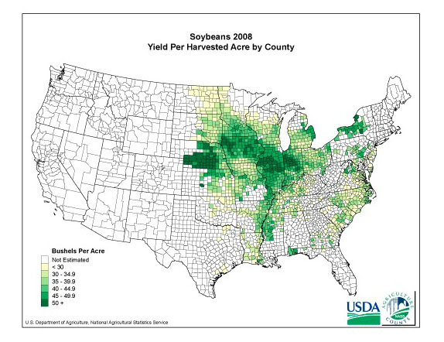
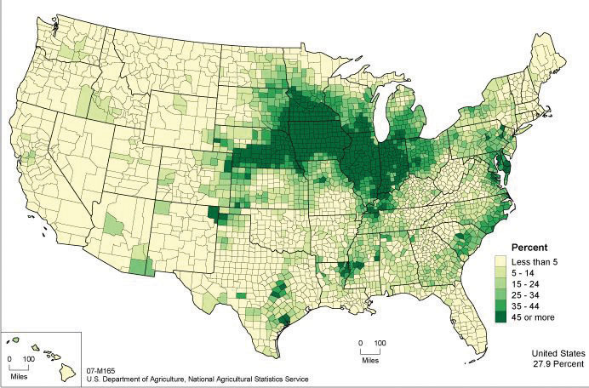
Corn and Soybeans are production substitutes
You can figure out price implications on your own – that’s the fun part!
Ariel can tell us all about Corn
CORN
SOYBEANS

Slide 16
Wheat – best left to Canadians
Brendan can tell us about wheat

Slide 17
Demand Side
Corn and Wheat are demand substitutes, in both human feed and animal feed
Corn and Soybeans are also demand substitutes – oil and protein
Corn-ethanol and soybean methyl ester (biodiesel) linked through energy markets and biofuel policies
Remaining protein are substitutes in animal feed
You can do the historical price charts and correlations yourselves to see the relationships

Slide 18
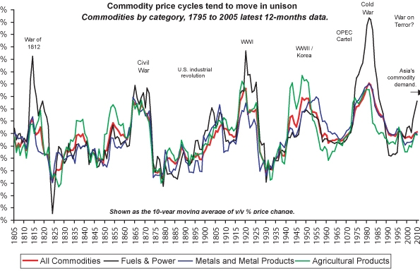
Source: Barry Bannister

Slide 19
Energy Price is the leader
Why does the price of energy lead all other commodities?
Everything we harvest from the planet requires energy. If energy were infinitely cheap, it would be possible to convert a mountain into pure elements for no cost. All commodity prices would move toward zero.
Food still requires other inputs (biological and chemical transformation in addition to mechanical transformation) but modern day ag. production is highly energy intensive

Slide 20
Some Things to watch
Supply
Crop reports, weather reports, planting
Competitor production, planting
Demand
Import Demand (e.g. BRIC countries)
Biofuel Regulations
Crude Oil price
Macroeconomic / Political Events:
FX and Bond markets go first
Energy and Industrials next
Soft commodities usually go last, but biofuel has tightened the relationship
Equity (Stock) markets are temperamental

Slide 21
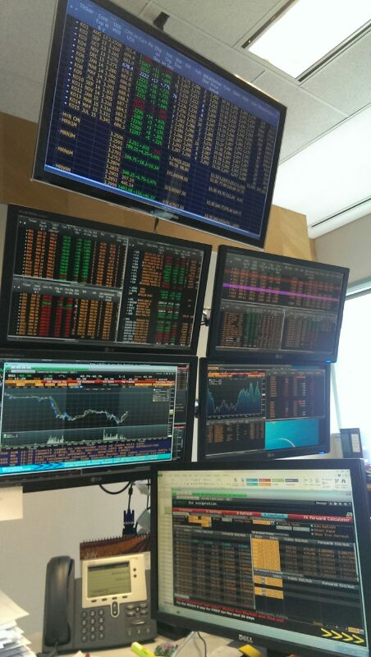
I don’t watch TV anymore
Keeping an Eye on:
Palm futures curve
USD-MYR forward rates
Soybean Oil (CBOT) , Dalian Refined Palm Olein
Energy (Crude, coal, nat gas), FX markets, Major equity markets
U.S. 10 year bonds, Major Bank CDS

Slide 22
USDA crop report on the 12th
http://www.fas.usda.gov/cmp/circular_schedule.asp
September 2013
 | 6 | U.S. Export Sales | 8:30 a.m. EST
 | 12 | Cotton, Grains, Oilseeds, and World Agricultural Production Data | 12:00 p.m. EST
 | 12 | Cotton: World Markets and Trade | 12:15 p.m. EST
 | 12 | Grains: World Markets and Trade | 12:15 p.m. EST
 | 12 | Oilseeds: World Markets and Trade | 12:15 p.m. EST
 | 12 | World Agricultural Production | 12:15 p.m. EST
 | 12 | U.S. Export Sales | 8:30 a.m. EST
 | 13 | Raisins: World Markets and Trade | 3 p.m. EST
 | 19 | U.S. Export Sales | 8:30 a.m. EST
 | 19 | Stone Fruit: World Markets and Trade | 3 p.m. EST
 | 26 | U.S. Export Sales | 8:30 a.m. EST
Expect heavy volume of trading just before and just after the announcement, as markets adjust to new information.
I’m gonna blog about this
A+

Slide 23
Economic Calendars
Yahoo Economic Calendar:
http://biz.yahoo.com/c/ec/201338.html
Bloomberg Economic Calendar:
http://www.bloomberg.com/markets/economic-calendar/
CME Economic Calendar:
http://www.cmegroup.com/education/econ_calendar.html
So many interesting things happening in the world

Slide 24
Where to Click in Stocktrak

