Slide 1
FRE 501 2013 Lab 3
Information and Expectations
Trading/Investing/Speculating
Admin

Slide 2
Mission Statement
Understand how commodity futures markets work,
Formulate and refine trading and hedging strategies, Learn and practice risk management,
In preparation for future professional roles

Slide 3
Federal Open Market Committee
FOMC meets 8 times a year to discuss/set the fed funds rate – the short term interest rate in the USD, amongst other things
Today is one of those 8 times. They release their statement around 2 pm on wednesday
Hawkish (aggressive) vs Dovish (peaceful) raise rates higher vs keep low rates
Why it Matters:
Fed monetary policy has been driving global economy since 2008

Slide 4
‘Carry’ Trade
Carry Trade: Borrow cheap money to buy risk assets
In 90s, JPY was the carry currency
In late 2000s, USD became the carry currency
People (banks, businesses, housewives) effectively been borrowing USD to buy :
Higher yielding currencies (AUD, IDR, MYR, INR, BRL, etc)
Real estate (Australia, HK, SG, Canada)
Current debt to gdp levels close to US housing bubble at its peak in 06-07
Riskier, higher yielding debt
in 2008/09 Indonesia borrowed at 20%
In 2011/12 Indonesia borrowed at 3%
In 2011: Mexico sold US $1bil of 100 year bonds
Commodities, including precious metals (AU, AG)
Markets have a short memory
Mexico defaults
(1827, 1833, 1844, 1850,1866, 1898, 1914, 1928-1930s, 1982)

Slide 5
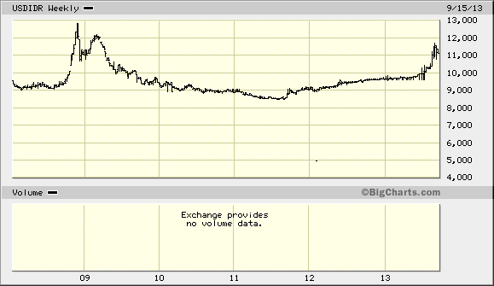
Carry Trade is unwinding as people flee risk assets (again) USDIDR

Slide 6
USDINR

Slide 7
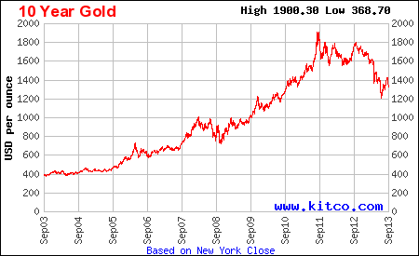
Gold

Slide 8
Information and Prices
Information
Expectations
Prices
Some human intelligence
If actionable
Notes:
New Information leads to Revised expectations, which leads to action, which leads to updated prices
Technology has made this process very fast, but human behavior will never change

Slide 9
The price of information
NYC: The $100,000 phone call
Bloomberg terminals – US24k a year
Inside Information:
Commodities, are subject to a different form of regulatory oversight compared to equities
Stock regulations are designed to protect the ‘little guy’. Commodity futures have no such concern, the concerns are with default risk/contagion and market manipulation

Slide 10
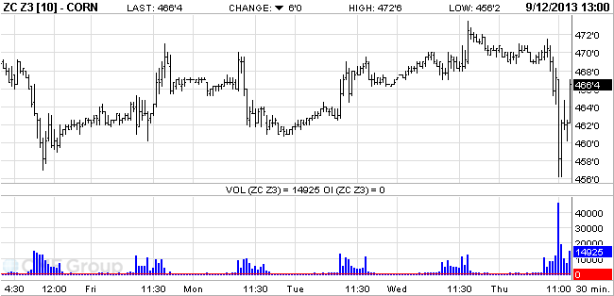
Information flows quickly nowadays
Corn at Last Week’s Crop Report
Notes:
Rapid drop, and increase – why?
Probably a bad headline, and then the fine print came later

Slide 11
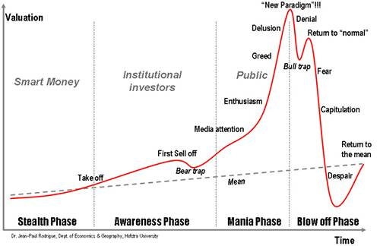
But Human Behavior will never change: Anatomy of a Bubble
Notes:
This applies to all markets – stocks, commodities, real estate, tulips,

Slide 12
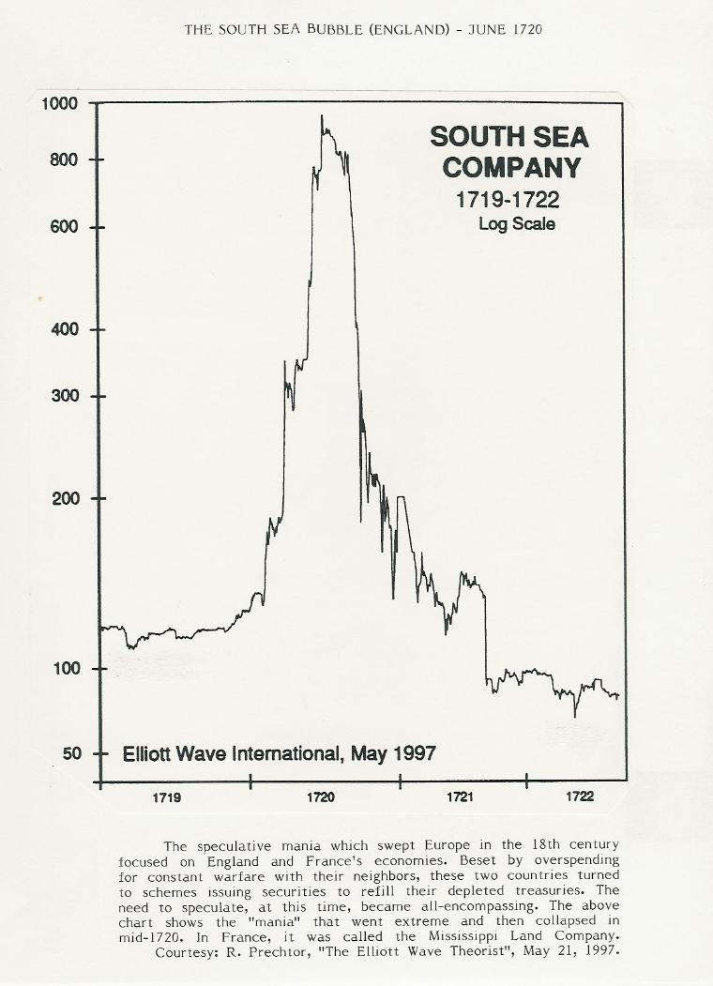
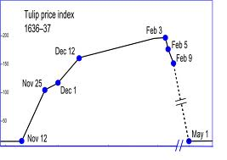
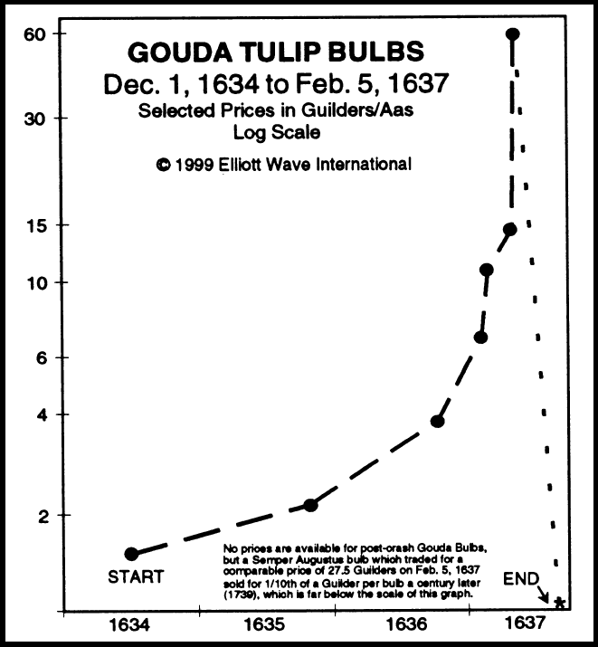
Bubbles

Slide 13
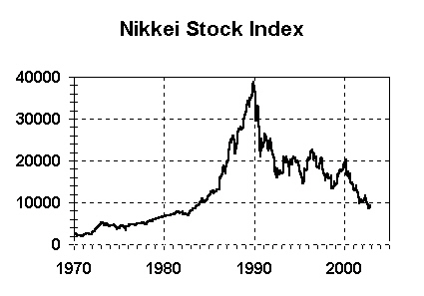
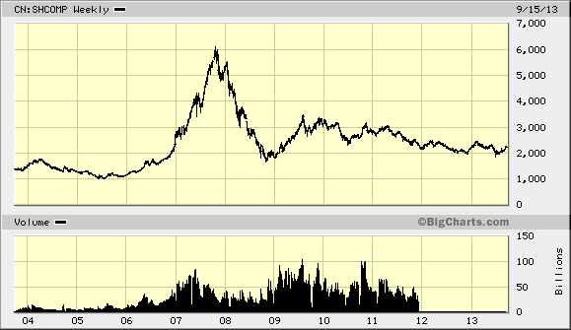
Bubbles
Japan Nikkei peak in 1990
China Shanghai Index peak in 2007
One guess for China Real Estate

Slide 14
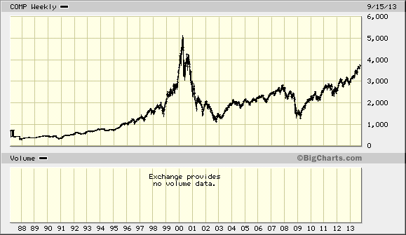
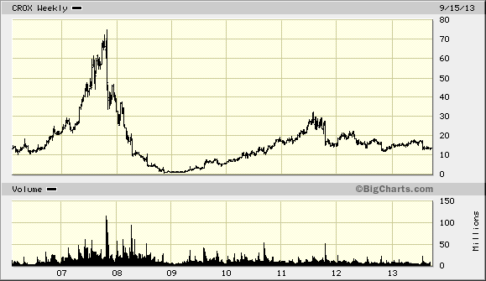
Tech bubble Nasdaq
Crox Stock

Slide 15
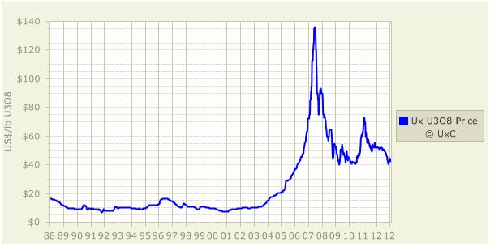
Less common – Uranium Bubble

Slide 16
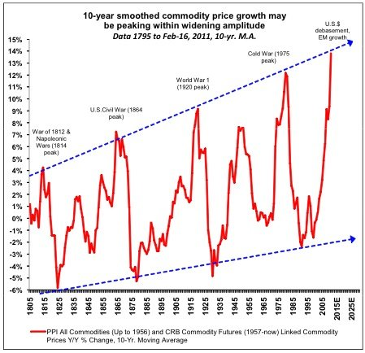
Current commodity super-cycle seems over

Slide 17
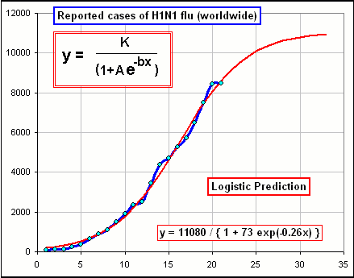
Information Transmission - just like the flu
Flu infection rate follows a logistic curve

Slide 18
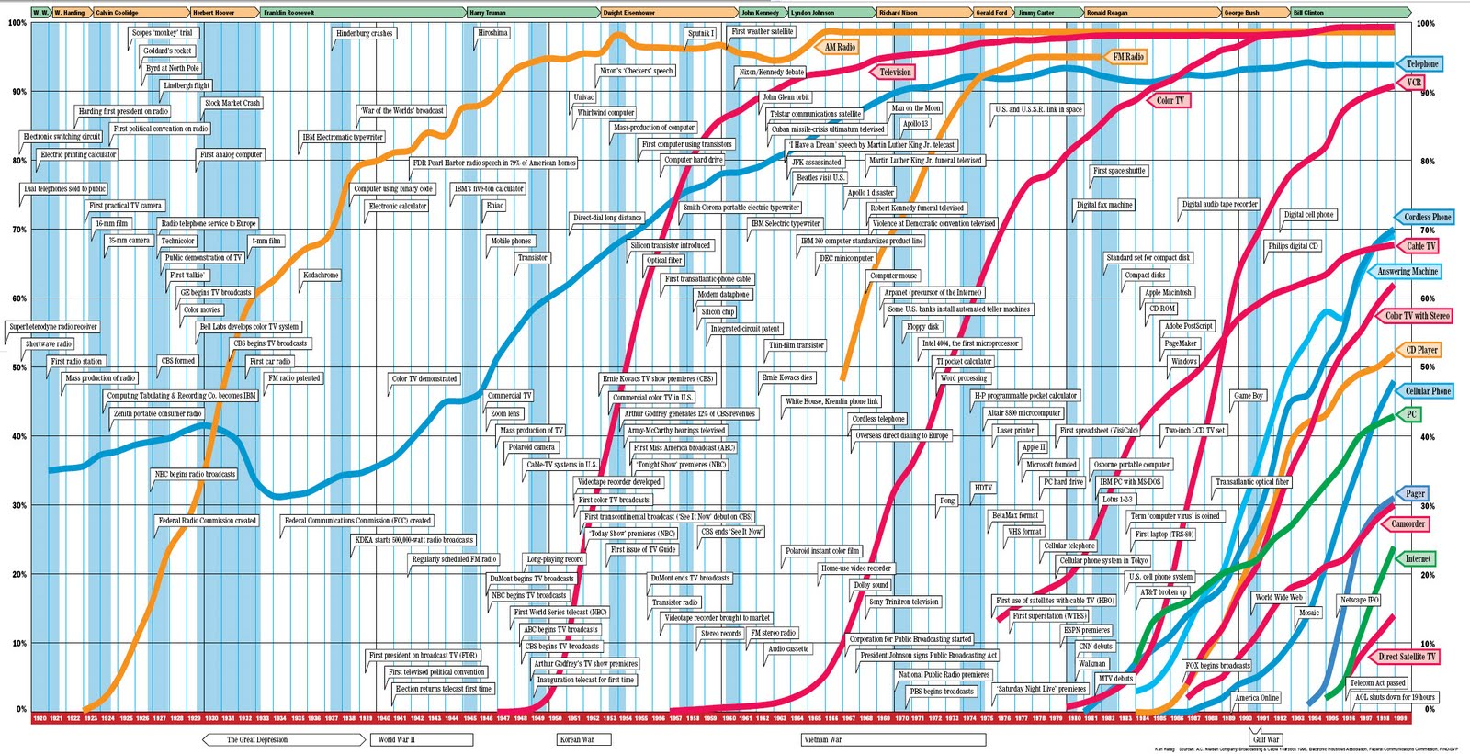
Technology Adoption “S” Curves
(related to the often cited network effect)
Notes:
Technology adoption works exactly the same way

Slide 19
Adoption effect on markets
Markets are based on human interaction
Information spreads in a logistic pattern Short term implication: prices adjust slowly, then rapidly, then slowly again
Expectations also spread accordingly Longer-term implication: human exhibit herdish behaviour as beliefs and expectations converge – bubbles form, inevitable booms and busts, Apple at $700

Slide 20
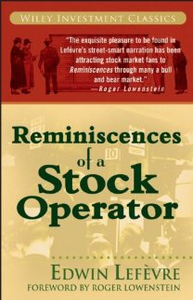
Some Interesting Resources
Barry Bannister – Expert on cyclicals (includes commodities)
Psychology of traders
http://www.financialsense.com/contributors/barry-b-bannister

Slide 21
Investing vs Speculating
Same Goal:
To end up with more than one started with
Different approaches:
Productive vs. Non-productive
Farming – planting one seed to harvest many later
Robbery, Gambling – taking from others, the fruit of their labour
Notes:
Some have asked about the difference between investing and speculating

Slide 22
What is trading?
Buying Goods where they are plentiful and Selling them where they are scarce
Local Setting: retailers and distributors are traders grocery stores, supermarkets, stationery shops
Regional Setting: traders move the goods between regions
Rural-Urban, Inter-city, Inter-country Large commodity trading firms: ADM, Bunge, Cargill, Dreyfus, Wilmar, Noble
Market-makers: provide liquidity to aid functioning of market
Prime brokerages (banks), used car shops

Slide 23
Ending Points
Tweeting: Use #mfre - experiment a little
Blogging:
Great way to share your thoughts/experiences (even if unrelated to the classes) with your classmates – feel free
Trading Game:
Remember the learning objectives You have 6 weeks to make as many mistakes as possible
Doing nothing to be in the middle of the class would be a tragic waste of a learning opportunity – you would remember nothing, and nobody will remember you either

