Slide 1
FRE 501 2013 Lab 4
Reflections on Week 1
Deviations from LOOP

Slide 2
Mission Statement
Understand how commodity futures markets work,
Formulate and refine trading and hedging strategies, Learn and practice risk management,
In preparation for future professional roles

Slide 3
Thank you Group 1

Slide 4
The Fed
So, given all the action last week, does the fed’s money printing affect commodity prices?

Slide 5
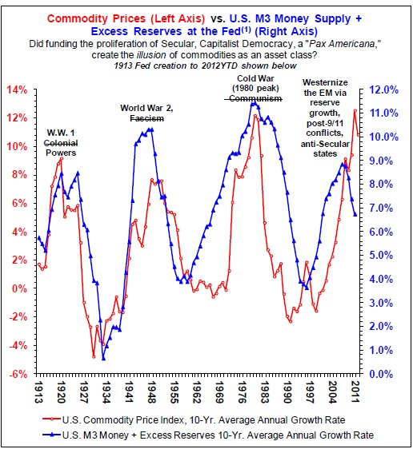

Slide 6
Law of One Price
Really nice model - helped me to understand the range of prices I observed in different ports/markets but couldn’t reconcile
But there are significant deviations in real-life for a variety of reasons, usually short-term, as they get ‘arb’-ed away

Slide 7
CHINA IMPORTER MARGINS
Olein = refined palm oil, ready for consumption CPO = Crude Palm Oil BMD = Bursa Malaysia Derivatives Exchange
Refining Cost ~ 40

Slide 8
Notes:
Chinese Government been fighting inflation with fixed rates, but more significantly, with bank lending quotas. Loan quotas towards the end of 2011, created a credit crunch in China (black market rates >20%). All loans restricted except for one category: strategic commodities – food, metals, timber
Relatively price indifferent – import against a bank LC at 3% (12 month term) and sell local at 5% loss for cash. Lend cash out at 20+% to pocket the difference. Extremely large import-financing game, still going on today

Slide 9
Notes:
Significant difference between futures price and cash price in early 2012. Why?

