Slide 1
FRE501 Trading Game: Week 1
Team 1
Blog Evaluation
Brendan, Mike, Sang and Vanilla

Slide 2
Initial Thoughts
Great work on the blogs everyone!
Diverse range of submissions.
Enjoyable reading personal views and experiences.
Ranking process WAS NOT an easy task when they are all so good!
As for our portfolio performances; it was a bit bleaker of a picture.
Don’t worry, week one blog evaluations WERE NOT based on portfolio performance. (if they were; most of us would not be getting very good grades…)
Notes:
Cool to see everyon

Slide 3
Overall Portfolio Performance
Not a great first week for the MFRE 2013 class.
Class average percent return -3.8%.
Class portfolio value average down to 96,216.45.
Highest return, 1.1%, Lowest return -13.4%.
Total class loss of -$105,147.50 attributed to long positions.
Short positions netted $2,710.00.
All statistics as of market close Friday September 20th. (some major changes already this week)

Slide 4
Overall week 1 returns

Slide 5
MFRE 2013 portfolio value over WEEK 1

Slide 6
Overall Portfolio Performance
Congratulations to Tekuni for ending week one at No.1 (1.1% return).
To conclude, week 1 was a rude-awakening to the constant price fluctuations of commodity markets.
Are these losses the result of poor decision making or surprising market events?
Mike, will now discuss this weeks big market altering news.

Slide 7
USDA Crop Production Report
Released on September 12
Slight increase in the expected U.S. corn production for 2013
3% reduction in estimated 2013 U.S. soybean production

Slide 8
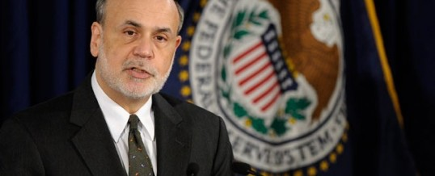
NO TAPER!
The economy wasn’t strong enough
The Dow and S&P 500 averages surged to record highs
Commodity market spiked
Notes:
Talk about how no one really seemed to benefit from this

Slide 9
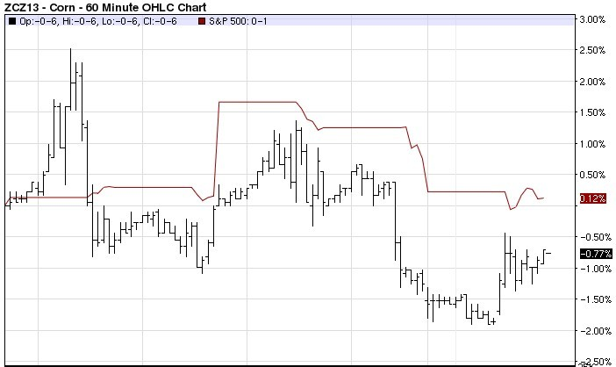

Slide 10
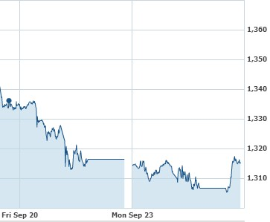
Bullard Taper Comments
St. Louis Federal Reserve Bank President James Bullard told Bloomberg News that a taper in October is possible
Commodities futures depressed
December corn sank 8.5 cents to $4.51/bushel at its Friday settlement
November soybeans dove 24.25 cents to $13.1525/bushel to end the week

Slide 11
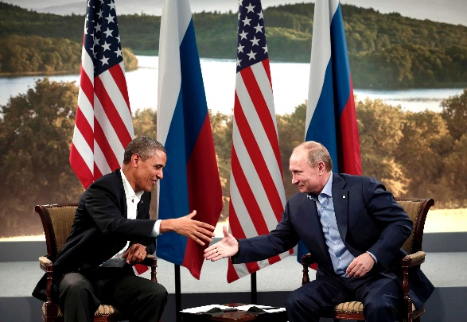
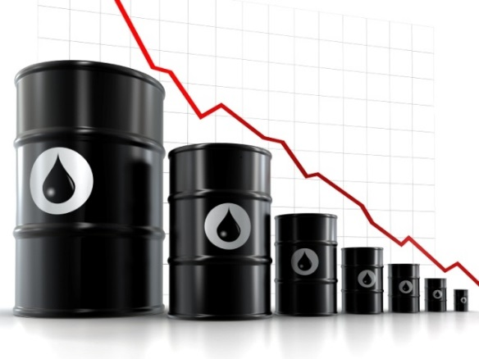
Ease in Syria Tensions
On Friday, Syria submitted information outlining the scope and site of its chemical weapons program to international authorities.
The price of October crude oil future fell about 1.6% on Friday and the weekly loss is more than 3%.
This drop in oil price contributed to the decline of commodities last Friday

Slide 12
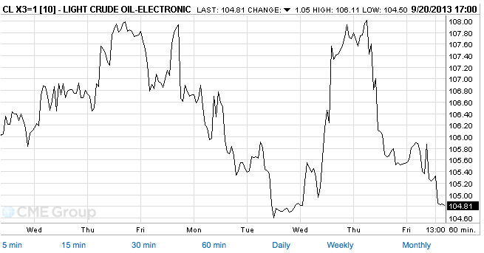
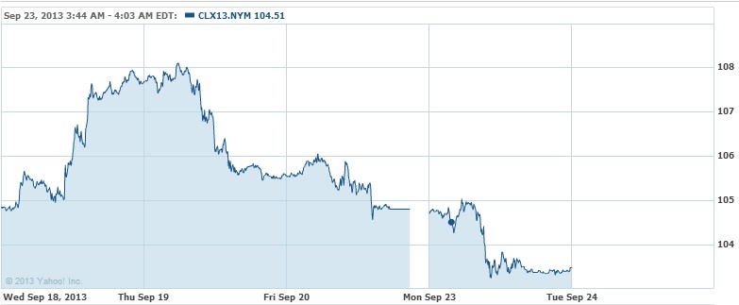

Slide 13
Evaluation Criteria
Post on time
A brief summary of trade and portfolio
Lessons learnt from your trading performance
Strategy for the week ahead, if any
Related news and resources for the class, if any
Quality rather than quantity
Notes:
Rather than

Slide 14
Top 5
Alejandro Barrero
Amanda Ji
Ariel Kagan
Linda Mao
Ruiji Wu
Notes:
vanilla

Slide 15
Ruiji Wu
A good model--- brief & sound;
Briefly conclude her trading options and returns;
Use facts & graphs to explain her loss;
Share lessons learnt from the game
List some news resources
http://blogs.ubc.ca/wrj1991/

Slide 16
Linda Mao
Brief summary of the trading decision;
Logical analysis for her trading options;
Learn lessons in respect of information filter, fast response to the big news, options of strategies and basic principle for judgement;
Connect reliable sources when necessary .
http://blogs.ubc.ca/maoling/

Slide 17
Amanda Ji
Well structured and organized
Lots of research work
Detailed analysis for each commodity
Clear reasoning
Relates world-wide news/trends to the trading
Passionate about futures trading
http://blogs.ubc.ca/amandaji/

Slide 18
Ariel Kagan
Excellent writing, blog was very enjoyable to read.
Clear demonstration of effort.
Clear description of week’s trades (portfolio overview)
Great use of visuals, both pictures and graphs.
Draws strong conclusions for weeks current events.
Inclusion of resources.
http://blogs.ubc.ca/akagan/

Slide 19
Alejandro Barrero
Good analysis of the decreasing coffee price
Graphs perfectly visualize the trend of price
Quite concise and clear
A portfolio summary will make it better
http://blogs.ubc.ca/alejandro/
Notes:
sang

Slide 20
Overview
Overall good performance on blog
Overall not-so-good portfolio performance
Information, Resource, Lessons
Notes:
sang

Slide 21
Recommendations
Do a portfolio summary
Blog VS.Paper
Make sure your blog accessible ON TIME
Add comments to earn EASY EXTRA POINTS (2pts each for top 5 comments)
What else? (class discussion)

Slide 22
Thank You
&
Good Luck Next Week

