Slide 1
Week three MFRE FUTURES TRADING GAME
Ariel, Tekuni, Mia, Linda

Slide 2
Outline
This week’s news
Spotlight: US Gov’t Shutdown
MFRE Portfolio reviews
Lessons Learned this week
Top Blogs!

Slide 3
This week’s news
USDA crop report

Slide 4
What did it contain?

Slide 5
Same old news

Slide 6
Crop stocks higher than expected
Corn
Soybean
China going to need more
etc etc

Slide 7
What do we do with it?

Slide 8
Read it

Slide 9
And make trading decisions

Slide 10
The question is....do we really do that!!!

Slide 11
Maybe no! For a number of us

Slide 12
Yes for some!

Slide 13
Did it move the market?

Slide 14
Most of us were not sure

Slide 15
Why?

Slide 16
We didn’t read it

Slide 17
We still not sure of how to relate the report to market

Slide 18
Can’t wake up at 3am

Slide 19
Sense some fatigue

Slide 20
people become tired of blogging video making and homework

Slide 21
Brendan says completing Masters while trading ......is like driving while texting

Slide 22
You’ll drive into a ditch!

Slide 23
US Government Shutdown

Slide 24
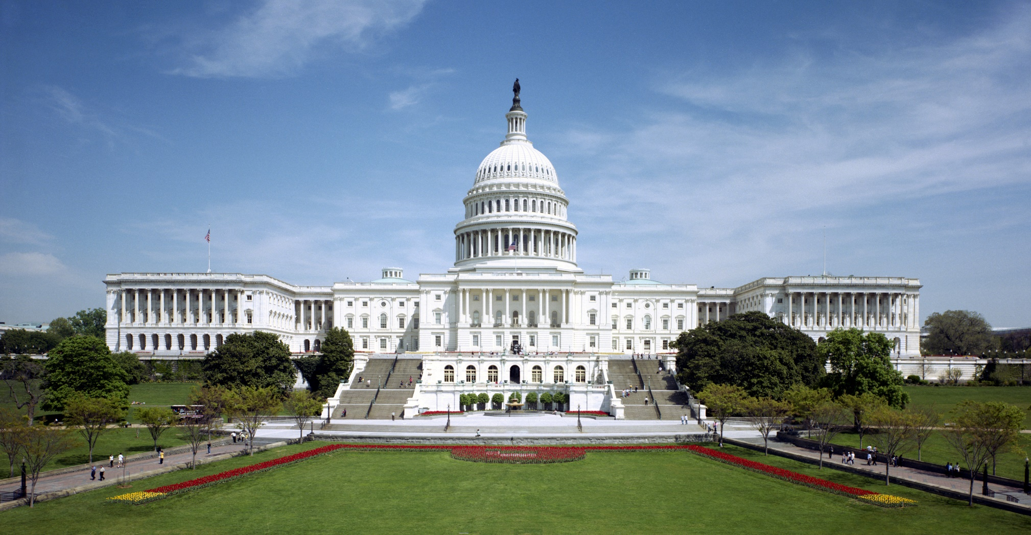
What happened?

Slide 25
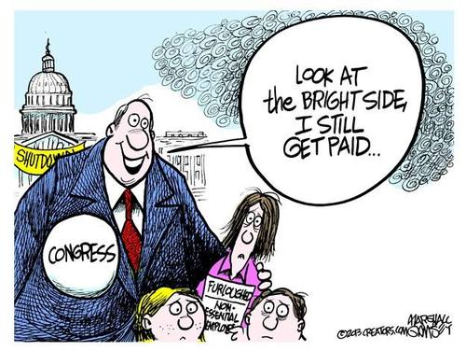

Slide 26
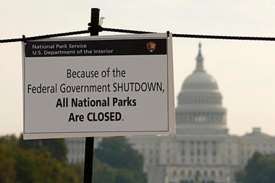
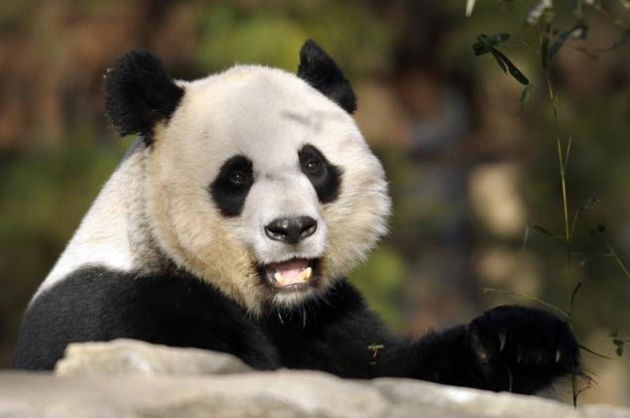
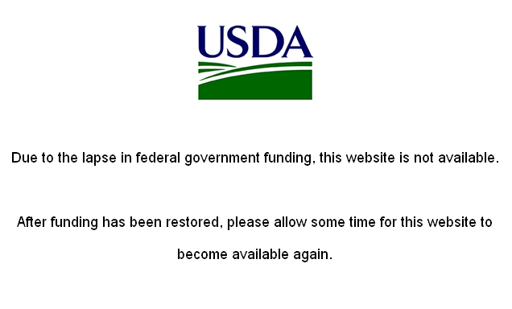

Slide 27
Lessons learned
Keep Calm
Try new strategies
Tell stories!

Slide 28
Week Review of MFRE Portfolio Performance
Sep 30 – Oct 4

Slide 29
Overview of portfolio return

Slide 30
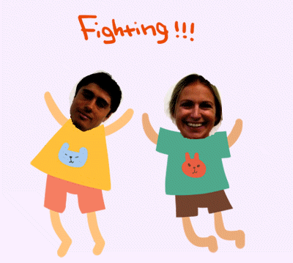
Trades Made Since First Week

Slide 31
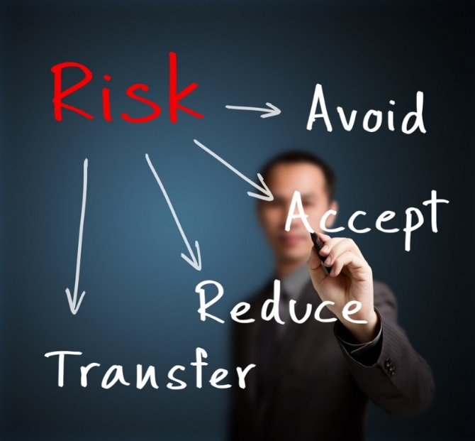
Sharpe Ratio
Getting Paid for Risk
A measure of what an investment returned for each "unit" of risk it carried.
The higher the Sharpe ratio, the better the investment's historical risk-adjusted performance.
$$\frac{\text{(}\text{Expected} \text{Portfolio} \text{Return}\text{ − }\text{Risk} \text{Free} \text{Rate}\text{)}}{\text{Portfolio} \text{Standard} \text{Deviation}}$$
Notice: Sharpe ratios work best when figured over a period of at least three years.

Slide 32
Sharpe Ratio Rankings

Slide 33
Top bloggers pool
Harmony
Airlie
Bee
Ruiji
Vanilla
Laura
Suey
Alex
GianMacro
Amanda

Slide 34
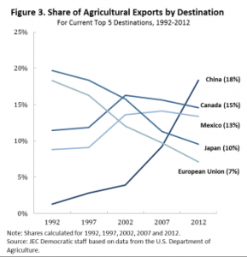
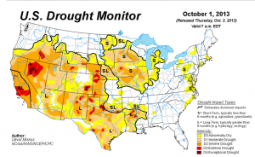
Vanilla
Vivid explanation of trading decision
Creative
Professional
Vanilla Chen

Slide 35
Laura
Introduce new concepts and application in analysis
Open interest
Spread
Correlation matrix
Combine the theory with her experience and analysis
Professional and deep analysis
We need more!
Laura

Slide 36
Harmony
Alex
Creative strategy base-fartlek
How to lose money-season 2
Two hedge position with two stop order
harmony's mfre blog
alex

Slide 37
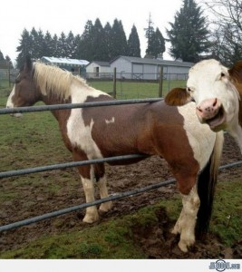
Airlie
Livestock future
New information
Analysis
Airlie

Slide 38
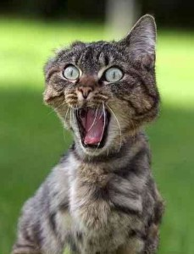
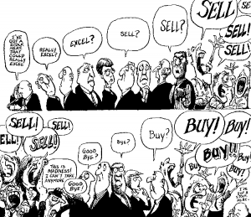
Amanda
Bee
Amanda style format!
Forecast of fall in volume
Great graphics
Well-written
Good analysis
Forecast of fall in price
U.S. shut down
Amanda
Bee

Slide 39
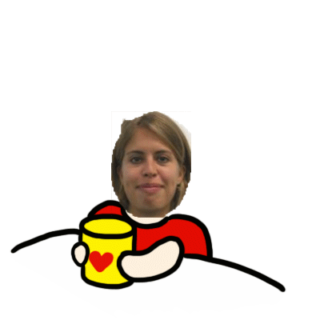
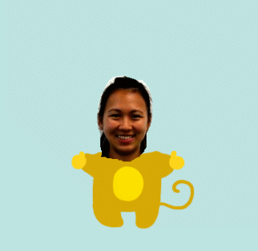
TOP FIVE BLOGGERS
Notes:
Beginning course details and/or books/materials needed for a class/project.

Slide 40
Thank you for listening!

