Slide 1
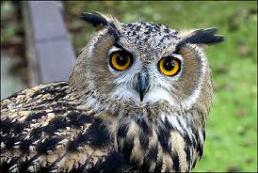
Food Web Investigation: Owls
Grade 1: Life Sciences – Needs of Living Things
Grade 7: Processes and Skills of Science – Scientific Method
Created by Kshamta Hunter and Marina Milner-Bolotin
Email: marina.milner-bolotin@ubc.ca kshamta@interchange.ubc.ca

Slide 2
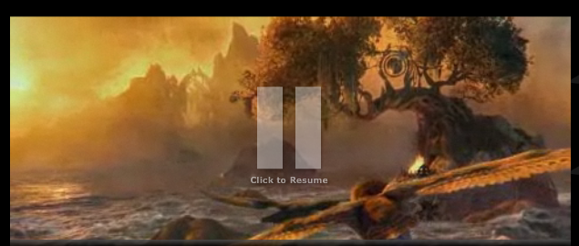
Owls in a Movie!
Legend of The Guardians : The Owls of Ga Hoole
Notes:
http://www.metacafe.com/watch/4803159/legend_of_the_guardians_the_owls_of_gahoole_movie_trailer/
Part I: Preparation – Getting the Students Excited and Ready for the Owls Activity!

Slide 3
Q1: Myth or Fact?
Owls do not drink water.
True
False
Notes:
Every animal needs water but owls usually get most of their water from the blood of the animals they eat!
CORRECT ANSWER: B

Slide 4
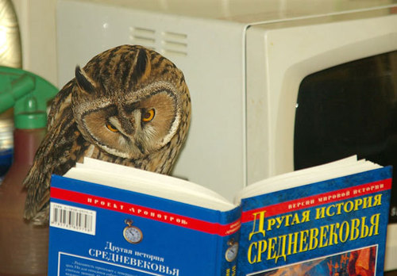
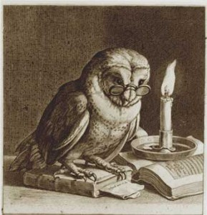
Owls in Children’s Books
Owls in children's books in different cultures! Are owls wise?
Notes:
Why are owls always depicted as wise creatures?
Athena – Greek goddess of wisdom is always accompanied by a owl!
Their wisdom has been associated with their solitary and nocturnal nature and also their clarity of vision in dark
Owl in different cultures are depicted differently: from wise to really bad creatures (bad sign in Kenyan culture).

Slide 5
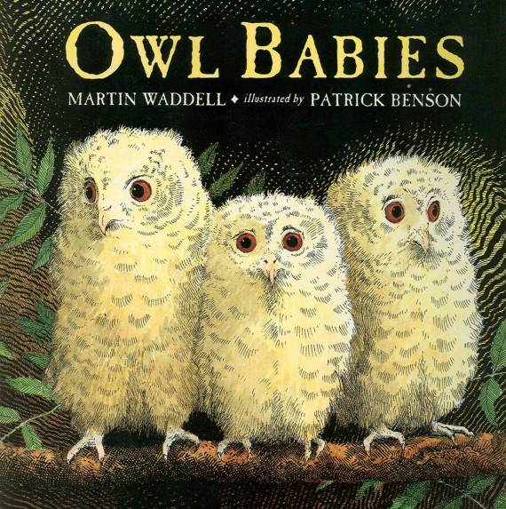
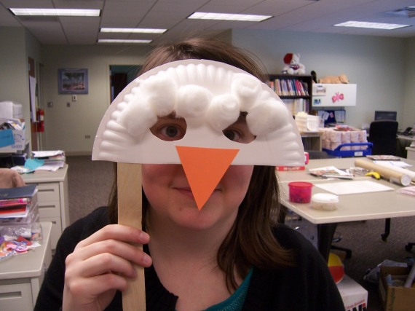
Owls in Children’s Books
Notes:
Good books to read with elementary students and make an owl mask at the end of the activity
Wow: book about owl staying up during the day to see all the neat things and colors during the day, students explore and learn about various colours
Owl babies: book about baby owls finding their mom.

Slide 6
Modified Jigsaw Collaborative Group Activity
Each group has information on one owl (1 card):
Simplify – synthesize your info
Share the information among all groups
Build owl classification based on what you found
Share your classification with others
Notes:
Use pictures of owls and short descriptions of various owls and classify them.
Every group gets 1 owl description – they have to translate a complicated description into simpler one and write down the most important features and then share the summary with other groups

Slide 7
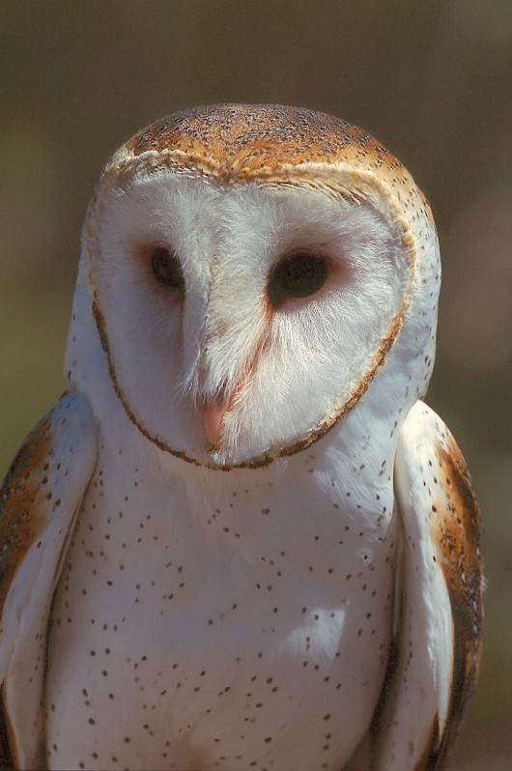
Group 1: Barn Owls
These pale, nearly worldwide, birds are closely associated with man through their traditional use in the Old World of barn lofts and church steeples as nesting sites. The species name "alba" also refers to the colour white.
Habits: Generally nocturnal, although it is not uncommon to see this species emerge at dusk or be active at dawn, occasionally being seen in flight during full daylight. Flight is noiseless, with wing beats interrupted by gliding.

Slide 8
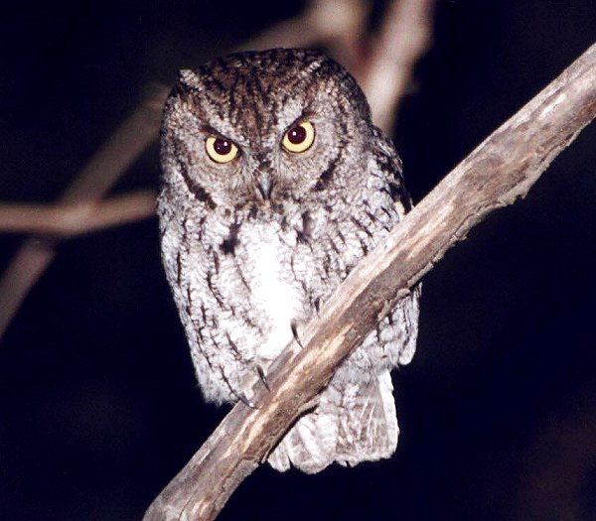
Group 2: Screech Owl
The Western Screech Owl is a small, nocturnal, woodland Owl of western North America and is one of the west's more common Owls at lower elevations.
Habits: Nocturnal, with activity generally beginning 20-30 minutes after sunset. Flight is noiseless with soft wing beats and gliding. Will become motionless if disturbed at roost, and can sometimes be caught by hand in this state. This owl is very aggressive when defending a nest site, and may attack humans.

Slide 9
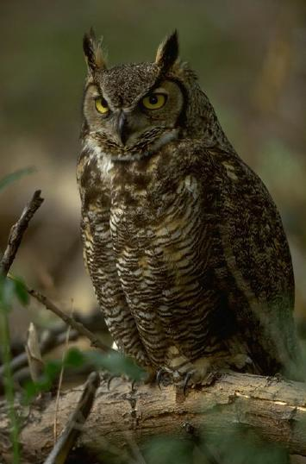
Group 3:The Great Horned Owl
Great Horned Owls can vary in colour from a reddish brown to a grey or black and white. The underside is a light grey with dark bars and a white band of feathers on the upper breast. They have large, staring yellow-orange eyes, bordered in most races by an orange-buff facial disc. The name is derived from tufts of feathers that appear to be "horns" which are sometimes referred to as "ear tufts" but have nothing to do with hearing at all.
Habits: Activity generally begins at dusk, but in some regions, may be seen in late afternoon or early morning. Both sexes may be very aggressive towards intruders when nesting.

Slide 10
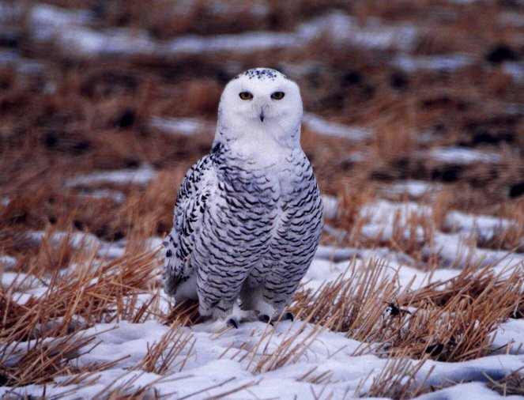
Group 4: Snowy Owl
The Snowy Owl is a large, diurnal white Owl that has a rounded head, yellow eyes and black bill. The feet are heavily feathered. A distinctive white Owl, their overall plumage is variably barred or speckled with thin, black, horizontal bars or spots. Intensity of dark spotting varies with the sex of the immature females being the darkest. Juveniles are uniformly brown with scattered white tips of down.
Habits: Snowy Owls are active during the daytime, from dawn to dusk. They make short flights, close to the ground, from perch to perch, and usually perches on the ground or a low post. During hot weather, they can thermo-regulate by panting and spreading their wings. Snowy Owls are very aggressive when defending their nest.

Slide 11
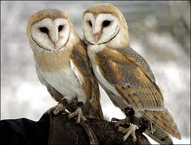
Scientific Owl Classification
Kingdom: Animalia
Phylum: Chordata
Subphylum: Vertebrata
Class: Aves
Order: Strigiformes
Family Tytonidae (barn and bay owls) and Strigidae (other owls)
Notes:
http://www.enchantedlearning.com/subjects/birds/info/Owl.shtml
Barn Owl
Pedagogy: post activity questions, find out how much students have learned and give them some feedback and terminology.

Slide 12
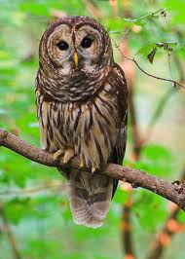
Q2: Owl Vocabulary (Fun Fact)
Owls are typically solitary birds. However, a group of owls is called a:
Hound
Colony
Troop
Parliament
Flock
Barred Owl
Notes:
Pedagogy: What is the purpose of this question? In order to know what and how much kids know?
Barred Owl:
CORRECT ANSWER: D
A parliament or a study of owls… Two cools words!
Notice, we have only 5 options for answers in i-clickers (other clickers offer more choices).

Slide 13
The Food Web Group Activity: Where do Owls Belong?
Notes:
Activity: Work in groups to put examples in each section and then put owls in the section where you think it belongs.

Slide 14
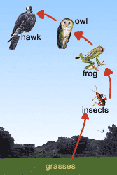
Quaternary Consumer Tertiary Consumer Secondary consumer Primary consumer Primary Producer
Notes:
Multiple representation of the same concept.

Slide 15
What do the Words Autotrophs and Heterotrophs mean?
Trophs
Nourish
Auto
Hetero
Self
Other, different

Slide 16
Does your answer make sense?
Trophs
Nourish
Auto
Hetero
An organism capable of synthesizing its own food from inorganic substances
An organism that relies on organic substances for nourishment
Notes:
In your view, will giving students these definitions right away be pedagogically sound?

Slide 17
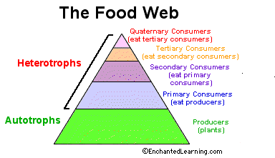
Where do Owls belong?
Notes:
Introduce hetero and autotrophs explain what the words mean.
http://www.enchantedlearning.com/subjects/birds/info/Owl.shtml

Slide 18
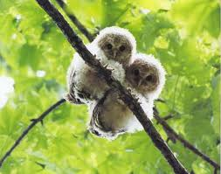
Q3: The Food Web
Which trophic level do owls have on the food web?
Primary
Secondary
Tertiary
Quaternary
Baby Owls
Notes:
Pedagogy: Post activity question!
CORRECT ANSWER: C

Slide 19
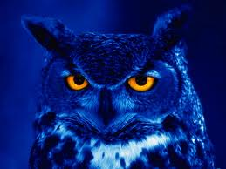
Q4: Predator-Prey
Do owls have any natural predators?
Yes
No
Don’t know
Night Owl
Notes:
Pedagogy: Post activity question, related to the groups activity.
Teacher’s assessment of how much student have learned so far from the activity.
List what they think of the possible preys of owls: Eagles, Hawks…
CORRECT ANSWER: A

Slide 20
Q5: Predator-Prey
In your view, how is the population of the top predators/consumers controlled?
Too much competition within these animals for food
These animals are not able to hunt very well due to their size
There is a dynamic equilibrium that exists between predator-prey populations
Notes:
Pedagogy: Discussion question!!! Co-construction of understanding, in groups!
WORDING: If the predators hunts too much, they run out of prey and the prey cannot sustain a large population
CORRECT ANSWER: C

Slide 21
Predator-prey population Equilibrium
Predators control the prey population by feeding on them, however if they eat too much of the prey, a decline in the prey population will also subsequently decrease the predator population. When the predator population declines, the prey population expands. Therefore a dynamic equilibrium exists between the two populations.
Notes:
Pedagogy: Explain and introduce the new term after group discussion!

Slide 22
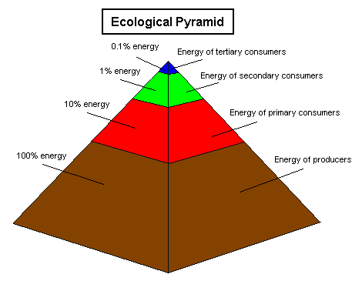
Energy at trophic levels
Energy is lost at each trophic level at each consumption!
Notes:
Energy consumption at each trophic level: could remove this slide, depending on how much you want to cover and the level of understanding for your students. Needs a bit of background and discussion.

Slide 23
Homework Ideas

Slide 24
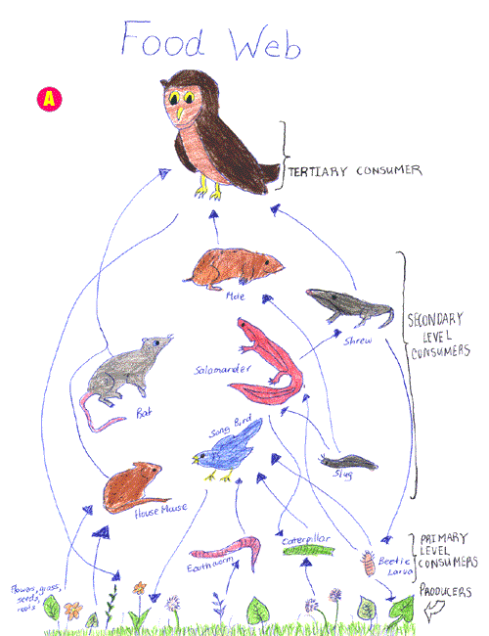
The FOOD WEB
Tertiary consumer
Creating a Food Web Diagram
Secondary consumer
Primary consumer
Producers
Notes:
http://schools.nyc.gov/offices/teachlearn/documents/standards/science/ms/101owl.html

Slide 25
Create Your Own Owl Puzzle
Food web
Heterotrophs
Autotrophs
Primary consumer
Primary producer
Secondary consumer
Tertiary consumer
Quaternary consumer
Ecological pyramid
Energy
Diurnal
Population
Equilibrium
Dynamic equilibrium
Stable equilibrium
Dynamic Equilibrium
Parliament
Barn own…
Owl pellet
Prey
Predator
Nocturnal…

Slide 26
Online Puzzlemaker

Slide 27
Vocabulary Games

Slide 28
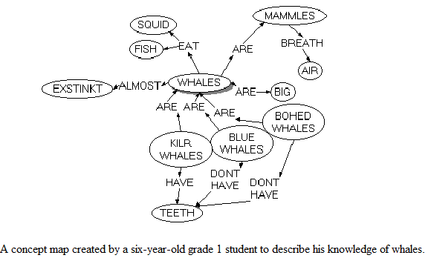
Owl Concept Map

Slide 29
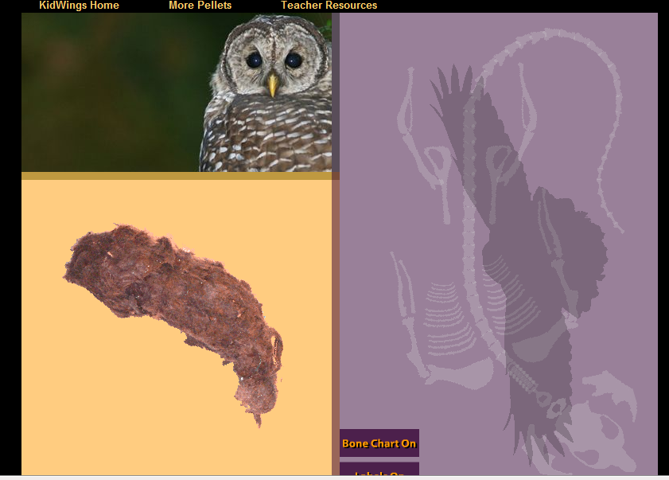
Virtual Owl Pellet Dissection
Notes:
You can have your students do a virtual online dissection before coming to the class to do the real dissection or if some students do not want to dissect a real pellet, they can do a virtual online dissection. Student also get a certificate at the end of the activity, this can be used to test if they have done the activity at home.
http://www.kidwings.com/owlpellets/flash/v4/index.htm

Slide 30
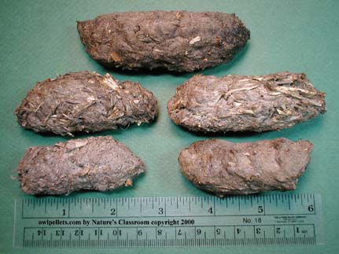
Part II: Owls Hands-On Activity – Dissecting an Owl Pellet

Slide 31
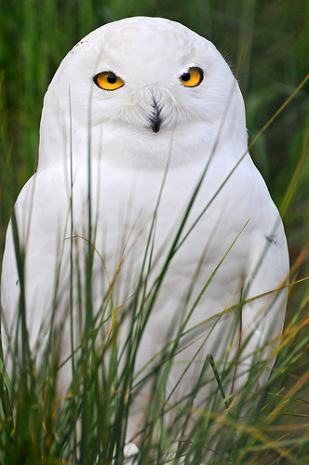
Investigation Activity P.E.O.E.: What do owls eat?
Hypothesis
Owls eat _____________
Experiment
Examine Owl’s regurgitated pellet
Data Collection
Investigate the bones, hair, feathers, nails, etc…
Conclusion
Was your hypothesis correct?
Snowy Owl from Zurich
Notes:
Pedagogy: Explain the scientific method and introduce the owl pellet activity.
PEOE: Predict, Explain, Observe, Explain

Slide 32
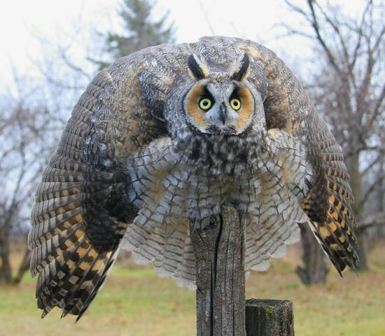
Pygmy Owl and other owls have pretty expressive body language if they are excited or alarmed
Interesting Fact!
Notes:
http://elkephant.wordpress.com/2008/05/
U-Tube Video: http://www.youtube.com/watch?v=BCgbYnNAbSM

Slide 33
Silent Killer
Owls' Silent Flight May Inspire Quiet Aircraft Tech
http://news.nationalgeographic.com/news/2004/12/1217_041217_owl_feathers.html
Reasons for silent flight:
primary feathers on the owls' wings are serrated like a comb
the trailing feathers on the back end of the wing are tattered like the fringe of a scarf
the rest of the owls' wings and legs are covered in velvety down feathers

Slide 34
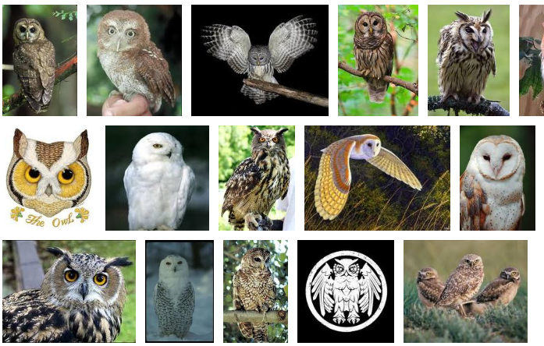
Owls in Pictures

