Slide 1
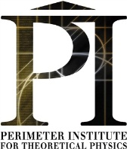
A Science Adventure of a Girl Who Wanted to Be a Physicist
Marina Milner-Bolotin
University of British Columbia
Vancouver, Canada
National Science & Engineering Research Council of Canada
Canadian Association of Physicists
Perimeter Institute for Theoretical Physics

Slide 2
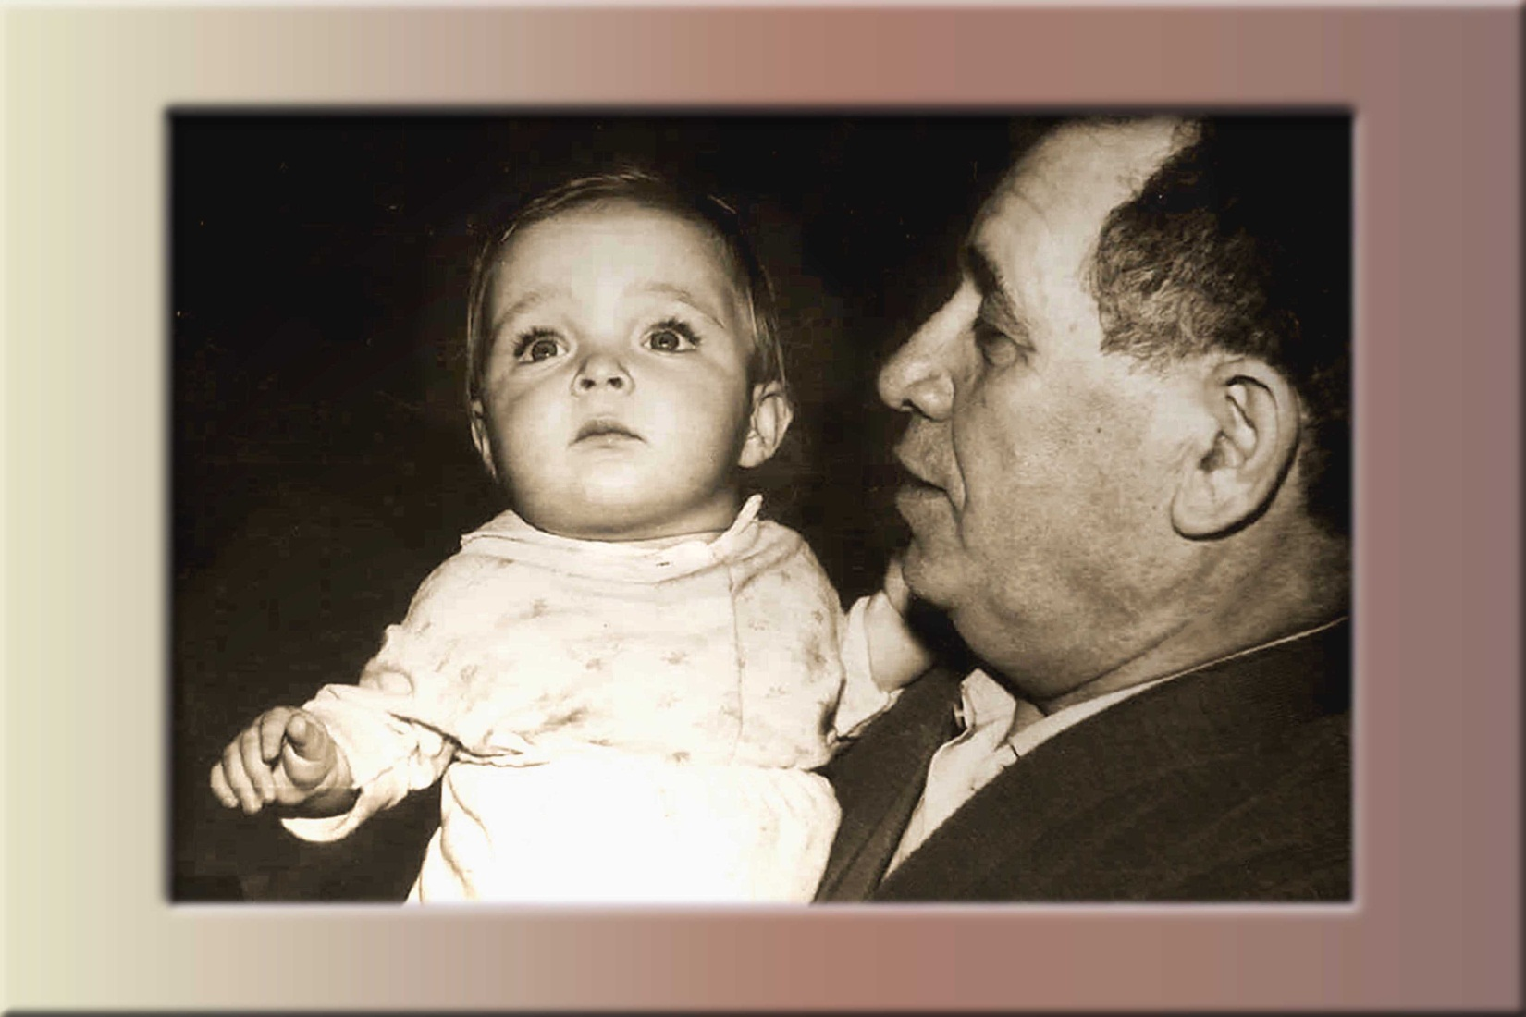
My Grandfather Encouraged Me to Study Physics at a Very Early Age
Notes:
My grandparents and my parents always encouraged me to study science. Their inspiration and support helped me believe in myself. They introduced me to amazing scientists like Richard Feynman… via encouraging me to read their books…
My grandparents and my parents
You can do it if you want it
Encouraged me to read popular science books
Supported my interest in physics
Provided role models of successful women/men scientists

Slide 3
Questions You Might Have
Do physicists make a difference?
Who are physicists?
Where can a physics carrier lead me?
Can I become one?
Notes:
What do they do?
How to become one?
Who is thinking of becoming a scientist?
Do you know anybody who is a scientist?
What do scientists do?
Where do they work?
How do they look like?
What might your science education lead you to?
Do scientists have families – children - life?
Are they “normal” people?

Slide 4
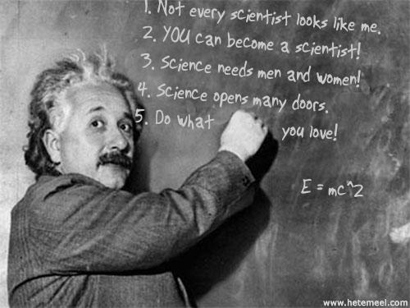

Slide 5
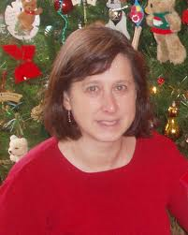
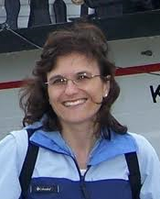
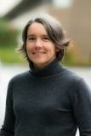
Whatever Career you Chose You Must Love What You Do!
Prof. Janis McKenna Physics and Astronomy
Prof. Elizabeth Croft Applied Science
Prof. Anne Condon Computer Science

Slide 6
Why Did I Choose to Study Physics?
Curiosity: want to know how things work
Intellectual challenge: working on interesting problems
Exciting collaborations: working with interesting people all over the world
Exciting job opportunities: industry, business, academe, teaching, government
Opportunities to inspire a new generation and make a difference

Slide 7
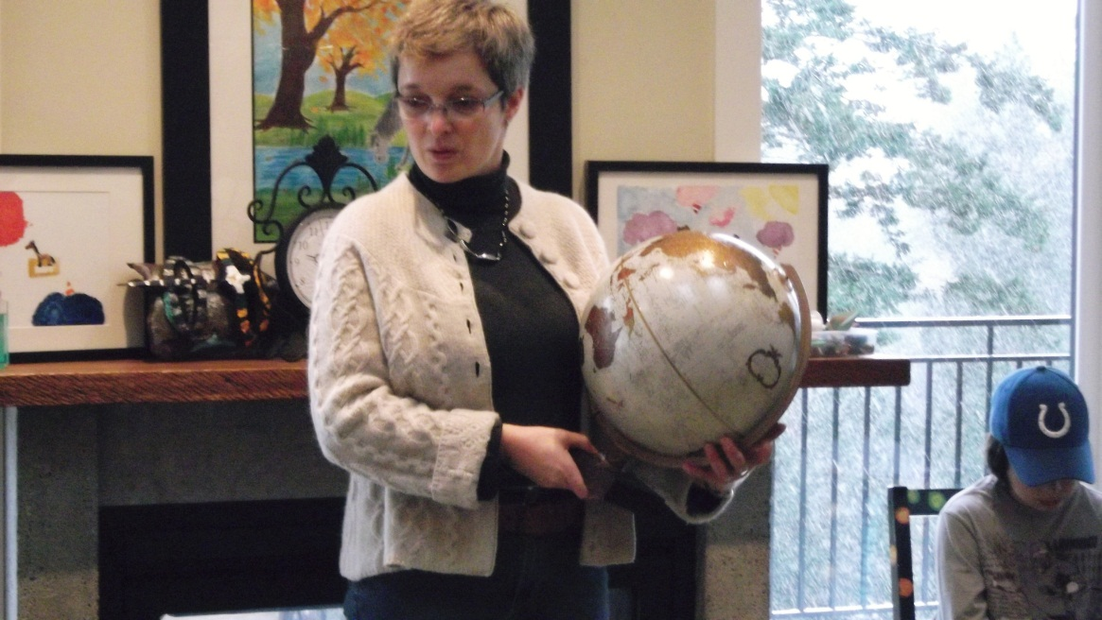
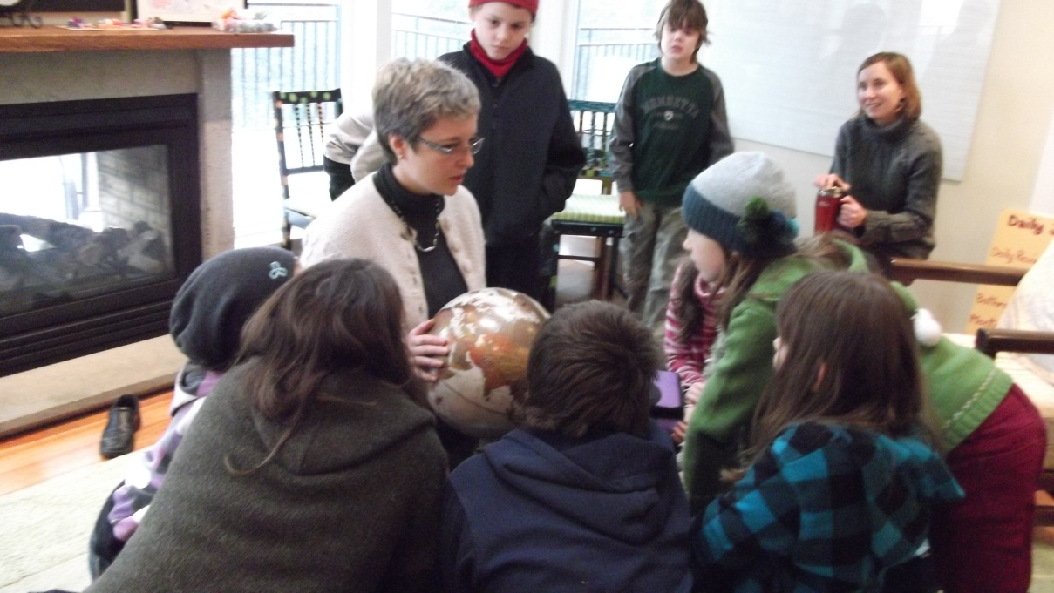
Where Physics Took Me…
Geographically
Intellectually
Personally
An elementary school visit

Slide 8
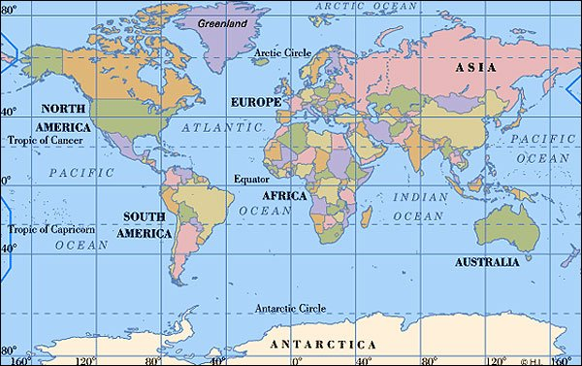
Geographically: Northern Hemisphere Version

Slide 9
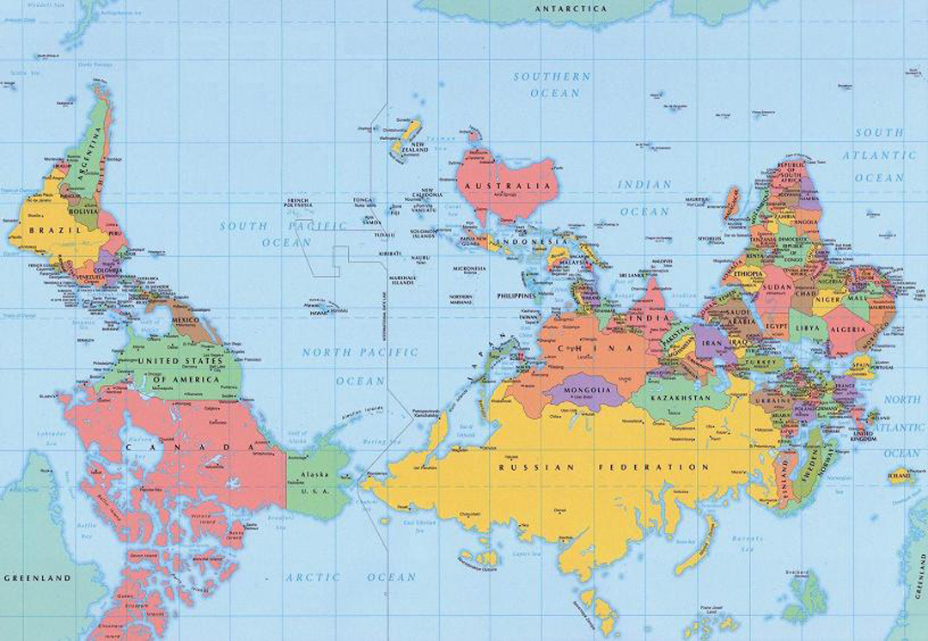
Geographically: Southern Hemisphere Version

Slide 10
Intellectually
Work at major research universities
Do research in physics education: designing and testing new physics teaching methods
Do physics and science outreach
Educate future science and physics teachers
Actively participate in American Association of Physics Teachers, Canadian Assoc. of Physicists…

Slide 11
Personally
I am passionate about my work
I have a family (my husband is a physicist @ UBC)
I am financially independent
I have friends all over the world
I travel to many places and meet amazing people
I help other physics teachers and students
I feel that I am making a difference…

Slide 12
Now It is My Turn to Encourage Others
Where Will Physics Take You?

