Slide 1
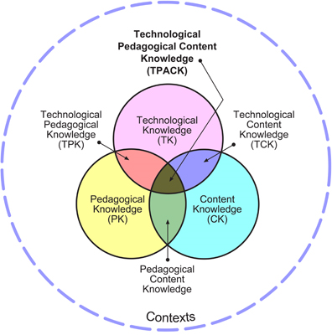
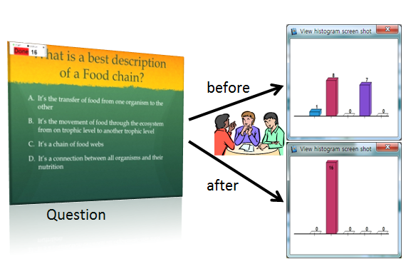
Investigating Science Questioning Practices of Future Elementary Teachers Design & Implementation of Elementary Science Questions Evaluation Rubric
Marina Milner-Bolotin¹, Kshamta Bhupendra Hunter¹ and Jeongho Cha²
¹ Dept. of Curriculum & Pedagogy, Faculty of Education, UBC, Canada; ² Division of Science Education, Daegu University, South Korea
Why to Investigate Science Questioning Practices?
Theoretical Framework and Implementation
Methods and Results
Conclusions
PEDAGOGICAL CONSIDERATIONS:
Science questions become a driving force behind student-centred inquiry-based K-12 science curriculum.
Teachers’ Pedagogical Content Knowledge (PCK) and their views of the Nature of Science (NOS) are reflected in the science questions they ask and how they react to students’ answers.
Learning to ask pedagogically effective science questions (i.e., Socratic teaching) is a life-long goal for many science teachers.
Teachers have to have a tool that will help them reflect on the quality of the science questions they intend on using.
PEDAGOGICAL-TECHNOLOGICAL CONSIDERATIONS:
Modern elementary and secondary schools become equipped with the “immediate feedback” technologies, (i.e. electronic response systems or clickers), but pedagogically-effective and classroom-tested science education materials (i.e. conceptual science questions) are still scarce.
“Clicker-enhanced” pedagogy depends on the quality of multiple-choice science questions teachers ask and not on the technology itself.
Effective multiple-choice science questions can be implemented with or without clickers.
1. Clicker-enhanced pedagogy is based on constructivism: students have to have an opportunity to construct their own understanding based on their prior knowledge, interactions with others and with the educational materials available to them (simulations, books, etc.).
2. Effective teaching requires teachers to have Technological-Pedagogical Content Knowledge (Koelher, 2009): to know how particular educational technology (Technological Knowledge) can be effectively implemented (Pedagogical Knowledge) in a specific subject context (Content Knowledge).
The study involved 49 pre-service elementary teachers enrolled in two 36-hour long elementary science methods courses taught by one of the researchers. Design and implementation of multiple-choice science questions was modeled using clickers. Pre-service teachers worked in groups to design and evaluate their own questions as one of the course assignments. At the end of the course, they designed 83 science questions. The questions were evaluated using the Rubric.
Pre-service teachers value pedagogically effective science questions, however feel held back by their lack of confidence in the ability to design effective science questions and by their limited access to technology (clickers). Science methods courses for pre-service teachers should emphasize the skill of designing effective science questions. The Elementary Science Questions Evaluation Rubric (ESQER) helps pre-service elementary teachers to evaluate the pedagogical effectiveness of their science questions they intend to use in their teaching.
The Rubric was validated by 12 secondary science teachers and was employed to evaluate 83 conceptual questions constructed by pre-service elementary teachers. ESQER not only helped teachers evaluate and challenge student misconceptions, it also helped build teachers’ Technological-Pedagogical Content Knowledge by helping them design and reflect on their questions. Moreover, technology integration and teachers’ reflections on their questions through ESQER supported inquiry-based science teaching. While the initial focus of ESQER was on elementary science questions, the Rubric can be adapted to extend beyond the elementary science classroom.
Figure 3: Examples of effective science “clicker” questions
Selected References
Armbruster, B., & Ostertag, J. (1983). Questions in Elementary Science and Social Studies Textbooks. In B. K. Britton, A. Woodward & M. Binkley (Eds.), Learning from Textbooks: Theory and Practice (pp. 69-94). Hillsdale, NJ: Lawrence Erlbaum Associates, Inc.
Bloom, B. S. (1956). Taxonomy of Educational Objectives: Cognitive Domain. (Vol. 1). New York: Longman.
Bransford, D., Brown, A. L., & Cocking, R. R. (2002). How people learn: Brain, mind, experience, and school. Washington, DC: NAP.
Duncan, D. (2005). Clickers in the Classroom. San-Francisco: Pearson.
Gall, M. D. (1970). The Use of Questions in Teaching. Review of Educational Research, 40(5), 707-721.
Greenhow, C., Dexter, S., & Hughes, J. E. (2008). Teacher Knowledge about Techn. Integration: An Examination of Inservice and Preservice Teachers' Instructional Decision-Making. Sci. Ed. Intern., 19(1), 9-25.
Hoffman, C., & Goodwin, S. (2006). A clicker for your thoughts: technology for active learning. New Library World, 107(1228/9), 422-3.
Koehler, M. J., & Mishra, P. (2009). What is technological pedagogical content knowledge? Contemporary Issues in Technology and Teacher Education, 9(1), 60-70.
Lasry, N. (2008). Clickers or Flashcards: Is There Really a Difference? The Physics Teacher, 46(May), 242-244.
Sobolewski, S. J. (1996). Development of Multiple-Choice Test Items. The Physics Teacher, 34(2), 80-82.
Warren, B., & Ogonowski, M. (1998). From Knowledge to Knowing: An Inquiry into Teacher Learning in Science. Center for the Development of Teaching: Paper Series, 1-25.
Science questions
Embody teachers' philosophy
Reflect teachers' NOS beliefs
Drive technology use (clickers)
Drive constructivist pedagogy
Promote student learning
Help implement formative assessment
(PCK)
Figure 2: Technological Pedagogical Content Knowledge
3. Clicker-enhanced pedagogies can be implemented differently, yet all of them benefit from immediate feedback – aggregated student responses to multiple-choice questions are displayed in real time. The teacher must be knowledgeable to find /design effective questions – questions that will target key concepts and unveil student difficulties. Then a teacher must be flexible to adjust the lesson based on students’ answers.
Elementary Science Questions Evaluation Rubric
Stage 1
Pose a multiple-choice science question
Stage 2
Students are given time to think and enter their individual responses using clickers (vote)
Stage 3
The responses are aggregated and displayed and a peer discussion follows
Stage 4
Students have a chance to vote again
Stage 5
Whole class discussion about correct, as well as incorrect responses (reasons for each)
Surface Pedagogical knowledge | Deep Pedagogical knowledge | Content Knowledge
Item type: multiple-choice, short answer, combined | Pedagogical purpose for assessment: FOR, AS, OF Learning | Content area: life science, physical science, earth
Clarity of the question: clear, unambiguous/ unclear | Pedagogical purpose: conceptual rational for using the question, timing | Cognitive level : Bloom’s taxonomy
Formal answer justification: Explain/justify your answer (present or not) | Embedded answer justification: distractors include possible misconceptions, focus on student difficulties | Scientific accuracy
 |  | Distractors’ quality: target student key conceptual difficulties
Figure 1: Functions of science questions in an elementary science classroom (NOS = Nature of Science)
Study Objectives
To investigate difficulties faced by elementary pre-service teachers in designing multiple-choice science questions.
To identify the elements of pedagogically effective multiple-choice science questions relevant to elementary science curriculum.
To develop an instrument to help in-service and pre-service elementary teachers to reflect on and evaluate the pedagogical effectiveness of science questions (Elementary Science Questions Evaluation Rubric – ESQER).
Contact
Figure 3: A possible approach to a clicker-enhanced pedagogy
Dr. Marina Milner-Bolotin: marina.milner-bolotin@ubc.ca

