Slide 1
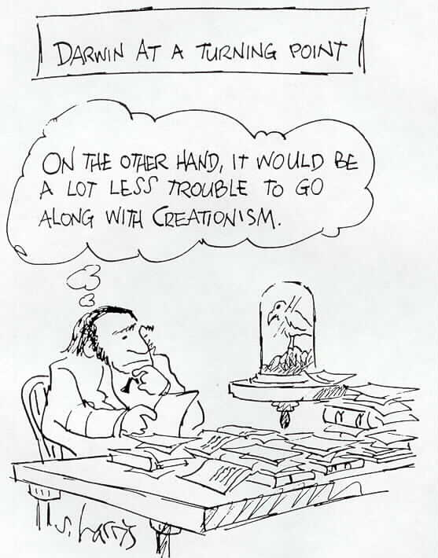
Nature of Science
Dr. Marina Milner-Bolotin
Department of Curriculum and Pedagogy
Meeting 7, October 17, 2012
EDCP 559: Research in Teaching and Learning of the Sciences – Fall 2012

Slide 2
John T. Scopes Trial
The Scopes Trial, formally known as The State of Tennessee v. John Thomas Scopes and commonly referred to as the Scopes Monkey Trial, was a famous American legal case in 1925 in which a high school teacher, John Scopes, was accused of violating Tennessee's Butler Act, which made it unlawful to teach evolution in any state-funded school.^{[1]} The trial was deliberately staged in order to attract publicity to the small town of Dayton, Tennessee, where it was held. Scopes was unsure whether he had ever actually taught evolution, but he purposefully incriminated himself so that the case could have a defendant. Scopes was found guilty and fined $100, but the verdict was overturned on a technicality. The trial served its purpose of drawing intense national publicity, as national reporters flocked to Dayton to cover the big-name lawyers who had agreed to represent each side. William Jennings Bryan, three-time presidential candidate for the Democrats, argued for the prosecution, while Clarence Darrow, the famed defense attorney, spoke for Scopes. The trial set modernists, who said evolution was consistent with religion, against fundamentalists who said the word of God as revealed in the Bible took priority over all human knowledge. The case was thus seen as both a theological contest and a trial on the veracity of modern science regarding the creation-evolution controversy.

Slide 3
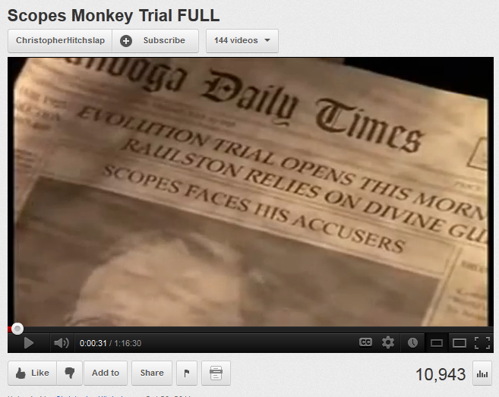
Scopes Monkey Trial FULL

Slide 4
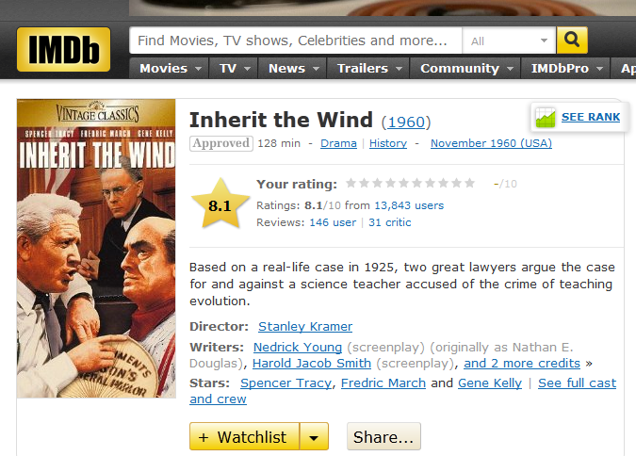

Slide 5
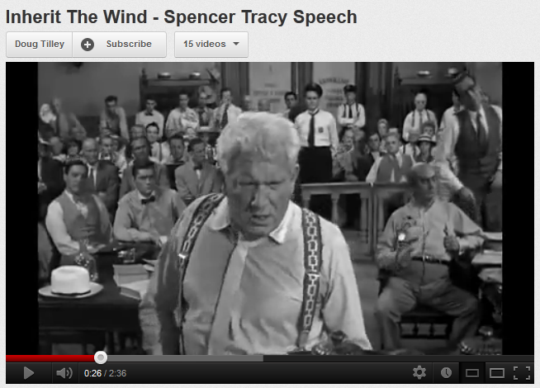
Inherit the Wind (Spencer Tracy)

Slide 6
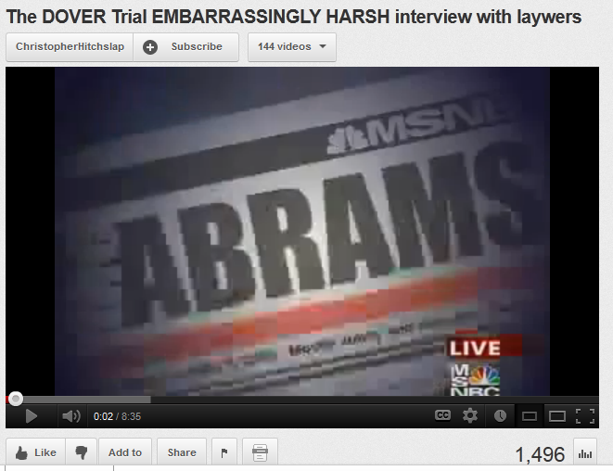
Is Scopes Monkey Trial History (Dover Pennsylvania, 2005)
Notes:
http://en.wikipedia.org/wiki/Kitzmiller_v._Dover_Area_School_District
http://www.youtube.com/watch?v=8hTZ5AYzs8o&feature=related – a great program on Nova

Slide 7
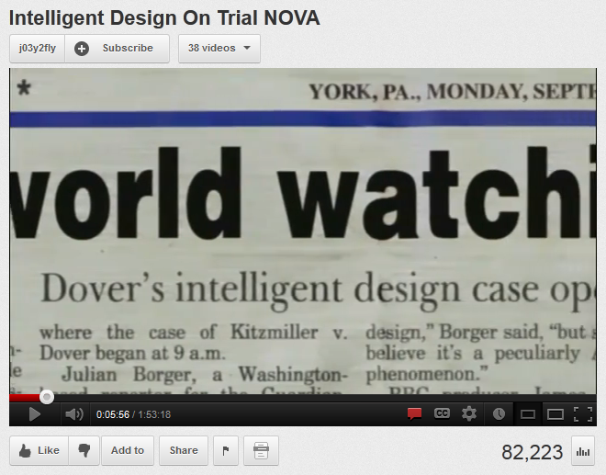
Intelligent Design on Trial NOVA

Slide 8
Brian Alters
Brian J. Alters (B.Sc., Ph.D. USC) is an Associate Professor of Education and Sir William Dawson Scholar at McGill University, where he also holds the Tomlinson Chair in Science Education and is both founder and Director of the Evolution Education Research Centre. He has taught science education at both Harvard and McGill Universities, and is regarded as a specialist in evolution education.
http://www.mcgill.ca/campaign/historymakers/alters/
This discussion is dedicated to Heather Fisher…
Notes:
http://www.mcgill.ca/campaign/historymakers/alters/

Slide 9
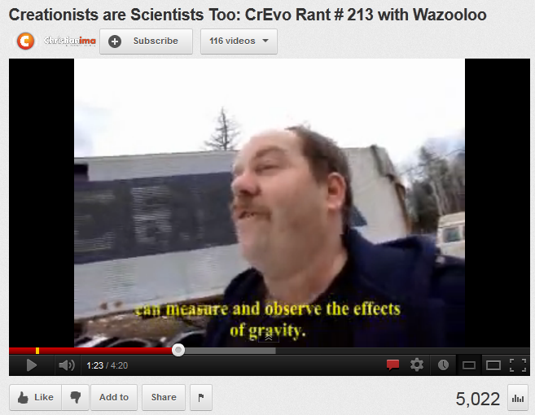
Is It Relevant to Canada? Has the Evolution-Creationism Debate Been Resolved?

Slide 10
1. The fundamental driving force in science is curiosity concerning physical universe.
Strongly agree
Agree
Disagree
Strongly disagree

Slide 11
2. Science aims at ever-increasing comprehensiveness and simplifications using mathematics as a simple, precise method of stating relationships.
Strongly agree
Agree
Disagree
Strongly disagree

Slide 12
3. The methods of science are better characterised by some value-type attributes than by techniques.
Strongly agree
Agree
Disagree
Strongly disagree

Slide 13
4. A basic characteristic of science is faith in the susceptibility of the physical universe to human ordering and understanding.
Strongly agree
Agree
Disagree
Strongly disagree

Slide 14
5. Science has a unique attribute of openness, both of mind and openness of the realm of investigation.
Strongly agree
Agree
Disagree
Strongly disagree

Slide 15
6. There exists an objective, external world, independent of the existence of an observer.
Strongly agree
Agree
Disagree
Strongly disagree

Slide 16
7. An ontological perspective consistent with logical positivism is naïve
Strongly agree
Agree
Disagree
Strongly disagree

Slide 17
8. Uniformitarianism is an axiomatic assumption that helps delineate what counts as science and what does not.
Strongly agree
Agree
Disagree
Strongly disagree

Slide 18
9. Scientific knowledge is tentative and should never be equated to truth. It has only temporary status.
Strongly agree
Agree
Disagree
Strongly disagree

Slide 19
10. Science rests on the assumption that the natural world cannot be altered by supernatural being.
Strongly agree
Agree
Disagree
Strongly disagree

Slide 20
11. Consensus among self-appointed experts is the basis of scientific knowledge.
Strongly agree
Agree
Disagree
Strongly disagree
He basi

Slide 21
12. There can be no sharp definition between observation and inference.
Strongly agree
Agree
Disagree
Strongly disagree

Slide 22
13. Scientists operate on the belief that the basic rules of the universe can be discovered by careful, systematic study.
Strongly agree
Agree
Disagree
Strongly disagree

Slide 23
14. There are different traditions in science about what is investigated and how, but they all have in common certain basic beliefs about the value of evidence, logic, and good arguments.
Strongly agree
Agree
Disagree
Strongly disagree

Slide 24
15. Science disciplines differ from one another in what is studied, techniques used, and outcomes sought, but they share a common purpose & philosophy.
Strongly agree
Agree
Disagree
Strongly disagree

