Slide 1
Engaging 21st century STUDENTS in Physics Learning: WHY, When, Where & HOW

Slide 2
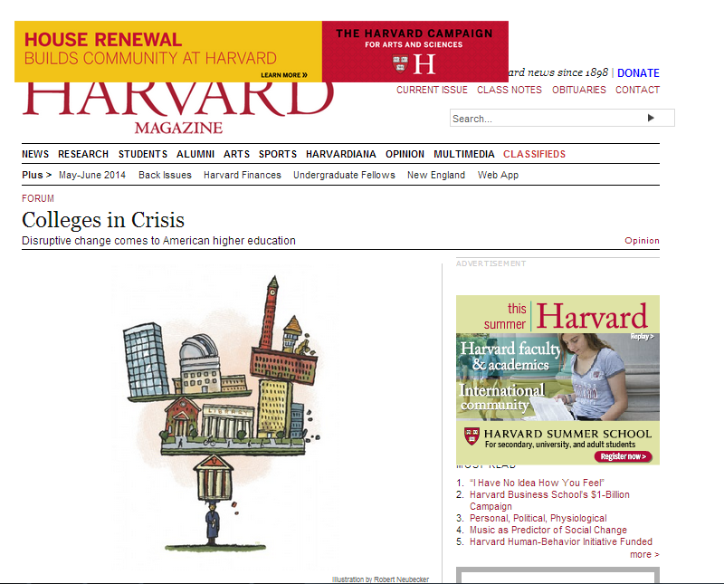
The FUTURE OF Our UNIVERSITIES: Crisis or Opportunity?
Political
Financial
Pedagogical
Administrative
Technological

Slide 3
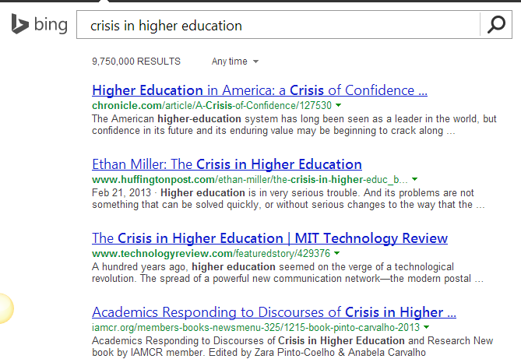
The FUTURE OF Our UNIVERSITIES: Crisis or Opportunity?
9,750,000 Results!
We recognize there is an issue, yet we are trying to fix a new problem using old approaches

Slide 4
Technological implications on university education
The concern about how we teach and what is the role of technology in education is not new!
But the access to information and the way we read and share it has tremendous implications on our students and on us.
It also changes our students’ expectations from us!

Slide 5
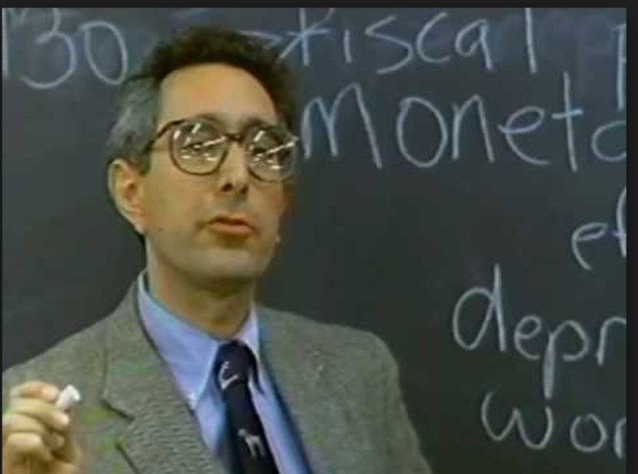
How Do we engage Students in Intro Science courses?
Why are students often disengaged?
Who are our students?
What can we do?
How can technology help?
What science do we need to teach them?
What are 21st century skills?

Slide 6
Implications for physics Teaching and Learning
The role of lectures/labs/tutorials
Multiple ways to engage students
Creative use of technology: learning any time anywhere
Technology for increasing collaboration and access
Making science learning relevant to the students

Slide 7
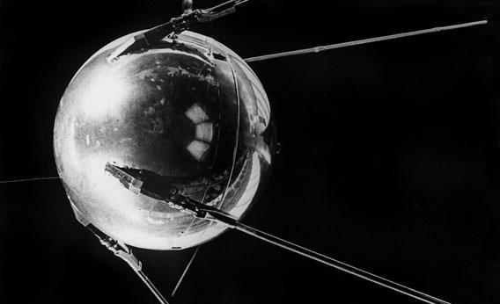
Bridging the Gap Between Theory and Practice
The efforts to teach science differently aren’t new
The importance of critical thinking for all isn’t new either
Despite exploding university enrollments, STEM illiteracy is ubiquitous
How do we create PER-Informed Physics Teaching Resources that make a difference?
October 4-26, 1957
STEM LITERACY –
13, 100, 000 Results in 0.21 s.

Slide 8
Igniting Student Curiosity with Science
Chemistry teacher Neil Dixon showed that science in classroom doesn't have to be boring…
How can we help students appreciate the intellectual excitement we experience while learning science?
Why did we become scientists or science educators?

Slide 9
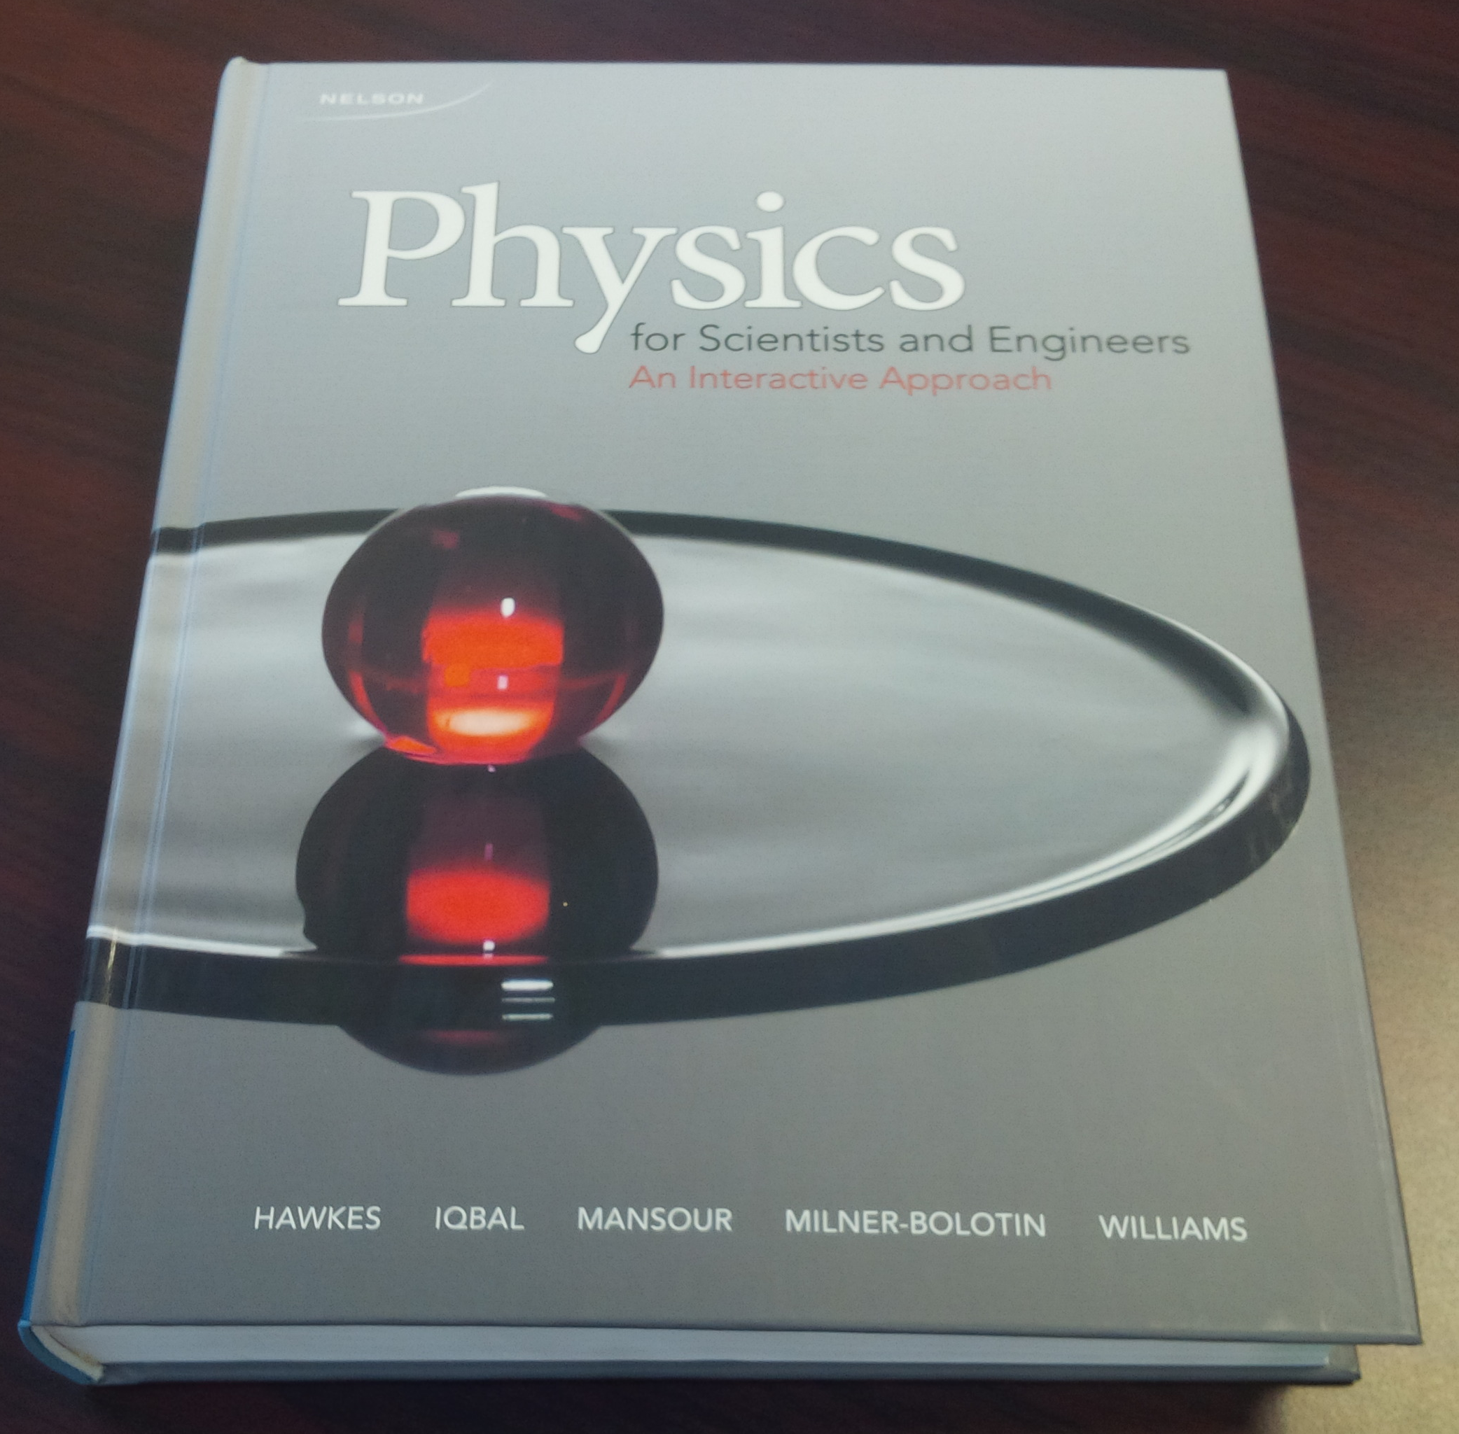
PER INSPIRED PHILOSOPHY Of our book
The book has to:
Be coherent and comprehensive, yet not to attempt to cover it all
Be based on our knowledge about physics learning
Reflect modern science and Canadian contributions
Be of interest to our modern students: relevance and style
Be engaging – intellectually, emotionally and visually
Take advantage of technology – for learning and collaboration

Slide 10
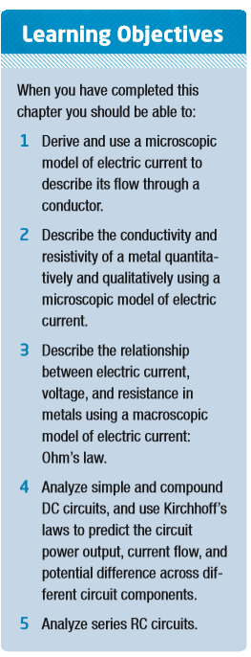
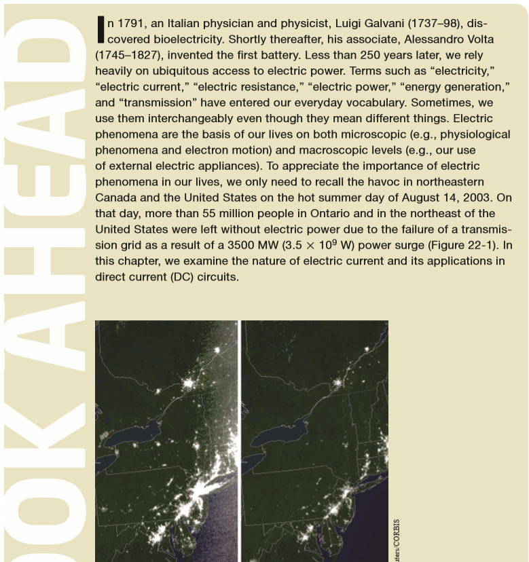
Physics for Scientists and Engineers (2014), Hawkes. Iqbal, Mansour, Milner-Bolotin, Williams

Slide 11
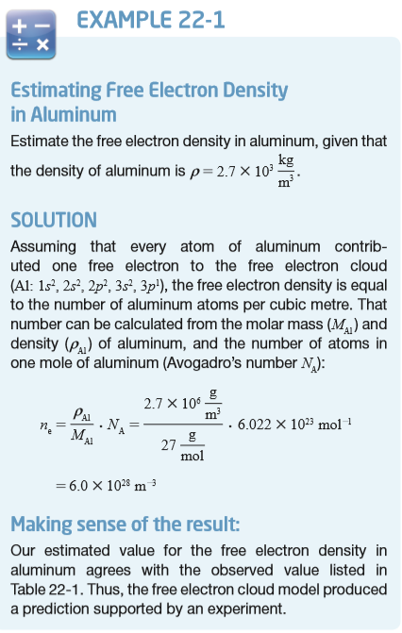
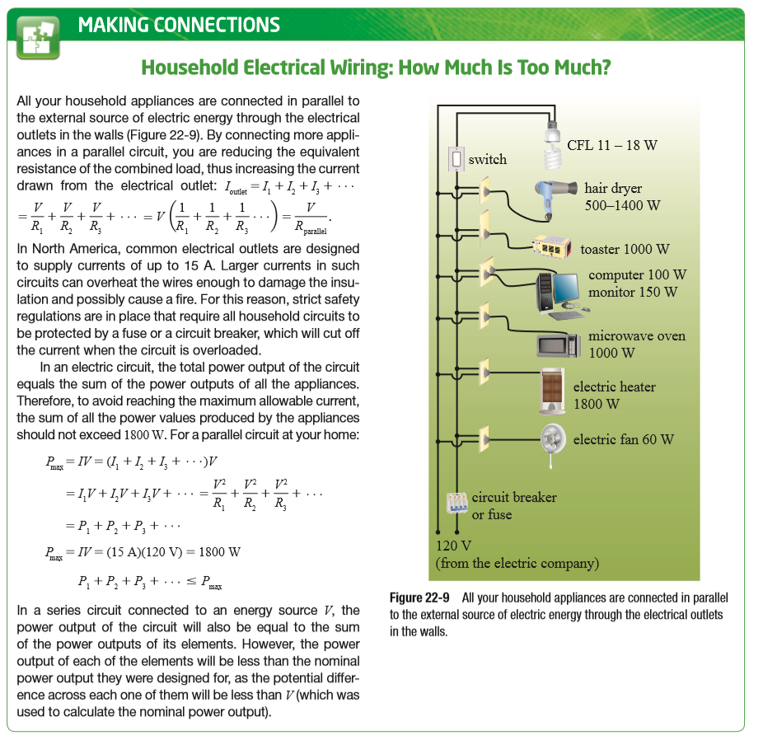
PER-Inspired Book Features

Slide 12
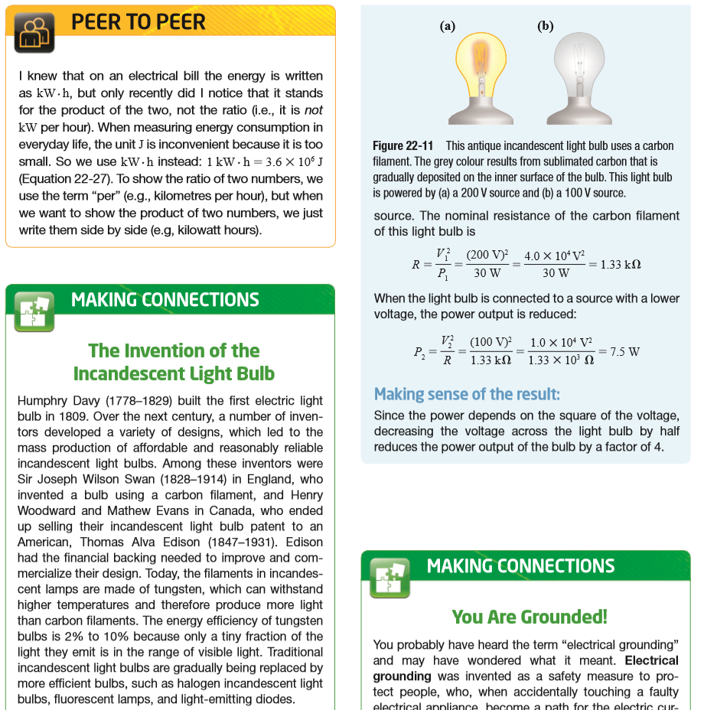
PER-Inspired Book Features

Slide 13
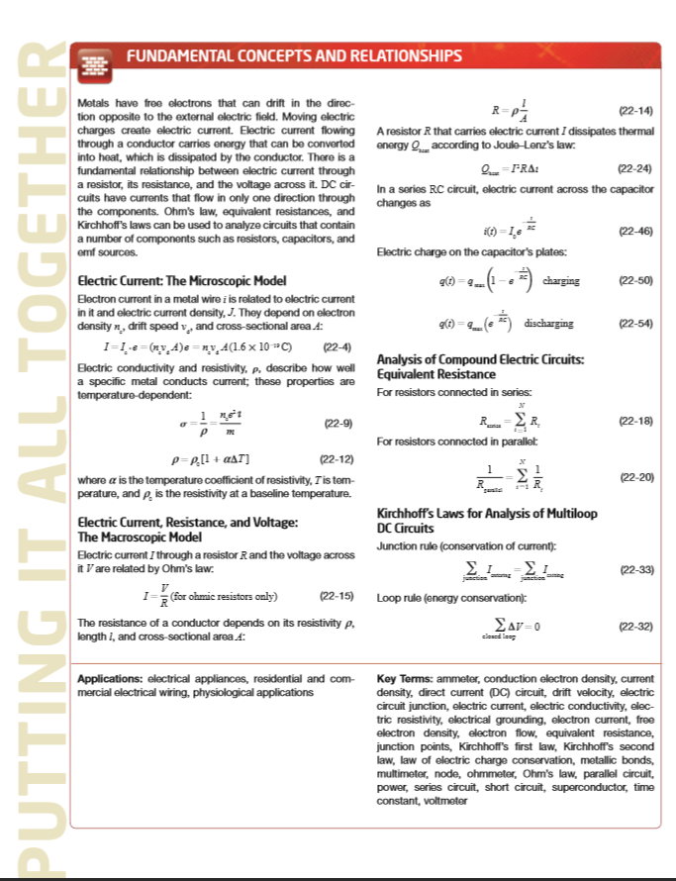
PER-Inspired Book Features

Slide 14
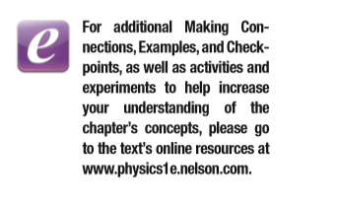
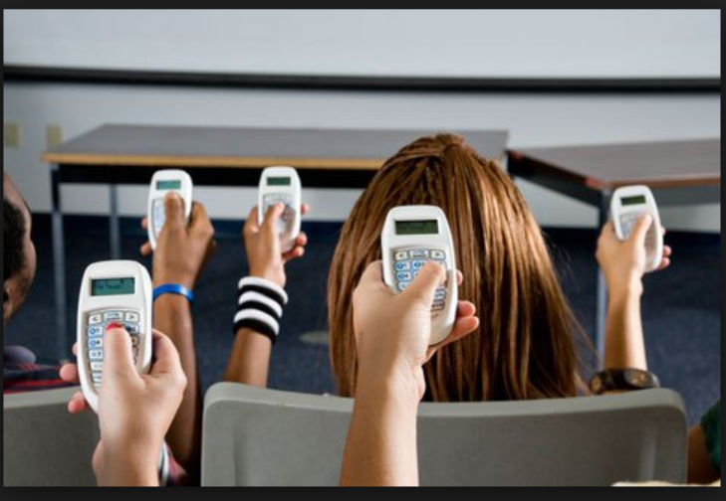
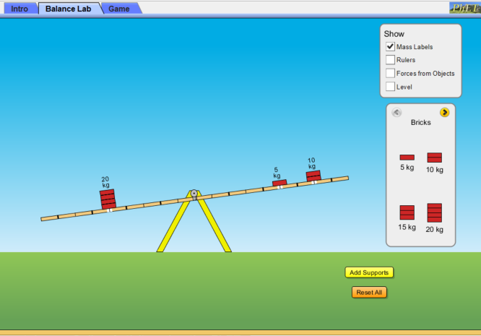
Taking Advantage of Technologies

Slide 15
Interested in more information?
Leanne Newell
Marketing Manager
Leanne.newell@nelson.com
416-752-9100 ext: 3535

